Slide 1
Chap. 5 The Digital Abstraction
Voltage Levels and the Static Discipline

Slide 2
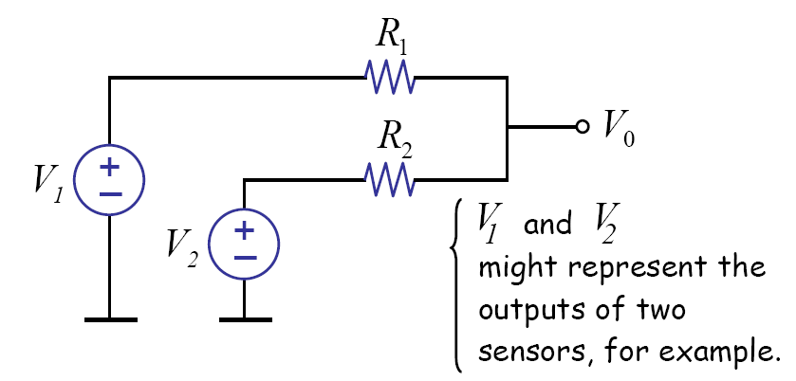
Analog Signal Processing

Slide 3
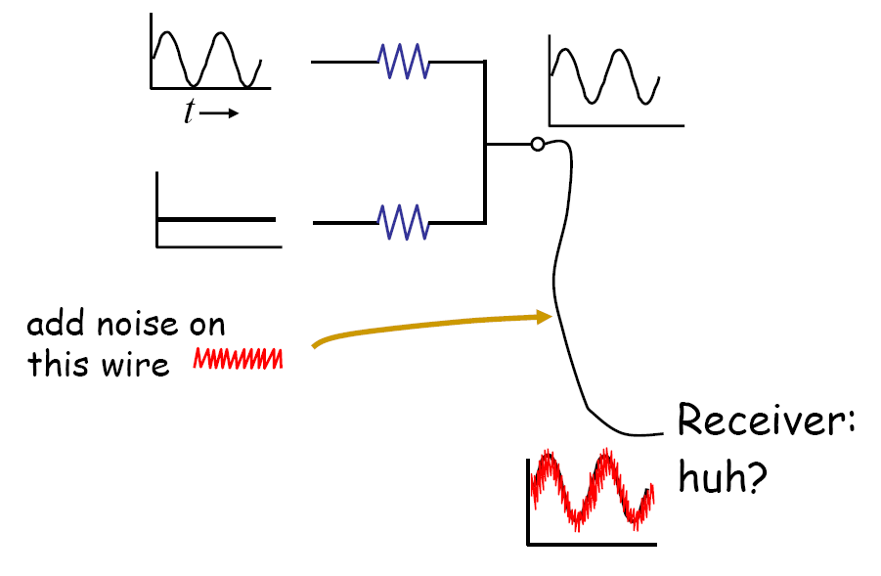
Noise Problem

Slide 4
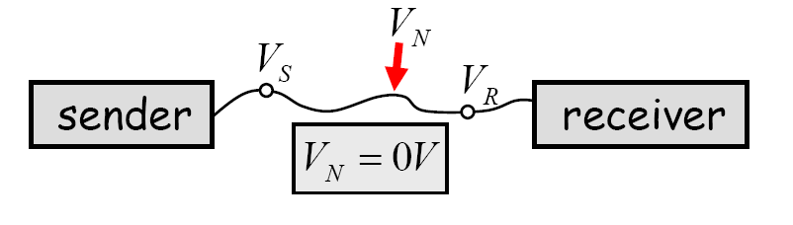
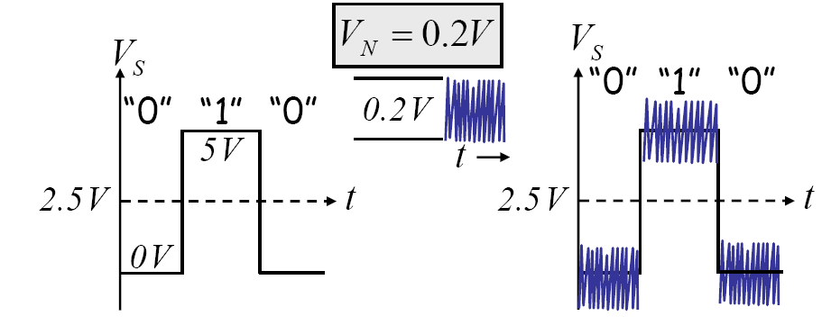
Digital System: Noise immunity !!

Slide 5
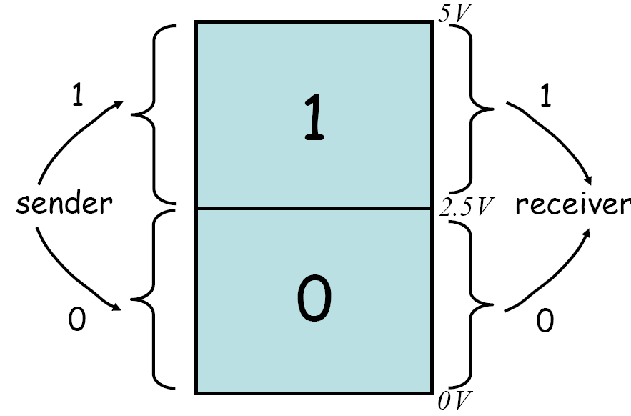
Value Discretization
What about 2.5 V ?

Slide 6
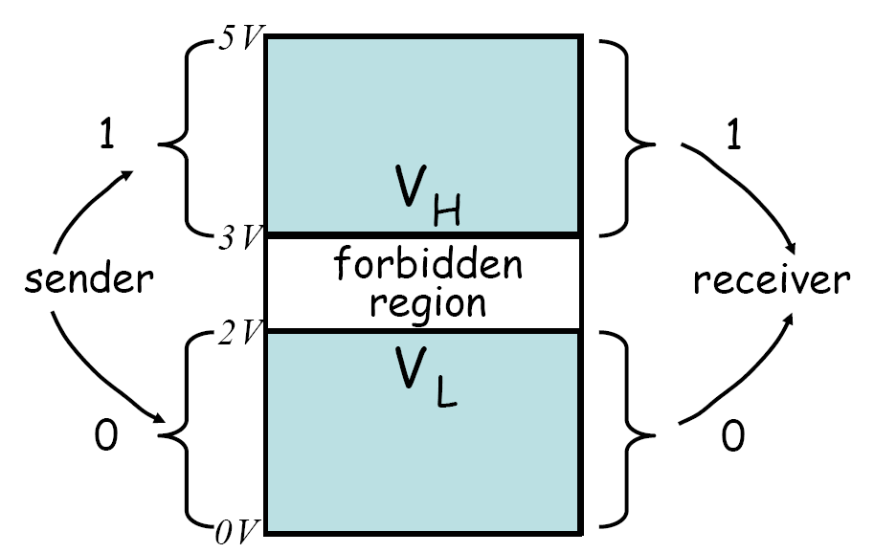
Forbidden Region
Where is the noise margin?

Slide 7
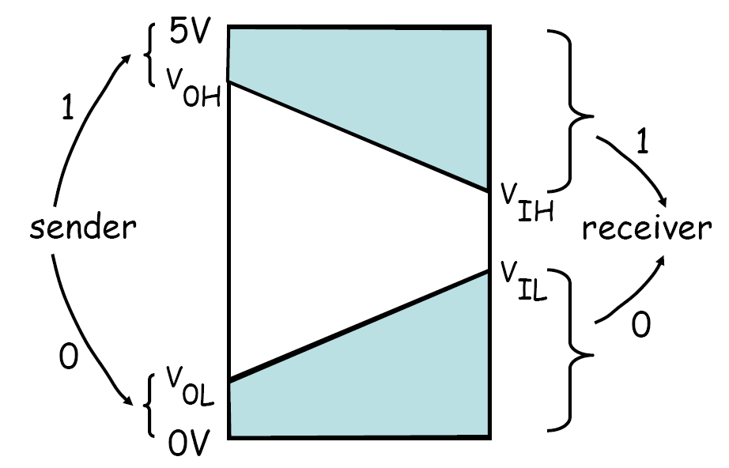
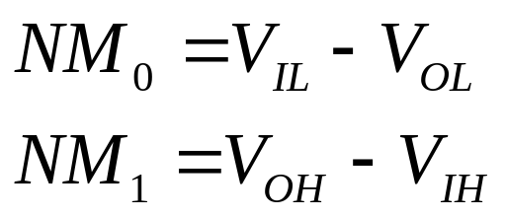
Actual Value Discretization
Noise margin

Slide 8
Static Discipline
If inputs to a digital system meet valid input thresholds, the system guarantees that its outputs will meet valid output thresholds.

Slide 9
Conclusion
Value discretization
Noise margin
Static discipline

