Slide 1
Chap. 6 The MOSFET Switches
MOSFET and Switch(S) Model
Static Analysis Using S Model
SR Model of MOSFET
Static Analysis

Slide 2
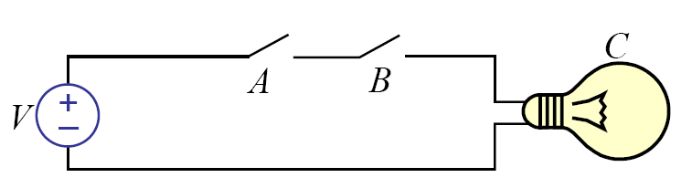
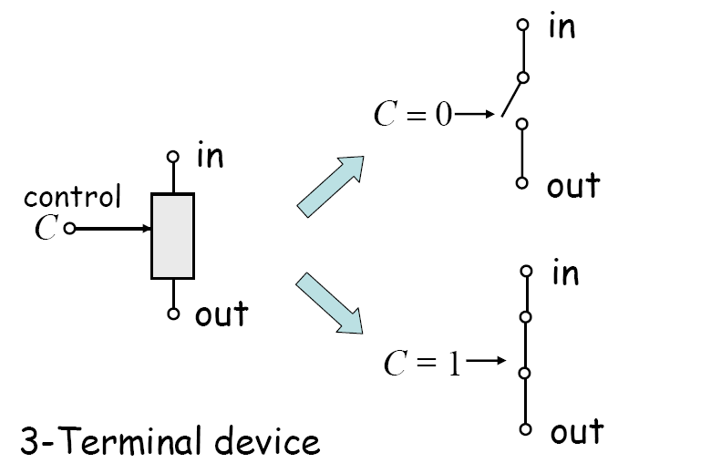
Switch Logic
Key: switch device

Slide 3
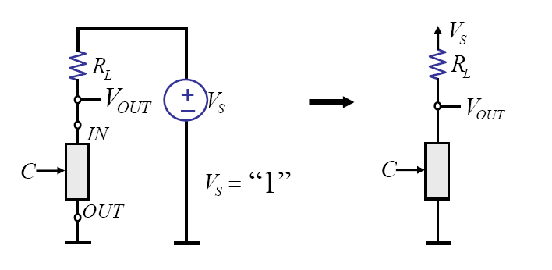
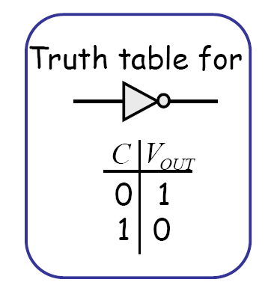
Logic Inverter

Slide 4
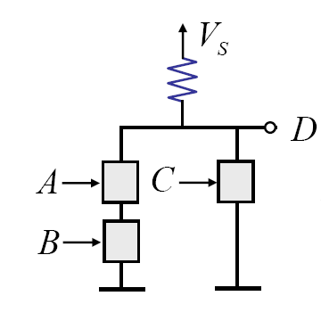
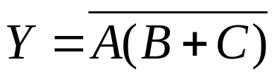
Example
1. Find the logic of this circuit.
2. Draw the following logic circuit:

Slide 5
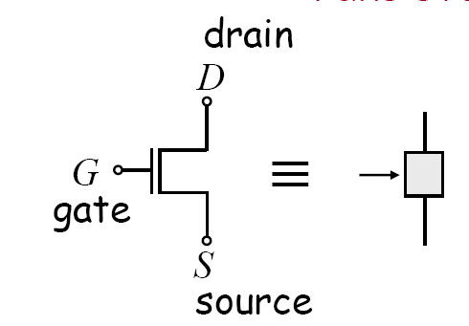
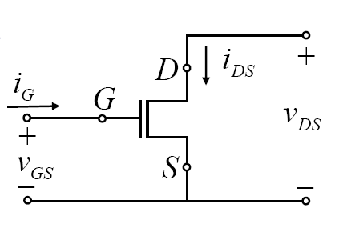
MOSFET
Metal Oxide Semiconductor Field-Effect Transistor

Slide 6
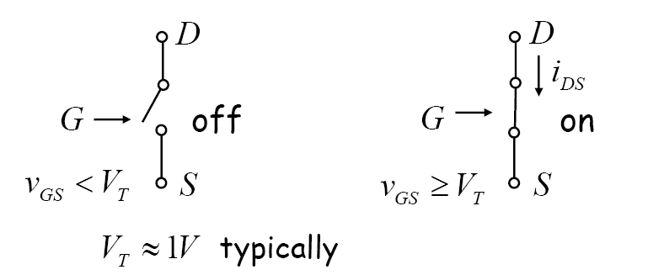
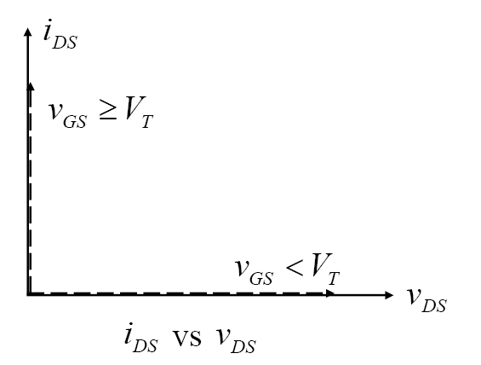
Switch (S) Model of MOSFET

Slide 7
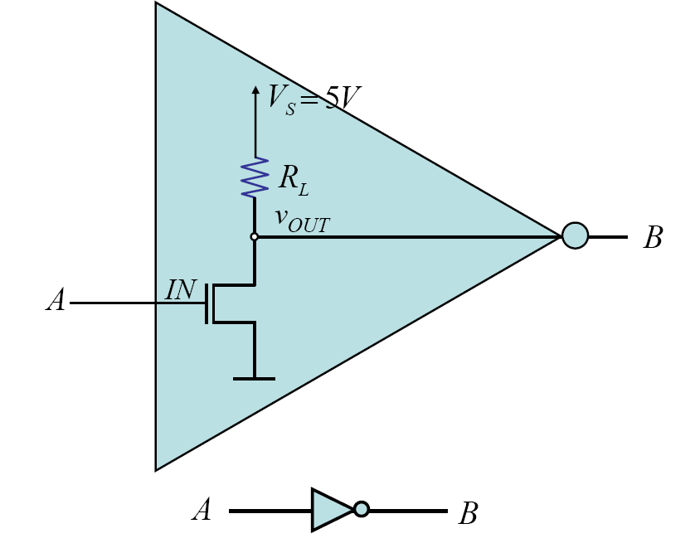
MOS Inverter

Slide 8
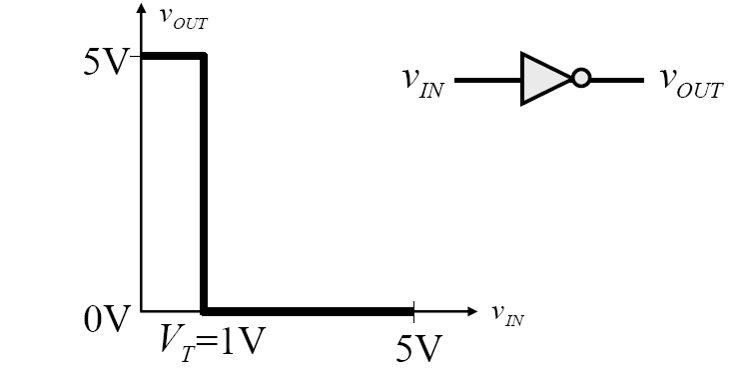
Voltage Transfer Characteristics
Does it satisfy the following static discipline?
  (1)
  (2)

Slide 9
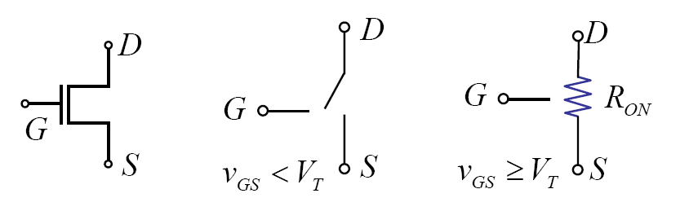
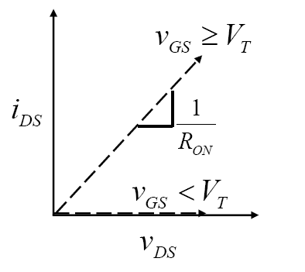
Switch Resistor (SR) Model of MOSFET
Better approximation

Slide 10
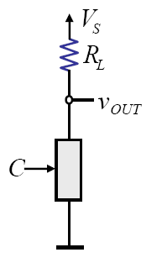
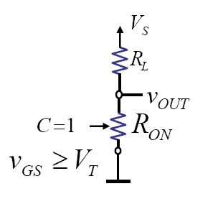
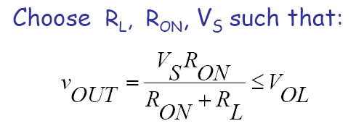
MOSFET Inverter: Revisted

Slide 11
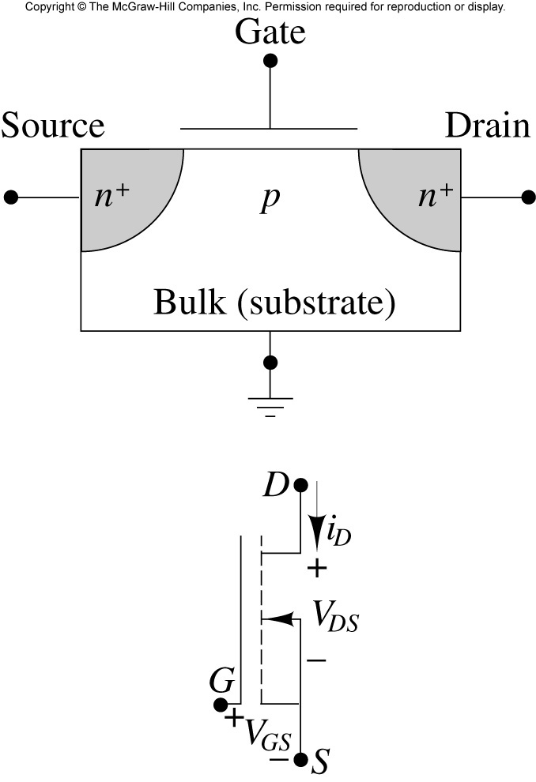
Physical Structure of MOSFET

Slide 12
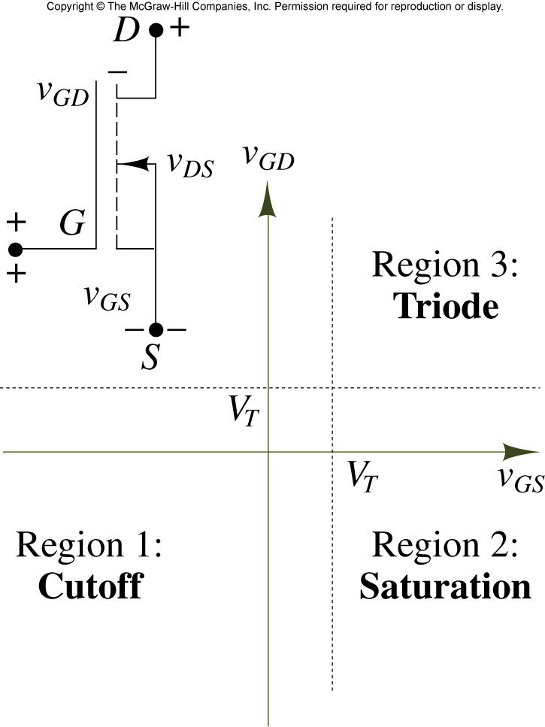
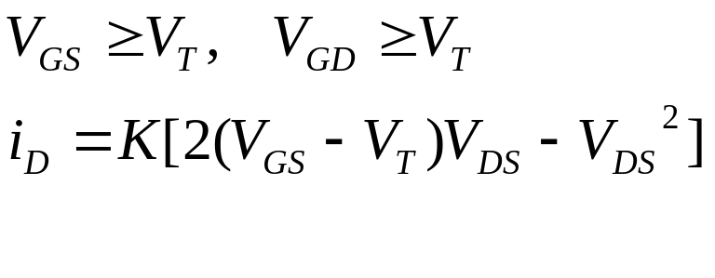
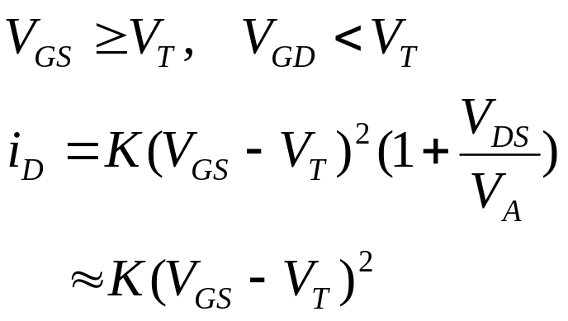
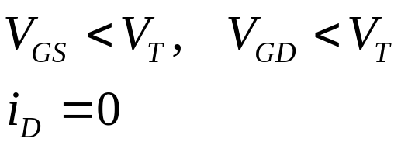
Regions of operation of NMOS transistor

Slide 13
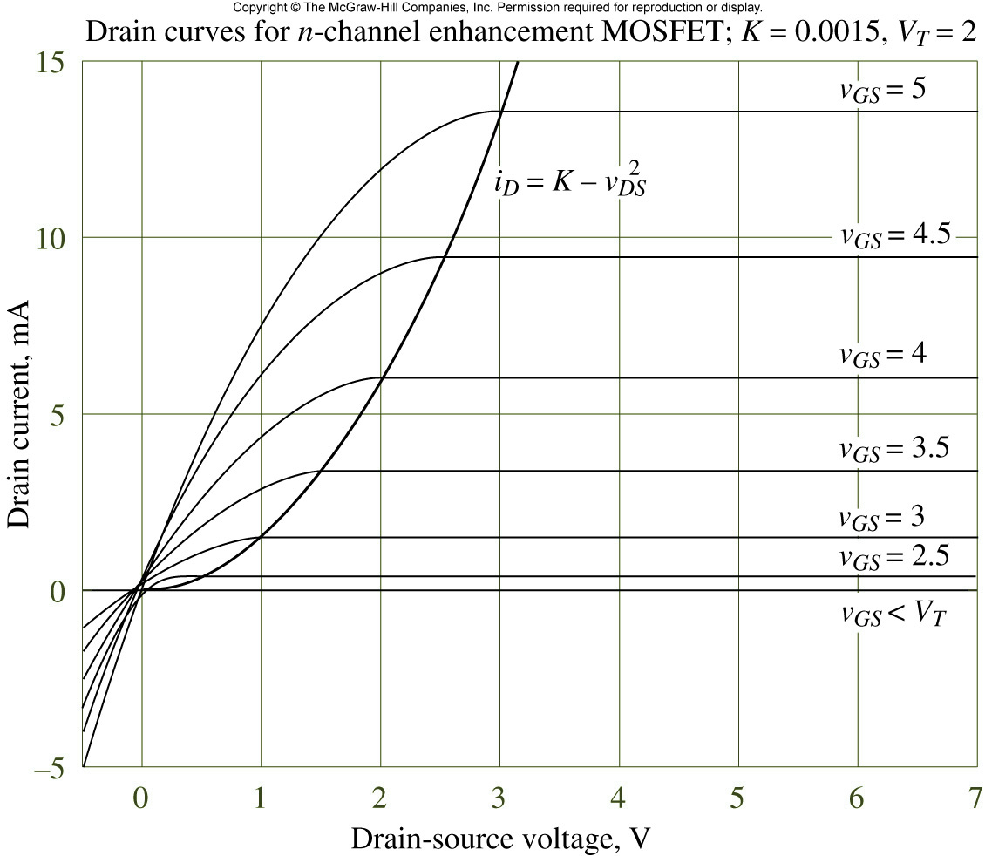
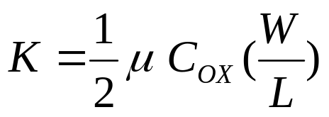
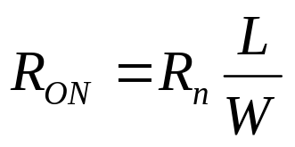
I-V Characteristic of NMOS
Conductance parameter

Slide 14

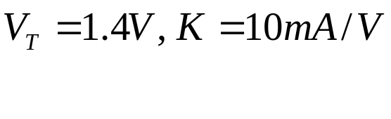



MOS Circuit Analysis

Slide 15
Inverter Characteristics: SR Model

Slide 16
Example 6.5
Determine W/L for correct inverter operation

Slide 17
Example 6.6
To satisfy the following static discipline redesign the inverter.

Slide 18
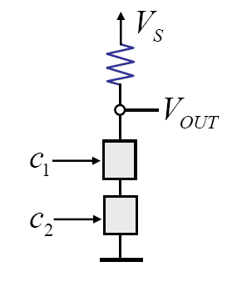
Static Analysis of NAND Gate: SR Model

Slide 19


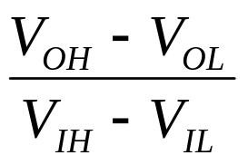
Signal Restoration and Gain
Noise 0.6 V
I
B
Buffer restores the signal level (example)
Gain =

Slide 20






Buffer Voltage Transfer Characteristics (VTC)

Slide 21



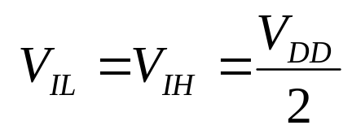
Inverter VTC
Ideal VTC

Slide 22
Conclusion
MOSFET and S Model
MOSFET and SR Model
MOSFET Analysis
Signal Restoration and Gain

