Slide 1
Chap. 9 Energy Storage Elements
Capacitors and Inductors
Series and Parallel Connections
Simple Circuit Examples
Energy, Charge, and Flux Conservation

Slide 2
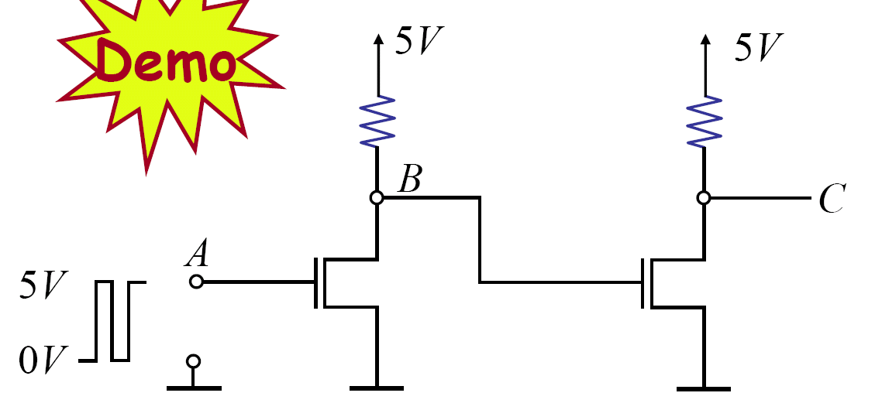
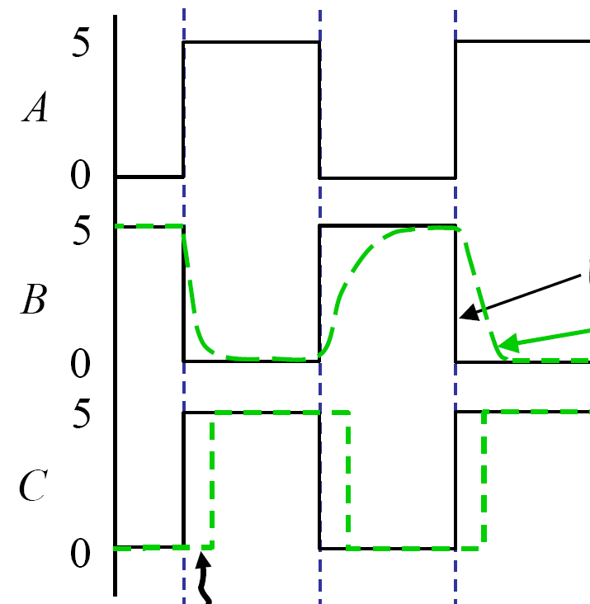
Motivation
Expected
Observed
Observed (Delay)

Slide 3
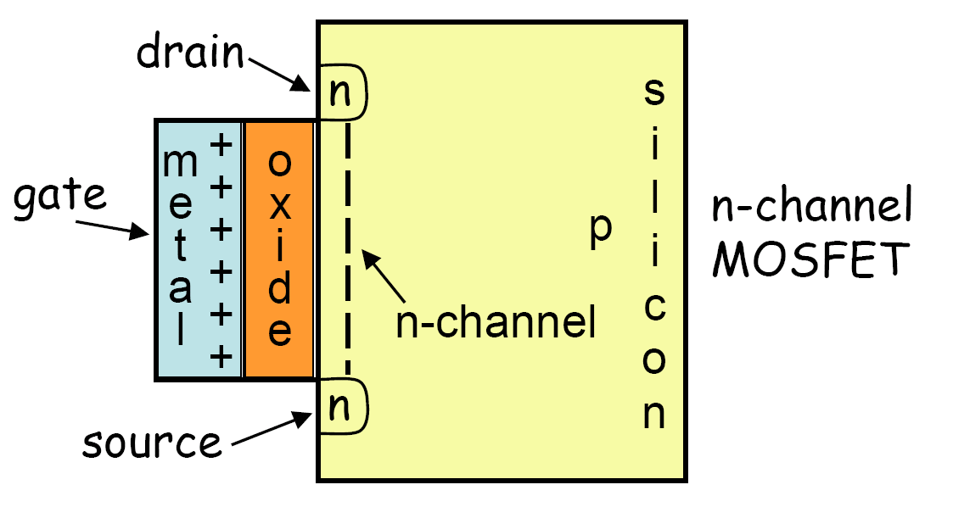
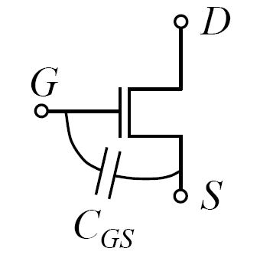
MOSFET Modeling

Slide 4
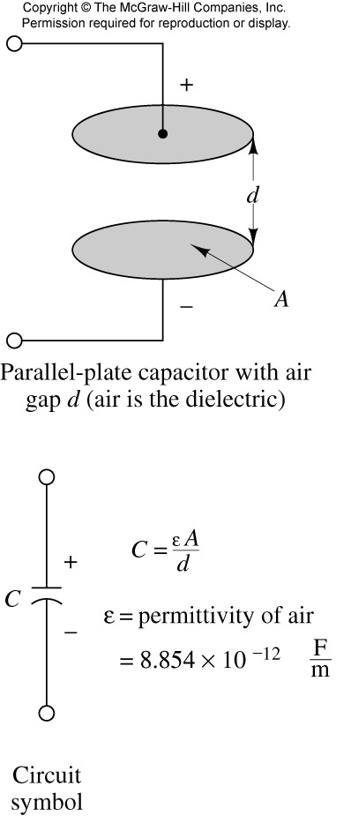
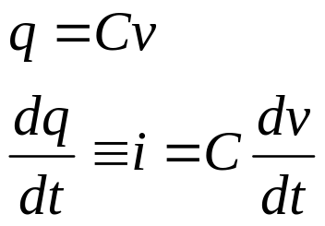
Ideal Linear Capacitor
i
+
v
-
C
v(t) =

Slide 5
Observations from i = C dv/dt
For DC voltage: Capacitor is an open circuit
For i to be finite, v(t) must be continuous
Typical units: uF ~ pF

Slide 6




Current Source and Capacitor
₊
₋
Step input

Slide 7




Voltage Source and Capacitor
₊
₋
+
-
Step input
Ramp input

Slide 8





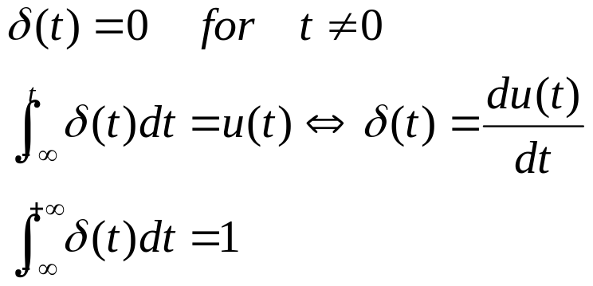
Unit Impulse Function

Slide 9

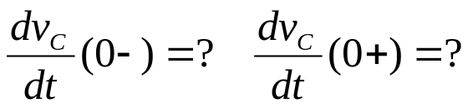
Capacitor Voltage is continuous
t = 0
i_{R}
A
2mA
₊
v_{c}
₋
2μF
1kΩ
B

Slide 10
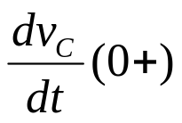
Exercise
Switch is closed at t=0. Find .
t = 0
1kΩ
+
v_{c}
-
3V
5μF
2kΩ
v_{c}(0⁻) = 1V

Slide 11
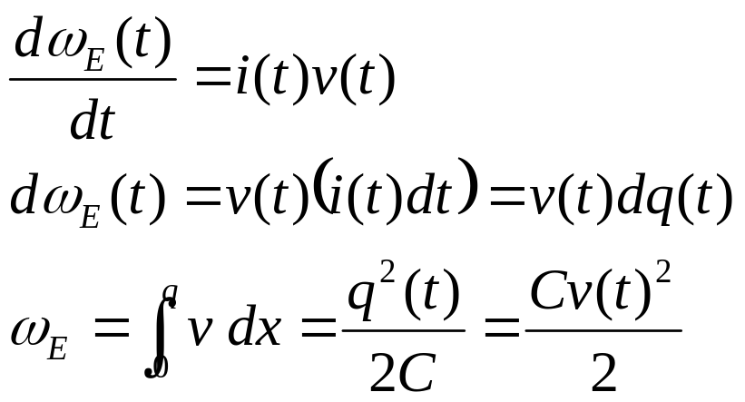
Energy Storage – memory device
_{10(V)}
₂
1 2 3 4 5 6 7 (ms)

Slide 12


Capacitor Loop: Charge Conservation
t = 0
C₁ = 1F
C₂ = 2F
Question: Is energy conserved?

Slide 13
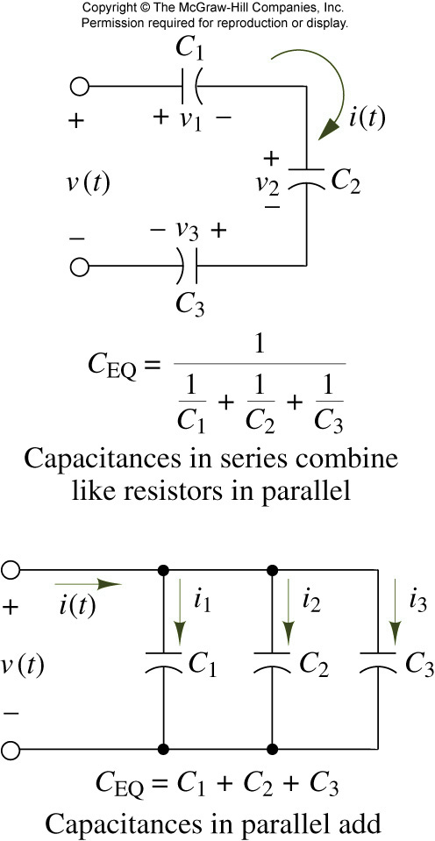
Combining capacitors in a circuit
Series connection:
Parallel connection:

Slide 14
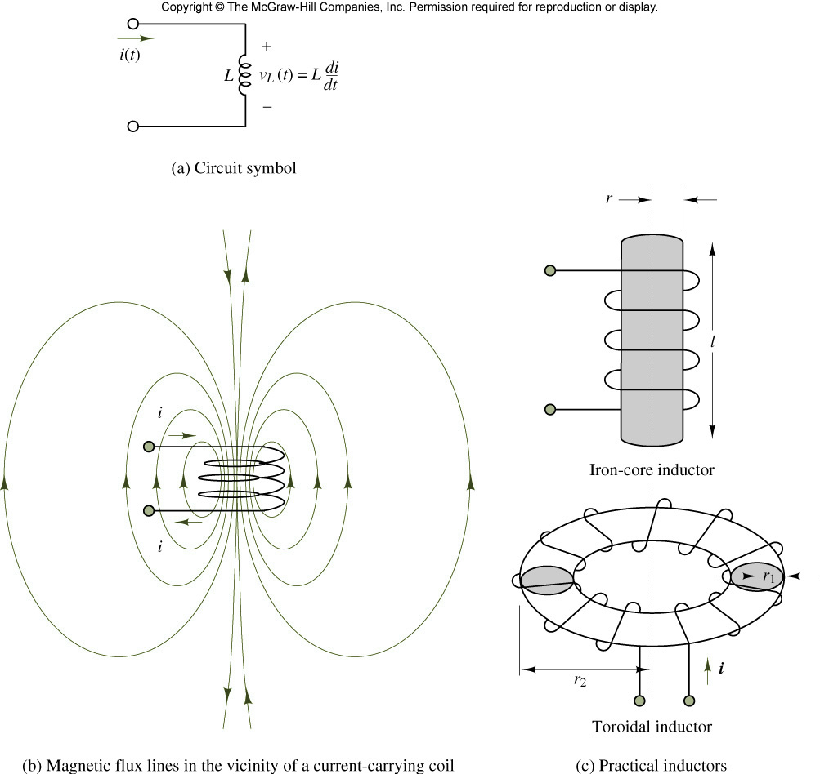
Inductance and practical inductors
V = L di/dt
i(t) =

Slide 15
Observations from v = L di/dt
For DC current: inductor is a short circuit
For v to be finite, i(t) must be continuous
Typical units: mH ~ H
Inductor circuit is dual to Capacitor circuit

Slide 16
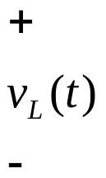


Voltage/Current Source and Inductor
+
-
Step input
Step input

Slide 17
Energy Storage in an Inductor
W_{L} = ½ L i_{L}²
_{10(mA)}
₂
1 2 3 4 5 6 7 (ms)

Slide 18
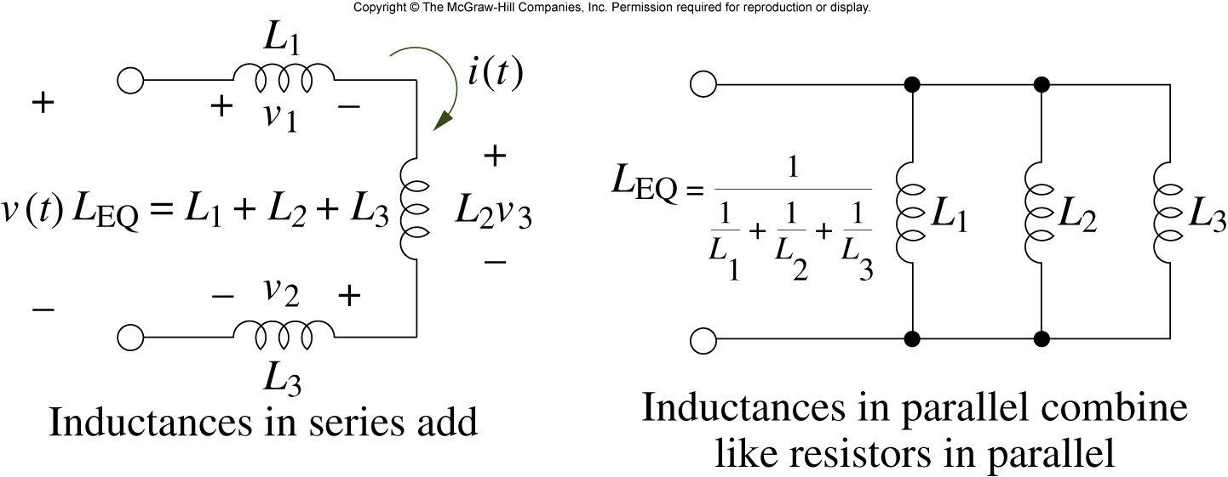
Combining inductors in a circuit
4-3

Slide 19
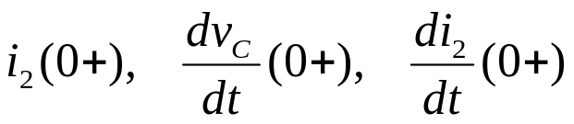
Exercise
Switch is closed at t = 0. Find the following:
+
1μF
-
2kΩ
i₁
t = 0
2kΩ
1mH
10V
i₂
v_{c}(0⁻) = 5V, i_{L}(0⁻) = 5mA

Slide 20


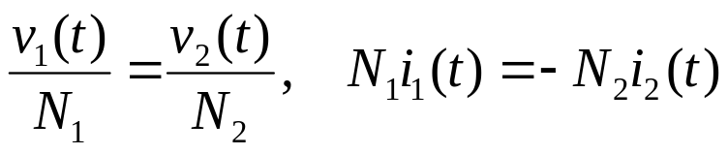
Transformer
i₁
i₂
i₁
i₂
+
v₁
-
+
v₂
-
+
v₁
-
+
v₂
-

Slide 21
Transformer Circuit
Z_{g}
i₁
i₂
Z_{g}
1 : n
+
v₂
-
+
v₁
-
Z_{L}
n²
v_{g}
+
+
v₁
-
Z_{L}
v_{g}
+

Slide 22
Chap. 10 First-Order Transients in
Linear Electrical Networks
Analysis of RC/RL Circuits
Intuitive Analysis
Propagation Delay
State and State Variables
Additional Examples
Digital Memory

Slide 23
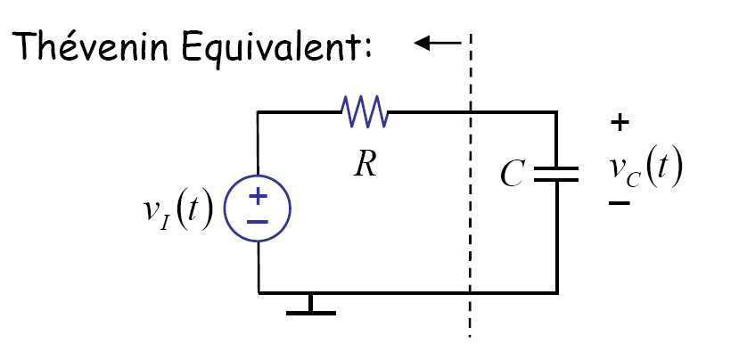
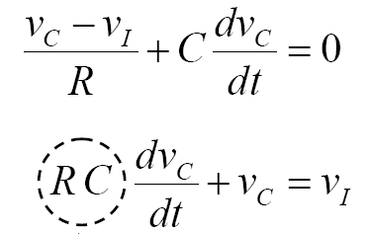
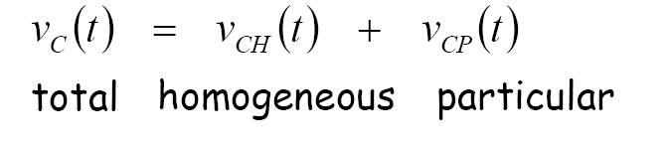
Simple RC Circuit: Series RC Circuit

Slide 24


Solutions
Find the particular solution
Find the form of homogeneous solution
Use initial condition to obtain the total solution
< example >
Particular Solution:

Slide 25




Homogeneous Solution
General Form:
C₁
C₁e⁻¹
t
Time constant:

Slide 26

Total Solution
Assume the following initial condition
The total solution becomes

Slide 27
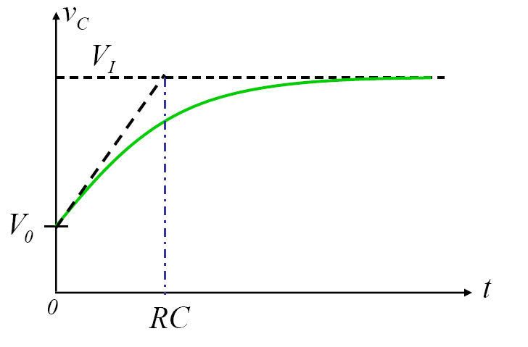
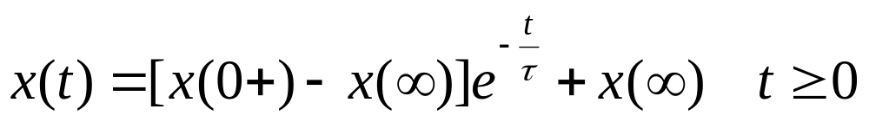
Total Solution (2)
General form:

Slide 28
Response to Square Wave
At steady state:

Slide 29
Exercise
Find the differential equation to obtain v_{c}
1kΩ
A
i
+
v_{c}
-
+
v_{s} (t)
2kΩ
1uF

Slide 30

DC Steady state
DC voltage or DC current source
After a long time:
Capacitor: open circuit
Inductor: closed circuit

Slide 31
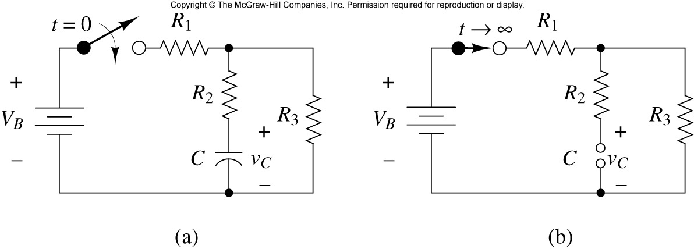
Circuit Example
a long time after the switch is closed: final solution

Slide 32



Parallel RC Circuit: Do it yourself !
₊
₋
Step input

Slide 33

RC Transient
₊
₋

Slide 34
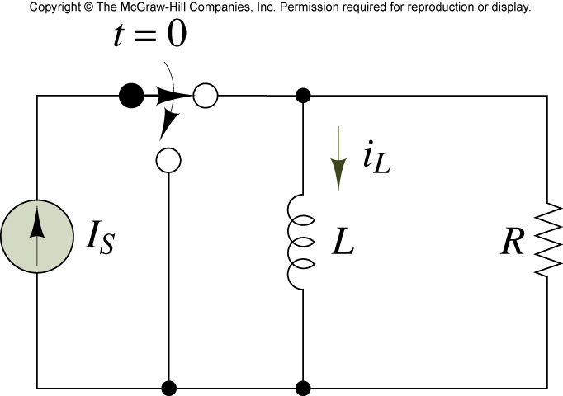
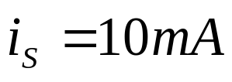
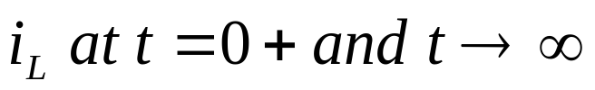
Exercise
Find

Slide 35
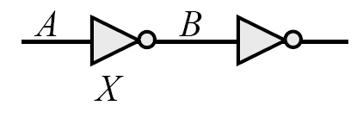
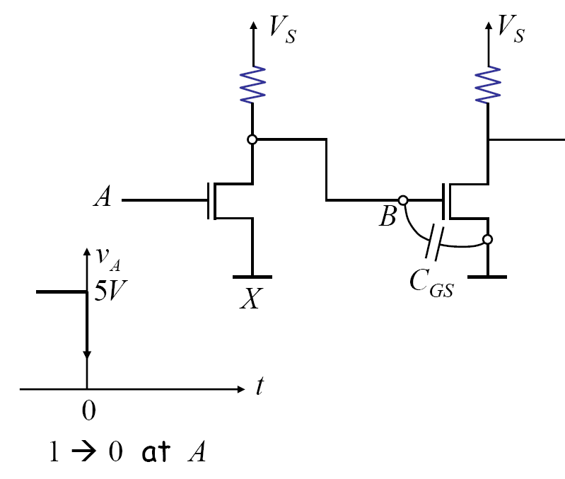
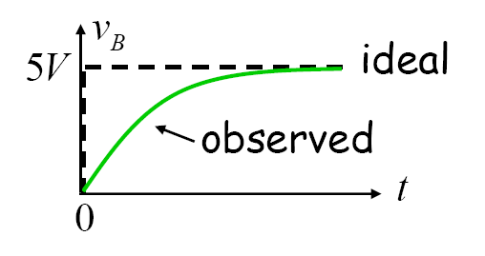
Digital Logic Again

Slide 36








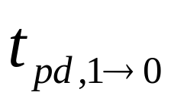

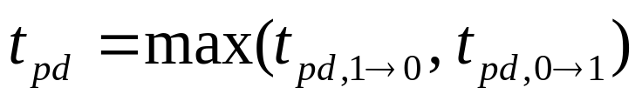
Propagation Delay
Propagation delay

Slide 37
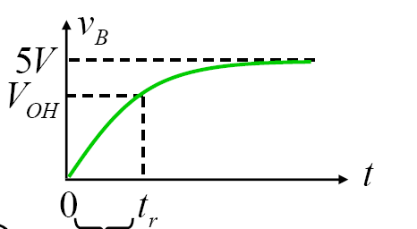
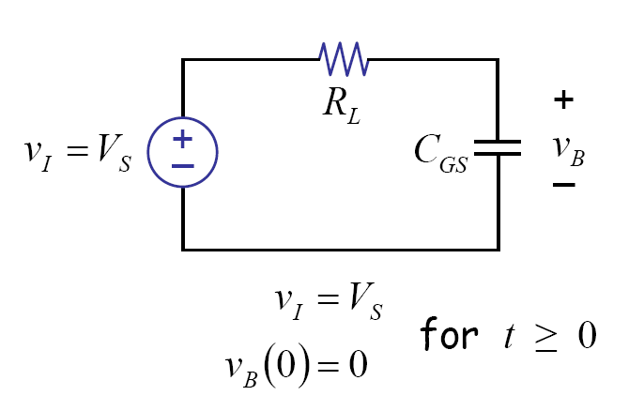

Rise time (vs. Fall time)
Equivalent Circuit:
Rise time

Slide 38
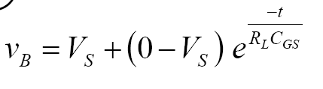
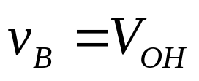
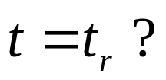
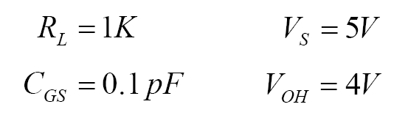
Rise time Computation
at
example

Slide 39
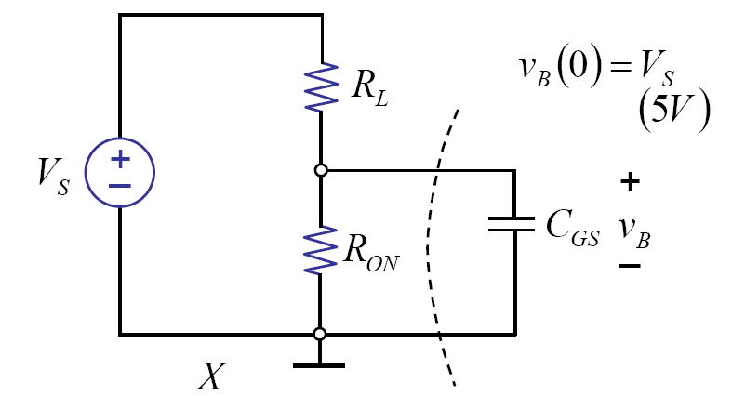
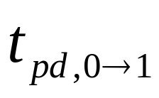
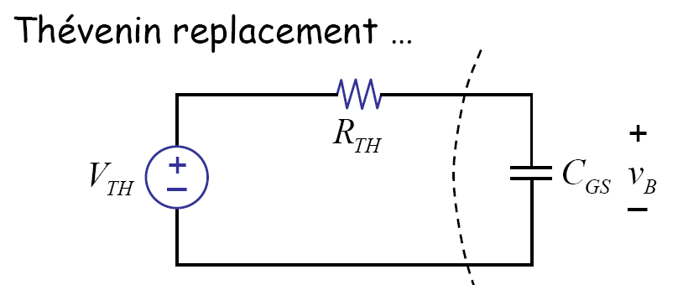
Fall Time: from the SRC Model

Slide 40

Fall Time Computation
From 5V to

Slide 41
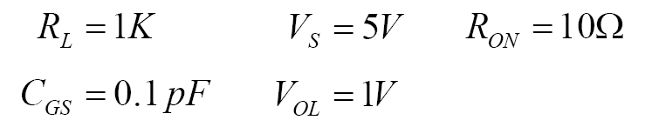
Propagation Delay Computation

Slide 42
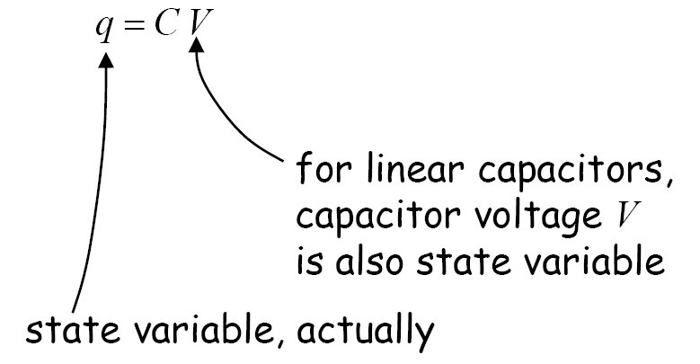
State and State variables
State
  Summary of past inputs relevant to predicting the future

Slide 43
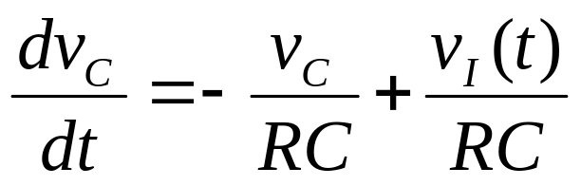



Another Interpretation
(state variable)= (State variable present value) + (input variable)
Total Solution = zero-input response + zero-state response

Slide 44
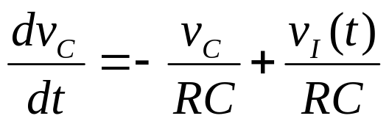
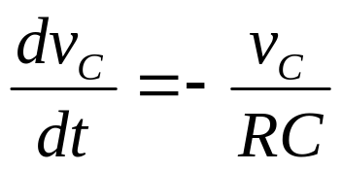
Total Solution
Zero-input response:
Zero-state response:

Slide 45


Ramp Input As an Example
Ramp input

Slide 46
Sine wave input
R
Sinusoical signal waveform:
v_{S}(t) = V cos(ω t)
+
v_{c}
-
v_{s}
+
C

Slide 47



Impulse Response
Pulse input -> impulse input

Slide 48
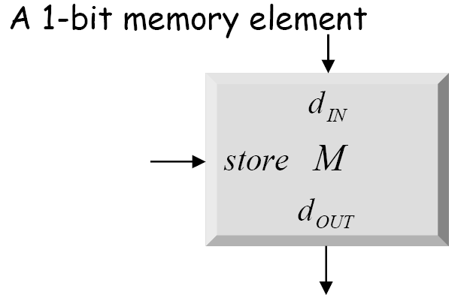
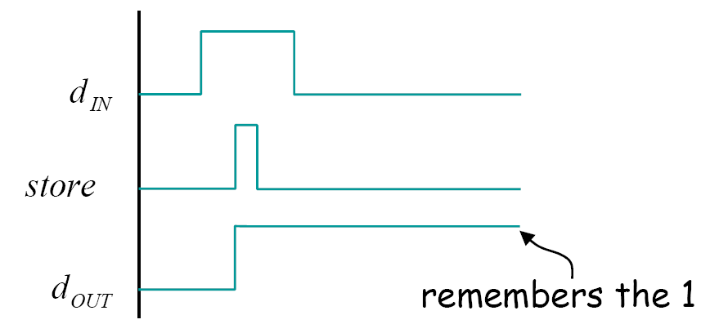
Memory Abstraction

Slide 49
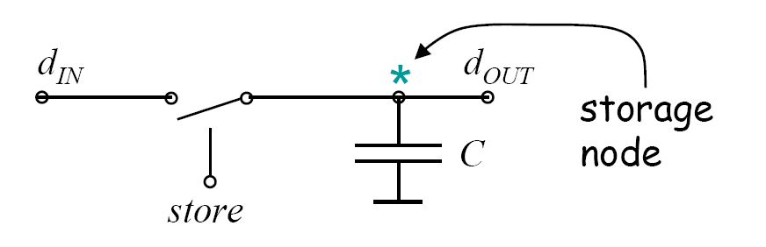
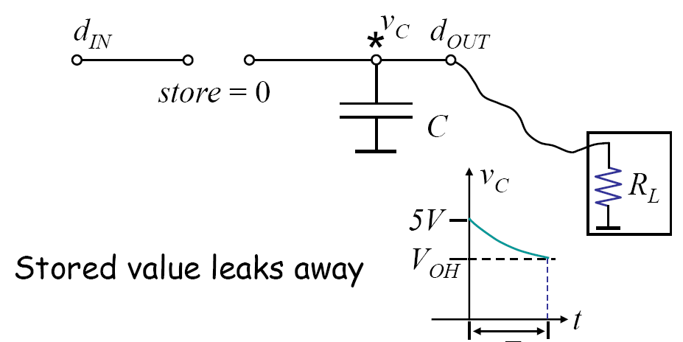
Building a memory element: First Attempt

Slide 50
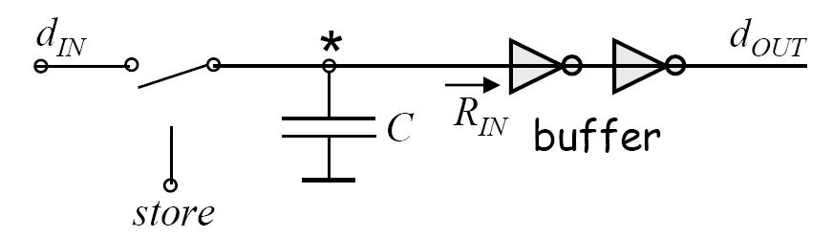


Second Attempt: buffer
is much larger than

Slide 51
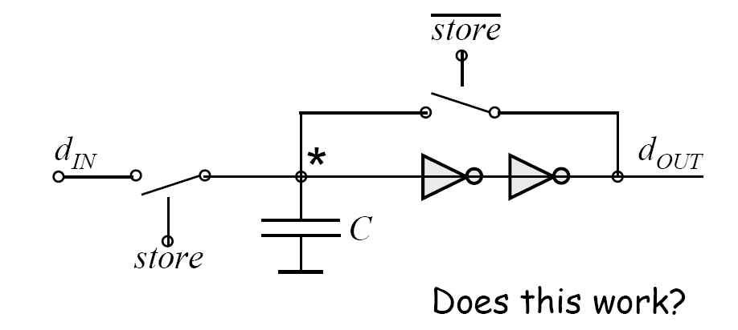
Third attempt: buffer + refresh

Slide 52

Finally: buffer + decoupled refresh
Refresh Period?

Slide 53
Conclusion
First order circuit
  Time constant
  DC steady state
Propagation delay
  Rise time and fall time
State and state variables
Memoy element

