Slide 1
OS Project 3
OS Team 7

Slide 2
Demo

Slide 3
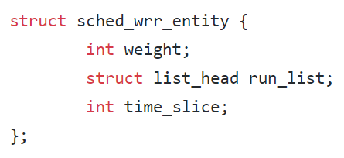
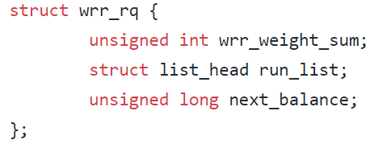
wrr_sched_entity / wrr_rq

Slide 4
wrr.c (Basic)
enqueue_task_wrr: enqueue task to wrr_rq
dequeue_task_wrr: dequeue task to wrr_rq
yield_task_wrr: Move first task of wrr_rq to last
pick_next_task_wrr: pick first task of wrr_rq and returns it
task_tick_wrr:
decreases time slice for task.
If it becomes zero, (probably) rescshedule it.

Slide 5
wrr.c (Multicore case)
CONFIG_SMP
If this flag is defined, we define more functions for multicore support
select_task_rq_wrr
Pick minimum weight CPU that can handle this task.
Passive load balance

Slide 6
wrr.c (Load balance)
SCHED_SOFTIRQ_WRR: Signal for load balancing our wrr rq
Init_sched_wrr_class: Registers handler for SCHED_SOFTIRQ_WRR
Run_rebalance_domains_wrr: Performs load balance
Find min_cpu, max_cpu
Find task that can be migrated
Migrate that task from min_cpu to max_cpu

Slide 7
Other Edited Files
Include/linux/init_task.h: Initialize base policy, wrr_sched_entity
Include/linux/interrupt.h: Added SCHED_SOFTIRQ_WRR
Include/uapi/linux/sched.h: Added SCHED_WRR policy
Kernel/kthread.c: Changed base policy to SCHED_WRR
Kernel/sched/core.c: Change base policy to SCHED_WRR, trigger load balance
Kernel/sched/debug.c: Print some informations about WRR
Kernel/sched/rt.c: change next scheduler to WRR

Slide 8
Concurrency control
Lock related with scheduler
task_struct.pi_lock : Lock of task_struct
rq.lock : Lock of runqueue
rcu_read_lock : Accquire when access cpu-related information. Almost every where.
Assume that every callback in sched_class will call with accquired rq's lock and rcu_read_lock
In setweight system call, we should get rq lock of given task
core.c's task_rq_lock : acquire given task_struct's pi_lock and correspond runqueue's lock and return runqueue
In load_balance, when move task, we should get source and destination run queue's lock.
Use core.c's double_rq_lock to get both lock for preventing deadlock

Slide 9
Test code
Calls lots of spinning process
Set process weight to random value between 1~20
While(1);
Call factorization code
For each weight, calculate factorization result ITER(=100) times
Get average for each weight

Slide 10
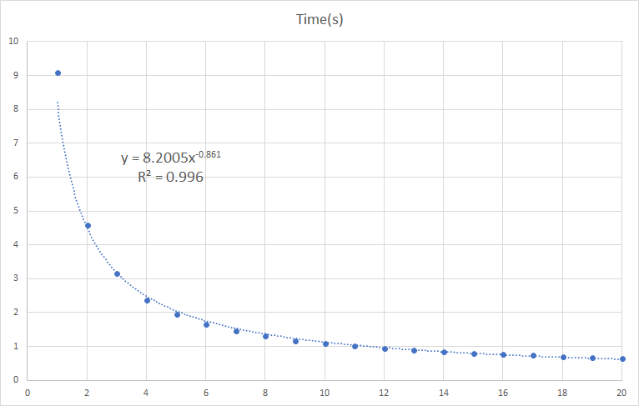
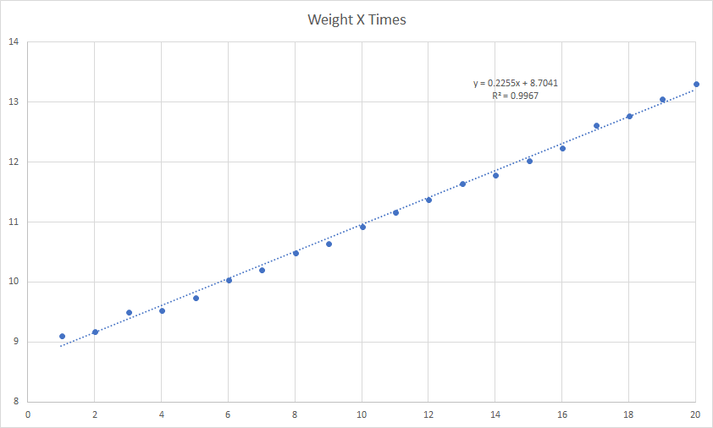
Average Wall-clock time by Weight
Without Active Load balancing
With Load balancing

