Slide 1
杭州肿瘤医院cell lines RNAseq 分析 2015年6月 / June 2015
保密 / Strictly Private & Confidential
Copyright © 2015. GENESEEQ Technology Inc. All rights reserved.

Slide 2
RNAseq analyses for Clinical Research
Main Goal: identifying candidate oncogenic genes via RNAseq based NGS analyses
DE analyses include:
IR = 0 V.S. IR >0 (control V.S. series of radiation intensity)
All possible pairwise DE between any different treatments with IR intensity.
Indentifying sample/treatment specific Alternative Splicing (AS) events;
Detecting cancer-diver Gene fusion events;
SNV identification and annotation;
Gene enrichment analyses of interesting candidate genes.

Slide 3


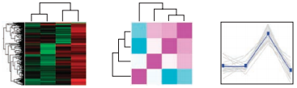
Sequencing and data analyses
Radiation
Reads (raw sequencing output)
(per sample)
Mapped to Human Reference Genome GRCh37/hg19
Abundance estimation
Identify differentially expressed transcripts
Detecting Alternative splicing, gene fusion events
Defining Expression patterns
Identifying and annotating SNV
Notes:
Add Alternative splicing

Slide 4
Basic Information
Sequencing information | details
Sequencing platform | Illumina Hiseq4000
Sequencing reaction | Illumina Hiseq 4000 PE75
Sequencing service | RNA-seq
Sample | Human cancer cell lines
Sequencing quality | Q30>90%
Analyses workflow and expected results | Shown in next slides

Slide 5
Bioinformatics Analysis
Bioinformatics | Methods
Human Genome Mapping | Reference genome GRCh37/hg19
Preliminary analyses (QC) | GC content, read length,
Reference guided alignment | STAR RNAseq mapping
Abundance quantification | RSEM
DE analysis | edgeR/DESEQ
DE candidate genes annotation and enrichment analysis | KEGG and Gene Ontology
Oncogenic gene fusion events identification | STAR, STAR-fusion and Oncofuse
Alternative splicing events | STAR, Bedtools, Diffsplice and ASprofile

Slide 6
QC Steps
QCs | Methods
RNA extraction QC | qubit 2.0, nanodrop 2000， Agilent 2100 bioanalyzer
Library QC | qubit 2.0, Agilent 2100 bioanalyzer
Before sequencing QC | qPCR Bio-Rad CFX384
Sequencing QC | Illumina Basespace Reporter
Raw output QC | fastQC， trimmomatic
Analyses workflow and expected results | Shown in next slides

Slide 7
Sample Information
Sample ID | Treatment | quantity
R1504202612 R1504202613 R1504202614 R1506023208 | Tumor Radiotherapy Recurrence after radiotherapy 180 cell line without radiation | 1 管 1 管 1 管 >3*10^6细胞
R1506023209 | 180 cell lines treat with IR 2Gy | >3*10^6细胞
R1506023210 | 180 cell lines treat with IR 6Gy | >3*10^6细胞
R1506023211 | 180 cell lines treat with IR 12Gy | >3*10^6细胞
R1506023212 | 180 cell lines treat with IR 18Gy | >3*10^6细胞
R1506023213 | 180 cell lines treat with IR 24Gy | >3*10^6细胞
R1506023214 | 180 cell lines treat with IR 36Gy | >3*10^6细胞
R1504202612 , R1504202613 and R1504202614 were sampled from the same patient at different times.
The left represents the same cell line under different radiation intensity treatments.

Slide 8
Experiments before sequencing
RNA样本情况 |  |  | mRNA纯化 |  |  |  |  |  | cDNA纯化得量（文库扩增进入） |  |  |  | 文库扩增
样本名称 | RIN | 浓度（ng/ul） | mRNA纯化 进入量（ng） | Qubit读数（ng/ml） | 稀释倍数 | 浓度（ng/ul） | 建库进入量（ng） | mRNA得率 | Qubit读数（ng/ml） | 稀释倍数 | 浓度（ng/ul） | 文库扩增 进入量（ng） | PCR循环数 | Qubit读数（ng/ml） | 稀释倍数 | 浓度（ng/ul） | 文库扩增 得量（ng） | 扩增倍数
R1504202612 | 1.8 | 16.66 | 583 | 24 | 100 | 2.4 | 48 | 8.23% | ﹤0.5 | 100 | —— | —— | 12 | 5.64 | 200 | 1.128 | 16.92 | ——
R1504202613 | 1.8 | 26.2 | 917 | 87 | 100 | 8.7 | 174 | 18.97% | ﹤0.5 | 100 | —— | —— | 12 | 7.17 | 200 | 1.434 | 21.51 | ——
R1504202614 | 7.1 | 222 | 4000 | 32.3 | 100 | 3.23 | 64.6 | 1.62% | 16 | 100 | 1.6 | 32 | 8 | 56.3 | 200 | 11.26 | 168.9 | 5.28
R1506023208 | 9.6 | 648 | 4000 | 39 | 100 | 3.9 | 78 | 1.95% | 27.4 | 100 | 2.74 | 54.8 | 8 | 88.2 | 200 | 17.64 | 264.6 | 4.83
R1506023209 | 9.5 | 189.2 | 4000 | 49.3 | 100 | 4.93 | 98.6 | 2.47% | 30.8 | 100 | 3.08 | 61.6 | 8 | 94 | 200 | 18.8 | 282 | 4.58
R1506023210 | 9.6 | 1020 | 4000 | 52.3 | 100 | 5.23 | 104.6 | 2.62% | 35.5 | 100 | 3.55 | 71 | 8 | 58.2 | 200 | 11.64 | 174.6 | 2.46
R1506023211 | 9.4 | 904 | 4000 | 43.1 | 100 | 4.31 | 86.2 | 2.16% | 28.4 | 100 | 2.84 | 56.8 | 8 | 97.3 | 200 | 19.46 | 291.9 | 5.14
R1506023212 | 9.4 | 962 | 4000 | 44.9 | 100 | 4.49 | 89.8 | 2.25% | 33 | 100 | 3.3 | 66 | 8 | 74 | 200 | 14.8 | 222 | 3.36
R1506023213 | 8.7 | 612 | 4000 | 42.3 | 100 | 4.23 | 84.6 | 2.12% | 28.9 | 100 | 2.89 | 57.8 | 8 | 70.7 | 200 | 14.14 | 212.1 | 3.67
R1506023214 | 9.4 | 1000 | 4000 | 101 | 100 | 10.1 | 202 | 5.05% | 27.1 | 100 | 2.71 | 54.2 | 8 | 51.8 | 200 | 10.36 | 155.4 | 2.87
R1506023210 | 9.6 | 1020 | 4000 | 49.7 | 100 | 4.97 | 99.4 | 2.49% | 29.7 | 100 | 2.97 | 59.4 | 8 | 244 | 200 | 48.8 | 780.8 | 13.14
R1506023214 | 9.4 | 1000 | 4000 | 35.7 | 100 | 3.57 | 71.4 | 1.79% | 24.8 | 100 | 2.48 | 49.6 | 8 | 171 | 200 | 34.2 | 547.2 | 11.03
RIN (RNA Integrity Number) indicates that R1504202612 and R1504202613 are strongly degraded (samples).
Notes:
排序

Slide 9
Sequencing throughput
Sample ID | Raw output |  | After removing rRNA reads |  | rRNA reads (%) | After quality trimming
 | Number of sequences | Number of bases | Number of sequences | Number of bases |  | Number of sequences | Number of bases
R1504202612 | 48,294,120 | 3,327,591,508 | 28,481,090 | 1838,699,516 | 41.03 | 22,845,913 | 1,656,864,396
R1504202613 | 96,358,516 | 6,822,318,686 | 63,320,156 | 4352,902,674 | 34.29 | 55,862,831 | 4,099,437,588
R1504202614 | 49,366,942 | 3,724,958,589 | 46,864,750 | 3536,028,169 | 5.07 | 44,934,915 | 3,311,341,530
R1506023208 | 57,458,224 | 4,336,726,729 | 54,380,282 | 4104,183,713 | 5.36 | 51,964,286 | 3,807,540,872
R1506023209 | 52,873,614 | 3,990,598,429 | 50,451,880 | 3807,647,004 | 4.58 | 48,627,070 | 3,590,180,973
R1506023210 | 71,039,406 | 5,361,670,320 | 68,090,952 | 5138,965,298 | 4.15 | 65,417,691 | 4,822,433,834
R1506023211 | 35,329,808 | 2,666,416,343 | 34,106,882 | 2574,051,163 | 3.46 | 32,748,273 | 2,413,745,058
R1506023212 | 56,011,144 | 4,226,864,565 | 53,903,524 | 4067,733,435 | 3.76 | 51,985,525 | 3,838,197,794
R1506023213 | 52,005,798 | 3,924,922,722 | 49,214,476 | 3714,084,895 | 5.37 | 47,411,285 | 3,500,447,755
R1506023214 | 52,300,996 | 3,946,579,146 | 50,451,324 | 3806,935,807 | 3.54 | 48,636,819 | 3,591,661,949
R1504202612 and R1504202613 came across serious rRNA contamination !
Notes:
排序

Slide 10
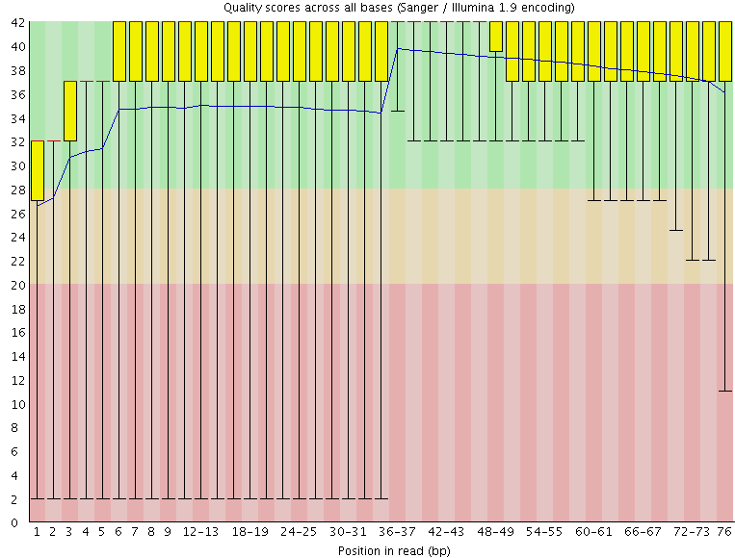
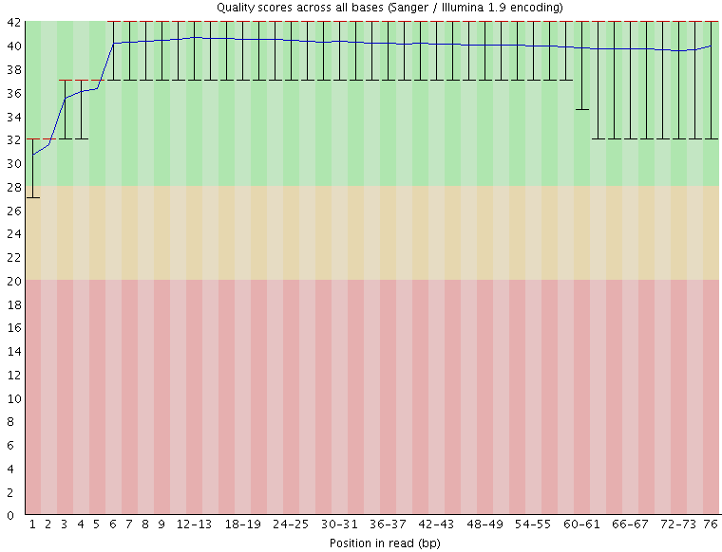
Sequencing QC
Before Quality trimming
After Quality trimming
Shown is sample R1504202612 (read 1) sequence quality score distribution before and after quality control. As can be seen, QC led to improved quality distribution by filtering low-quality data.
Notes:
换个样本

Slide 11
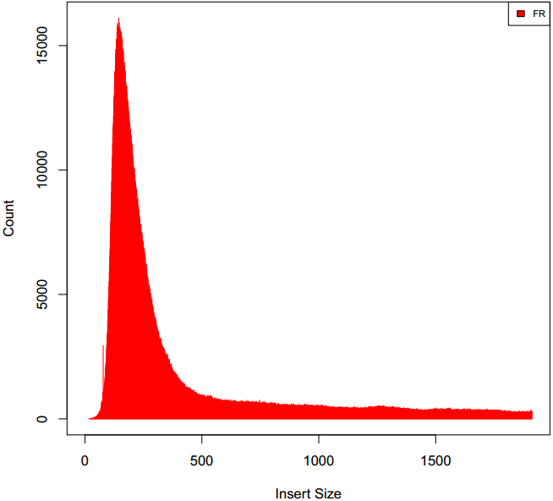
Sample Insert Size
SAMPLE | MEDIAN_INSERT_SIZE | MEAN_INSERT_SIZE
R1504202612 | 167 | 185.11
R1504202613 | 112 | 126.38
R1504202614 | 228 | 272.14
R1506023208 | 281 | 368.22
R1506023209 | 329 | 490.23
R1506023210 | 296 | 408.66
R1506023211 | 289 | 390.41
R1506023212 | 276 | 361.91
R1506023213 | 274 | 362.54
R1506023214 | 261 | 329.45
Median and mean Insert sizes.
The two contaminated samples stand out as outliers.
Insert size histogram for R1506023210

Slide 12
RnaSeq alignment metrics
Basic Mapping Metrics
Metrics | R1504202612 | R1504202613 | R1504202614 | R1506023208 | R1506023209 | R1506023210 | R1506023211 | R1506023212 | R1506023213 | R1506023214
Number of input reads pairs | 10650391 | 26928453 | 21512380 | 24785196 | 23411246 | 31384994 | 15702369 | 25044090 | 22813600 | 23421656
Average input read length | 145 | 147 | 147 | 146 | 147 | 147 | 147 | 147 | 147 | 147
Uniquely mapped reads number | 8856325 | 14826652 | 20064481 | 23352352 | 22028358 | 29560656 | 14899274 | 23719099 | 21491292 | 21838688
Uniquely mapped reads % | 83.15% | 55.06% | 93.27% | 94.22% | 94.09% | 94.19% | 94.89% | 94.71% | 94.20% | 93.24%
Average mapped length | 144.83 | 145.54 | 147.34 | 146.46 | 147.51 | 147.29 | 147.28 | 147.51 | 147.55 | 147.56
Number of reads mapped to multiple loci | 706802 | 8715720 | 1119511 | 973902 | 934829 | 1258140 | 636232 | 1018441 | 977745 | 993729
% of reads mapped to multiple loci | 6.64% | 32.37% | 5.20% | 3.93% | 3.99% | 4.01% | 4.05% | 4.07% | 4.29% | 4.24%
Number of reads mapped to too many loci | 24075 | 555436 | 14895 | 6714 | 4018 | 7365 | 4914 | 5484 | 5738 | 5458
% of reads mapped to too many loci | 0.23% | 2.06% | 0.07% | 0.03% | 0.02% | 0.02% | 0.03% | 0.02% | 0.03% | 0.02%
% of reads unmapped: too many mismatches | 0.22% | 0.12% | 0.04% | 0.03% | 0.03% | 0.03% | 0.03% | 0.03% | 0.03% | 0.03%
% of reads unmapped: too short | 9.53% | 9.52% | 1.29% | 1.73% | 1.81% | 1.69% | 0.94% | 1.11% | 1.40% | 2.40%
% of reads unmapped: other | 0.24% | 0.87% | 0.13% | 0.06% | 0.06% | 0.06% | 0.06% | 0.06% | 0.05% | 0.06%
Only R1504202613 has uniquely mapped reads <80%;
Only R1504202613 has >10% reads mapped to too many loci (>10 loci);
All these indicate R1504202613 is an outlier improper for transcripts quantification and differential expression analyses.

Slide 13
RNAseq mapping metrics (genomic feature based)
Sample | Intragenic Rate | Exonic Rate | Intergenic Rate | Intronic Rate
R1504202612 | 0.84 | 0.64 | 0.16 | 0.20
R1504202613 | 0.95 | 0.46 | 0.05 | 0.49
R1504202614 | 0.96 | 0.83 | 0.04 | 0.13
R1506023208 | 0.97 | 0.90 | 0.03 | 0.07
R1506023209 | 0.98 | 0.93 | 0.02 | 0.05
R1506023210 | 0.98 | 0.91 | 0.02 | 0.07
R1506023211 | 0.98 | 0.91 | 0.02 | 0.07
R1506023212 | 0.97 | 0.90 | 0.03 | 0.08
R1506023213 | 0.98 | 0.90 | 0.02 | 0.07
R1506023214 | 0.97 | 0.88 | 0.03 | 0.09
As shown in the table, only a few proportion of reads were mapped to intergenic, intronic regions.
Notes:
Rate == proportion; intragenic == exonic + intronic;

Slide 14
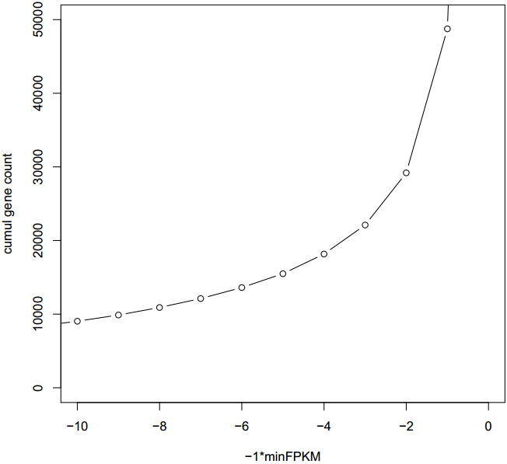
Abundance estimation (using RSEM)
Number of Isoforms expressed by at least x FPKM
Shown is sample R1506023210, of which expression abundance was estimated at gene level.

Slide 15
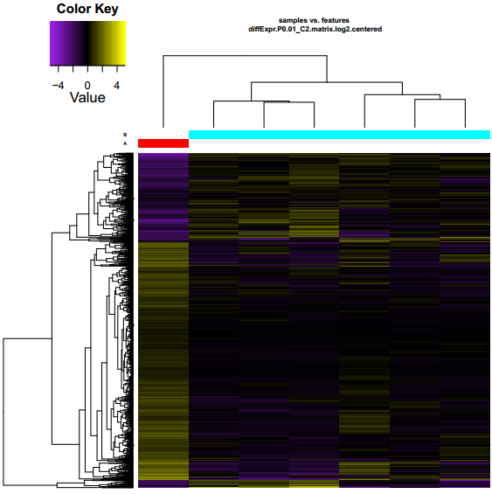
Differential Gene Expression analysis
Control cell line(A)
V.S.
Cell lines with different radiation intensity treatments(B)
0 Gy
18 Gy
24 Gy
36 Gy
2 Gy
6 Gy
12 Gy
Hierarchical clustering of transcripts and samples. Shown is a heat map showing the relative expression levels of each transcript (rows) in each sample (column). Rows and columns are hierarchically clustered. Expression values (FPKM) are log2-transformed and then median-centered by transcript.
Notes:
名称改为IR

Slide 16
Differential Gene Expression analysis
Comparison | number of DE candidate
Radiotherapy R1504202612 V.S. R1504202614 (before and after Radiotherapy) | 3288
Cell lines Radiated
Control V.S. all radiation series combined | 1519
R1506023208 V.S. R1506023209 | 668
R1506023208 V.S. R1506023210 | 598
R1506023208 V.S. R1506023211 | 515
R1506023208 V.S. R1506023212 | 977
R1506023208 V.S. R1506023213 | 922
R1506023208 V.S. R1506023214 | 2095
R1506023209 V.S. R1506023210 | 319
R1506023209 V.S. R1506023211 | 331
R1506023209 V.S. R1506023212 | 700
R1506023209 V.S. R1506023213 | 783
R1506023209 V.S. R1506023214 | 1565
R1506023210 V.S. R1506023211 | 279
R1506023210 V.S. R1506023212 | 390
R1506023210 V.S. R1506023213 | 380
R1506023210 V.S. R1506023214 | 749
R1506023211 V.S. R1506023212 | 469
R1506023211 V.S. R1506023213 | 401
R1506023211 V.S. R1506023214 | 768
R1506023212 V.S. R1506023213 | 335
R1506023212 V.S. R1506023214 | 385
R1506023213 V.S. R1506023214 | 333
Candidates selection criteria:
P-value cutoff for False Discovery Rate (FDR) = 0.05;
FPKM Fold change >=4.
** FPKM stands for expected number of fragments per kilobase of transcript sequence per millions base pairs sequenced

Slide 17
DE genes found in multiple analyses
 | R1506023208_vs_210 | R1506023208_vs_211 | R1506023208_vs_212 | R1506023208_vs_213 | R1506023208_vs_214
R1506023208_vs_209 | 97 | 67 | 75 | 80 | 100
R1506023208_vs_210 |  | 82 | 120 | 100 | 137
R1506023208_vs_211 |  |  | 76 | 80 | 100
R1506023208_vs_212 |  |  |  | 146 | 241
R1506023208_vs_213 |  |  |  |  | 233
 | Control V.S. all radiation series combined
R1504202612 V.S. R1504202614 (before and after Radiotherapy) | 338

Slide 18
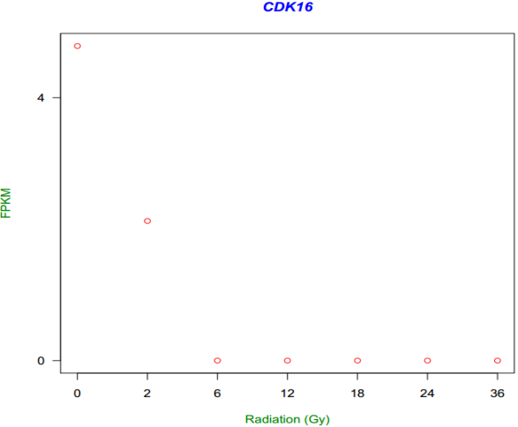
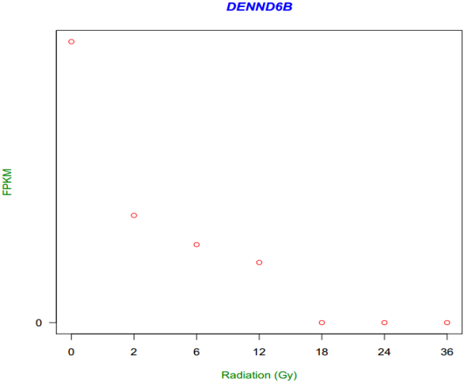
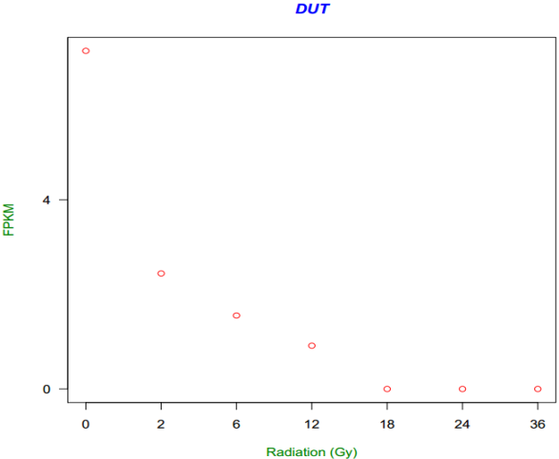
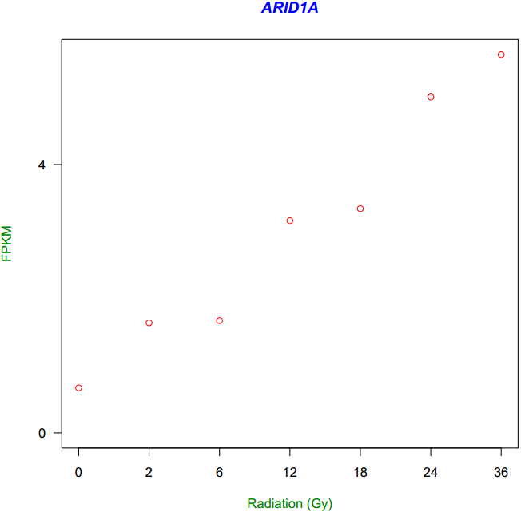
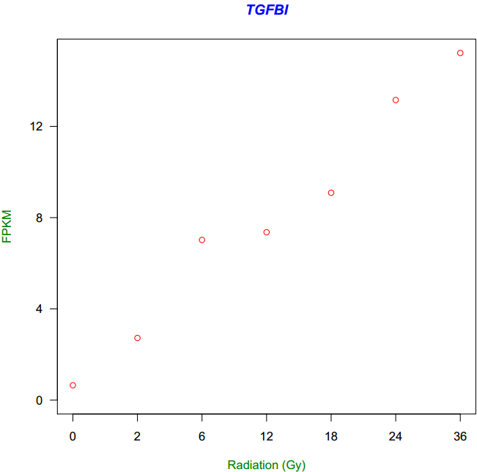
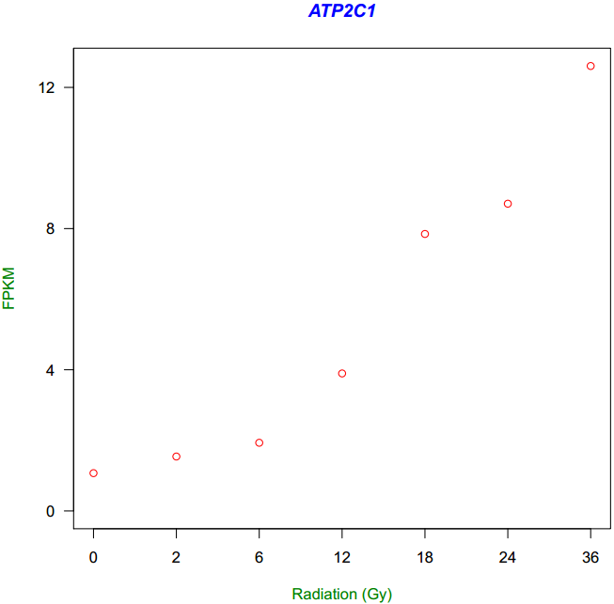
Correlation between Gene expression level and Radiation intensity
Negative Correlation
Positive Correlation

Slide 19
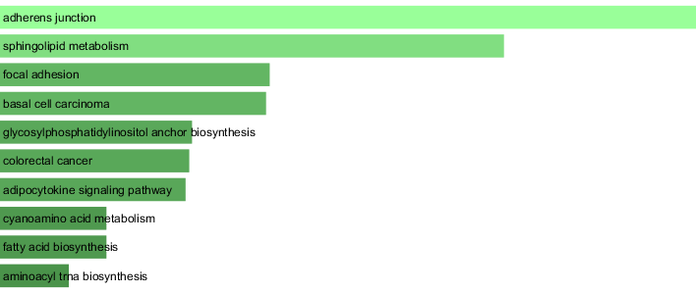
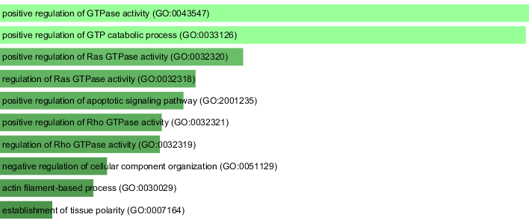
Function enrichment of Differentially expressed Genes using Enrichr
Control V.S. Radiotherapy
KEGG pathway enrichment
GO Biological Process enrichment
Check out online http://amp.pharm.mssm.edu/Enrichr/enrich?dataset=12y7 within 30 days!

Slide 20
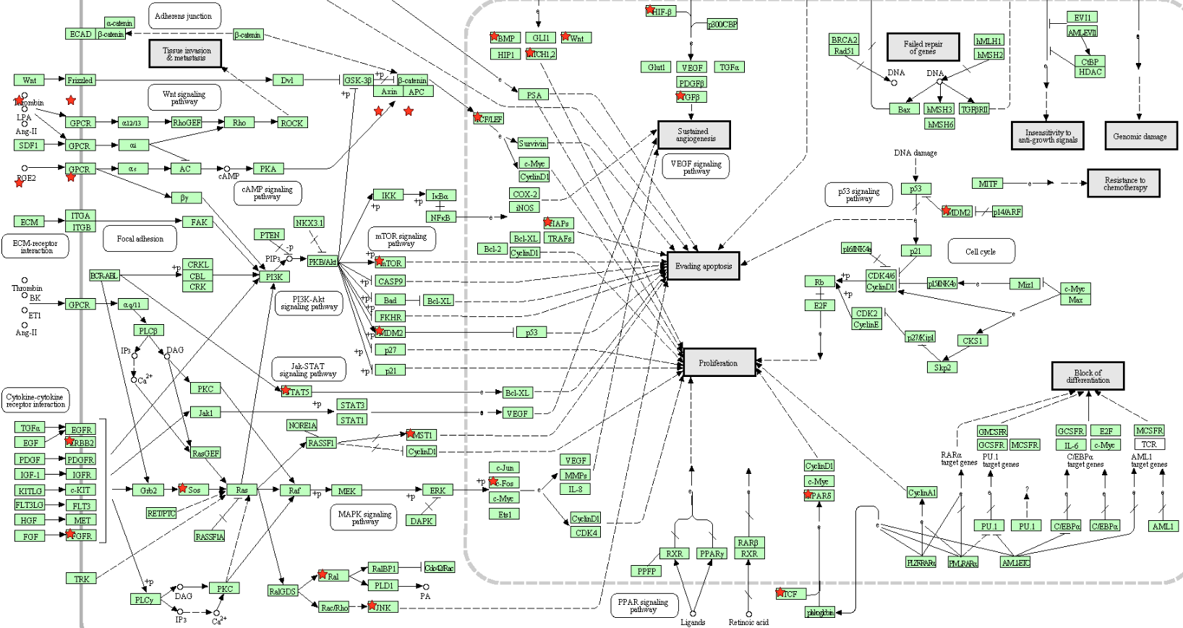
DE candidates KEGG pathway enrichment using DAVID
Shown is a significantly enriched cancer pathway based on enrichment analysis of DE candidate genes identified for ‘Control Cell lines V.S. Radiated Cell lines’.
Genes in red are the DE candidate genes involving in this KEGG pathway.

Slide 21
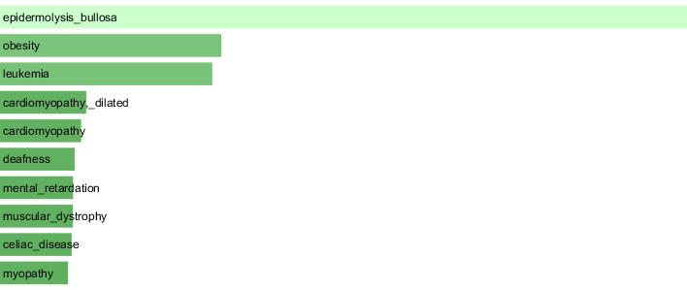
Disease Signature Enrichment using Enrichr
Control V.S. Radiotherapy OMIM disease signature
http://amp.pharm.mssm.edu/Enrichr/enrich?dataset=12y7 within 30 days!

Slide 22
Fusion events with significant oncogenic potential
Driver Fusion events
SAMPLE_ID | GENOMIC | 5_FPG_GENE_NAME | 5_FRAME | 3_FPG_GENE_NAME | 3_FRAME | DRIVER_PROB
R1506023210 | chr15:40328604>chr3:40503528 | SRP14 | 1 | RPL14 | 1 | 0.0001
 | chr8:101721725>chr13:25671647 | PABPC1 | 2 | PABPC3 | 1 | 0.0002
 | chr1:155170976>chr19:3492460 | THBS3 | 1 | DOHH | 2 | 0.0004
 | chr20:57603885>chr1:151958641 | ATP5E | 0 | S100A10 | 0 | 0.0007
 | chr20:43535178>chr5:140698490 | YWHAB | 0 | TAF7 | 0 | 0.0092
 | chr17:57721636>chr17:57816309 | CLTC | 0 | VMP1 | 0 | 0.0099
 | chr14:73569999>chr12:62777772 | RBM25 | 0 | USP15 | 2 | 0.0108
 | chr1:27101365>chr1:201300380 | ARID1A | 2 | PKP1 | 0 | 0.0124
 | chr3:184040871>chr17:38179469 | EIF4G1 | 0 | MED24 | 2 | 0.0139
 | chr6:24701820>chr1:43241400 | ACOT13 | 0 | C1orf50 | 0 | 0.0290
 | chr2:200828561>chr15:72876276 | C2orf47 | 0 | ARIH1 | 0 | 0.0319
 | chr1:52306071>chr11:102102632 | NRD1 | 2 | YAP1 | 0 | 0.0472
 | chr20:43514427>chr2:75107487 | YWHAB | 0 | HK2 | 2 | 0.0616
 | chr7:6624720>chr4:30722520 | ZDHHC4 | 2 | PCDH7 | 0 | 0.0878
 | chr11:27516918>chr3:58304475 | LIN7C | 0 | RPP14 | 0 | 0.1396
 | chr16:81478955>chr9:131018177 | CMIP | 0 | GOLGA2 | 0 | 0.1923
 | chr19:18685906>chr1:234744204 | UBA52 | 2 | IRF2BP2 | 2 | 0.2658
 | chrX:70520425>chr10:94413692 | NONO | 0 | KIF11 | 0 | 0.3829
 | chr1:21069624>chrX:153275957 | HP1BP3 | 0 | IRAK1 | 0 | 0.9999
Shown is fusion events with oncogenic potential, identified by Oncofuse for sample R1506023210.
GENOMIC Chromosomal coordinates for both breakpoints (as in input file).
5_FPG_GENE_NAME The HGNC symbol of 5' fusion partner gene.
5_FRAME Frame of translated 5' FPG
DRIVER_PROB The Bayesian (Bonferroni-corrected) probability of fusion being a driver.
Notes:
Probability排序

Slide 23
Alternative Splicing (AS) events identification
sample | All Identified Junctions | Annotated Junctions | AT/AC | GC/AG | GT/AG | Non-canonical
R1504202612 | 19795 | 0.93 | 16 | 102 | 9799 | 188
R1504202613 | 26198 | 0.88 | 18 | 160 | 12816 | 444
R1504202614 | 193620 | 0.83 | 123 | 1339 | 95919 | 300
R1506023208 | 219939 | 0.79 | 105 | 1502 | 110101 | 384
R1506023209 | 214182 | 0.78 | 108 | 1381 | 106997 | 357
R1506023210 | 231490 | 0.76 | 107 | 1582 | 115667 | 416
R1506023211 | 196611 | 0.83 | 93 | 1236 | 98365 | 280
R1506023212 | 229805 | 0.76 | 115 | 1576 | 114820 | 367
R1506023213 | 208187 | 0.80 | 107 | 1346 | 104100 | 336
R1506023214 | 215845 | 0.78 | 103 | 1475 | 107713 | 345
Shown in the table, from column 4 onwards are different intron-motifs.

Slide 24
Differential AS events
Treatment | Sample | Number of significant AS events
Comparison 1
Before chemotherapy | R1504202612 | 720
After chemotherapy | R1504202614
Comparison 2
No-radiation | R1506023208 | 1,421
IR 2Gy | R1506023209
IR 6Gy | R1506023210
IR 12Gy | R1506023211
IR 18Gy | R1506023212
IR 24Gy | R1506023213
IR 36Gy | R1506023214
Shown in the table is the number of AS event unique to different treatments.
Since R1504202612 is a seriously-degraded sample, results should be interpreted with caution.

Slide 25
SNV Identification
Sample | Non-synonymous SNVs | Total Number of SNVs
R1504202612 | 166 | 2,058
R1504202614 | 3,895 | 52,206
R1506023208 | 1,709 | 17,127
R1506023209 | 4,234 | 40,585
R1506023210 | 3,515 | 39,554
R1506023211 | 4,001 | 37,126
R1506023212 | 4,334 | 49,345
R1506023213 | 4,166 | 43,901
R1506023214 | 4,119 | 50,653
Shown in the table is the number of total number of Single-Nucleotide-Variants and that lead to non-synonymous changes.

Slide 26
Cross-examining WES and RNAseq analyses
DE and WES-SNV
R1504202612_FPKM | R1504202613_FPKM | R1504202614_FPKM | Gene | R1504202612_SNV | R1504202613_SNV | R1504202614_SNV
0.717 | 3.902 | 0.078 | GAPVD1 | - | 6.58% | -
0.908 | 7.65 | 0.926 | SPEN | 42.86% | 19.05% | -
38.118 | 59.698 | 271.842 | KRT6B | - | 52.29% | 47.29%
10.7 | 0.359 | 1.497 | NPM1 | 4.81% | - | -
40.554 | 1.977 | 0.055 | BCL11A | - | - | 25.53%
13.709 | 204.741 | 0.297 | KMT2E | - | - | 14.71%
1.242 | 0.924 | 7.553 | FGFR3 | 50% | - | -
0.096 | 0.86 | 0.104 | PCNT | - | - | 3.55%
10.174 | 130.179 | 0 | KIAA0947 | 57.14% | - | -
6.257 | 33.629 | 3.631 | COL6A3 | - | 43.01% | 40%
Shown in the table are DE candidates with variable SNV frequencies across different periods of the same patient.

Slide 27
Cross-examining WES and RNAseq analyses
DE and WES-SV
Breakpoints | stand_left | strand_right | SV_type | Paired_Reads | Splitted_Reads | Left_gene(:DE) | Right_gene (:DE)
chr19:55604686;chr19:55605662 | + | - | DELETION | PE:9 | SR:0 | PPP1R12C:DE | PPP1R12C:DE
chr6:32489617;chr6:32551782 | - | + | DUPLICATION | PE:24 | SR:0 | HLA-DRB5:DE | HLA-DRB1
chr14:105413057;chr14:105418463 | - | + | DUPLICATION | PE:4 | SR:0 | AHNAK2:DE | AHNAK2:DE
chr12:52844352;chr12:52885337 | - | + | DUPLICATION | PE:9 | SR:0 | KRT6B:DE | KRT6A
chr5:110284223;chr6:136582614 | - | + | INTERCHROM | PE:3 | SR:0 | CTD-2089O24.1 | BCLAF1:DE
chr5:110284484;chr6:136594225 | + | - | INTERCHROM | PE:3 | SR:0 | CTD-2089O24.1 | BCLAF1:DE
chr6:66803829;chr13:45523973 | - | + | INTERCHROM | PE:3 | SR:0 | NUFIP1P | NUFIP1:DE
chr15:28391602;chr15:31125089 | - | - | INVERSION | PE:3 | SR:0 | HERC2:DE | HERC2P10
chr21:27374313;chr21:27374675 | - | - | INVERSION | PE:4 | SR:0 | APP:DE | APP:DE
chr22:36597696;chr22:36651360 | - | - | INVERSION | PE:8 | SR:0 | APOL4 | APOL1:DE
Shown in the table are DE candidates that are also Structural variants.

Slide 28
Thank You!

