Slide 1
9例组织样本的全外显子检测 2015年6月
保密 / Strictly Private & Confidential
Copyright © 2013-2014. GENESEEQ Technology Inc. All rights reserved.

Slide 2
Clinical Research
课题设计方向 –全外显子检测
3个病人，总计9个样本
病人原发样本、放射(中/后)样本、复发样本提取DNA全外显子测序
生物信息学分析, 比较同一病人三样本间关系
获得病例
收集样本
提取DNA
世和全外显子测序及分析
各样本基因突变
Meta-analysis
同一病人三样本间关系

Slide 3
Basic Information
基本信息 | 详细
测序平台 | Illumina Hiseq 4000
测序反应 | Illumina PE75
测序方式 | 全外显子WES测序
测序深度 | 100倍以上
测序质量保证 | Q30>90%
分析流程及预期结果 | 详见后页

Slide 4
Steps
实验步骤 | 说明
DNA 提取 | 提取并对DNA进行全面质控
建库 | 建立高通量测序文库
富集 | 从全基因组中提取全外显子
测序 | 使用Illumina Hiseq 4000及最新试剂盒进行双向测序
测序质检 | 对测序数据进行质检
生物信息学分析
可得到结果 | 说明
SNV | 点突变，及其对蛋白功能的影响
Indel | 碱基插入或缺失，及其对蛋白功能的影响
CNV | 拷贝数变异
SV | 结构变异

Slide 5
Sample informations
样本编号 | 病人姓名 | 病人年龄 | 癌症类别 | 样本信息
R1504202609 | 叶燕玉 | 76 | 肿瘤样本 | 76-A
R1504202610 | 叶燕玉 | 76 | 放疗后样本 | 76-C
R1504202611 | 叶燕玉 | 76 | 复发样本 | 76-D
R1504202612 | 周玉荣 | 80 | 肿瘤样本 | 88-A
R1504202613 | 周玉荣 | 80 | 放疗后样本 | 88-C
R1504202614 | 周玉荣 | 80 | 复发样本 | 88-D
R1504202615 | xx | 60 | 肿瘤样本 | 60-A
R1504202616 | xx | 60 | 放疗中样本 | 60-B
R1504202617 | xx | 60 | 复发样本 | 60-D

Slide 6
Sample Information
序号 | 样本编号 | 世和编号 | DNA提取
 |  |  |  | QC-Nanodrop |  |  | QC-Qubit
 |  |  | 体积（ul） | 浓度(ng/ul) | A260/280 | A260/230 | 浓度(ng/ul) | 总量
1 | 叶玉燕 | R1504202609 | 200 | 9.3 | 1.89 | 2.6 | 5.4 | 1.08ug
 |  | R1504202610 | 200 | 24.2 | 1.97 | 2.52 | 19.34 | 3.868ug
 |  | R1504202611 | 200 | 3.3 | / | / | 1.942 | 388.4ng
2 | 周玉荣 | R1504202612 | 200 | 6.6 | / | / | 3.74 | 748ng
 |  | R1504202613 | 200 | 31.2 | 1.83 | 1.83 | 22.4 | 4.48ug
 |  | R1504202614 | 200 | 58.2 | 1.86 | 2.06 | 47.6 | 9.52ug
3 | 未知 | R1504202615 | 200 | 5.0 | / | / | 3.12 | 624ng
 |  | R1504202616 | 200 | 46.6 | 1.86 | 2.22 | 37.8 | 7.56ug
 |  | R1504202617 | 200 | 28.2 | 1.90 | 2.56 | 18.16 | 3.632ug

Slide 7
Bioinformatics Analysis
Raw reads
Trimmomatic
QC
Variant discovery
BWA
Ref: hg19
Mapping
Variant annotation
In-house softwares
PICARD
Sort/Duplicate marking
Post filtering
GATK
Local realignment
Post analysis
Base quality recalibration
生物信息分析流程

Slide 8
Sample QC
#ID | Raw-reads | Raw-data(MB) | HQ-reads | HQ-data(MB) | HQ-read-pct | HQ-data-pct
R1504202609-READ1 | 75675086 | 5714 | 66344710 | 4995 | 87% | 87%
R1504202609-READ2 | 75675086 | 5713 | 66344710 | 4959 | 87% | 86%
R1504202610-READ1 | 62400687 | 4711 | 54306752 | 4088 | 87% | 86%
R1504202610-READ2 | 62400687 | 4711 | 54306752 | 4056 | 87% | 86%
R1504202612-READ1 | 39846837 | 3008 | 31625672 | 2381 | 79% | 79%
R1504202612-READ2 | 39846837 | 3007 | 31625672 | 2349 | 79% | 78%
R1504202613-READ1 | 57804426 | 4364 | 48715414 | 3668 | 84% | 84%
R1504202613-READ2 | 57804426 | 4364 | 48715414 | 3631 | 84% | 83%
R1504202614-READ1 | 59816423 | 4516 | 50407449 | 3795 | 84% | 84%
R1504202614-READ2 | 59816423 | 4515 | 50407449 | 3758 | 84% | 83%
R1504202611-READ1 | 70504397 | 5321 | 62452518 | 4700 | 88% | 88%
R1504202611-READ2 | 70504397 | 5321 | 62452518 | 4670 | 88% | 87%
R1504202615-READ1 | 75381350 | 5691 | 64747419 | 4877 | 85% | 85%
R1504202615-READ2 | 75381350 | 5691 | 64747419 | 4832 | 85% | 84%
R1504202616-READ1 | 78379759 | 5918 | 70889641 | 5337 | 90% | 90%
R1504202616-READ2 | 78379759 | 5918 | 70889641 | 5309 | 90% | 89%
R1504202617-READ1 | 70001135 | 5284 | 59168452 | 4454 | 84% | 84%
R1504202617-READ2 | 70001135 | 5283 | 59168452 | 4412 | 84% | 83%
NA18535-WES-HZ-READ1 | 31054613 | 2344 | 26130463 | 1967 | 84% | 84%
NA18535-WES-HZ-READ2 | 31054613 | 2343 | 26130463 | 1947 | 84% | 83%
样本QC信息表

Slide 9
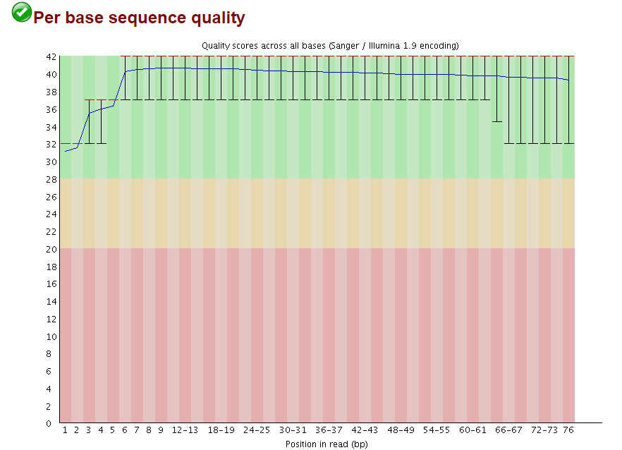
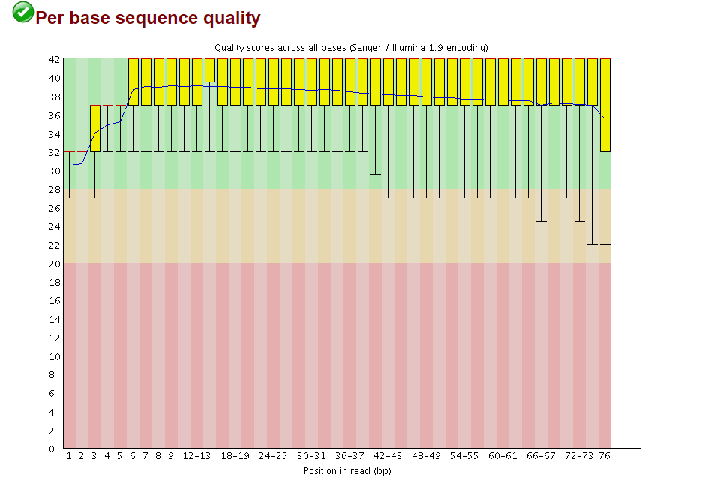
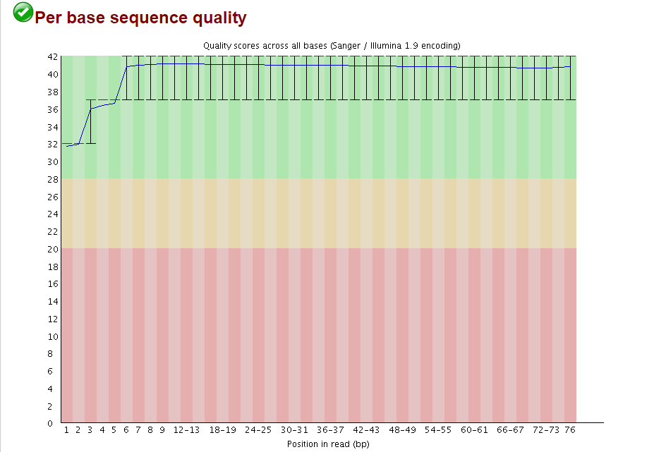
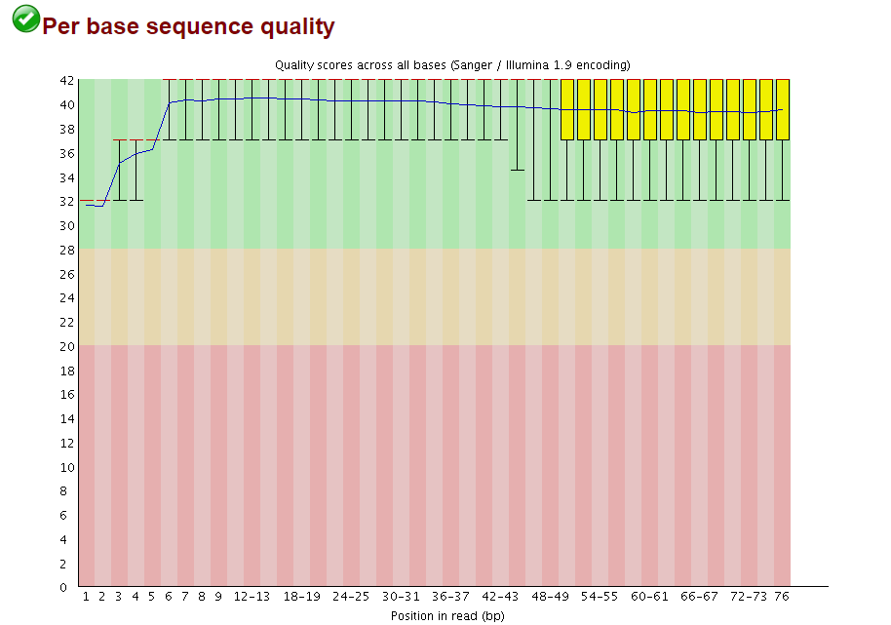
Example sequencing quality QC: Almost all bases are Q>30 across the whole read
A
B
C
D
R1504202609样本数据质量分布：
（A）QC前Read1；（B）QC前Read2；（C）QC后Read1；（D）QC后Read2

Slide 10
Sample Insert size
#SAMPLE | MEDIAN_INSERT_SIZE | MEDIAN_ABSOLUTE_DEVIATION
R1504202609 | 223 | 41
R1504202610 | 248 | 41
R1504202612 | 311 | 58
R1504202613 | 264 | 45
R1504202614 | 253 | 40
R1504202611 | 209 | 37
R1504202615 | 248 | 45
R1504202616 | 193 | 28
R1504202617 | 250 | 51
NA18535-WES-HZ | 273 | 41
所有样本Insert Size信息

Slide 11
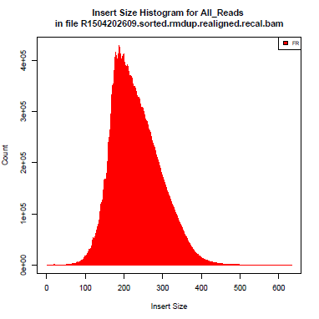
Sample insert size
R1504202609样本insert size分布

Slide 12
Sequencing coverage
#Sample | Mean
R1504202609 | 412X
R1504202610 | 304X
R1504202612 | 170X
R1504202613 | 260X
R1504202614 | 292X
R1504202611 | 359X
R1504202615 | 404X
R1504202616 | 448X
R1504202617 | 323X
NA18535-WES-HZ | 143X
所有样本测序深度均大于150X

Slide 13
Mapping Stat
#Sample | mapped
R1504202609 | 99.73%
R1504202610 | 99.95%
R1504202612 | 99.95%
R1504202613 | 99.94%
R1504202614 | 99.91%
R1504202611 | 99.94%
R1504202615 | 99.96%
R1504202616 | 99.93%
R1504202617 | 99.66%
NA18535-WES-HZ | 99.94%
各样本reads比对到参考基因组(hg19)信息。

Slide 14
Raw Variants
Sample | Raw Variant
R1504202609 | 26054
R1504202610 | 24170
R1504202611 | 24035
R1504202612 | 19066
R1504202613 | 23590
R1504202614 | 21261
R1504202615 | 25629
R1504202616 | 25185
R1504202617 | 23515
NA18535-WES-HZ | 17858
由于癌组织都没有其相对应的阴性对照（如血液或癌旁组织），无法通过阴性对照去除遗传突变信息；
因此先单独分析各癌样本中与Reference（hg19）的差异（结果中含有大量正常人SNP）。

Slide 15
Variant Filtering
Sample | Variants after filtering
R1504202609 | 1598
R1504202610 | 1110
R1504202611 | 1037
R1504202612 | 910
R1504202613 | 1020
R1504202614 | 1089
R1504202615 | 1394
R1504202616 | 1028
R1504202617 | 1134
将raw variants进行筛选，去除正常人含有突变(可去除大部分，但无对照，因此不能完全去除遗传突变)：
剔除已核查常规SNP（内部数据库）
根据Non_flaged SNP筛选
剔除在1000Genomes中出现频率在2%以上的突变
根据NA样本剔除突变
剔除突变频率在90%以上的突变

Slide 16
SNV Result
Gene | AA Change | R1504202609 | R1504202610 | R1504202611
BRCA1 | A1152V | 27.19% | 42.61% | 47.30%
ADH1A | K105X | 22.86% | - | -
TP53 | T86M | 23.08% | - | -
TP53 | R116W | 36.11% | - | -
TSC2 | E1423G | 41.46% | 50.65% | 48.10%
MYO1C | D50V | 5.66% | - | -
LRP6 | R557T | 30.43% | - | -
病人1三个不同时期突变情况（部分）

Slide 17
SNV Result
Gene | AA Change | R1504202612 | R1504202613 | R1504202614
APC2 | A1452T | - | 52.00% | -
AXL | I252V | 55.36% | - | -
BRCA2 | K2729N | - | 50.00% | 77.27%
IGSF3 | S77P | 35.29% | 5.71% | 12.50%
CTNND1 | S486fs | - | 29.63% | -
EGLN1 | A107S | 40.00% | - | -
SOS1 | I1063F | - | - | 26.67%
TP53 | E39X | - | 32.58% | -
TP53 | Y87H | - | - | 53.85%
病人2三个不同时期突变情况（部分）

Slide 18
SNV Result
Gene | AA Change | R1504202615 | R1504202616 | R1504202617
CREBBP | P1386Q | 28.39% | 6.47% | 41.01%
FIGN | L285P | 6.76% | 3.57% | -
MSH4 | T767M | 35.00% | 58.06% | 48.28%
PPP1R26 | R967Q | 22.50% | - | -
PTPRH | G164fs | 41.42% | 30.16% | 31.36%
TET2 | V1900D | 30.65% | - | 69.39%
TP53 | P58S | 4.44% | - | -
TP53 | A6V | 55.17% | 11.58% | 80.65%
病人3三个不同时期突变情况（部分）

Slide 19
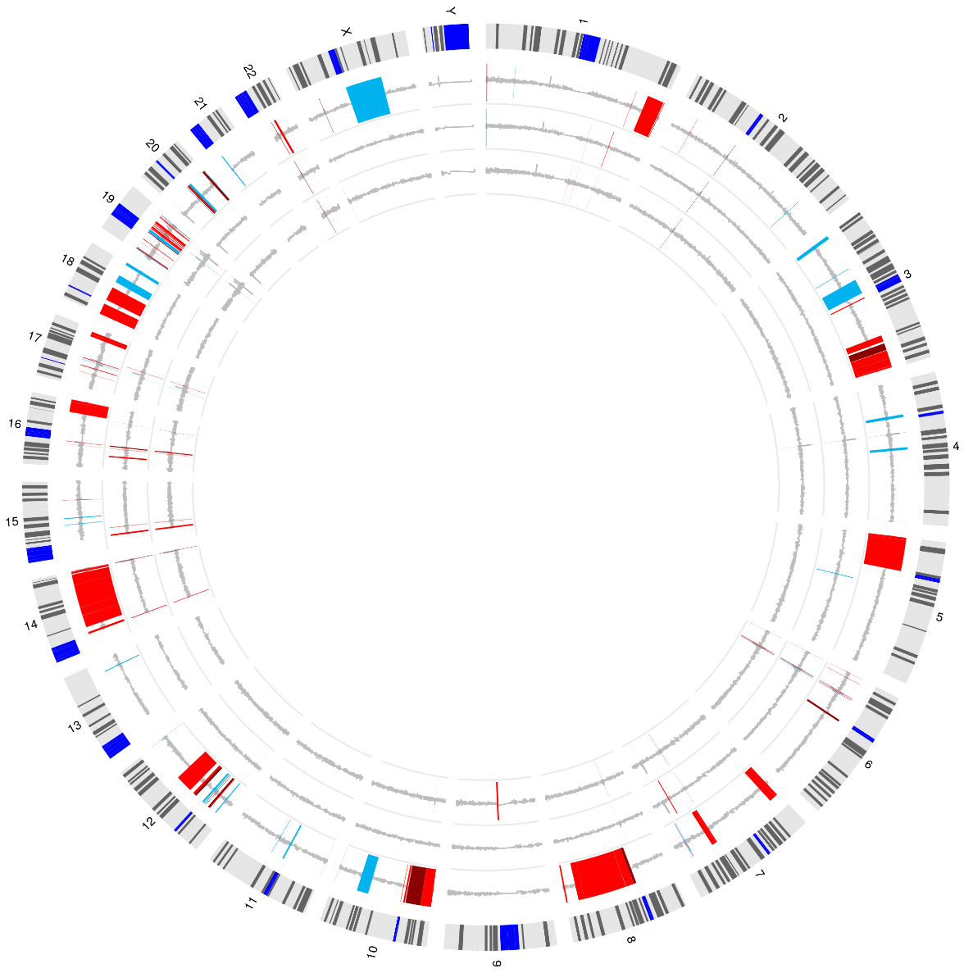
CNV
病人1的三个样本CNV环状图。
最外圈为参考基因组；
再依次从外至内分别为：
R1504202609
R1504202610
R1504202611
Notes:
同一病人病不同时期的CNV放到一起

Slide 20
Structural variants basic metrics
Sample | DELETION | DUPLICATION | INTERCHROM | INVERSION
NA18535-WES-HZ | 15 | 15 | 29 | 94
R1504202609 | 40 | 49 | 65 | 126
R1504202610 | 22 | 39 | 44 | 117
R1504202611 | 21 | 30 | 41 | 103
R1504202612 | 18 | 21 | 33 | 92
R1504202613 | 23 | 29 | 45 | 133
R1504202614 | 24 | 31 | 45 | 126
R1504202615 | 34 | 46 | 47 | 145
R1504202616 | 24 | 44 | 50 | 709
R1504202617 | 29 | 45 | 41 | 141
每个样本中所发现的不同SV types。

Slide 21
Structural variants change over time
Chromosome | SV_type | Left_gene | Right_gene | R1504202609 | R1504202610 | R1504202611
chr2;chr2 | DELETION | SLC9A2 | SLC9A2 | Y | Y | Y
chr5;chr6 | INTERCHROM | CTD-2089O24.1 | BCLAF1 | Y | Y | Y
chr11;chr11 | DUPLICATION | OR8G7P | OR8G1 | Y | Y | Y
chr8;chr8 | INVERSION | RGS20 | RGS20 | Y | N | N
chr6;chr22 | INTERCHROM | CCNC | SMARCB1 | Y | N | N
chr2;chr19 | INTERCHROM | ZNF512 | PIK3R2 | Y | N | N
chr10;chr10 | DELETION | BMPR1A | BMPR1A | Y | N | N
chr3;chr3 | DUPLICATION | FANCD2 | FANCD2P2 | Y | Y | N

Slide 22
谢谢！

