Slide 1
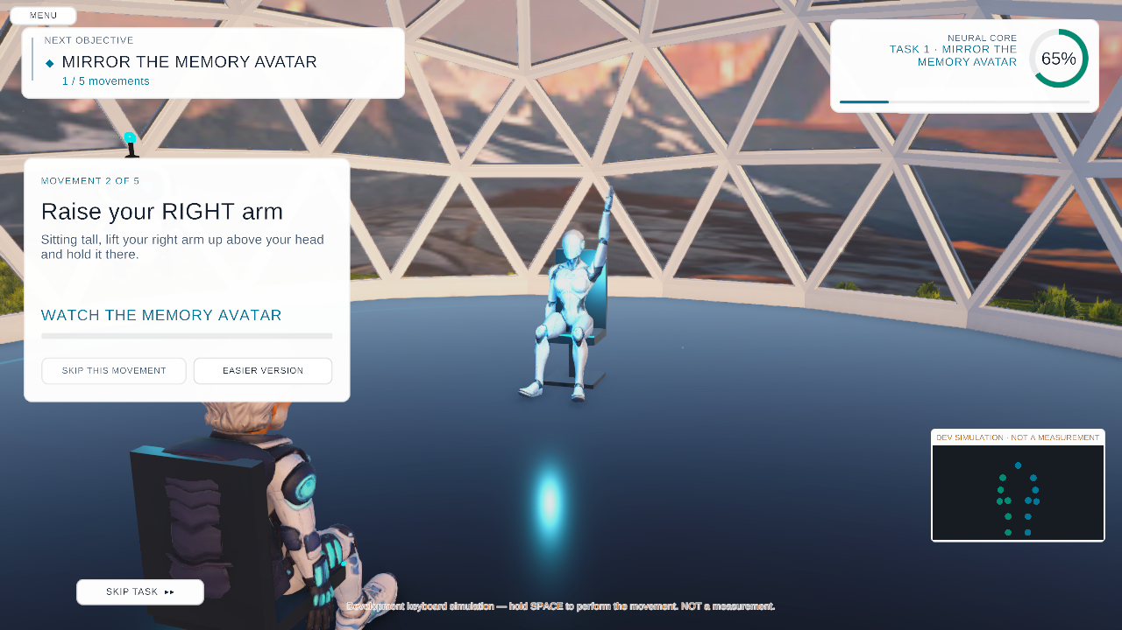
PARKISCAN
NEUROVERSE
A game-based home assessment and digital twin for Parkinson’s disease
GAME
VOICE · EYES · MOTION
DIGITAL TWIN
CLINICIAN DASHBOARD
Level 3 · Mirror the Memory Avatar (development simulation, earlier UI theme)
ParkiScan Neuroverse · Game + Digital Twin
Happiest Health · Reimagining and Reforming Healthcare in India Summit 2026 · Digital Twin Challenge, Phase 1
Three levels. One story. Eye tracking, voice, drawing, memory, reaction time, movement and gait are collected as game objectives, then land on one patient record and a clinician dashboard.
[CodeZero] · [Arya Kelychankandy] [Kajjol Aiyer]
Integrated M.Tech CSE with Business Analytics · VIT Chennai
Notes:
Neuroverse is part of ParkiScan: a game that people can play at home, and a digital twin that turns what the game records into something a clinician can review. It is our submission to the Happiest Health Digital Twin Challenge. It is a research prototype, not a diagnostic device.

Slide 2
The problem, and why a game
THE PROBLEM
WHY AN INTERACTIVE GAME
1
About 5.8 lakh people in India live with Parkinson’s, roughly 10% of the global burden [1].
ESTABLISHED
Gamification is used to raise engagement in health interventions; the review finds the evidence promising but limited [3].
2
Early signs can be subtle. A prodromal phase with small, non-obvious changes can precede diagnosis [2], and mild changes are easy to put down to ageing.
ESTABLISHED
Smartphone tasks (voice, tapping, gait, balance, memory) can quantify Parkinson’s severity at scale [6]; eye-movement changes are documented in PD [7].
3
Care relies on occasional clinic visits and questionnaires: a snapshot every few months, based on recall.
ESTABLISHED
VR / exergames are feasible and safe in PD; versus conventional exercise results were similar, with low-certainty evidence (8 trials, 263 people) [4,5].
4
Symptoms fluctuate with medication state and happen at home, between visits. Wearable and home technology can supply objective data between visits [8].
NEUROVERSE · PROPOSED
Neuroverse turns these tasks into one 3-level story with avatars, feedback and a skip on every task, so repeat sessions at home stay tolerable. Engagement and diagnostic value are not yet tested.
Not a standalone diagnostic tool. Neuroverse records objective measures with quality flags so a clinician can compare sessions. The overall Parkinson’s classification is withheld until it is validated on clinician-labelled sessions.
[1] Khurana & Gourie-Devi 2025 · [2] Postuma 2015 · [3] Johnson 2016 · [4] Dockx 2016 (Cochrane) · [5] Garcia-Agundez 2019 · [6] Zhan 2018 · [7] Anderson & MacAskill 2013 · [8] Espay 2016
2 / 10
Notes:
Parkinson's affects about 5.8 lakh people in India. Early signs are subtle, and a prodromal phase can come before diagnosis. Yet care depends on visits every few months and recall-based questionnaires, while symptoms change with medication and happen at home. A game is engaging enough to repeat. Gamification can raise engagement, and exergames in rehabilitation perform similarly to conventional exercise, with low certainty. Neuroverse itself is not yet validated: it gives clinicians objective measures to compare over time.

Slide 3
Complete game flow: assessments as objectives
Each assessment is a game objective in one continuous story, never a separate test. Every task can be skipped; a skip is recorded as not collected.
Start
Level 1
Level 2
Level 3
Return to
Twin report
Clinician
language · avatar
The Awakening
Repair Land
Lost Path
homeland
6 charts
dashboard
LEVEL 1 · VISUAL · VOICE · MEMORY
LEVEL 2 · FINE MOTOR · COGNITION · REACTION
LEVEL 3 · WEBCAM POSE · GAIT · SELF-REPORT
Follow the Memory Lantern
Webcam iris gaze after a 5-point check. Pointer error, % on target, re-acquisition latency, flash reaction time.
Trace the neural circuit (spiral)
Radial deviation, 4–7 Hz tremor-band proxy, LDLJ smoothness, pen lifts.
Mirror the Memory Avatar
Five arm movements: peak elevation, pose similarity, tracking confidence.
Memory Core (microphone)
Sustained “Ahh”, pa-ta-ka, clap to 90 BPM, repeat a sentence. F0, jitter and shimmer proxies, HNR, pauses, rhythm CV, speech rate.
Connect nodes · Repair component
Sequencing accuracy, wrong links, inter-selection time, placement and rotation error.
Standing path or seated drive
March on the spot: steps, cadence, step-interval SD, stop/go latency. Seated: steering wheel, lane offset, brake and go latency.
Recover the lost memory
Hits, omissions, false recognitions, order match, recall time.
Reactor signal
Reaction time mean and SD, false and missed responses.
Six check-ins (questionnaire)
Self-report per domain, shown as given, never scored.
Telemetry on every task: completion time, accuracy, errors, response pattern, input source and a data-quality state (valid, caveats, insufficient, invalid, not collected).
3 / 10
Notes:
The game is one story in three levels, starting with language and avatar. Level 1 covers visual tracking through the Memory Lantern, using webcam eye tracking, and voice through the Memory Core: a sustained vowel, pa-ta-ka, clapping to a beat, and repeating a sentence. Level 2 covers fine motor control with spiral tracing, plus sequencing and reaction time. Level 3 uses pose: mirroring an avatar, walking on the spot or a seated steering drive, and six questionnaire check-ins. Every task records time, errors and a quality flag, and can be skipped.

Slide 4
Real-time sensors: what comes from where
Three separate sources, never mixed up: webcam and microphone, wearable IMUs, and the game itself.
WEBCAM + MICROPHONE
IMPLEMENTED
WRIST + ANKLE IMU
BUILT · LIMITED
GAME TELEMETRY
IMPLEMENTED
on-device, no upload
ESP32 + MPU-6050 · 100 Hz · ±4 g · ±500 °/s
every task, every session
Face and iris mesh (478 points): gaze for the lantern
BlazePose (33 points): arm elevation, steps, wheel steering
Microphone: voice features and clap timing
2-D, single camera: an estimate, not a clinical-grade measure
Wrist: acceleration and angular velocity, 4–7 Hz tremor-band ratio, peak frequency, gyro RMS
Ankle: cadence, step regularity, freeze index and band power (as in Model A)
Complements the camera in spiral, gait and seated tasks
Task completion time, accuracy, errors, response latency
Pointer and trace paths, input source, skip state
Per-domain quality flags; QA or simulated runs are labelled
IMU DATA PATH: TIMESTAMP → TRANSMIT → VALIDATE → SYNCHRONISE → FEATURES
ESP32 + MPU-6050
Python receiver
Local UDP 127.0.0.1
Unity bridge
Per-task window
Session record
seq, t_ms, t_us per sample · 921600 baud JSON
schema and range checks; duplicates, out-of-order and stale data rejected
validated samples only; simulated packets flagged
placement-tagged; aligned to the game clock
features stored with the task record; raw readings kept as CSV
stored with the session; the twin’s wearable grid is simulated or Daphnet today
Status. Firmware, receiver, Unity bridge, simulator and tests are built. The ankle model is trained on real Daphnet accelerometer data; the wrist and ankle boards have not yet been run through a full play session on live hardware. The wrist tremor features exist, but no wrist model is trained.
Moore-type freeze index and Daphnet data: Bächlin et al. 2010 [9] · Wearable technology in PD: Espay et al. 2016 [8]
4 / 10
Notes:
Three sources, kept separate. The webcam and microphone give gaze, pose and voice, processed on the device. Wrist and ankle sensors, built from an ESP32 and an MPU-6050, give acceleration and angular velocity at 100 hertz. Each sample is timestamped, validated by a Python receiver, sent locally to Unity and aligned to the game clock. The game itself gives timing, errors and paths. To be clear: this sensor path is built and tested, but not yet run end to end on live hardware.

Slide 5
AI, datasets and methodology
Ten datasets reviewed. Seven were used for training or evaluation, all with participant-grouped validation; three are proposed.
Dataset | Modality | Role in Neuroverse | Status
Daphnet Freezing of Gait | 3 accelerometers, 10 people, 64 Hz | Model A (freeze in 3 s); 1-D CNN; twin clinical header | Trained · LOSO
Gait in Neurodegenerative Disease | Insole stride intervals, 31 people | Gait PD vs control; severity (research) | Trained · tiny set
Spiral drawings (digitised tablet) | Pen trajectories, 40 people | Spiral model, same extractor as the game | Trained · experimental
Parkinsons (Oxford voice) | Sustained-vowel features, 32 people | Voice research model, not applied to game audio | Trained · research only
Parkinson’s speech recordings | 26 recordings × 40 people | Speech research model | Flagged · failed held-out test
Parkinson’s Telemonitoring | Home voice, UPDRS, 42 people | UPDRS regression | Flagged · below mean baseline
ET_PD_VIS | Gaze heat-map and scan-path images | Image-feature model on TMT A/B/C | Flagged · AUC 1.00, likely confound
NDDCNN | Not verified by us | Not in the repository | Proposed
Parkinson’s Disease Classification | Vowel /a/ ×3, 252 people, 754 features | Candidate for voice-model evaluation | Proposed
TMT-PD | Eye-tracker events, 28 PD + 12 controls | Candidate for gaze-task validation | Proposed
Multimodal
Per-domain outputs sit side by side with quality flags. A fused classifier is proposed once clinician-labelled sessions exist.
Proposed only
Vision Transformers, LSTMs and Transformer speech encoders for diagnosis are not implemented.
No diagnostic accuracy is claimed.
MODEL FAMILIES AND THEIR ACTUAL ROLES
Gradient boosting · random forest · MLP
tabular features: Models A and B, spiral, voice, gait
1-D CNN (raw 3×256 windows)
Daphnet detection, AUC 0.85 vs 0.88 boosting
Pretrained CNN perception
BlazeFace, Face Landmarker, BlazePose: gaze and pose, not trained by us
Transformer ASR (faster-whisper, local)
follows the sentence task; not a diagnostic model
Voice biomarkers for PD telemonitoring [10] · Daphnet [9] · Datasets: Hausdorff 2000, Isenkul 2014, Little 2007, Sakar 2013/2018, Tsanas 2010, Mendeley Data ET_PD_VIS and TMT-PD (2026)
5 / 10
Notes:
We reviewed ten datasets. Seven were used for training or evaluation, including Daphnet freezing of gait, spirals, gait and voice; our own checks flagged several, and the speech set failed its held-out test. NDDCNN, the Parkinson's Classification set and TMT-PD are proposed. Our models are gradient boosting, a one-dimensional CNN, pretrained face and pose networks, and a local speech model that follows the sentence task. Vision transformers and LSTMs are proposed, not implemented, and we claim no diagnostic accuracy.

Slide 6
System architecture
Capture on the device, process locally, build one patient record, review with a clinician, feed the next session.
CAPTURE
UNITY 3D GAME · ON THIS COMPUTER
PARKISCANML SERVICE · 127.0.0.1
RECORD, REVIEW, ACT
1
Patient + avatar
2
6
Sync · preprocessing · features
9
Record + digital twin
avatar and language chosen once; persistent participant ID
Levels 1–3 + finale
session JSON/CSV, IMU alignment, voice, spiral, gait and gaze features
FHIR-style record, levodopa PK/PD, risk models A and B, what-if
lantern, Memory Core, spiral, nodes, mirror avatar, walking, drive
3
Webcam + microphone
Modality models
7
10
Clinician dashboard
iris gaze, body pose, voice, claps; processed on device
On-device perception
Daphnet freeze model, spiral (experimental); others research-only, never applied to game data
Face Landmarker, BlazePose (ONNX, GPU)
in the game (F2, post-game button) and in a browser
4
Wrist + ankle IMU
5
Questionnaire + telemetry
ESP32 + MPU-6050, 100 Hz, via local receiver and UDP
six check-ins; per-task metrics, quality flags, session ID
8
Multimodal assessment
11
Rehabilitation + next session
per-domain metrics + data-quality state; overall class withheld
clinician-set home activities, re-assessed
next session: assessment and rehabilitation loop
Implemented and exercised in QA
Built; limited data or no live-hardware test
Proposed extension
All data stays on the computer
6 / 10
Notes:
The architecture runs left to right. The patient picks an avatar and plays. Webcam, microphone and the wrist and ankle sensors feed the Unity game. Sessions go to a local Python service that synchronises, extracts features and runs the modality models. The results build the patient record and digital twin, shown on the clinician dashboard, and the loop returns to the next session. Green is implemented, amber is built with limits, and violet is proposed.

Slide 7
Avatar, patient record and the digital twin
AVATAR AND PATIENT IDENTITY
TWIN CREATION PIPELINE
The player picks an avatar and outfit at the start.
A persistent participant ID is created on this device and stamped on every task, session and telemetry event.
Sessions accumulate under that ID: one longitudinal record.
The avatar is the player’s visual self in the game. The twin is the data: it is keyed by the participant ID, not by the avatar.
Collect
Preprocess
Features
Analyse
Record
Update
game · webcam · voice · IMU · questionnaire
sync, validate, quality state
per-task metrics
modality models
FHIR-style patient
every new session
IMPLEMENTED NOW
PROPOSED, NOT CLAIMED
Synthetic FHIR R4 record (SNOMED CT, LOINC), tagged SYNTHETIC; real Daphnet clinical header for 10 people
Levodopa PK/PD: dopamine effect and ON/OFF state
Simulated 7-day wearables + real Daphnet sensors
Model A: freeze within 3 s, AUC 0.76 (0.72–0.83), real data, leave-one-person-out
Model B: freeze within 2 h, AUC 0.806, synthetic cohort
What-if re-simulation; game session synced at the end of Level 3
Game measures as inputs to Models A and B: needs clinician-labelled game sessions
Personal PK/PD fitted to real patients: today it uses published population values
A validated, predictive twin of an individual
Model B accuracy reflects the simulator, not clinical accuracy
TWIN VERSUS PROFILE VERSUS DASHBOARD
Static profile a snapshot of facts
Dashboard displays data, does not model it
Digital twin one patient’s record plus models, updated by each session; simulates and forecasts
Digital twins in health [11] · Daphnet clinical header [9] · Levodopa PK: Hayashi 2025 · Closest published pre-freeze benchmark (AUC 0.76): Palmerini 2017 [13]
7 / 10
Notes:
The avatar is the player's visual self; a persistent participant ID links every session into one longitudinal record. A twin differs from a profile or dashboard: it combines the record with models, updates after each session, and simulates what-if changes. Today it has a synthetic health record, a levodopa model, wearable streams, and two risk models: freezing within three seconds from real ankle data, AUC 0.76, and within two hours from a synthetic cohort. Game measures sit beside them but do not yet feed the models.

Slide 8
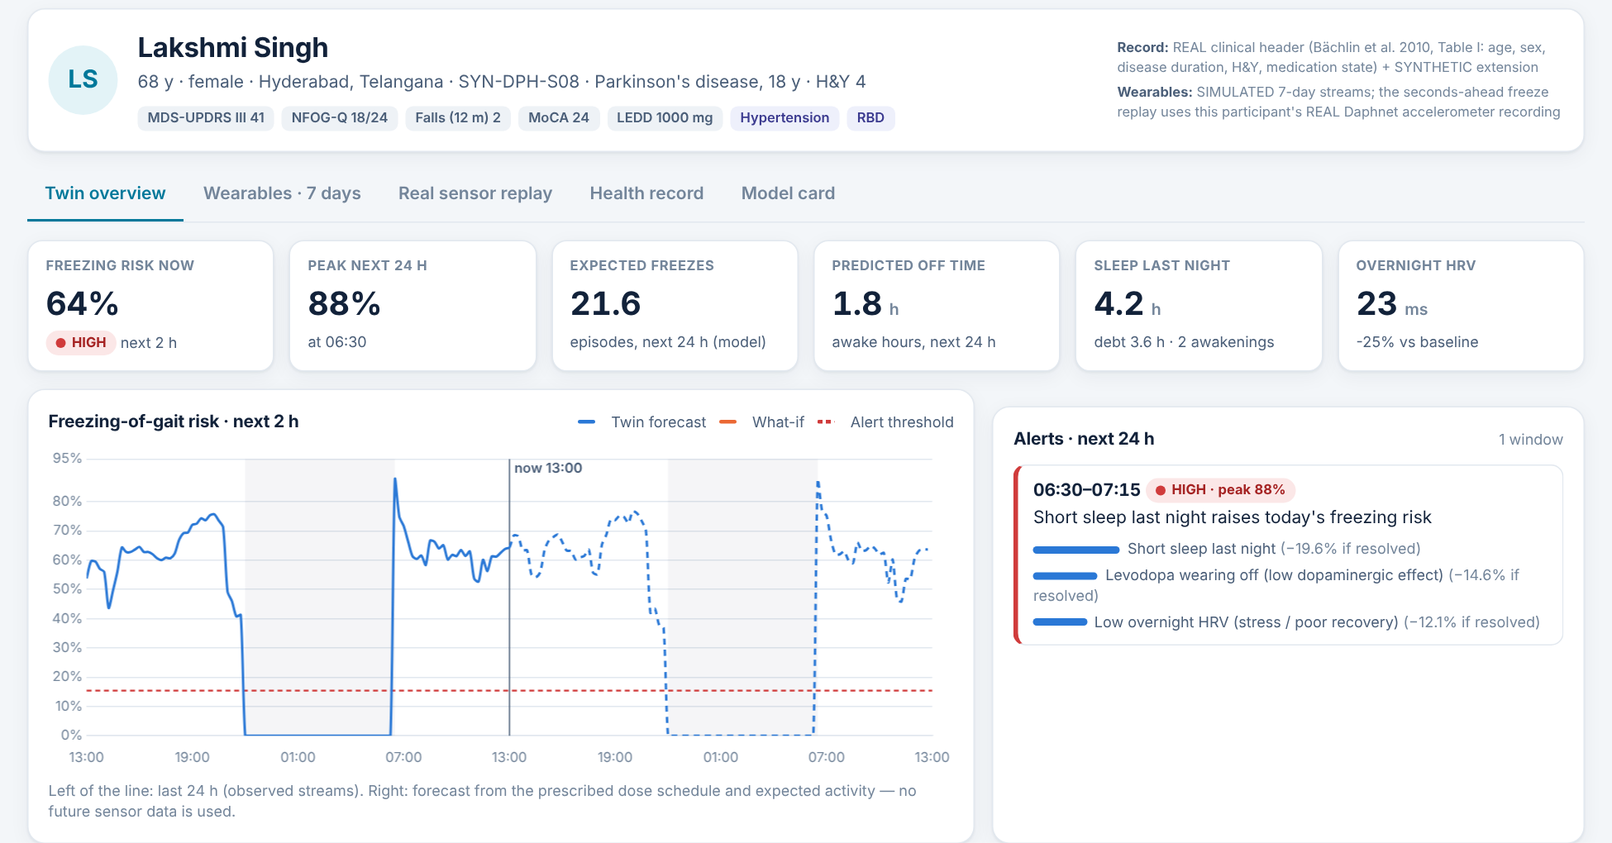
Clinical dashboard and assessment outputs
Domain | What the clinician sees | Source
Voice | Sustained vowel, pa-ta-ka, rhythm, speech rate | Mic · game
Visual tracking | On-target %, error, re-acquisition, reaction | Webcam · game
Spiral / fine motor | Radial deviation, tremor-band proxy, smoothness | Game · wrist IMU*
Cognition | Accuracy and response time per task | Game
Pose and movement | Peak arm elevation, left vs right arm, pose similarity | Webcam
Gait | Cadence, step variability and alternation, stop/go latency; freeze alerts | Webcam · ankle IMU*
Questionnaire | Six domains, as reported, never scored | Game
Trend | Game sessions listed per patient, beside the ON/OFF curve | Twin record
Twin overview: 2-hour freezing risk, alerts with drivers, ON/OFF curve (synthetic patient)
AFTER THE GAME
* when the wearable is connected
Level 3 twin report
OPEN CLINICIAN
Opens on the
How it fits together
Game metrics and the questionnaire are stored on the twin and shown beside the levodopa ON/OFF curve. The clinician reads them together with the risk forecast; they do not yet feed the models. Model A warns 62% (148/237) freezes with a 4.6 s median lead.
6 charts · session syncs
DASHBOARD button
player’s own twin
Also F2 anywhere, and CLINICIAN DASHBOARD on the title screen, Three Lands and pause menu. Live from the twin service; otherwise an offline snapshot. Tabs: overview, what-if, sensor replay, game sessions, record, model card.
Dashboard values are synthetic patient data (Daphnet-anchored twin). Model results come from ParkiScanML/reports; AUC with 95% subject-bootstrap CI.
8 / 10
Notes:
After the last level, the twin report shows six charts, and the Open Clinician Dashboard button opens the dashboard on the player's own twin. The clinician sees voice, visual tracking, spiral measures, cognition, pose, gait and questionnaire answers, next to risk, alerts with their drivers, and a what-if planner. Our freeze warning flagged 62 percent of freezes, with a median lead of 4.6 seconds.

Slide 9
Home use: assessment today, rehabilitation as an extension
TRACK 1 · ASSESSMENT AND MONITORING (BUILT)
HOME-TO-CLINIC LOOP
Anyone can play; the output is measures and flags, never a diagnosis.
Short sessions, seated mode for Level 3, large targets, skip on every task.
Each session is time-stamped, so measures line up with the medication ON/OFF curve.
The clinician reviews sessions on the dashboard before the next visit.
1
Play at home
short sessions, any day
2
Record locally
metrics and quality flags on the device
3
Sync to the twin
end of Level 3; the participant ID links sessions
TRACK 2 · REHABILITATION FOR DIAGNOSED USERS (PROPOSED)
Only for people already diagnosed; activities chosen by their clinician.
Candidates already in the game: rhythm clapping and cueing, mirrored arm movements, marching on the spot, steering tasks, cognitive and reaction tasks.
Evidence: VR and exergames in PD are feasible and safe; results are similar to conventional exercise, low certainty [4,5]. Rhythmic cueing improves gait in PD [12].
No therapeutic claim is made for Neuroverse; it needs its own trial.
Clinician review
dashboard: sessions, risk, what-if
4
5
Individual plan
clinician adjusts activities and medication timing
6
Next session
progress compared with earlier sessions
[4] Dockx 2016 · [5] Garcia-Agundez 2019 · [12] Ghai 2018 (rhythmic auditory cueing meta-analysis) · Evidence is for serious games in general, not for Neuroverse.
9 / 10
Notes:
At home, assessment is built: short sessions, a seated mode, and clinician review. Rehabilitation for people already diagnosed is proposed. The evidence for serious games and rhythmic cueing is encouraging, but it concerns the approach in general, not Neuroverse, which would need its own trial. The loop connects home play to clinical review and an individual plan.

Slide 10
Hackathon requirements and references
Requirement (challenge) | Neuroverse | Where
Twin of one patient, one adverse event | Parkinson’s patient; freezing of gait | Twin service
Static data: synthetic EHR | FHIR R4, SNOMED CT, LOINC, tagged SYNTHETIC | twin/ehr.py
Dynamic data: wearables / IoT | Real Daphnet IMUs; simulated steps, HR, sleep, HRV; ESP32 path | Daphnet, firmware
Fuse and predict | Model A AUC 0.76; Model B AUC 0.806 (record only 0.779) | reports/
Doctor dashboard | In the game (F2, post-game) and browser; what-if | Game, /dashboard
Sandbox data rules | Synthetic or anonymised only; processed locally | Whole project
Submission package | GitHub, Apache-2.0, architecture, deck; 20-min video in preparation | Repository
REFERENCES
[1] Khurana S, Gourie-Devi M. Community-based epidemiology of PD in India. Cureus 2025;17(3):e80248.
[2] Postuma RB et al. MDS research criteria for prodromal PD. Mov Disord 2015;30:1591–1601.
[3] Johnson D et al. Gamification for health and wellbeing: a systematic review. Internet Interv 2016;6:89–106.
[4] Dockx K et al. Virtual reality for rehabilitation in PD. Cochrane Database Syst Rev 2016;12:CD010760.
[5] Garcia-Agundez A et al. Exergames for PD rehabilitation: a systematic review. J NeuroEng Rehabil 2019;16:17.
[6] Zhan A et al. Smartphones and machine learning to quantify PD severity. JAMA Neurol 2018;75(7):876–880.
[7] Anderson TJ, MacAskill MR. Eye movements in neurodegenerative disorders. Nat Rev Neurol 2013;9:74–85.
[8] Espay AJ et al. Technology in PD: challenges and opportunities. Mov Disord 2016;31(9):1272–1282.
[9] Bächlin M et al. Wearable assistant for PD patients with freezing of gait. IEEE TITB 2010;14(2):436–446.
[10] Little MA et al. Dysphonia measurements for telemonitoring of PD. IEEE TBME 2009;56(4):1015–1022.
[11] Katsoulakis E et al. Digital twins for health: a scoping review. npj Digit Med 2024.
[12] Ghai S et al. Rhythmic auditory cueing in parkinsonian gait: meta-analysis. Sci Rep 2018;8:506.
[13] Palmerini L et al. Motor patterns preceding freezing of gait. Front Neurol 2017;8:394.
Datasets: Hausdorff 2000 J Appl Physiol 88:2045 · Little 2007 BioMed Eng OnLine 6:23 · Sakar 2013 IEEE JBHI 17:828 · Sakar 2018 (UCI) · Tsanas 2010 IEEE TBME 57:884 · Isenkul 2014 (UCI) · ET_PD_VIS and TMT-PD, Mendeley Data 2026.
10 / 10
Notes:
Finally, the mapping to the challenge: a twin of one patient, a synthetic health record, wearable data, fusion and prediction, a doctor dashboard, sandbox-compliant data and the submission package. References are on the slide. Neuroverse needs independent clinical validation. Thank you.

