Slide 1
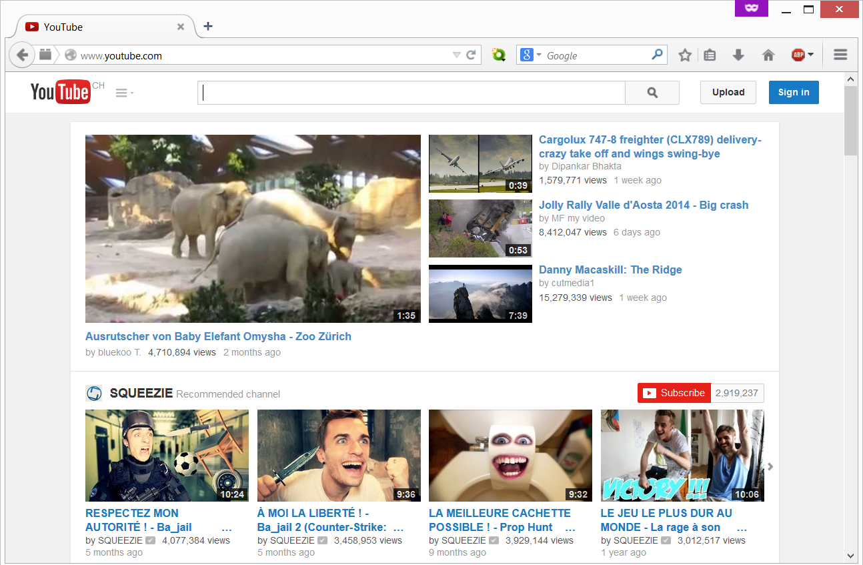

Slide 2
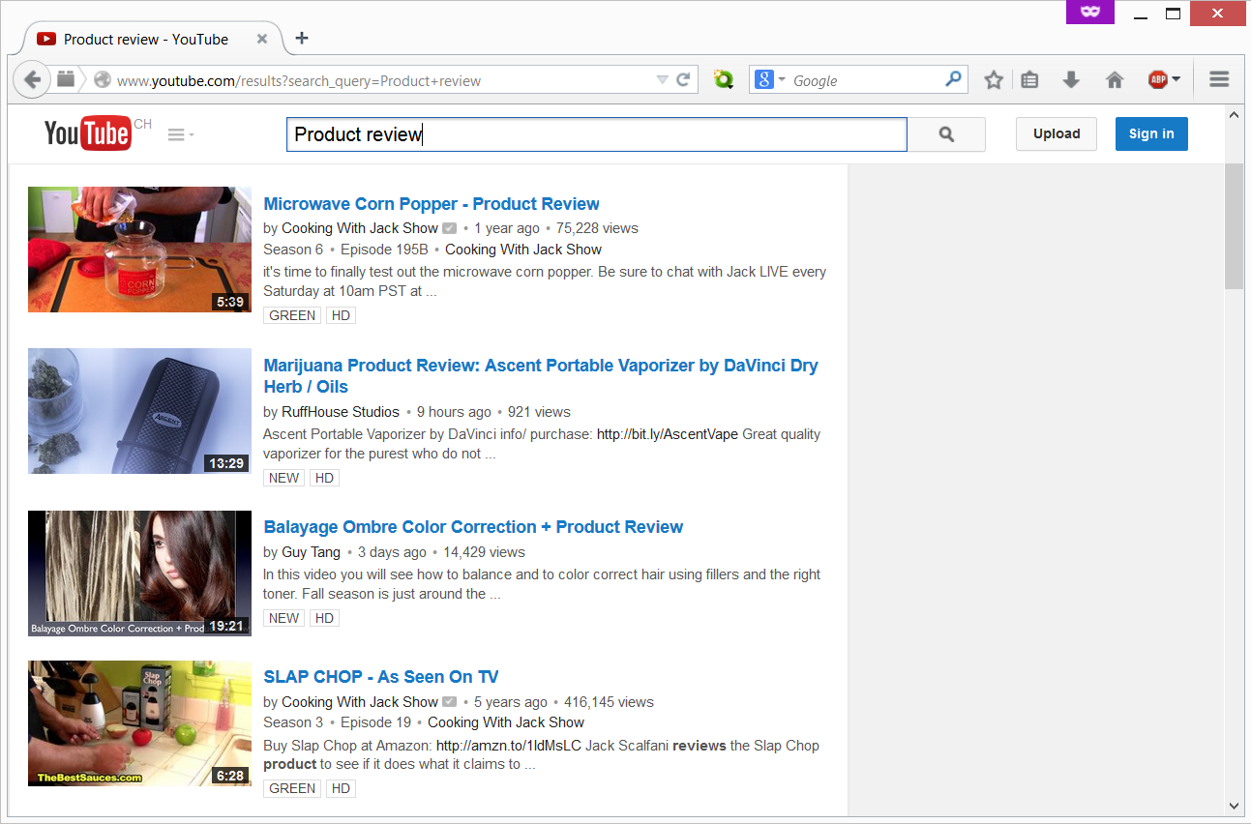

Slide 3
About 3,180,000 results
Notes:
93 millions if you just search for review.

Slide 4
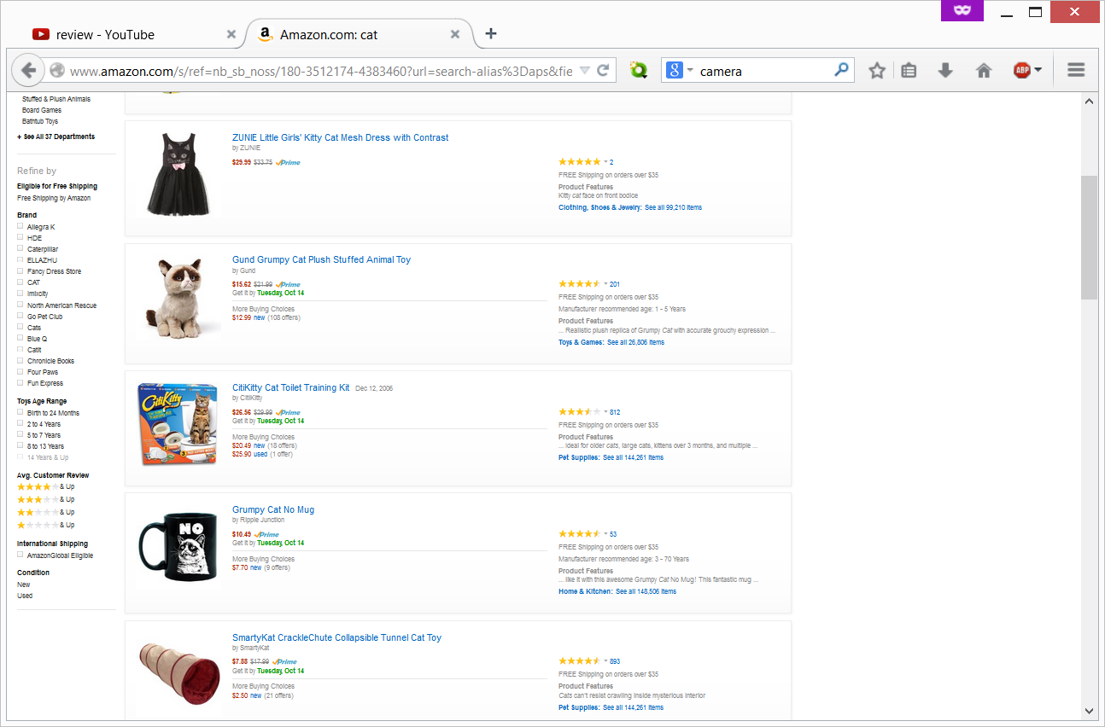

Slide 5


Slide 6


Slide 7
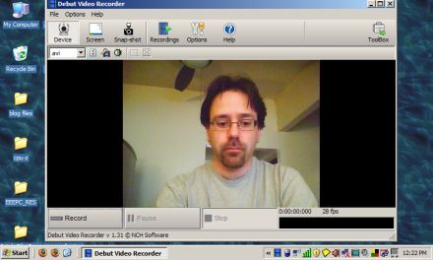

Slide 8
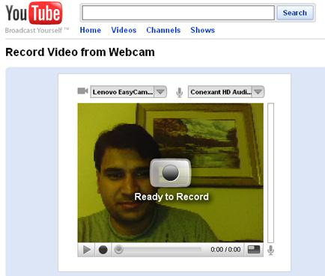

Slide 9
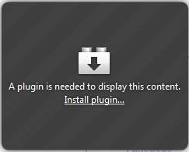

Slide 11


Slide 12
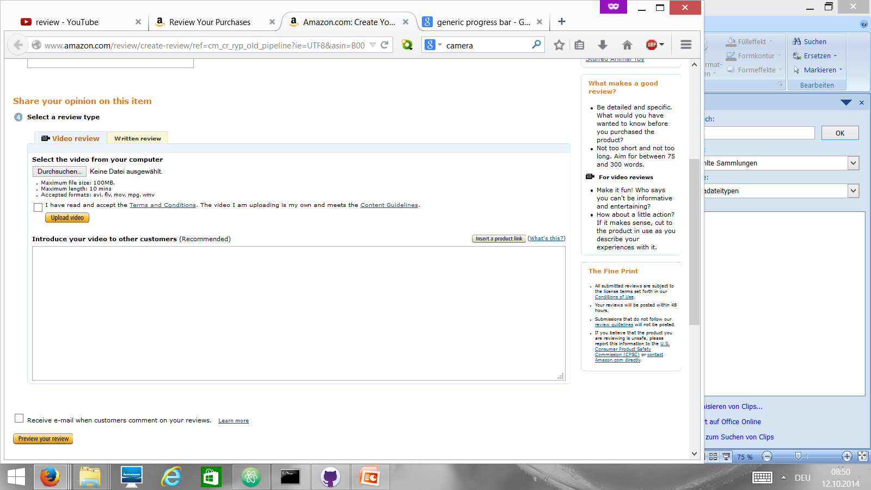

Slide 15

use
Steamy Pluto

