Slide 1
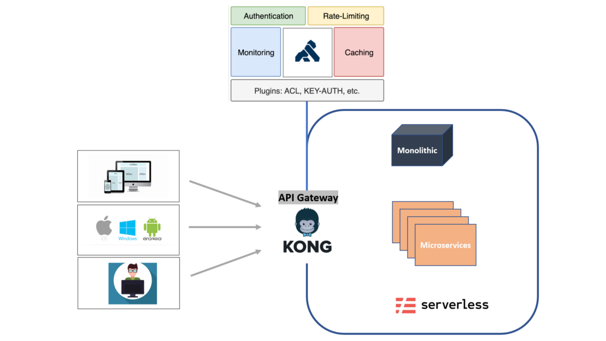

API Security Improvement
API Gateway with KONG[1 week]
Setting route & proxy
Setting authentication to support with Auth0
API Authentication(For 3rd party)[1 week]
Chatbot(Convolab)
Manage API
Internal Test[2 days]
Aris Platform
API

Slide 2
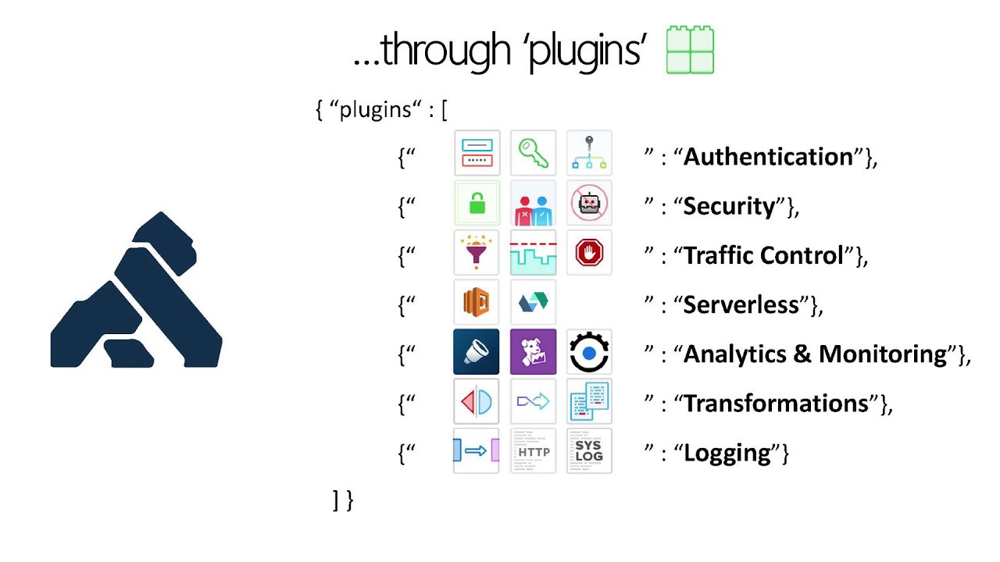
Kong(All of features)

Slide 3
Account
Support universal login(Auth0)[4 days]
Google
Facebook
Manual(email & password)
other…
Store(Aris Platform)[2 week]
User Management
Invite(Gmail)
Manual Insert
Super Admin Control Panel[1 week]
Access to manage customer store
Test[3 days]

