Slide 1
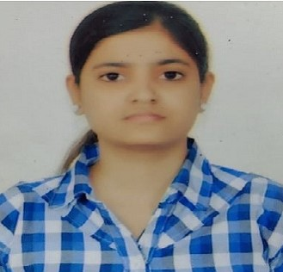
INTRODUCTION MYSELF
HELLO EVERYONE

Slide 2


MY SELF
MY SELF MISHRA KAJOL.
I LIVE IN AHMEDABAD

Slide 3

QUALIFICATION
MY GRADUATION COMPLETED IN BACHELOR IN ENGINEERING IN IT BRANCH FROM GTU.
SSC , HSC PASSED IN GBSE BOARD

Slide 4
MY PERSONALITY
THOUGHTFUL ,
CAREFUL,
SINNERIER
REALABLE PERSON.
QUITE
DETERMIND

Slide 5
STREANTH & WEAKNESS
STRENGHT
TIME MANAGEMENT
MULTITASKING
PROBLEM SOLVING
DISCIPLE
WEAKNESS
SENSITIVE
OVERTHINKING
STUBBORN

Slide 6
I BELIEVE IN MYSELF, NEVER GIVE UP
BELIEVE SYSTEM

Slide 7
CAREER PATH
My interest in web designing and UI/UX in it field.
My Skill in HTML5,CSS,jquery,js,bootstrap.
And also Problem Solving.

Slide 8


