Slide 1



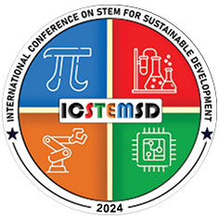
 | ATHARVA EDUCATIONAL TRUST'S ATHARVA COLLEGE OF ENGINEERING
 | (Approved by AICTE, Recognized by Government of Maharashtra & Affiliated to University of Mumbai - Estd. 1999 - 2000) ISO 2100:2018 ISO 14001:2015 ISO 9001:2015 NAAC A+ Accredited
International Conference on Science, Technology, Engineering & Mathematics for Sustainable Development ( ICSTEMSD 2024)
15th -16th February 2024
Paper ID : 234 | Author’s Name : Vivek Jha
Institute Name: | Atharva College Of Engineering
Presentation given by: | Vivek Jha, Prathamesh Gaikwad, Aniket Jha , Sahil Kadam
Paper Title: | Next Generation Real Estate
Track No.: | RECENT TRENDS IN IT

Slide 2
INDEX
❖ Introduction
❖ Objective
❖ Literature Survey
❖ Block Diagram
❖ Result
❖ Conclusion
❖ Future Scope
❖ References
International Conference on Science, Technology, Engineering & Mathematics for Sustainable Development ( ICSTEMSD 2024)

Slide 3
INTRODUCTION
Making buying and selling of real state property as liquid as a stock market trading.
Blue Broker is a Platform where you can buy and sell a property just like stock trading and gold trading.
It is profitable for both – The Buyer and Seller.
The Buyer Can easily buy a Part of the Property without having a lot to invest and can reduce the risk factor.
International Conference on Science, Technology, Engineering & Mathematics for Sustainable Development ( ICSTEMSD 2024)

Slide 4
OBJECTIVE
Enhancing Accessibility: Develop a user-friendly platform that allows a broad spectrum of investors, from individuals to institutional investors, to easily access and trade real estate assets through REITs.
Liquidity and Diversification: Provide a market where investors can buy and sell shares or units in various types of REITs, offering liquidity and diversification within the real estate sector.
Transparency and Information: Create a transparent marketplace that offers comprehensive information about the underlying real estate assets heldby REITs, financial performance, and regulatory compliance.
Risk Mitigation: Implement risk management mechanisms to protect investors from potential market volatility and real estate market fluctuations.
International Conference on Science, Technology, Engineering & Mathematics for Sustainable Development ( ICSTEMSD 2024)

Slide 5
LITERATURE SURVEY
Sr. no | Title | Publication | Year | Abstract
1 | Botswana Stock Exchange Listed Property Companies as an Alternative Indirect Real Estate Investment in Botswana | Research Gate | 2020 | In this article the survey was taken and the property was listed to see if the person or investors wants to buy the whole property or the part of the property as an investment. Most of the people wanted a centralised system and were not convinced with the current system of real estate investment.
2 | A Systematic Review of Smart Real Estate Technology: Drivers of, and Barriers to, the Use of Digital Disruptive Technologies and Online Platforms | MDPI | 2021 | The Systematic use of technology can change the real estate market for good. Use of big9 technology makes the unorganised real estate market a organised sector. But consumers often have regrets about their buy/rent decisions, and the majority of these relateto a lack of information provided by online channels
International Conference on Science, Technology, Engineering & Mathematics for Sustainable Development ( ICSTEMSD 2024)

Slide 6
LITERATURE SURVEY
Sr. no | Title | Publication | Year | Abstract
3 | Stock Price Prediction using LSTM: | IEEE | 2022 | This study proposes a hybrid model that combines long short-term memory (LSTM) and auto-regressive integrated moving average (ARIMA) techniques for stock price prediction. The authors evaluate the performance of the model using historical data from the National Stock Exchange of India and demonstrate its high accuracy.
International Conference on Science, Technology, Engineering & Mathematics for Sustainable Development ( ICSTEMSD 2024)

Slide 7
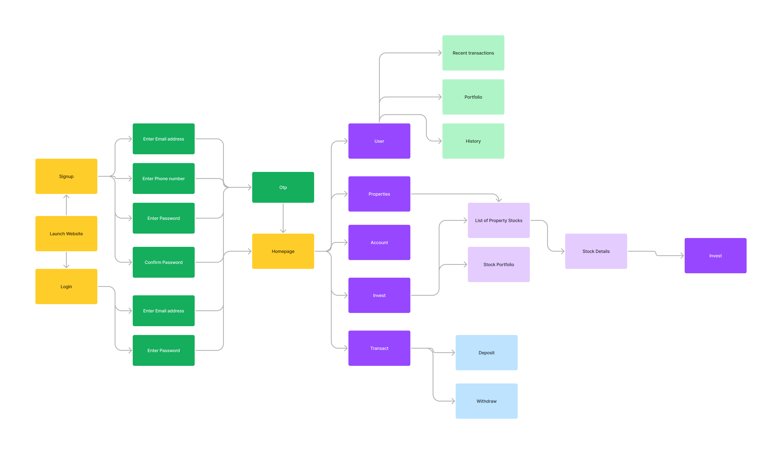
Block Diagram
International Conference on Science, Technology, Engineering & Mathematics for Sustainable Development ( ICSTEMSD 2024)

Slide 8
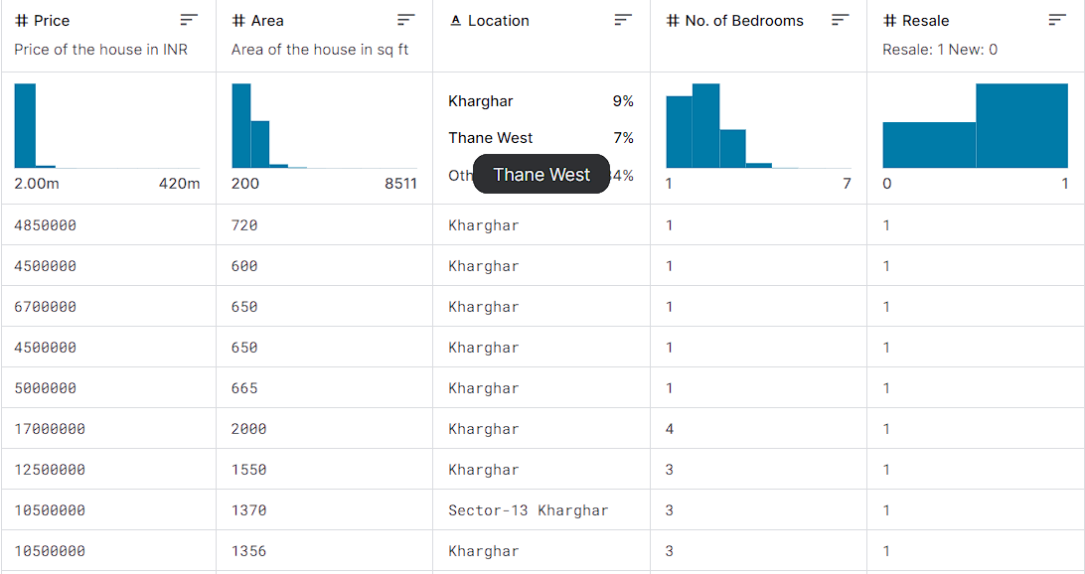
dATAsET
This dataset comprises data that was scraped.
It includes: collection of prices of new and resale houses located in the metropolitan areas of India the amenities provided for each house.
International Conference on Science, Technology, Engineering & Mathematics for Sustainable Development ( ICSTEMSD 2024)

Slide 9

RESULT
International Conference on Science, Technology, Engineering & Mathematics for Sustainable Development ( ICSTEMSD 2024)

Slide 10
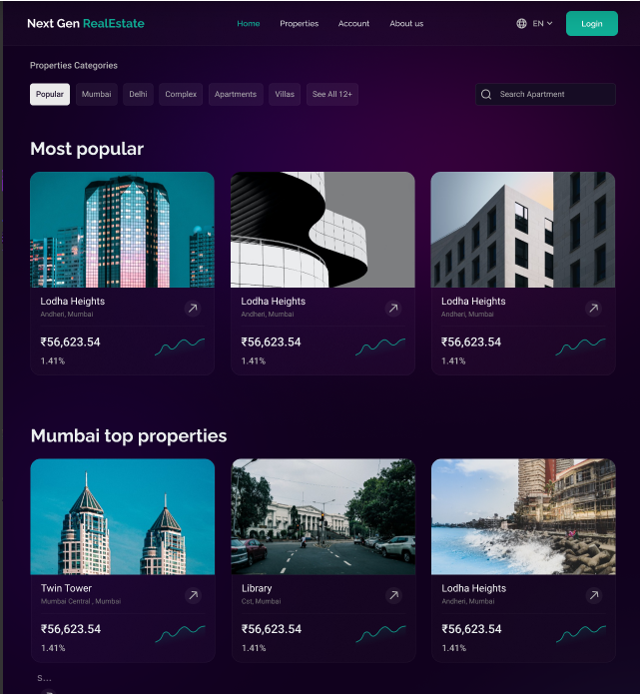
RESULT
International Conference on Science, Technology, Engineering & Mathematics for Sustainable Development ( ICSTEMSD 2024)

Slide 11
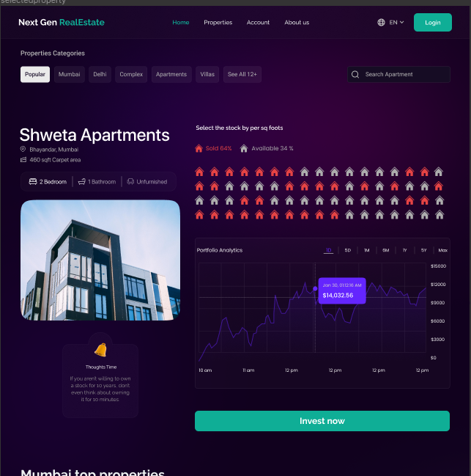
RESULT
International Conference on Science, Technology, Engineering & Mathematics for Sustainable Development ( ICSTEMSD 2024)

Slide 12
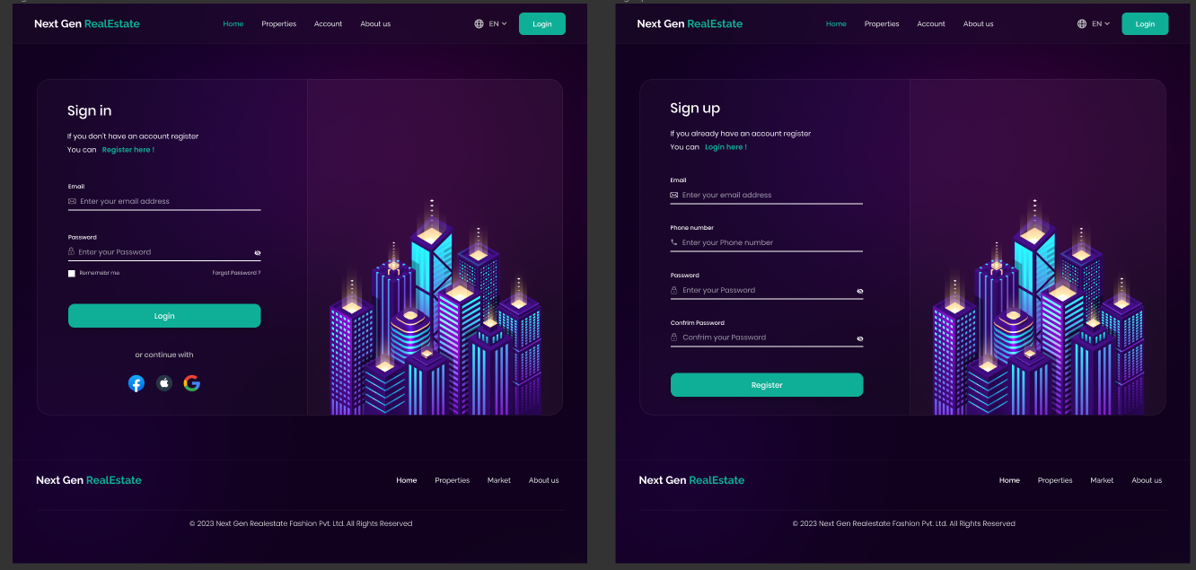
RESULT
International Conference on Science, Technology, Engineering & Mathematics for Sustainable Development ( ICSTEMSD 2024)

Slide 13
CONCLUSION
Using Website Development Technology and Machine learning we have created a next generation real estate website where you can buy and sell any property in parts and don't have to worry about huge investment and risks.
The Next Gen Real Estate system, driven by LSTM technology, represents a transformative leap forward in the real estate industry.
By harnessing the power of deep learning and sequential data analysis, the system empowers stakeholders with unprecedented predictive capabilities, enabling them to navigate the complex landscape of property investment with confidence.
The fusion of historical data, market dynamics, and user preferences culminates in a robust forecasting mechanism that facilitates strategic decision- making, ultimately maximizing returns and minimizing risks.
International Conference on Science, Technology, Engineering & Mathematics for Sustainable Development ( ICSTEMSD 2024)

Slide 14
FUTURE SCOPE
Market Growth: The real estate market is expanding, and fractional property investment aligns with the growing trend of democratizing access to real estate.
Diversification: Fractional property investments allow users to diversify their portfolios beyond traditional stocks and bonds, appealing to a wide range of investors.
Global Expansion: Potential to expand the platform globally, offering access to various international real estate markets.
Secondary Market: Introduce a secondary market where users can trade their fractional property shares, enhancing liquidity.
International Conference on Science, Technology, Engineering & Mathematics for Sustainable Development ( ICSTEMSD 2024)

Slide 15
REFERENCES
Prof. Shyamsundar Magar(2020): Botswana Stock Exchange Listed Property Companies as an Alternative Indirect Real Estate Investment.
P. Iyappan, B. Nanthini Devi, P. Nivedha and V. Sayoojya(2021): A Systematic Review of Smart Real Estate Technology.
Poorna Shankar, Neha Sharma, Ashish Ghosh (2022): Stock Price Prediction using LSTM.
Neelam Chawla, Basanta Kumar(2022): Indian real estate regulations and urban
International Conference on Science, Technology, Engineering & Mathematics for Sustainable Development ( ICSTEMSD 2024)

Slide 16
Thank you

