Slide 1
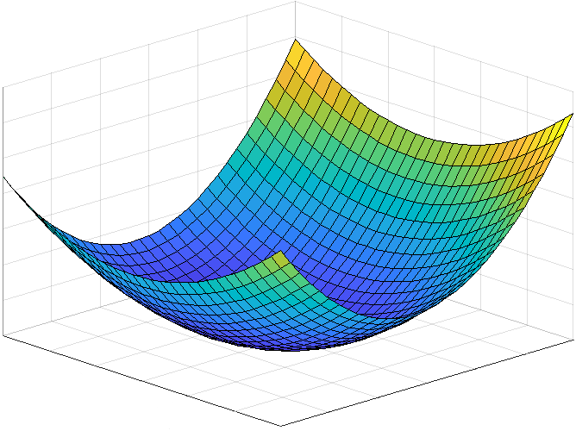
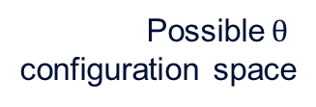
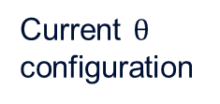



Current loss
Loss surface
Direction of steepest descent
Current $\text{θ}$ configuration
Possible$\text{θ}$ configuration space
$$l$$
Gradient
$${\text{θ}}_{2}$$
$${\text{θ}}_{1}$$

