Slide 1
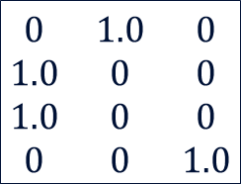
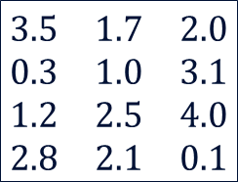
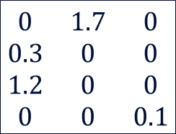
k
k
k
$$\begin{matrix}3.5 & 1.7 & 2.0 \\ 0.3 & 1.0 & 3.1 \\ 1.2 & 2.5 & 4.0 \\ 2.8 & 2.1 & 0.1\end{matrix}$$
$$\begin{matrix}0 & 1.0 & 0 \\ 1.0 & 0 & 0 \\ 1.0 & 0 & 0 \\ 0 & 0 & 1.0\end{matrix}$$
$$\begin{matrix}0 & 1.7 & 0 \\ 0.3 & 0 & 0 \\ 1.2 & 0 & 0 \\ 0 & 0 & 0.1\end{matrix}$$
multiply
=
n
n
n
D (distances)
M (mask)
D_{m}

