Slide 1
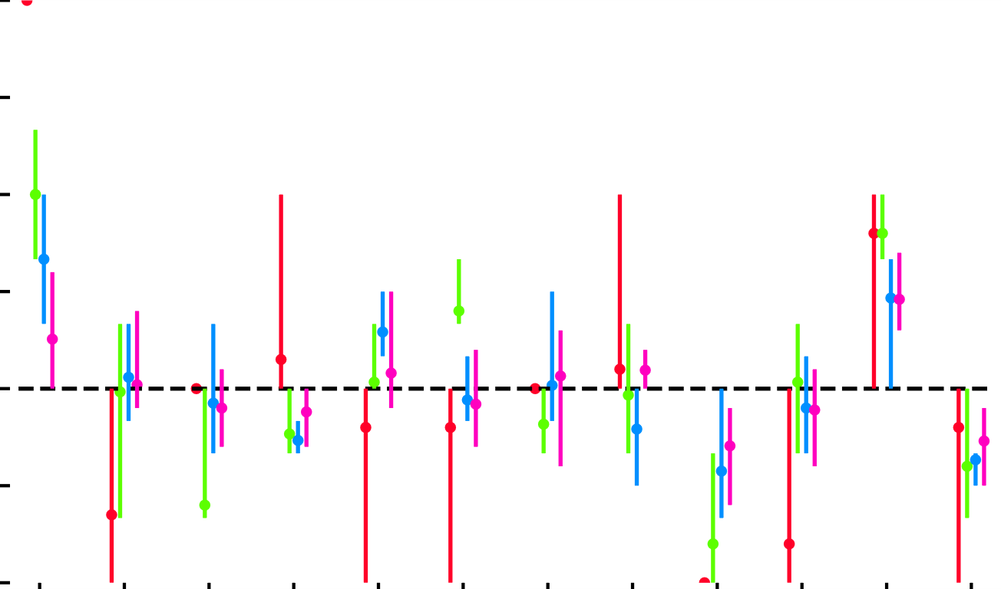

3
$$k=\begin{matrix}12 & 36 & 72 & 120\end{matrix}$$
k-Means
Share
2.5
2
1.5
1
0.5
Setting
0
M₁
M₂
M₃
M₄
M₅
M₆
M₇
M₈
m₁
m₂
W₁
W₂

