Slide 1
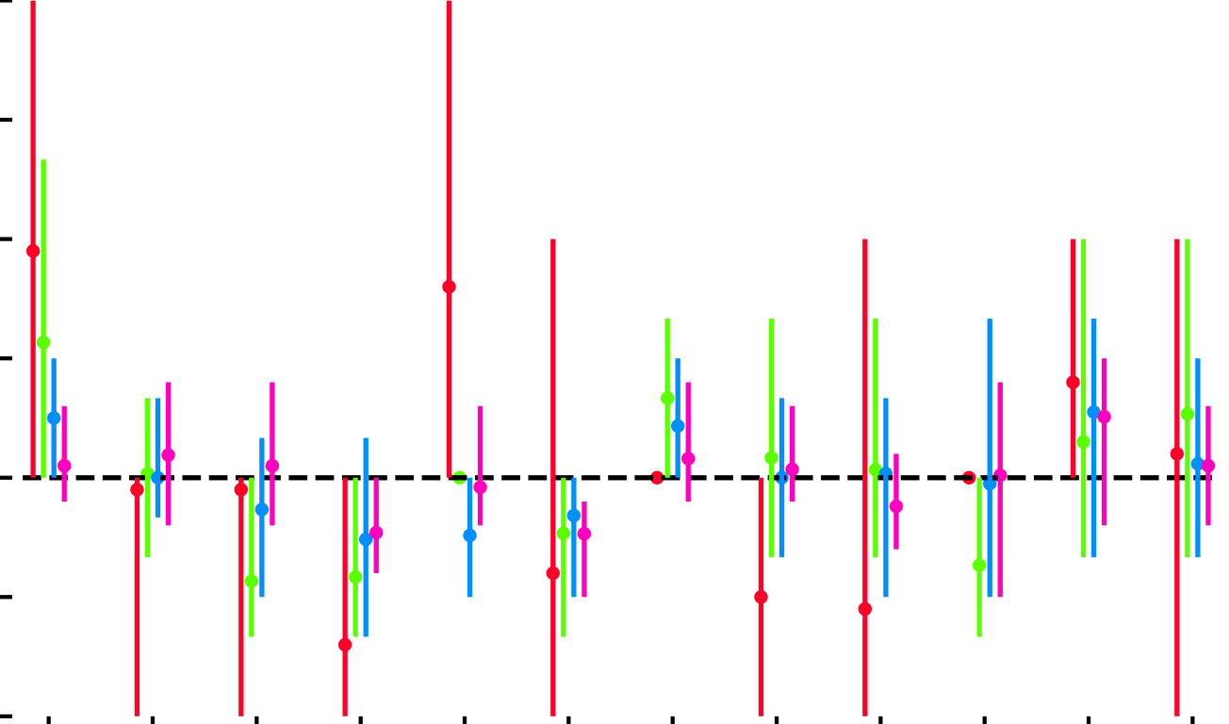
3
ACAI + k-Means
Share
2.5
2
1.5
1
0.5
Setting
0
M₁
M₂
M₃
M₄
M₅
M₆
M₇
M₈
m₁
m₂
W₁
W₂

