Slide 1
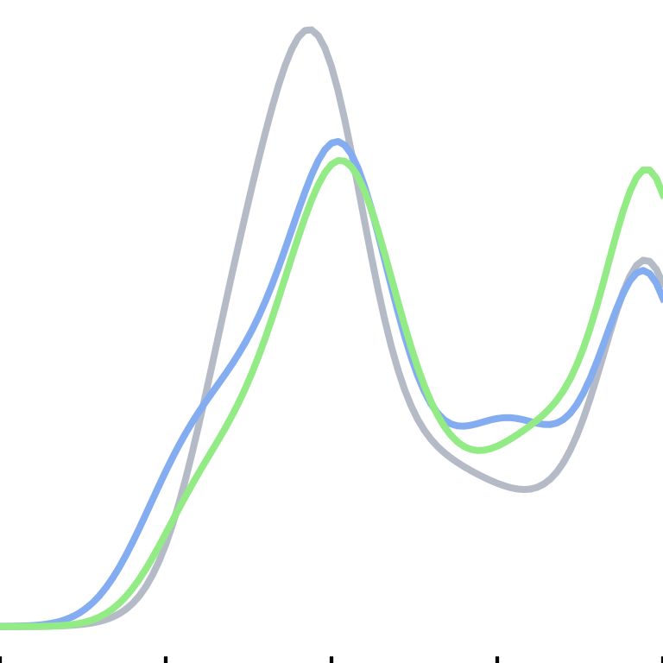

$$k=36$$
Density
Purity
0
0.25
0.5
0.75
1

