Slide 1
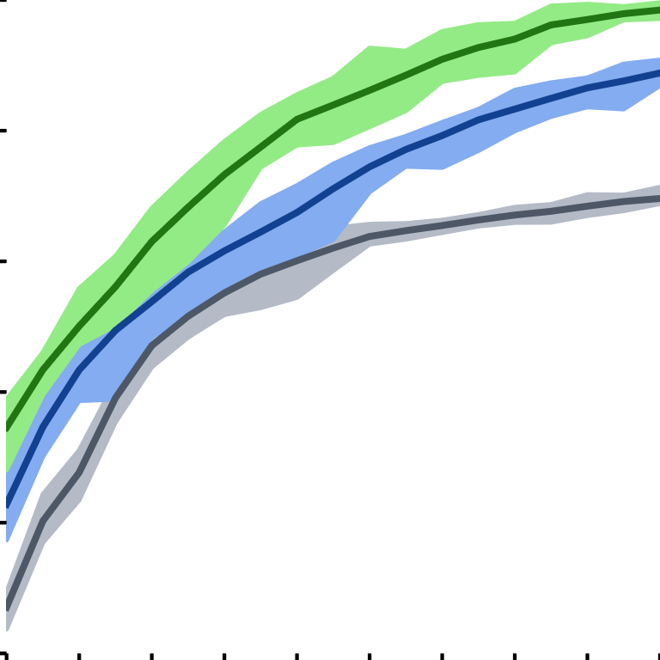

0.8
Purity
0.7
0.6
0.5
ACAI + k-Means
AE + k-Means
0.4
k-Means
$$k$$
0.3
12
36
60
84
108

