Slide 1
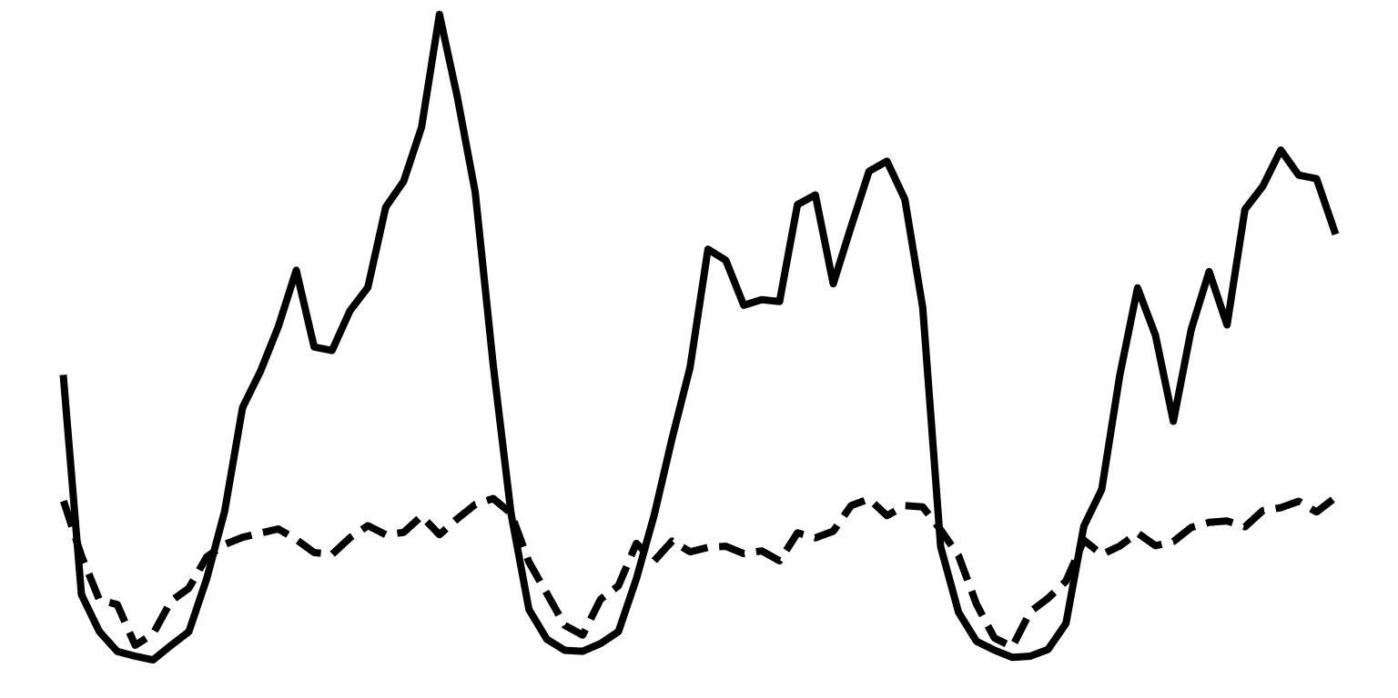
DL users
DL thp.
15.0
7.0
-1.0
[SD]
Day 1
Day 2
Day 3

