Slide 1
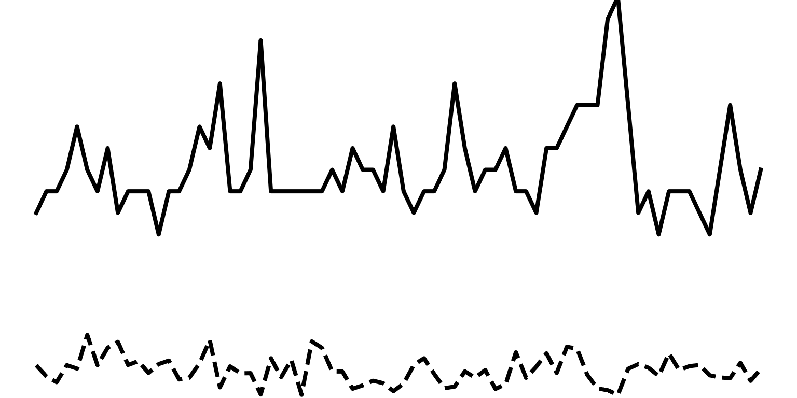
UL latency
PUSCH SINR
8.0
2.0
-4.0
[SD]
Day 1
Day 2
Day 3

