Slide 1
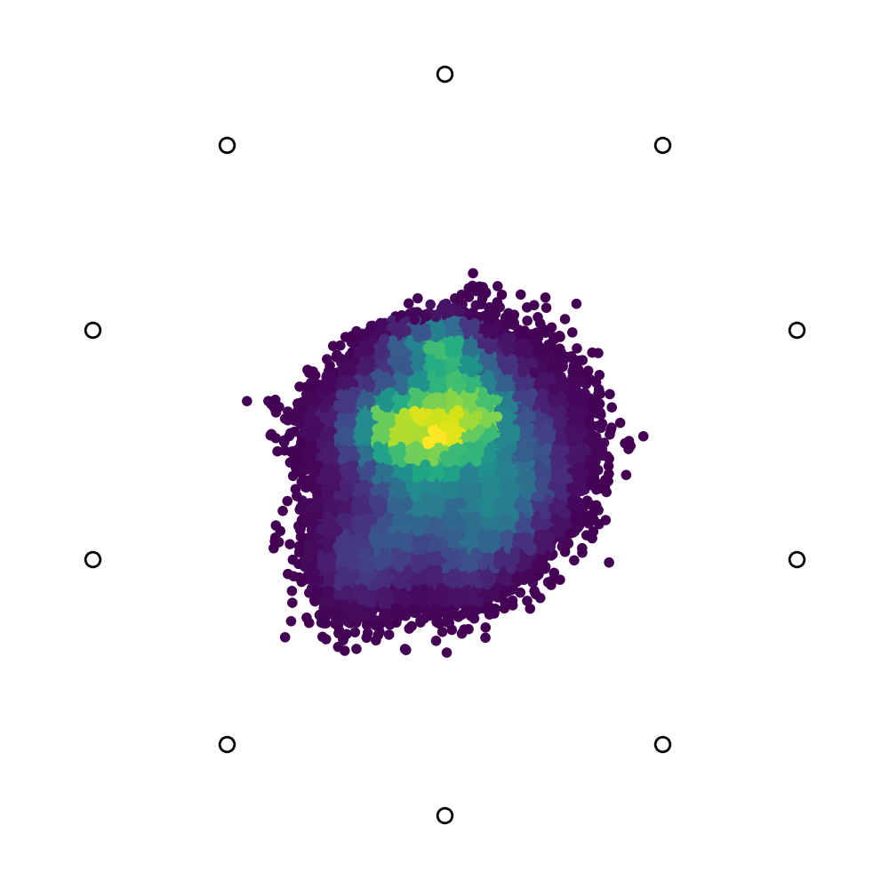
b₁
b₂
b₃
Density: Low
High

