Slide 1
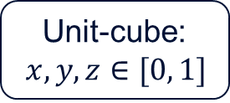
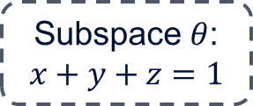
y
Unit-cube:
$x,y,z∈[0, 1]$
Subspace $θ$:
$$x+y+z=1$$
Convex hull: simplex
x
Base-point
z

