Slide 1
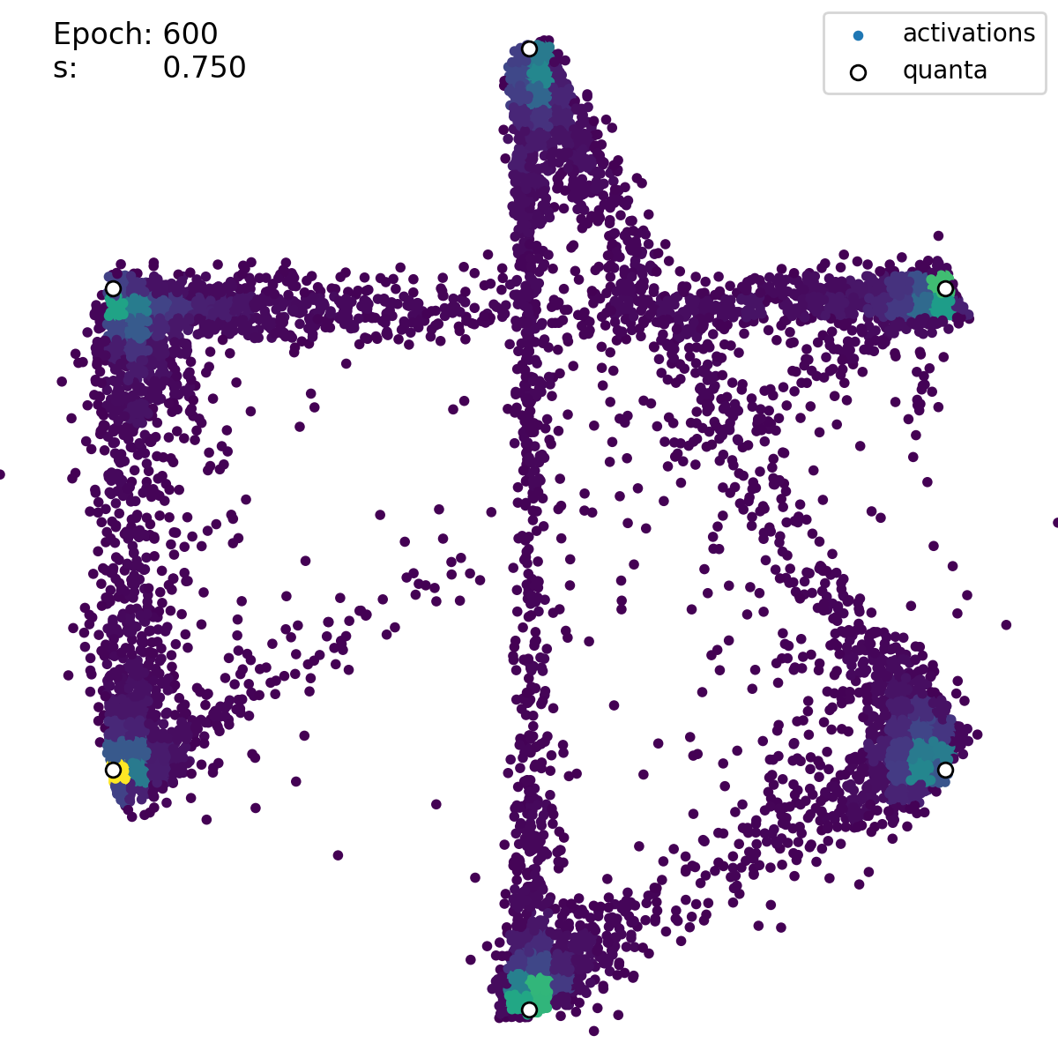
Subgraph / State Cluster
Network State
Populated transition
Unpopulated transition

