Slide 1


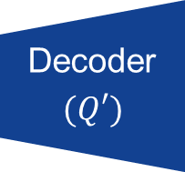
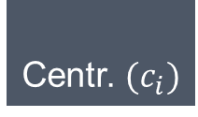




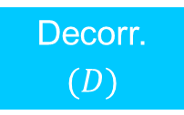


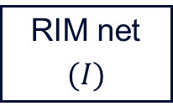
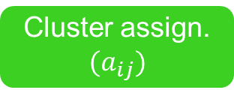

Phase 1 + 3: DAN (pre-)training
$$p_{g}$$
Decorr.
$$(D)$$
Cor. loss $({\text{ℒ} }_{cor}^{Q})$
Cor. loss $({\text{ℒ} }_{cor}^{D})$
Encoder
$$(Q)$$
$$Z_{r}$$
Decoder
$$(Q′)$$
Data
Rec. data
Rec. loss $({\text{ℒ} }_{rec}^{QQ′})$
$$Z_{c}$$
Phase 2:
RIM-init.
RIM net
$$(I)$$
RIM loss $({\text{ℒ} }_{rim}^{I})$
Phase 3:
DEC-training
Centr. $(c_{i})$
Concatenation
DEC loss $({\text{ℒ} }_{dec}^{Q})$
Deconcatenation / split
Tensor propagation
Cluster assign. $$(a_{ij})$$
Tensor propagation w/o gradient
Nearest n.

