Slide 1
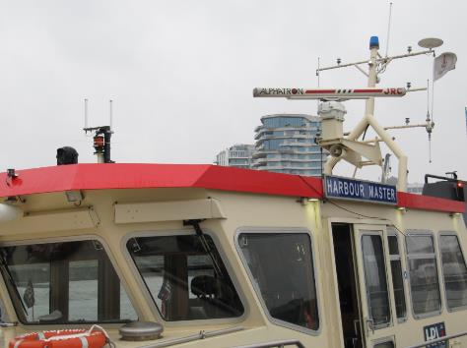
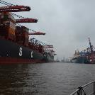
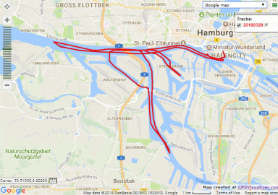
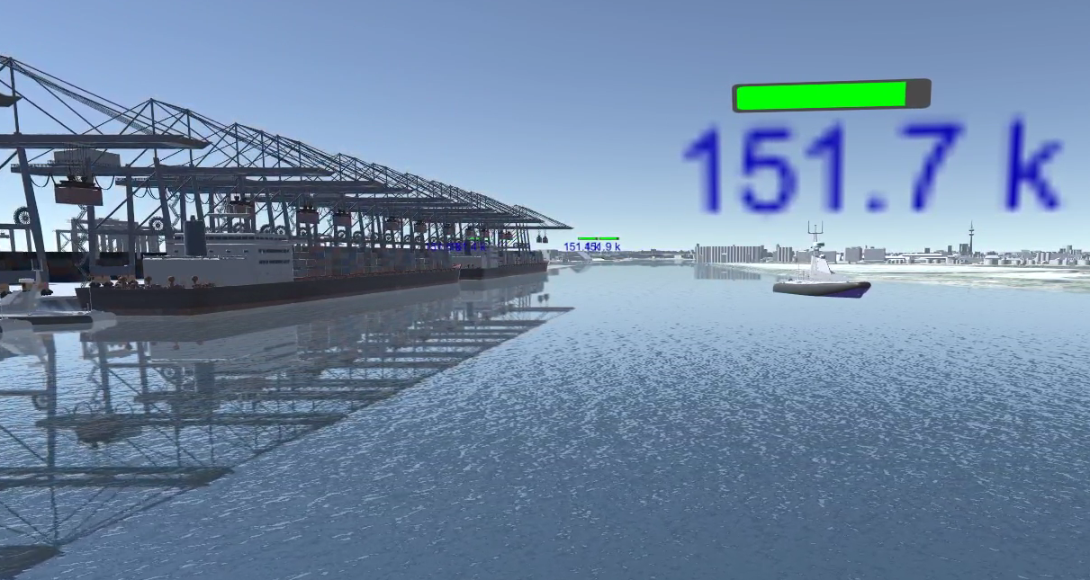
Measurements
Loc. Traces
Training
Digital Twin
Env. Info.
Actors
AI module
Pred. locations
AI module
Pred.QoS
CCO
Network
Simulator
MPP
BA
Settings
Data Collector
Deployment
PLANAR
Mobile Network

