Slide 1
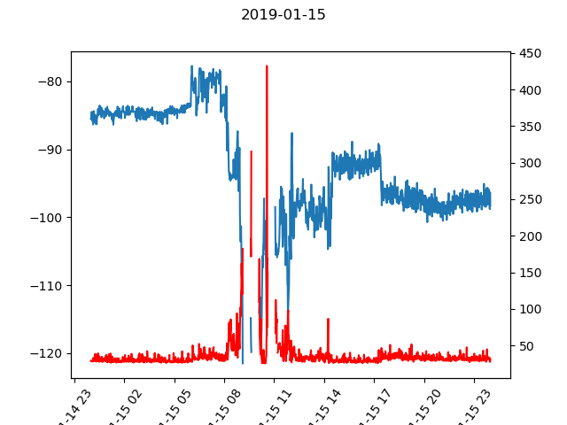
RSRP of USRP1 [dBm]
Ping [ms]

