Slide 1
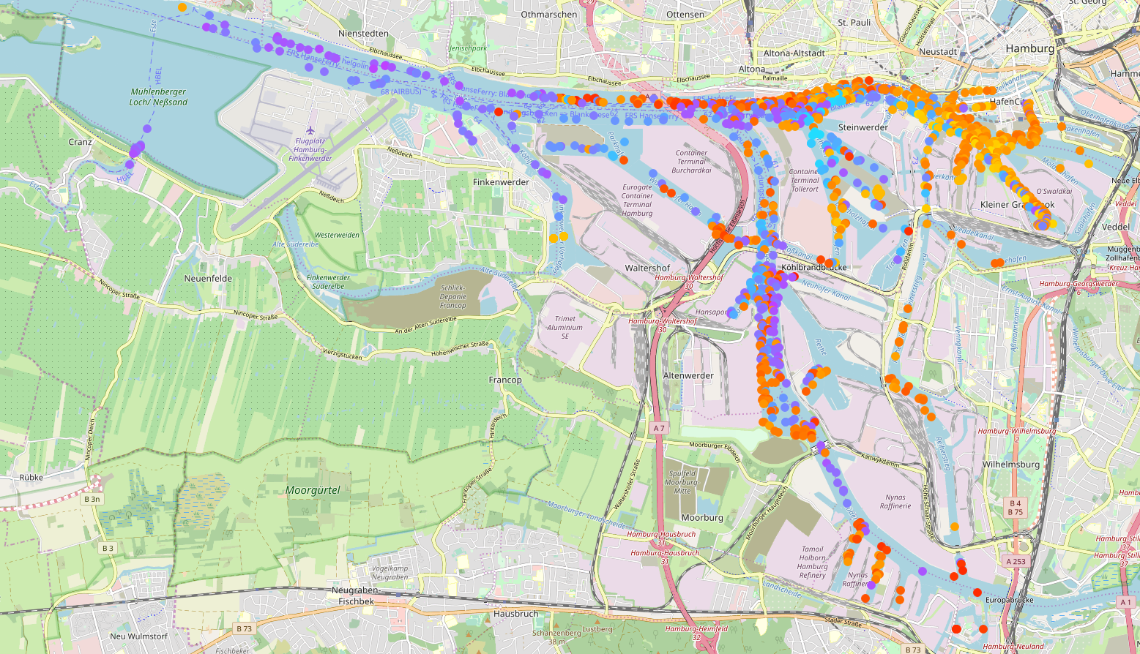
Heinrich Hertz tower
Shadowing
-120
[dBm]
-60
Cell₁
Cell₂

