Slide 1
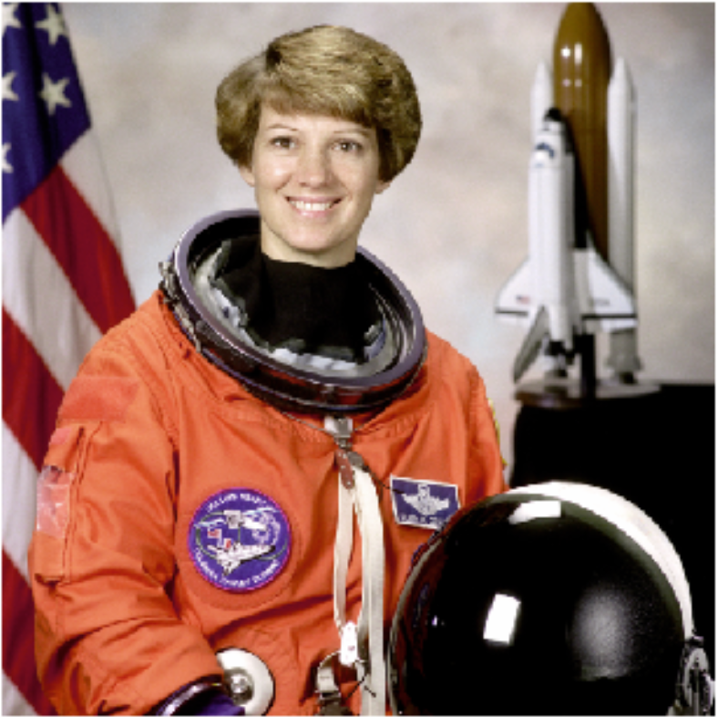
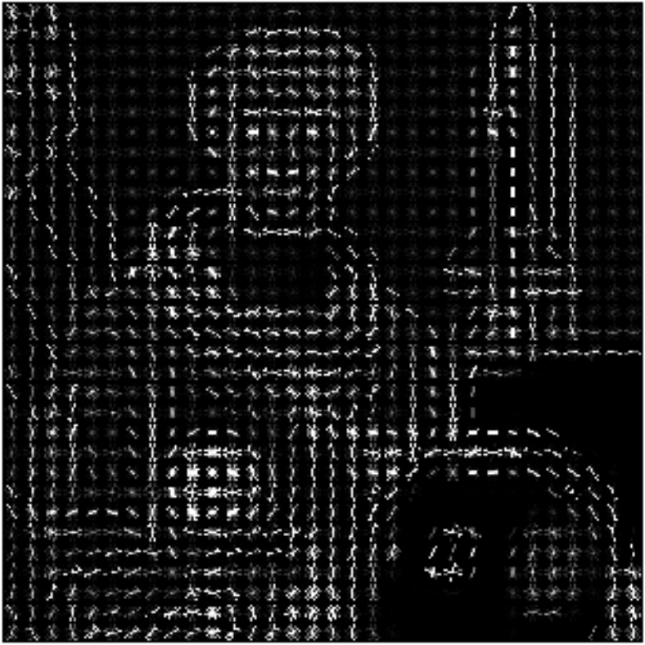
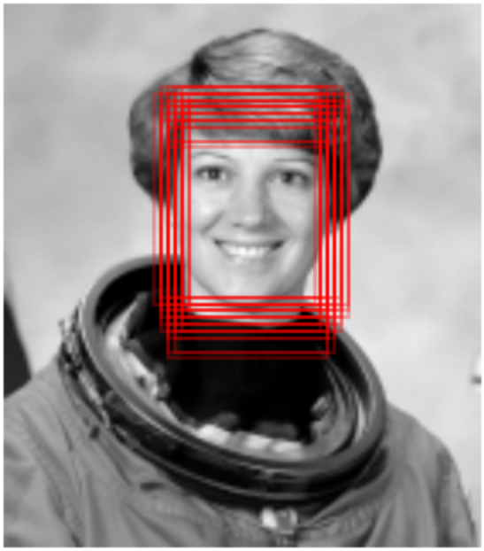
Grad. magnitude
Grad. direc.
Input
Preproc.
Grad. calc.
Hist. calc.
HOG vector
SVM
Result

