Slide 1
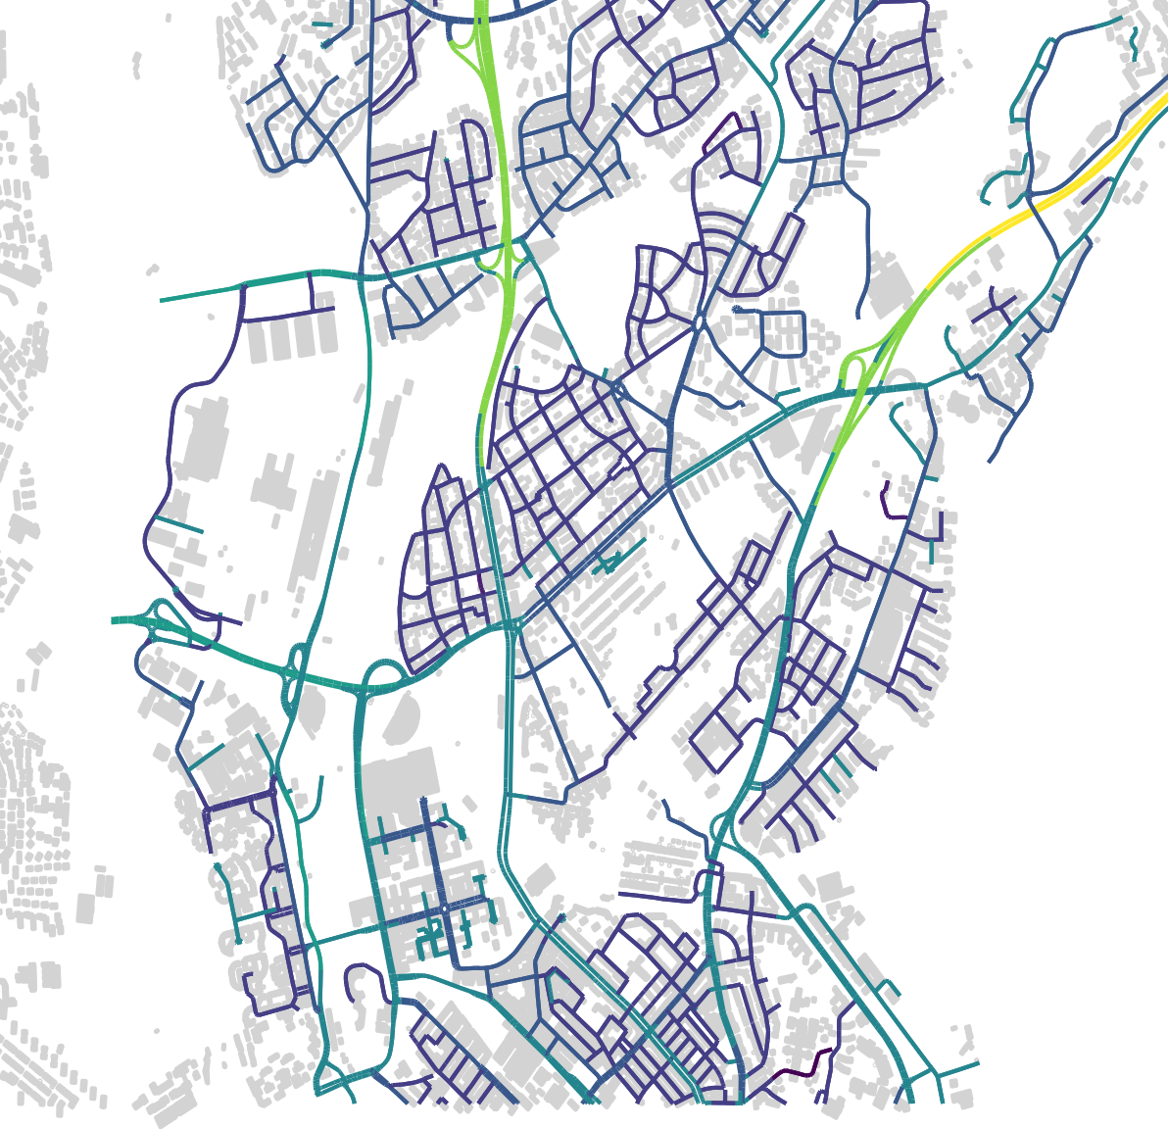
Omni micro
3-sect. macro

