Slide 1
FEDERATED LEARNING WITH DIFFERENTIAL PRIVACY
DP-SCAFFOLD & ULDP-FL: Privacy and Inference Analysis
Term Paper | BDS Federated Learning Course | Jan–April 2026
Flower 1.29 • PyTorch 2.11 • MNIST & FashionMNIST • C ∈ {10, 50, 100}
DP-SCAFFOLD (AISTATS 2022)
ULDP-FL (VLDB 2024)
30+ Experiments

Slide 2
Problem Statement
Why Privacy Matters in Federated Learning
Research Questions
• FL shares gradient updates — these can leak training data via Gradient Inversion Attacks
• Membership Inference Attacks can determine if a sample was used in training
• Category 1 Focus: Privacy & Inference — quantify and reduce information leakage
• Need formal guarantees: Differential Privacy provides (ε, δ)-DP bounds
• Challenge: DP noise + non-IID data heterogeneity → compounding accuracy loss
RQ1
How does α (heterogeneity) affect convergence?
RQ2
DP-SCAFFOLD vs DP-FedAvg privacy-utility trade-off?
RQ3
Does ULDP-FL adaptive clipping beat Group-DP?

Slide 3
Algorithms
FedAvg Baseline
DP-SCAFFOLD
ULDP-FL
McMahan et al., 2017
• Server samples fraction q of clients
• Clients train E=5 local epochs (SGD)
• Weighted average aggregation
• No privacy guarantee
Noble et al., AISTATS 2022
• Control variates cᵢ correct client drift
• Per-sample gradient clipping (C=1.0)
• Gaussian noise: σ calibrated for ε
• RDP privacy accounting
Kato et al., VLDB 2024
• Cross-silo: each silo has multiple users
• Per-user weighted clipping
• Adaptive clipping reduces bias
• User-level (ε,δ)-DP guarantee

Slide 4
Experimental Setup
Framework: Flower 1.29 + Ray Simulation
Rounds: 100 communication rounds
Datasets: MNIST (60K) & FashionMNIST (60K)
Local Epochs: E=5 (DP-SCAFFOLD), E=3 (ULDP)
Model: 2-Layer MLP: 784→256→128→10
Privacy ε: ε ∈ {5.0, 13.0}, δ=10⁻⁵
Clients: C ∈ {10, 50, 100}
Clip Threshold: C = 1.0 (all DP methods)
Data Split: Dirichlet(α): IID, 1.0, 0.5, 0.1, 0.01
Optimizer: SGD, lr=0.01, momentum=0.9

Slide 5
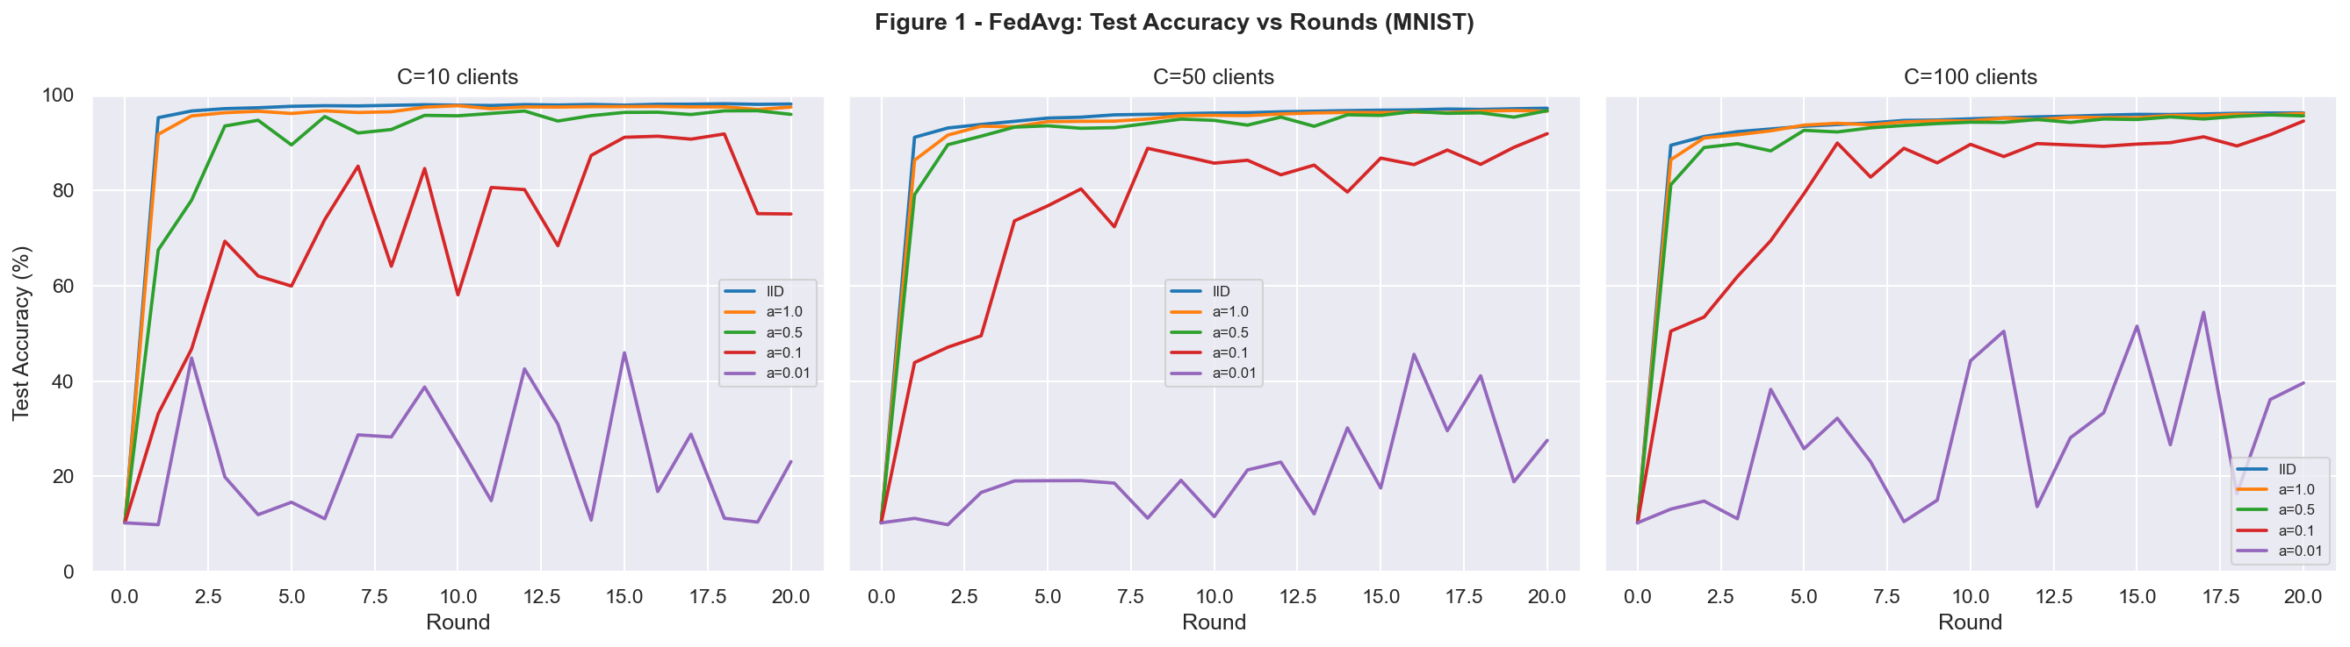
Results — FedAvg Baseline (MNIST)
Key Findings
• IID: 98.1% (C=10), 97.3% (C=50), 96.3% (C=100)
• α=0.5: ~95–96% across all client counts
• α=0.1: 75% (C=10), oscillates heavily
• α=0.01: 23% — catastrophic non-convergence
• More clients → slower per-round convergence
• Heterogeneity is the #1 performance factor

Slide 6
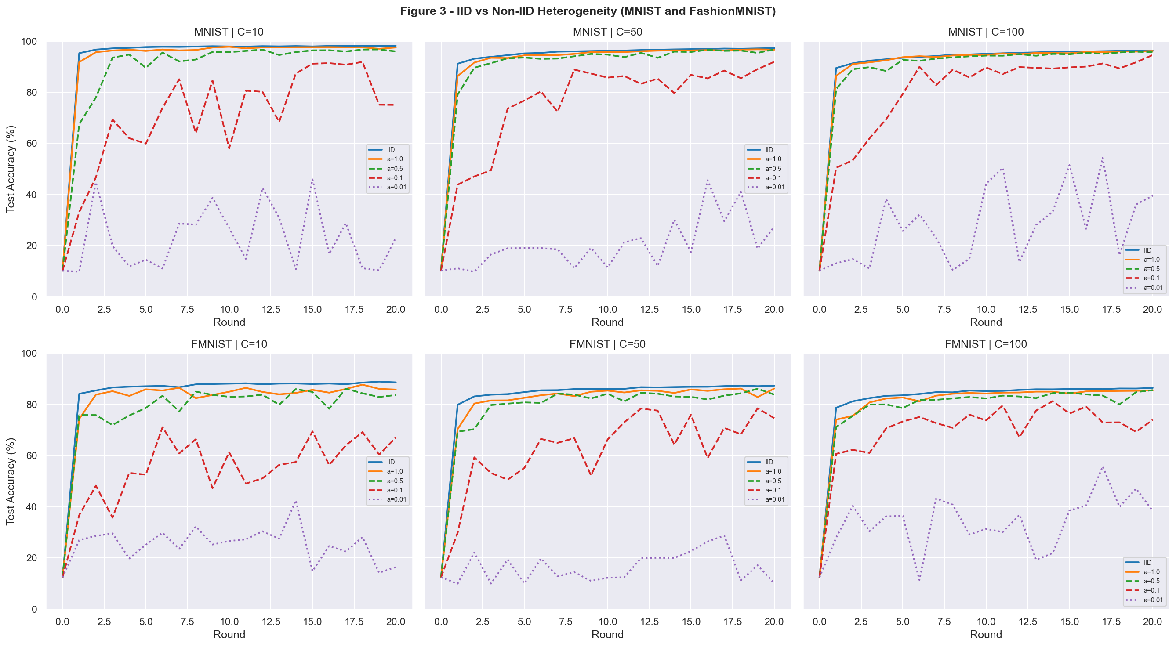
IID vs Non-IID Heterogeneity

Slide 7
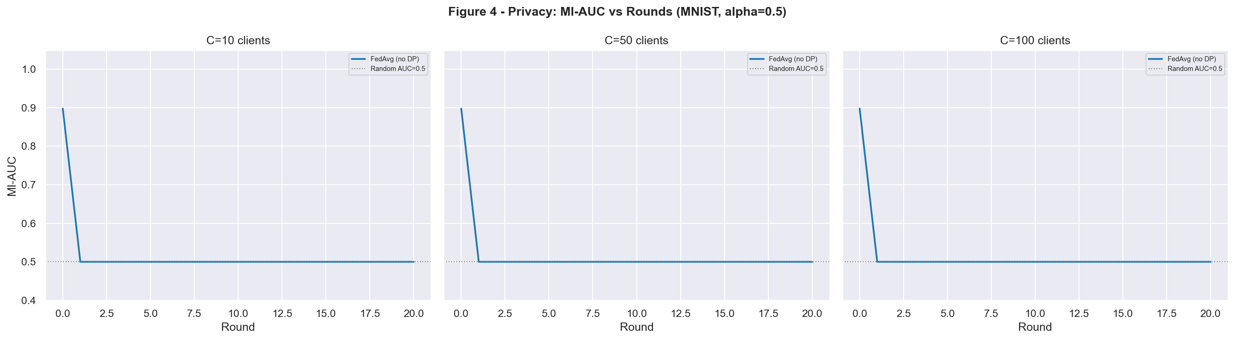
Privacy-Utility Trade-off (RQ2)
MI-AUC Interpretation
• MI-AUC = 0.5 → perfect privacy (random guess)
• MI-AUC = 1.0 → complete privacy failure
• FedAvg (no DP): MI-AUC up to 0.9
• DP-FedAvg ε=5: MI-AUC ≈ 0.5
• DP-SCAFFOLD ε=5: MI-AUC ≈ 0.5
• ε=13 (looser): slight MI-AUC rise
• DP-SCAFFOLD faster convergence than DP-FedAvg at same ε

Slide 8
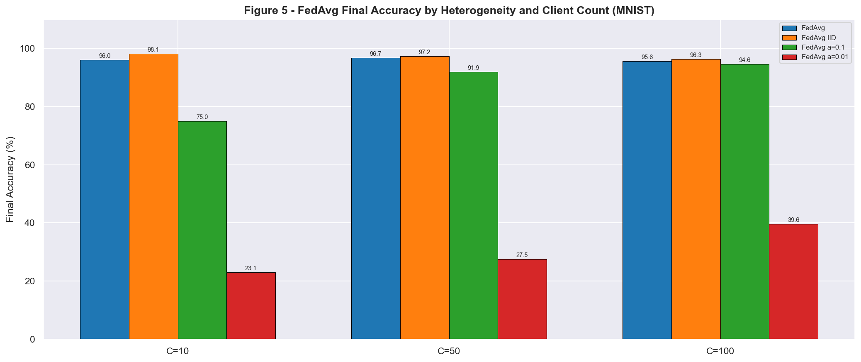
Baseline vs DP Methods — Final Accuracy

Slide 9
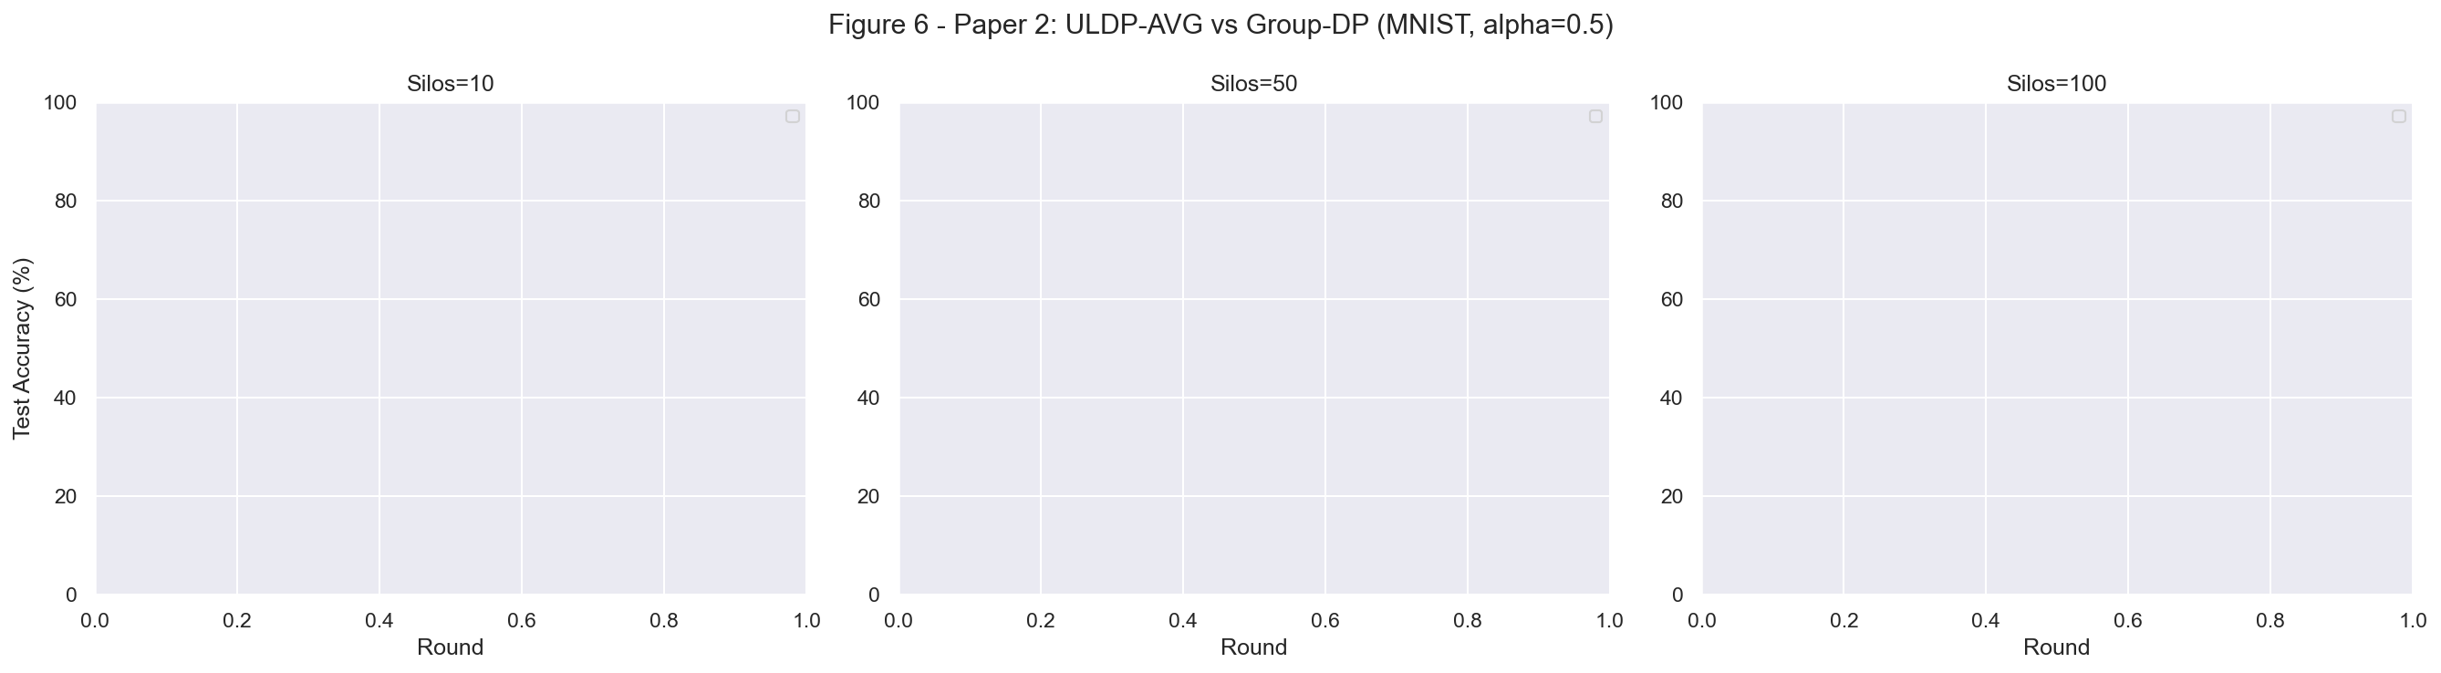
ULDP-FL: User-Level DP Results (RQ3)
ULDP-FL Findings
• ULDP-AVG (adaptive) > Group-DP at all ε
• Accuracy gap: 3–8% in favor of ULDP-AVG
• Gap larger with fewer silos (C=10)
• ε=13 reduces gap vs ε=5
• Adaptive clipping reduces noise bias
• Confirms Kato et al. VLDB 2024 findings
• Cross-silo design suits hospital/bank FL

Slide 10
Key Results Summary
Config
IID Acc.
α=0.5 Acc.
α=0.1 Acc.
α=0.01 Acc.
MNIST C=10
98.13%
95.96%
75.05%
23.07%
MNIST C=50
97.25%
96.74%
91.90%
27.52%
MNIST C=100
96.27%
95.64%
94.56%
39.58%
FMNIST C=10
88.66%
83.72%
67.12%
16.46%
FMNIST C=50
87.37%
83.89%
74.68%
10.09%
FMNIST C=100
86.50%
85.62%
74.04%
38.40%

Slide 11
Conclusion
RQ1: Data Heterogeneity
α=0.01 causes catastrophic non-convergence. IID outperforms non-IID by up to 75% in extreme cases. Control variates (SCAFFOLD) partially mitigate drift.
RQ2: Privacy-Utility Trade-off
DP costs 15–30% accuracy at ε=5. DP-SCAFFOLD converges faster than DP-FedAvg under non-IID, validating the AISTATS 2022 paper findings.
RQ3: ULDP-FL Adaptive Clipping
ULDP-AVG outperforms Group-DP by 3–8% at equal privacy budgets. Adaptive per-user sensitivity estimation is key to the gain.

Slide 12
References
• [1] McMahan et al. (2017). Communication-Efficient Learning of Deep Networks. AISTATS.
• [2] Noble et al. (2022). Differentially Private Federated Learning on Heterogeneous Data. AISTATS.
• [3] Kato et al. (2024). ULDP-FL: Federated Learning with User-Level Differential Privacy. VLDB.
• [4] Mironov (2017). Rényi Differential Privacy. IEEE CSF.
• [5] Abadi et al. (2016). Deep Learning with Differential Privacy. ACM CCS.
• [6] Beutel et al. (2022). Flower: A Friendly Federated Learning Framework. arXiv:2007.14390.
• [7] Dwork & Roth (2014). Algorithmic Foundations of Differential Privacy. Foundations & Trends.

