Slide 1


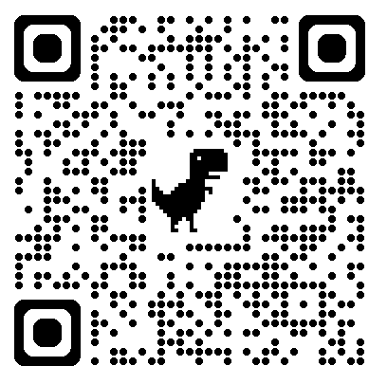


KineST: A Kinematics-guided Spatiotemporal State Space Model for Human Motion Tracking from Sparse Signals
Shuting Zhao*, Zeyu Xiao*, Xinrong Chen
Fudan University
Looking for PhD Position ！！！
Research Interests:
Human Motion Tracking,
Avatar,
3D Perception,
Scan It !
Page
WeChat

Slide 2
KineST: A Kinematics-guided Spatiotemporal State Space Model for Human Motion Tracking from Sparse Signals
Shuting Zhao*, Zeyu Xiao*, Xinrong Chen
Fudan University
Looking for PhD Position ！！！
Research Interests:
Human Motion Tracking,
Avatar,
3D Perception,
Scan It !
Page
WeChat

