Slide 1
CS305: Fall2008
Mental and
Conceptual Models
Readings:
Chapter 2 of ID-Book

Slide 2
Topic Outline
Conceptual models
  Mental models
  Metaphors
Interaction styles
Heading towards… Prototyping, design

Slide 3
Mental and Conceptual model
Need to first think about how the system will appear to users (i.e. how they will understand it)
A conceptual model is a high level description of:
  “the proposed system in terms of a set of integrated ideas and concepts about what it should do, behave and look like, that will be understandable by the users in the manner intended”

Slide 4
Mental Models
Also hear term mental model. Same?
Norman:
  “The models people have of themselves, others, the environment and the things with which they interact. People form mental models through experience, training, and instruction.”
Often a more specific idea than conceptual model
  I.e. focuses on a specific system

Slide 5
For either idea….
You want to understand what the user already has in their head
Then, you want to:
  Maybe build your system in response to this
  Work to create a different model in their head as they use your system
Always keep in mind when making design decisions how the user will understand the underlying model

Slide 6
Understanding a conceptual model
How will the user think about the system?
  Based on data, functions, a metaphor?
Are there existing systems, concepts that will influence how the user will think about the system?
What kind of interface metaphor, if any, will be appropriate?
What kinds of interaction modes and styles to use?
Breakdowns?
  ISIS example and back-button

Slide 7
Question?
What’s a “portal”?
  What’s that mean to you?
Example of a high-level conceptual model?

Slide 8
Discuss
What possible high-level conceptual models are there for…
Help system for:
  Large photo management application
  OR
  VLSI/CAD/component diagramming tool
Room reservation system
Radio recording application

Slide 9
A few slides back we said:
How will the user think about the system?
  Based on data, functions, a metaphor?
Next:
  Models based on functions (how we interact with the system)
  Then, metaphors

Slide 10
Conceptual models based on activities
Giving instructions
  issuing commands using keyboard and function keys and selecting options via menus
Conversing
  interacting with the system as if having a conversation
Manipulating and navigating
  acting on objects and interacting with virtual objects
Exploring and browsing
  finding out and learning things

Slide 11
1. Giving instructions
Where users instruct the system and tell it what to do
  e.g. tell the time, print a file, save a file
Very common conceptual model, underlying a diversity of devices and systems
  e.g. CAD, word processors, VCRs, vending machines
Main benefit is that instructing supports quick and efficient interaction
  good for repetitive kinds of actions performed on multiple objects

Slide 12
2. Conversing
Underlying model of having a conversation with another human
Range from simple voice recognition menu-driven systems to more complex ‘natural language’ dialogues
Examples include timetables, search engines, advice-giving systems, help systems
Recently, much interest in having virtual agents at the interface, who converse with you, e.g. Microsoft’s Bob and Clippy

Slide 13
Pros and cons of conversational model
Allows users, especially novices and technophobes, to interact with the system in a way that is familiar
  makes them feel comfortable, at ease and less scared
Misunderstandings can arise when the system does not know how to parse what the user says
  e.g. child types into a search engine, that uses natural language the question
  Let’s try it!

Slide 14
Something like a conversation…
Can you think of a common technique in GUI based applications where
  A series of interactions happen
  Questions/responses guide what happens from one step to the other
Your answer is?
Is this like a conversation? Shares any characteristics?

Slide 15
3. Manipulating and navigating
Involves dragging, selecting, opening, closing and zooming actions on virtual objects
Exploit’s users’ knowledge of how they move and manipulate in the physical world
Exemplified by
  what you see is what you get (WYSIWYG) and
  the direct manipulation approach (DM)
Shneiderman (1983) coined the term DM, came from his fascination with computer games at the time

Slide 16
Core principles of DM
Continuous representation of objects and actions of interest
Physical actions and button pressing instead of issuing commands with complex syntax
Rapid reversible actions with immediate feedback on object of interest

Slide 17
Advantages of DM
Give me some!

Slide 18
Why are DM interfaces so enjoyable?
Novices can learn the basic functionality quickly
Experienced users can work extremely rapidly to carry out a wide range of tasks, even defining new functions
Intermittent users can retain operational concepts over time
Error messages rarely needed
Users can immediately see if their actions are furthering their goals and if not do something else
Users experience less anxiety
Users gain confidence and mastery and feel in control

Slide 19
What are the disadvantages with DM?
Some people take the metaphor of direct manipulation too literally
Not all tasks can be described by objects and not all actions can be done directly
Some tasks are better achieved through delegating
  e.g. spell checking
Can become screen space ‘gobblers’
Moving a mouse around the screen can be slower than pressing function keys to do same actions

Slide 20
4. Exploring and browsing
Similar to how people browse information with existing media (e.g. newspapers, magazines, libraries, pamphlets)
Information is structured to allow flexibility in way user is able to search for information
  e.g. multimedia, web

Slide 21
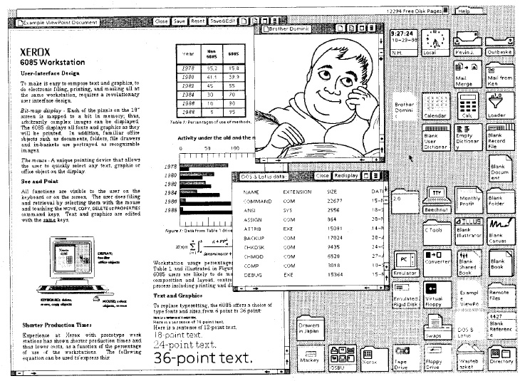
Conceptual models based on objects
Usually based on an analogy with something in the physical world
Examples include books, tools, vehicles
Classic: Star Interface
based on office
objects
Johnson et al (1989)

Slide 23
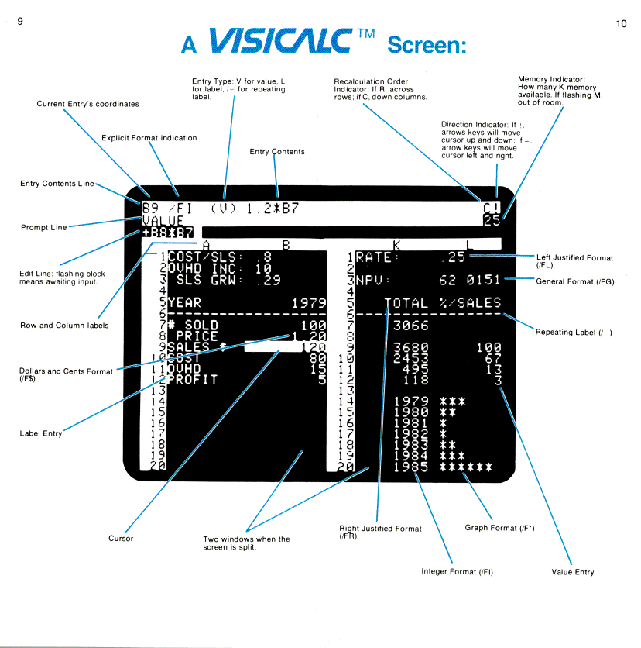
Another classic: the spreadsheet (Bricklin)
Analogous to ledger
sheet
Interactive and
computational
Easy to understand
Greatly extending
what accountants
and others could do
www.bricklin.com/history/refcards.htm

Slide 25
Spreadsheet metaphors
Do users of Excel
  Think of ledgers?
  Use it to do “what if” analyses?
What do we do?
Keep lists!
What tasks are useful for lists?
  Sort by column
  Filter by criteria
  Summarize
  See Data menu in Excel

Slide 26
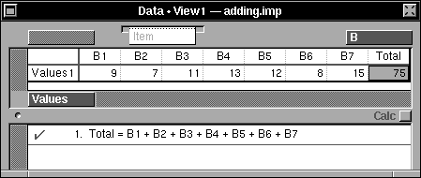
Lotus Improv

Slide 27
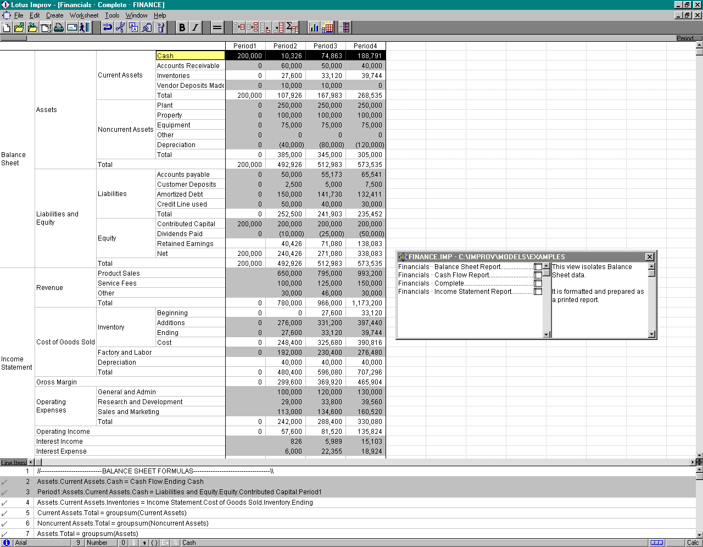

Slide 28


Slide 30
Which conceptual model is best?
Direct manipulation is good for ‘doing’ types of tasks, e.g. designing, drawing, flying, driving, sizing windows
Issuing instructions is good for repetitive tasks, e.g. spell-checking, file management
Having a conversation is good for children, computer-phobic, disabled users and specialised applications (e.g. phone services)
Hybrid conceptual models are often employed, where different ways of carrying out the same actions is supported at the interface - but can take longer to learn

Slide 31
Interface metaphors
Interface designed to be similar to a physical entity but also has own properties
  e.g. desktop metaphor, web portals
Can be based on activity, object or a combination of both
Exploit user’s familiar knowledge, helping them to understand ‘the unfamiliar’
Conjures up the essence of the unfamiliar activity, enabling users to leverage of this to understand more aspects of the unfamiliar functionality

Slide 32
Examples of Metaphors
Gimme some!
  Button
  Folders in a GUI
  Icons like disk, print, etc.
  Window controls (max, close, min)
  Window – view into something bigger
  Paint apps: canvas, color wheel/chooser, brush, spraypaint can, etc.
  Notepad (used for jotting quick docs)
  Mouse-over on web: hand, cross-hair

Slide 33
Task bar (like spread-out desk, pull open paper, one on-top)
Sticky notes
Speaker for volume control. Slider bar like hi-fi equipment
Powerpoint slides
Tabbed interfaces

Slide 34
Examples of Metaphors
Last term’s examples
  OneNote – notebook
  Paint (easel, brushes,…)
  Calculator
  Email (letters! INBOXES
  MediaPlayer like CD player
  Word processor – like a typewriter
  Trash can on desktop
  Folders, filecabinets

Slide 35
Examples of Metaphors
Last term’s examples!
  Sticky notes
  DVD players looks like a real HW device
  Bird takes pizza order
  OS X dashboard (overall view of system)
  Piece of paper in word processor etc.
  First-person shooter games
  Paintbrush tool in graphics apps
  Shopping cart on website
  Bookmarks
  Bulletin board system
  Recycle bin / trashcan
  gmail’s conversations / also chatting
  briefcase

Slide 36
Benefits of interface metaphors
Makes learning new systems easier
Helps users understand the underlying conceptual model
Can be very innovative and enable the realm of computers and their applications to be made more accessible to a greater diversity of users

Slide 37
Problems with metaphors?
Give me some examples!

Slide 38
Problems with interface metaphors
Break conventional and cultural rules
  e.g. recycle bin placed on desktop
Can constrain designers in the way they conceptualize a problem space
Conflict with design principles
Forces users to only understand the system in terms of the metaphor
Designers can inadvertently use bad existing designs and transfer the bad parts over
Limits designers’ imagination in coming up with new conceptual models

Slide 39
Conceptual models: from interaction mode to style
Interaction mode (what we discussed before):
  what the user is doing when interacting with a system, e.g. instructing, talking, browsing or other
Interaction style:
  the kind of interface used to support the mode, e.g. speech, menu-based, gesture

Slide 40
Interaction Styles
A physical UI be built upon various mechanisms
  Command line
  Menu selection
  Form-fill
  Direct manipulation
    mouse, pen, etc.
  Anthropomorphic
    Voice, ink (Tablet PCs)

Slide 41
Which interaction style to choose?
Need to determine requirements and user needs
Take the budget and other constraints into account
Also will depend on suitability of technology for activity being supported
This topic will be covered more later when discuss how to actually design conceptual models

Slide 42
Conclusion: What’s the relevance of all this?
Conceptual and mental models
  Users bring existing models with them
  You can leverage this or create a new model for your system
  May lead to high-level conceptual model for your interface
Interaction Mode and Interaction Style
  What’s the high-level way a user interacts with a new system? (Why? What’s the benefit?)
  Is there a high-level metaphor / model?
  Can lower-level metaphors be used in lower-level UI design?

