Slide 1
2026. 11. 12

Slide 2
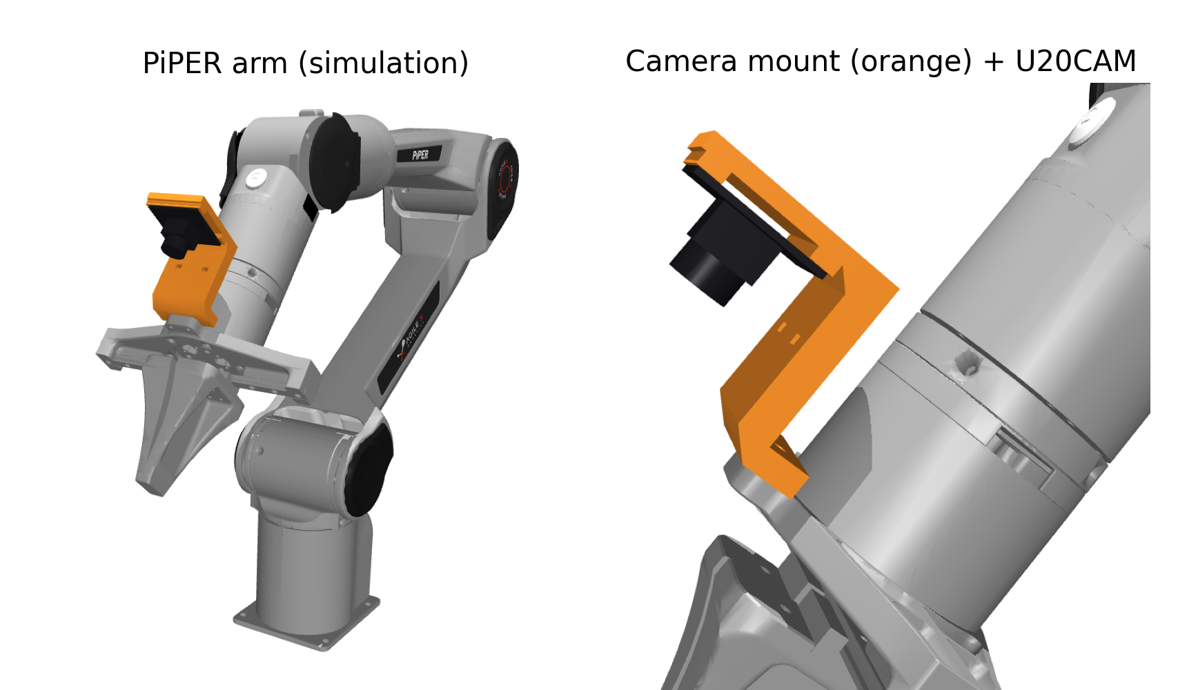
Jiyong Lee
Previous
    I studied how to install the PiPER SDK and wrote a guide on GitHub
-https://github.com/kakabab12/LAB-1309
    I designed a 3D-printed mount for the wrist camera (U20CAM)
    I studied for the SQLD certificate exam on 11/12
Next
  I will learn how to use the PiPER arm with Chanhyeok

