Slide 1
2026. 10. 29

Slide 2
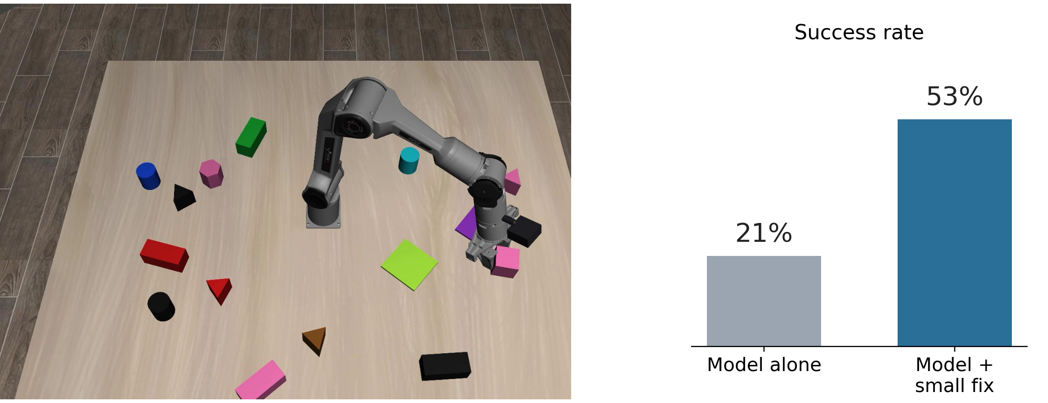
Jiyong Lee
Previous
  Task switching for a robot arm (SmolVLA on PiPER)
    I built a simulation of our PiPER arm with up to 14 objects of 5 shapes
    With a small fix for the last few cm, the success rate rose from 21% to 53%
Next
  I will train it to handle a new command in the middle of a task

