Slide 1
2026. 10. 14

Slide 2
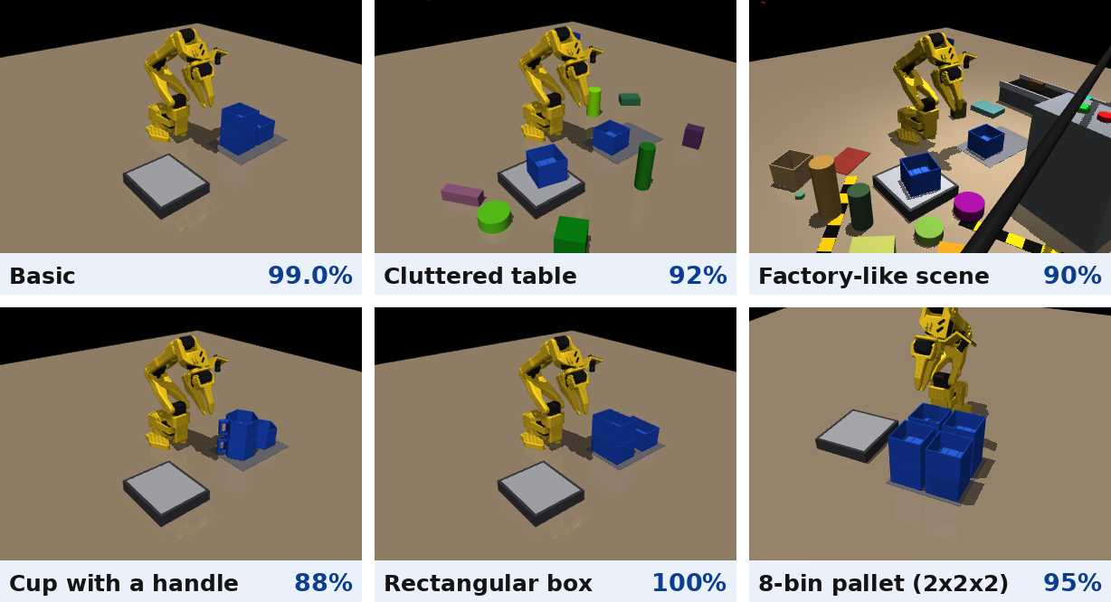
Jiyong Lee
Previous
  Capstone project (smart factory stacking) in simulation
    I rebuilt our capstone system in MuJoCo because the robot arm was broken
      It used the same SO-101 arm, scale, blue bins and cameras as the capstone
    I trained ACT, and the robot stacked three bins with 99.0% success
    I ran it in various environments, including lighting changes (88–100%)
Next
  I will submit the paper for the undergraduate paper competition by Oct. 19
  I will submit the RISE support documents

