Slide 1
2026. 11. 13

Slide 2
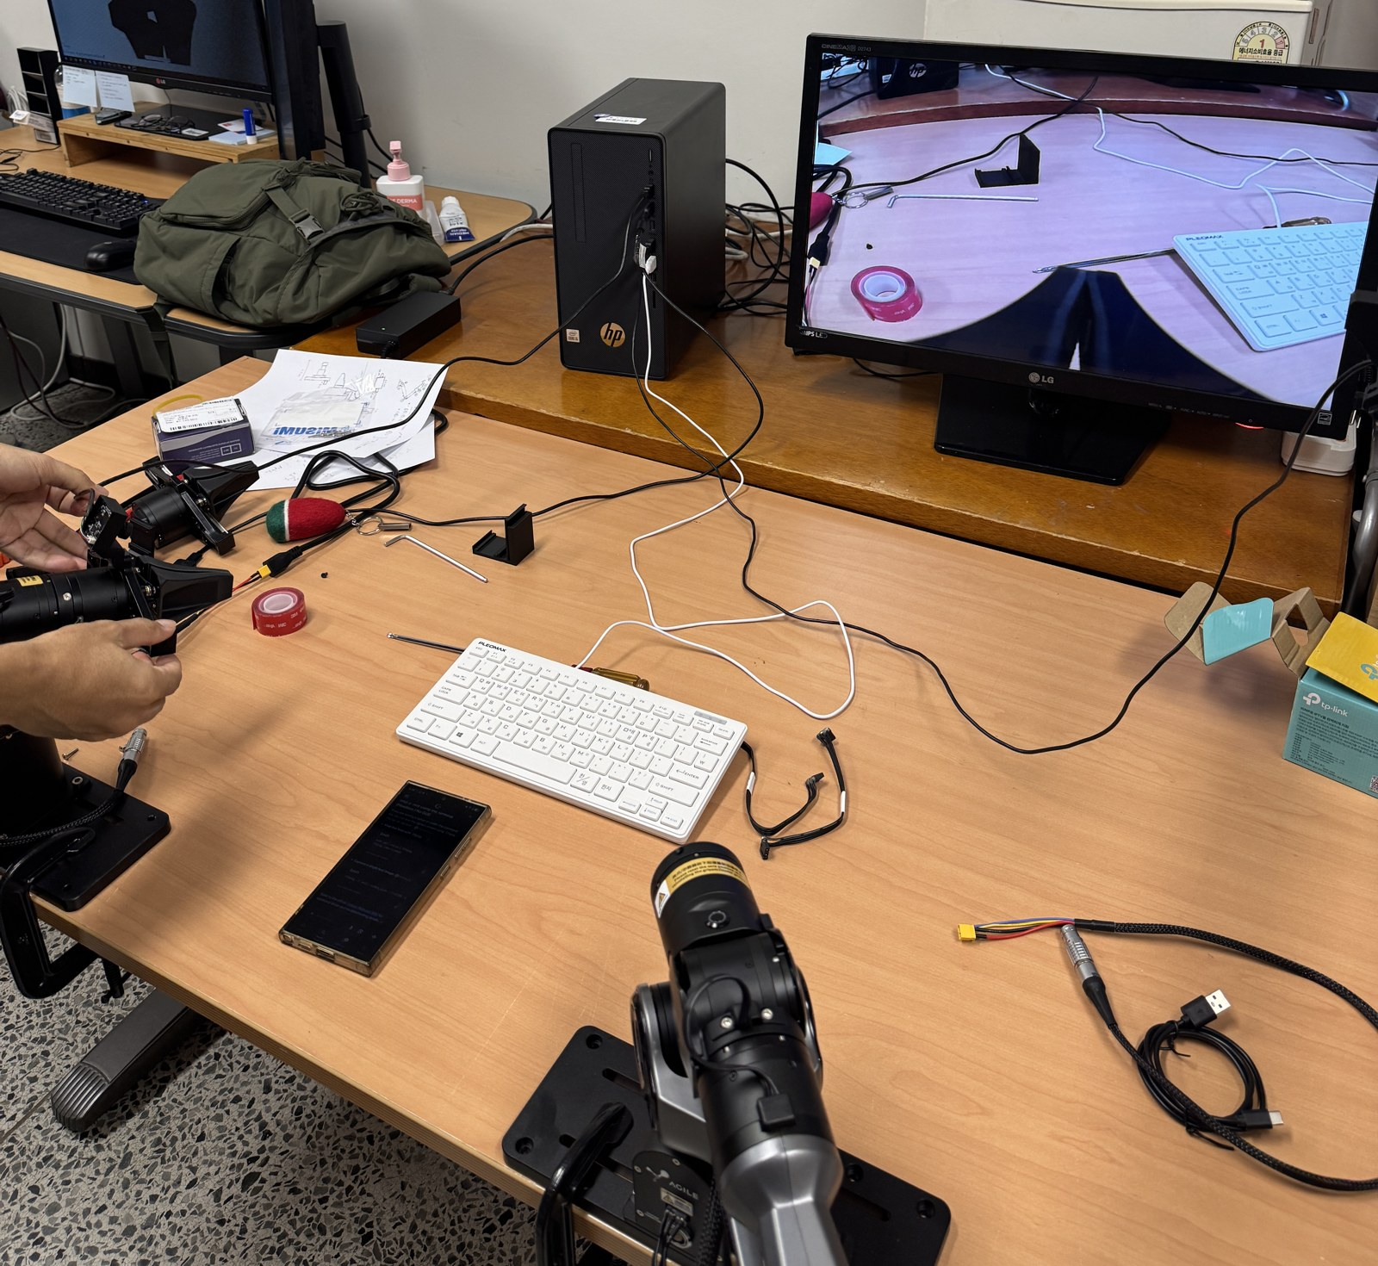
Jiyong Lee
Previous
    Connected the real PiPER arm to the PC (CAN) and test-drove all 6 joints
    3D-printed the 5 camera mount parts that Chanhyeok asked for
    Prepared for the SQLD certificate exam on 11/14
Next
  I will connect the cameras to the PiPER and try collecting data step by step

