Slide 1

MENTORS · SOP
Estimate
to identity.
How mentee mapping moved from facility guesses
to a living Kobo pin for every HCW.
Jacaranda Health

Slide 2
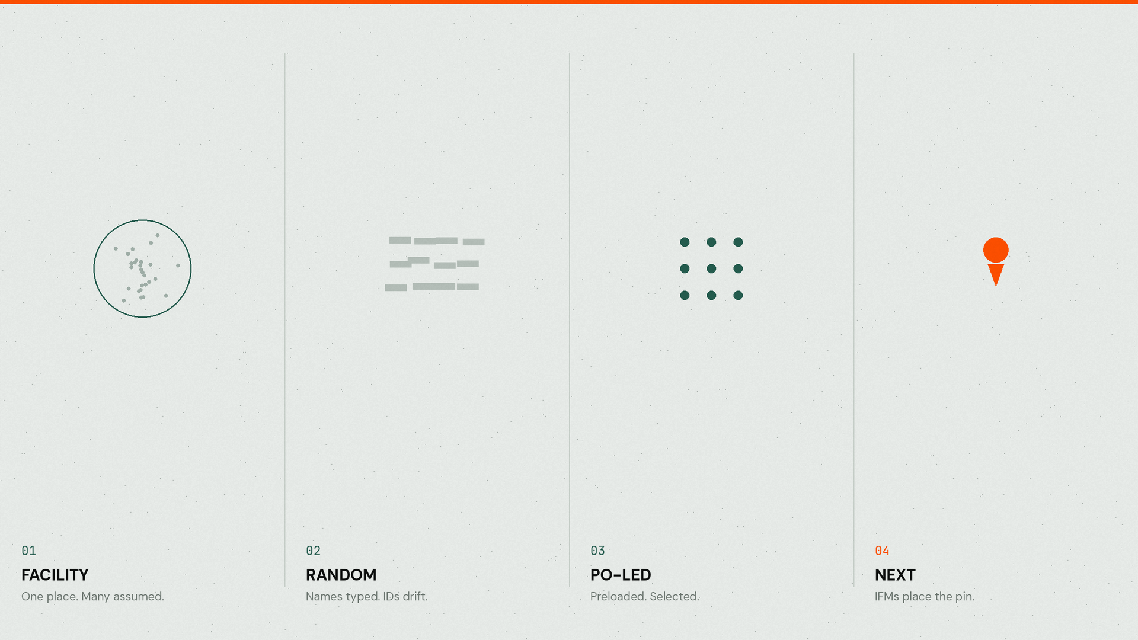
Where we came from
02/14

Slide 3

2018 — 2023
We counted
the building.
· A CME in a facility meant every HCW there was “trained.”
· 7,441 HCWs — an estimate from maternity-wing headcount.
· Attrition made the number look better than the truth.
03/14

Slide 4
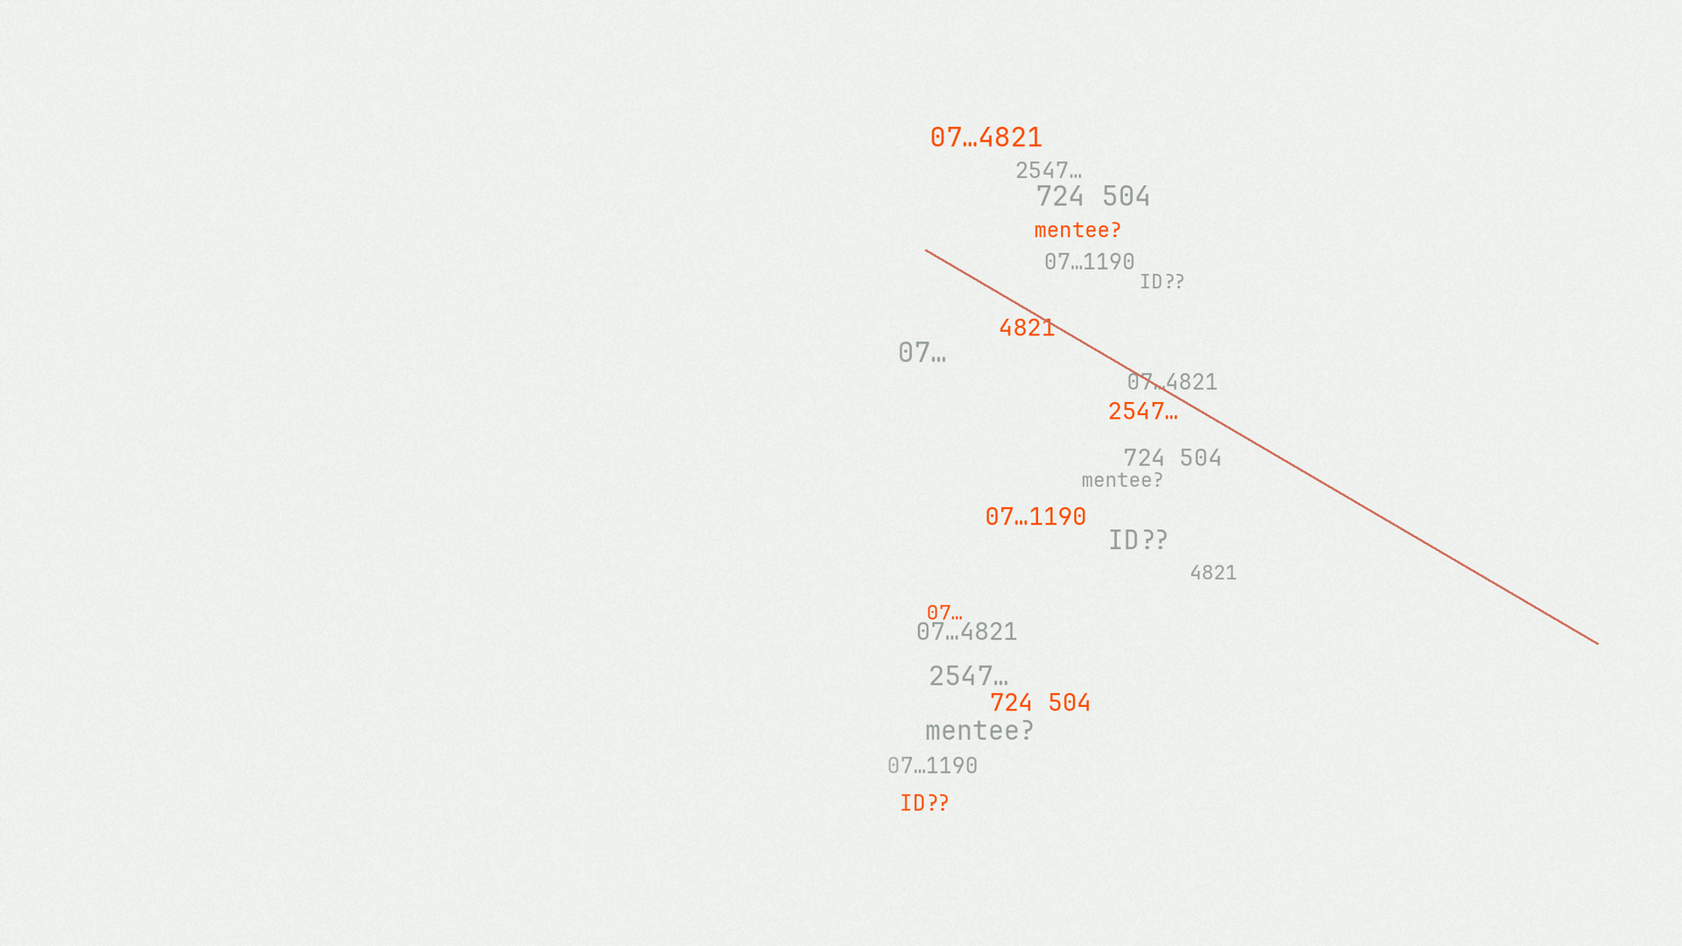
THE PIVOT
We typed
the person.
· Facility → name → phone (mentee_id) → activities.
· Better than assumptions. Still memory-bound.
· Mistyped phones broke the unique key.
04/14

Slide 5
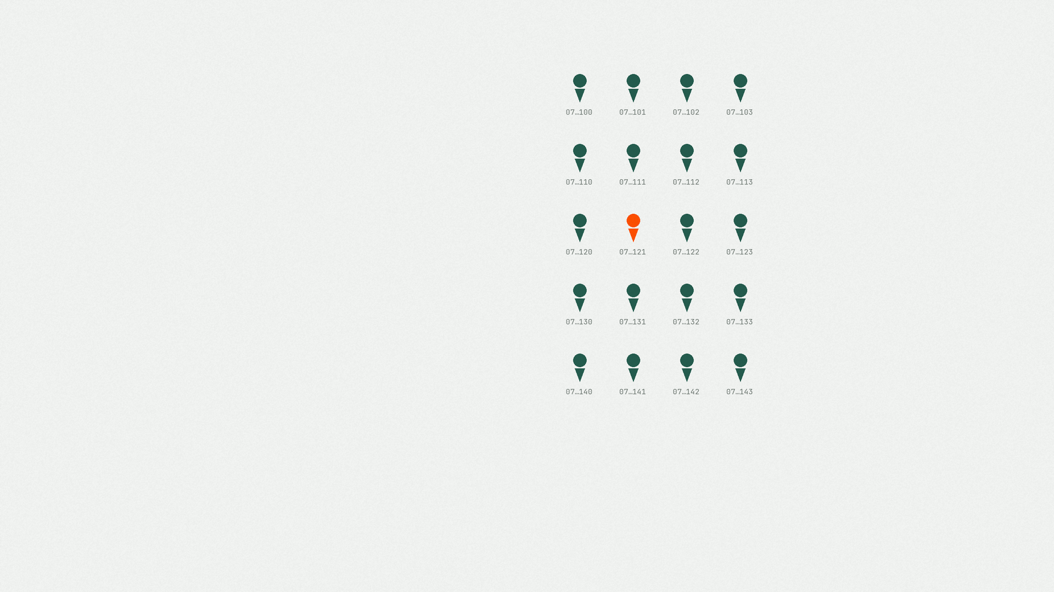
CURRENT
We preload
the pin.
Map
POs register eligible HCWs on site.
Select
IFMs pick names in Kobo — no inventing.
Link
WhatsApp joins in-person to DELTA.
Same mentee. In person, hybrid, or DELTA.
05/14

Slide 6

What broke the old way
01
No mentee-level truth
Facilities can’t tell you who was mentored.
02
Field noise
Typed phones and names drifted under pressure.
03
Manual preload pain
Quality rose. Keeping tools current did not.
04
Attrition lag
Inactive people haunted the forms.
06/14

Slide 7
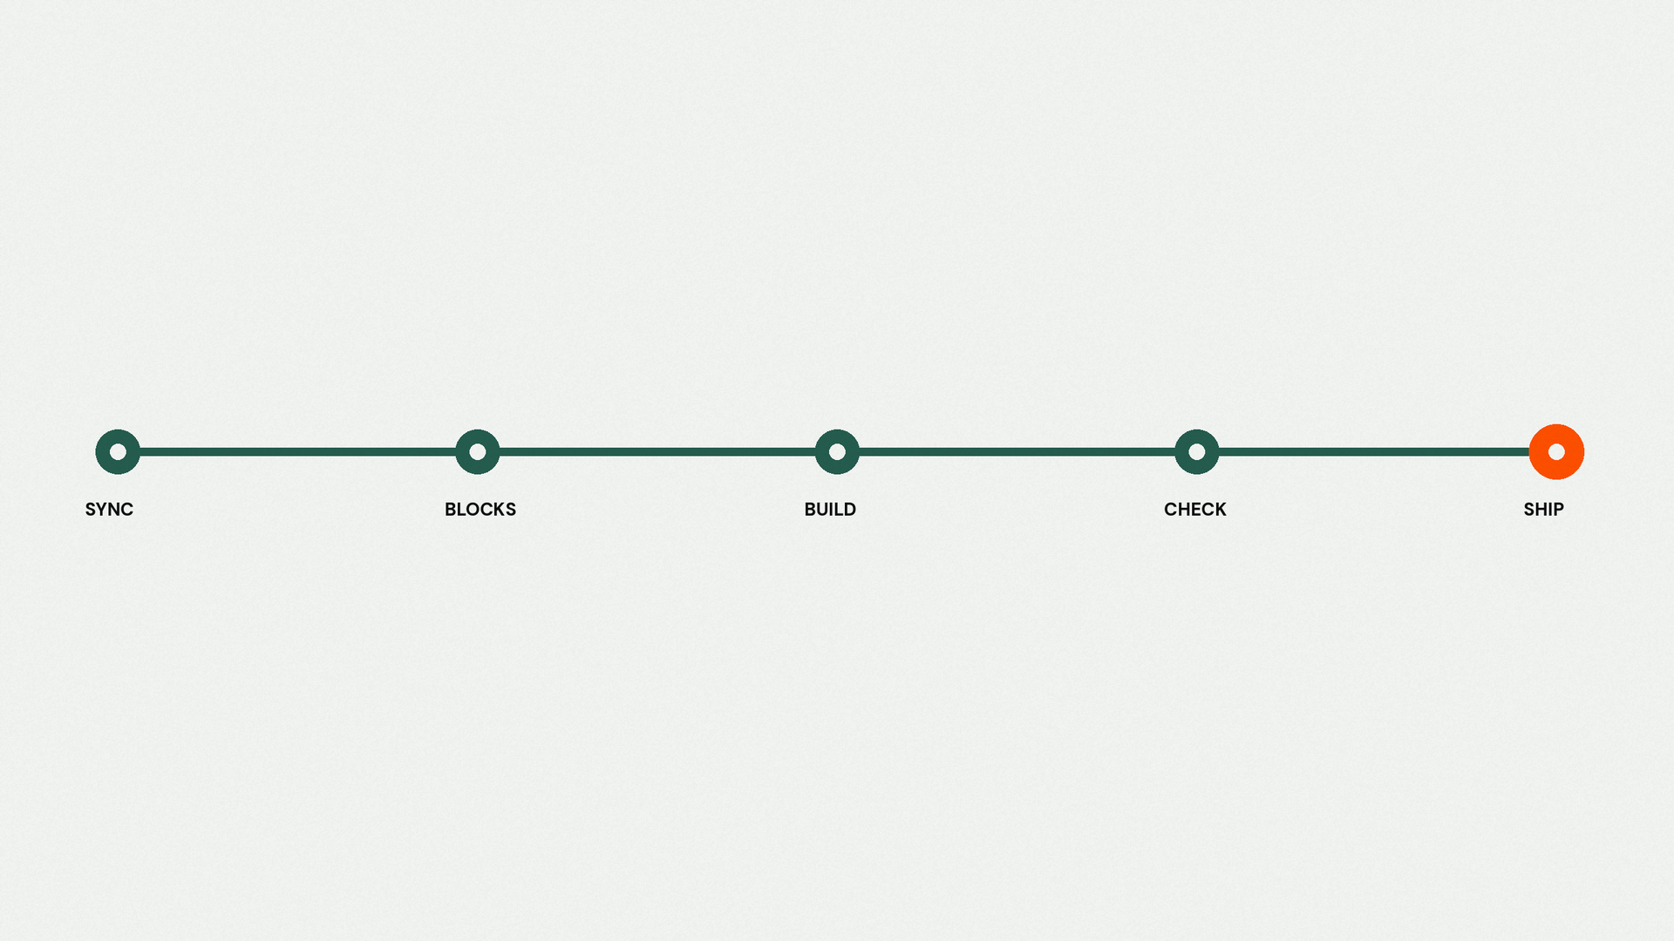
How the tools stay true
Database → fragments → builders → proof → field.
01 Sync — clean source of truth
02 Blocks · 03 Build · 04 Check · 05 Ship — one grammar across tools
07/14

Slide 8

SYNC
One sheet. No ghosts.
Pull
Latest mentee + IFM rows into the working sheet.
Clean
Names, IDs, counties, facilities — Kobo-safe.
Normalize
Active / Inactive · MENTORS / Newborn / Both.
Drop
Missing ID, name, county, facility, or code — gone.
Dedupe
Facility–program–status before any builder runs.
08/14

Slide 9
BLOCKS
Shared grammar.
Survey
Choices
Settings
type · name · label · hint
required / messages
relevant · constraint
calculation · choice_filter
appearance · notes
list_name
name
label
choice_filter
allow_choice_duplicates
09/14

Slide 10
BUILD
Five tools. One spine.
01
EmONC Curriculum Tracking Form
02
Newborn Curriculum Tracking Form
03
MoH Skills Assessment Checklist
04
EmONC Knowledge Assessment
05
Newborn Knowledge Assessment
10/14

Slide 11
CHECK
Prove it. Then ship.
→
Active + correctly programmed records only
→
Relevance matches field names
→
Choices align with select_one / select_multiple
→
Required + choice filters behave
→
Messages and hints read clean
→
Hide logic waits for answers
→
No duplicate facilities, mentees, or IFMs
11/14

Slide 12

When a pin doesn’t appear
Identity
Program
Facility
· Invalid mentee_id (format, spaces, length, prefix)
· Inactive / blank status or date_activated
· Missing from Mentee or IFM database
· Wrong Program value (Newborn / EmONC / Both)
· EmONC In-person = No
· Both Newborn flags blank/No → Error!
· Name typos break relevance (Centre/Center)
· Reused facility codes — one dropped
· Code blank or mapped to wrong site
12/14

Slide 13

SHIP
Upload.
Version.
Release.
13/14

Slide 14

NEXT
IFMs place the pin.
A dedicated Kobo tool for facility-led mentee mapping —
where care happens.
14/14

