Slide 1
Spot the Difference
Icebreaker · Original vs. Edited Historical Photo
Two photos. Same moment. What changed?

Slide 2
How we play
1. Pair up or form small groups (2–4 people).
2. You’ll see Photo A, then Photo B — both look almost identical.
3. You have 60 seconds to list every difference you notice.
4. Share your finds with the room — no phones, trust your eyes.
5. We’ll reveal the edits and the (true) historical story behind them.
Tip: look closely at people, objects on wrists, and the sky.

Slide 3
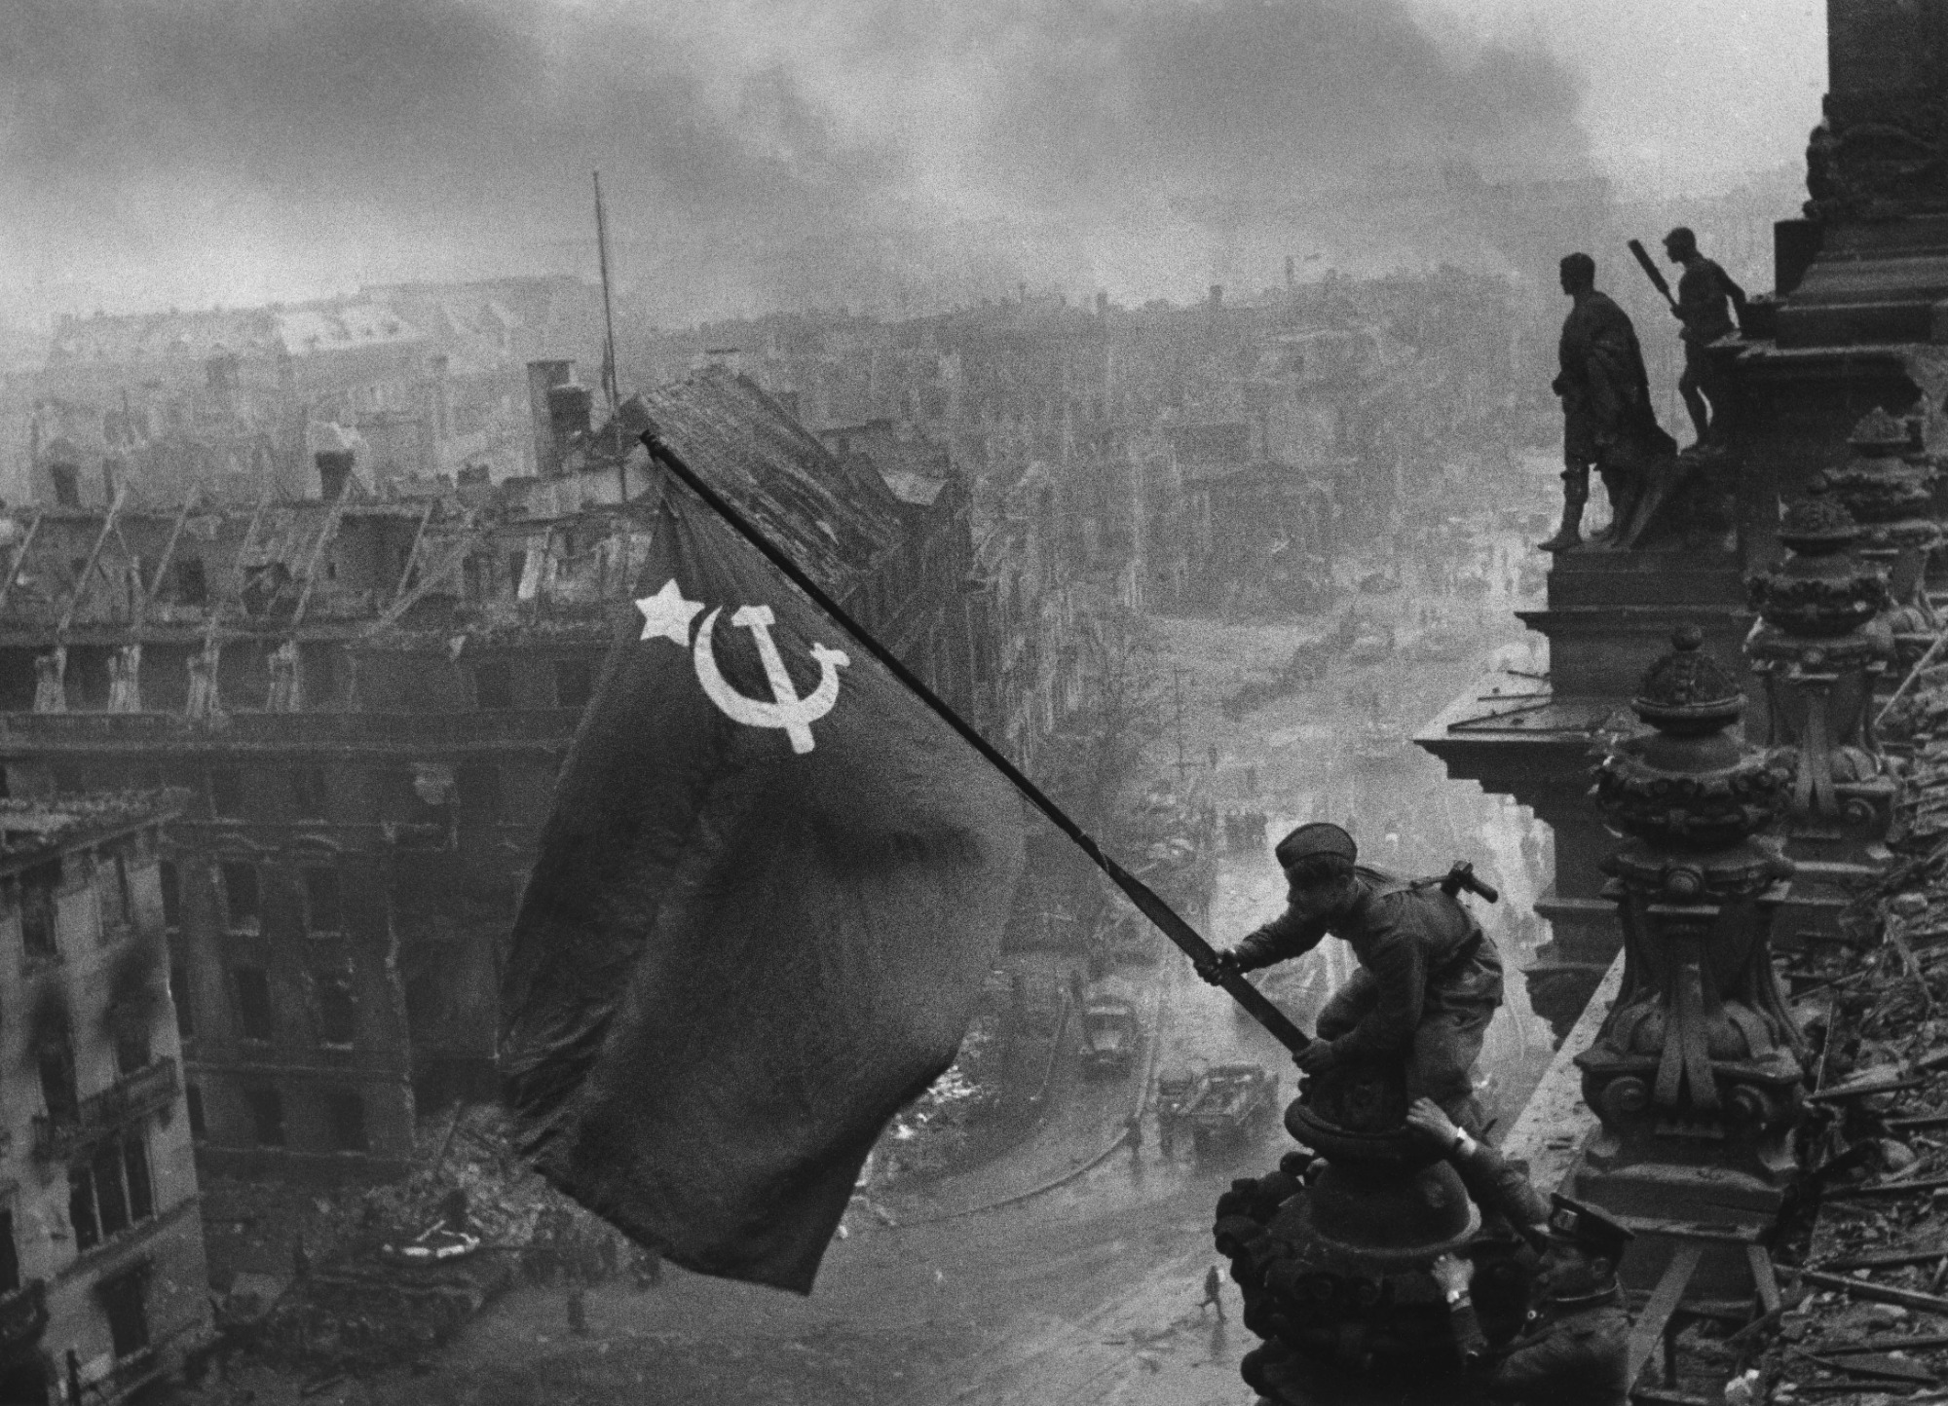
Photo A — study this first
Raising a Flag over the Reichstag, Berlin — May 1945 (photographer: Yevgeny Khaldei)

Slide 4
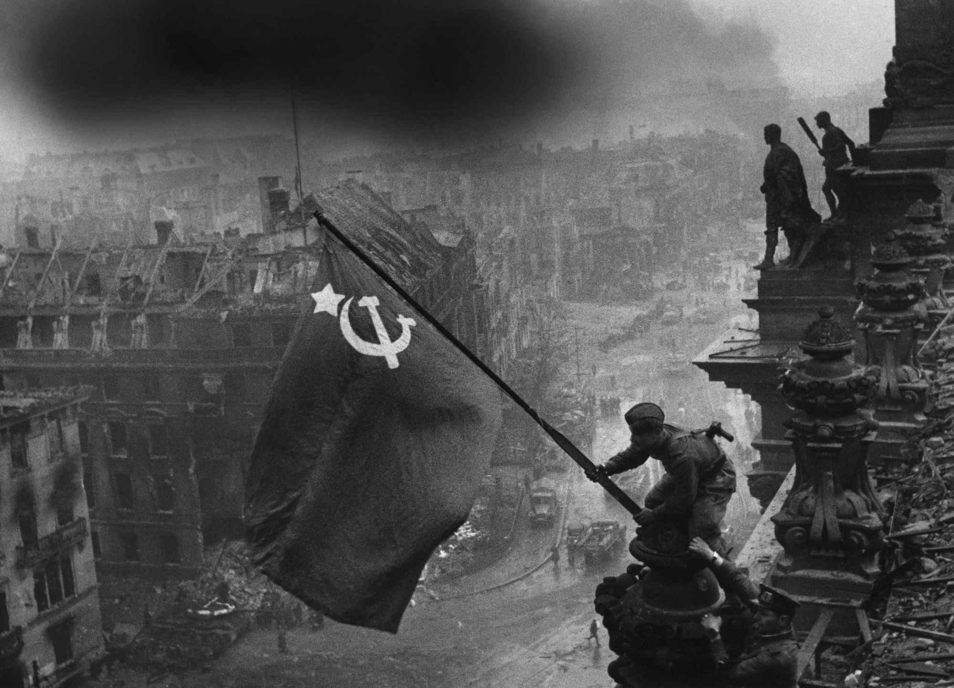
Photo B — find what changed
60 seconds on the clock. Write down every difference you see.

Slide 5
Side by side — compare carefully
A · Original
B · Edited (as shared)

Slide 6
The two edits
1. The wristwatch
2. Extra smoke
On the supporting soldier’s right hand, a wristwatch was removed. Two watches could look like looting — so the published version cleaned that detail up.
Darker, heavier smoke was added in the sky to make the victory feel more dramatic — a more “glorious” battlefield atmosphere.
Discussion: Why might publishers edit a “documentary” photo? What should we notice when images travel through media today?

Slide 7
Look twice. Ask what changed — and why.
Thanks for playing. Go around: one difference you spotted, or one question this raised for you.

