Slide 1
ICEBREAKER
3 MINUTES
Spot the difference
Two prints. One photograph.
Berlin, 2 May 1945. A flag is raised over the Reichstag.
You will see the picture as it was taken, then the version that was shared.
Exactly two things changed.
Look once. Then look closer.
1 / 5
Notes:
Read it, then move on. Ask the room to stay quiet until both photographs have been up. The whole exercise is about three minutes. Do not hint yet.

Slide 2
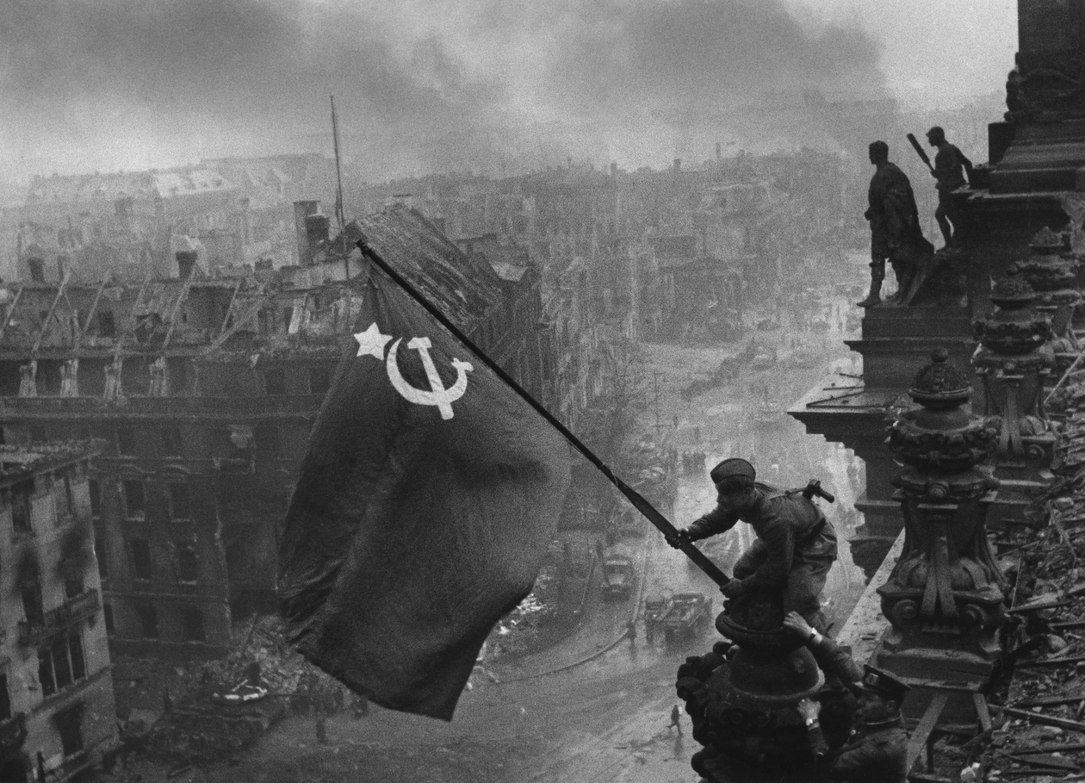
01
As
taken
Before anyone
retouched it.
2 / 5
Notes:
Hold for about twenty seconds. Tell them to scan the sky and the people, not only the flag. Do not take answers yet.

Slide 3
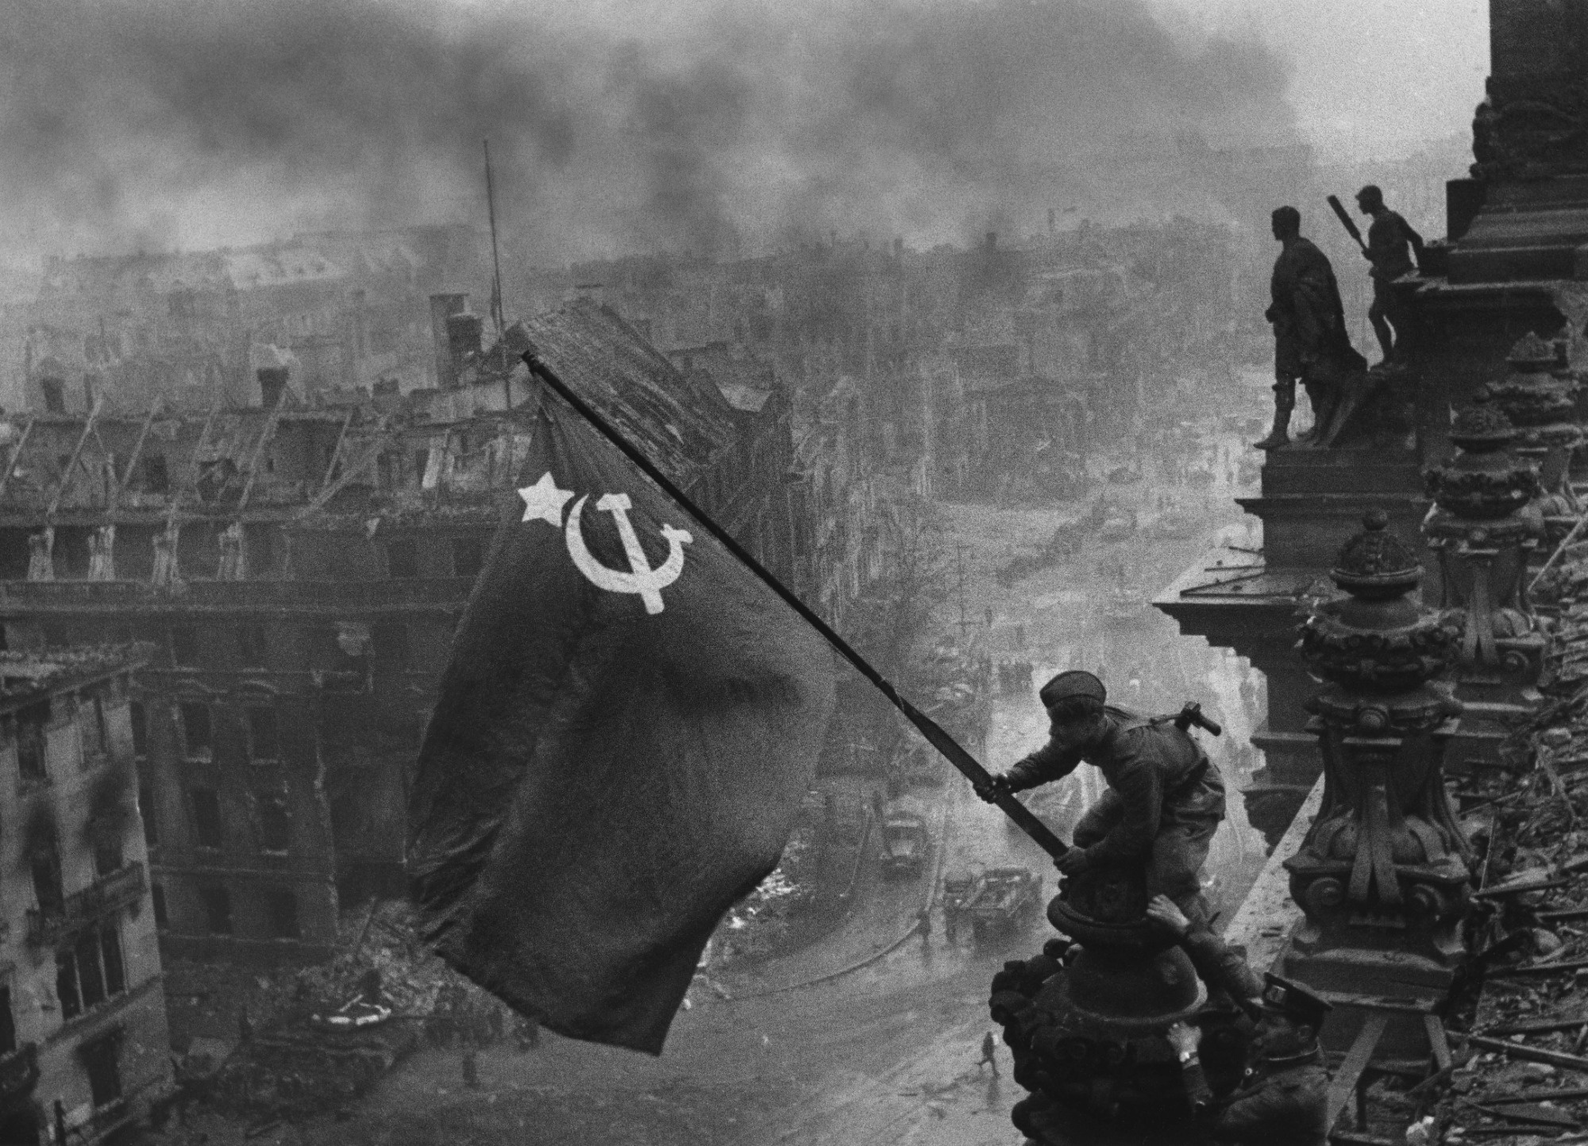
02
As
shared
The print
that went out.
What was
added?
What was
removed?
3 / 5
Notes:
Another twenty seconds. Ask them to keep the answer to themselves. Then go to the pair so they can check.

Slide 4
Same frame. Two changes.
One is in the sky. One is on a person.
As taken
As shared
Say what changed. Don’t say why. Not yet.
4 / 5
Notes:
Half a minute. Take two or three answers and do not confirm them. If the room only sees the smoke, point back at the line: one change is on a person. Then reveal.

Slide 5
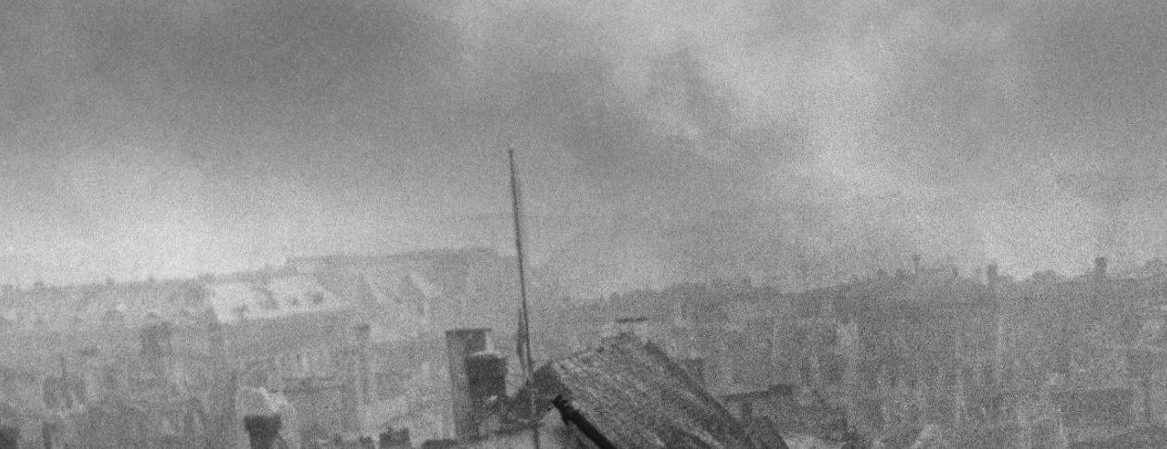
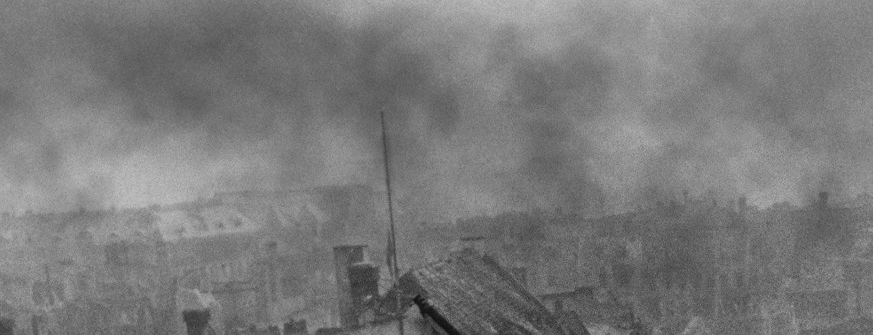
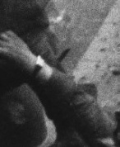
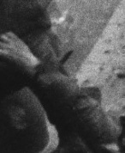
What changed
Which one did you see first?
ADDED
AS TAKEN
AS SHARED
Smoke over the ruins. A heavier sky makes the battle look bigger than the frame.
REMOVED
AS TAKEN
AS SHARED
The wristwatch on the right hand of the soldier bracing the flag.
A watch on each wrist could be read as loot. The shared print left one.
Yevgeny Khaldei, 2 May 1945. The moment happened. The print was adjusted before it was shown.
5 / 5
Notes:
Read the two changes, then stop. Ask which one they saw first — that is the icebreaker. The other wrist still has a watch; only the right hand was cleared. Do not open a long discussion unless the room wants one.

