Slide 1
ICEBREAKER
4 MINUTES
Two versions
of one photograph.
Find the two changes made before this picture was shared.
BERLIN, 2 MAY 1945 · ROOF OF THE REICHSTAG
PAIRS · 90 SECONDS
1 / 6
Notes:
Leave the history for the reveal. Set the room up: pairs, ninety seconds, exactly two differences. Then go to the next slide for the rules, and leave the photographs up while they look.

Slide 2
HOW TO PLAY
Three steps, then the pictures.
01
Look
Both pictures are the same moment. The one on the right is the picture that was shared.
02
Hunt
In pairs. Ninety seconds. There are two differences.
03
Call them out
We'll put the two changes on screen, and say why each one was made.
2 / 6
Notes:
Read the three steps and move on. Don't hint at smoke or the watch. If you are short on time, this slide can be spoken over the title slide instead.

Slide 3
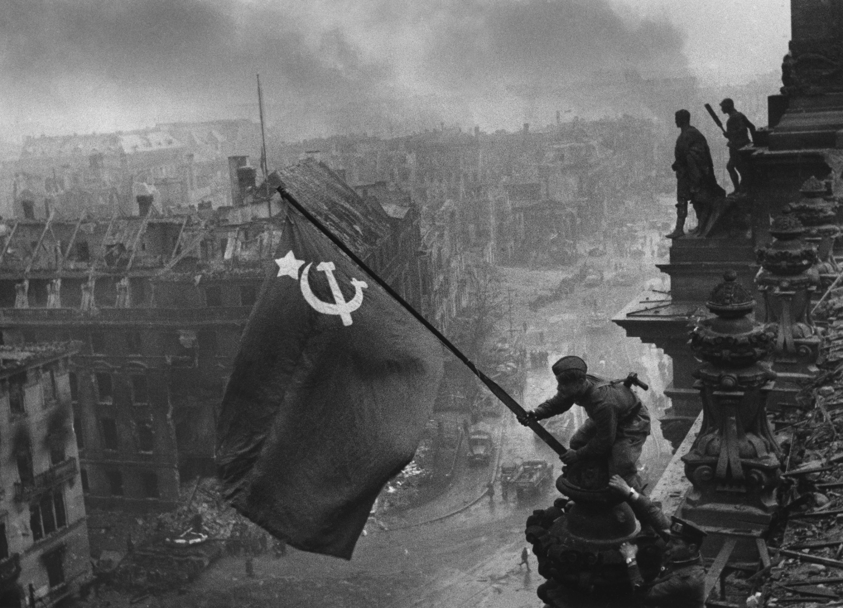
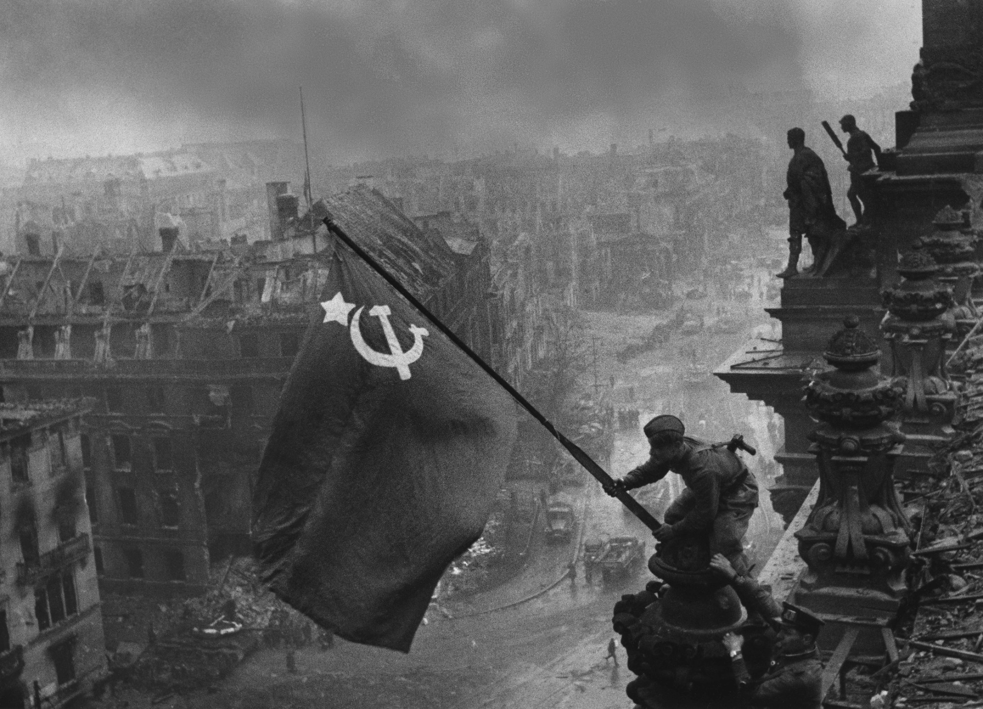
SPOT THE TWO DIFFERENCES
90 SECONDS
ORIGINAL
THE PICTURE THAT WAS SHARED
Call them out when you have both.
3 / 6
Notes:
Leave this up and stay quiet. Most rooms find the sky first. The watch is small — on the raised right hand of the soldier supporting the flag, low in the frame. A second watch, on the other wrist, is in both pictures. If they only have one difference after ninety seconds, use the hint slide. Otherwise skip it.

Slide 4
A HINT, IF YOU NEED IT
Look in these two places.
One change is in the sky. One is on the raised right hand.
ORIGINAL
SHARED
4 / 6
Notes:
Skip this slide if the room already has both changes. The circles only say where to look. Give them another twenty seconds, then reveal.

Slide 5
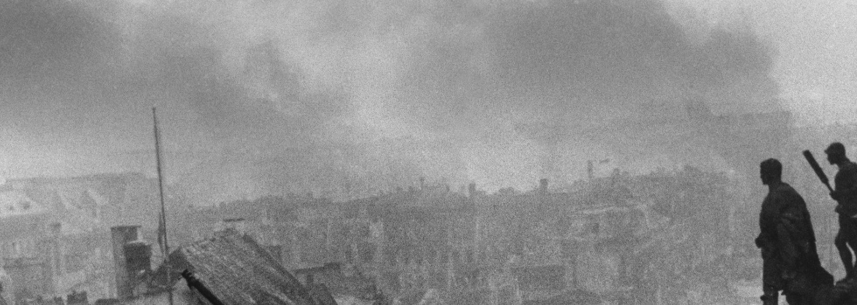
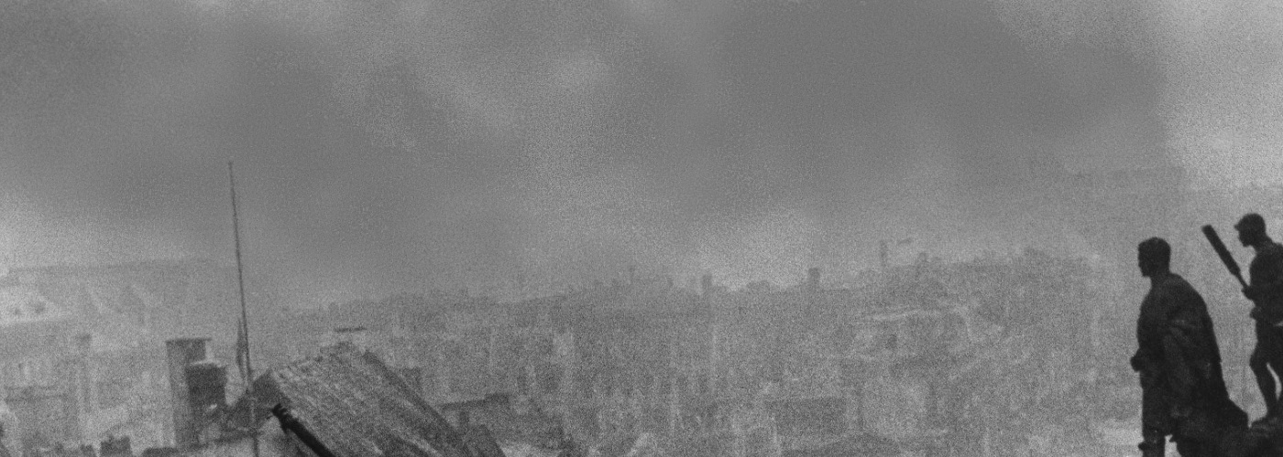
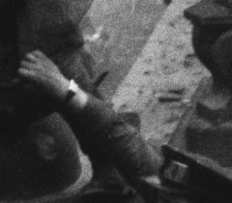
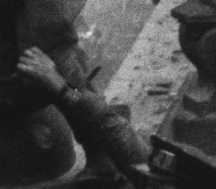
WHAT WAS CHANGED
Two edits, before it was published.
01
The smoke
More smoke was laid into the sky, so the city would look deeper in the fighting and the moment more heroic.
ORIGINAL
SHARED
02
The wristwatch
The watch on the supporting soldier’s raised right wrist was removed. He was wearing one on each wrist, and a second watch could be read as looting. The watch on the other wrist is still in both pictures.
ORIGINAL
SHARED
5 / 6
Notes:
Say it plainly, then stop. Photographer: Yevgeny Khaldei, Reichstag roof, Berlin, 2 May 1945. Before publication the sky was given more smoke, and one of the two watches was taken out of the picture because two watches on one soldier could be read as looting. Don't name the soldiers — the identifications are disputed. Point at the raised hand on the right-hand crop so the room can see the bright band is gone.

Slide 6
OVER TO YOU
What do we tidy up
before we show it?
Sixty seconds with the person next to you.
Then one pair shares it with the room.
Photograph by Yevgeny Khaldei, on the roof of the Reichstag, Berlin, 2 May 1945.
Before it was published, smoke was added to the sky and one wristwatch was removed.
6 / 6
Notes:
Keep it light. One pair is enough. If the room goes quiet, offer a prompt: a slide, a photo, a number we round before anyone else sees it. You can end on the reveal and skip this slide if you only wanted the spotting game.

