Slide 1

MENTORS · STANDARD OPERATING PROCEDURE
Mentee Mapping
From the Mentee Database to Kobo Tool Updates
Jacaranda Health

Slide 2
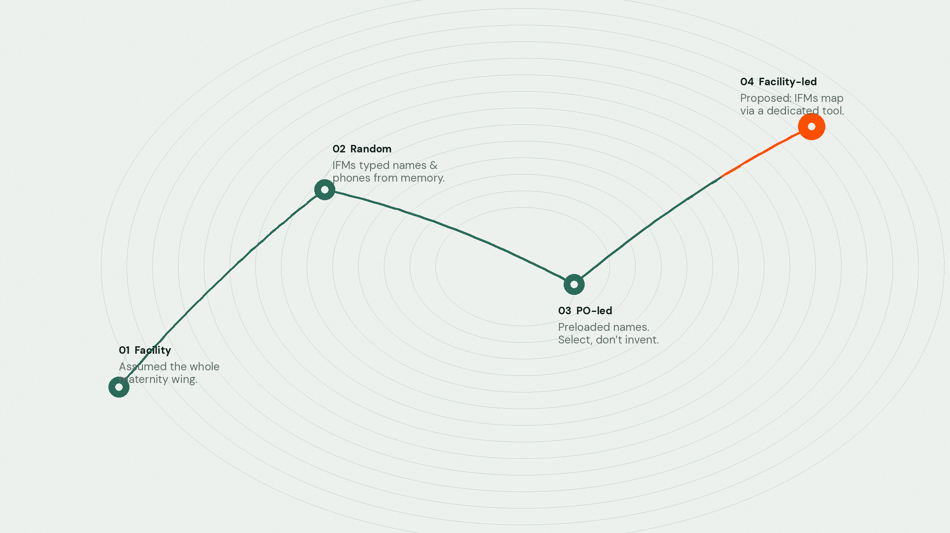
Where we came from
Four ways of seeing reach — until the pin was the mentee.
02 / 14

Slide 3

2018 — 2023
Facility-level mapping
At the start of MENTORS, reach was counted by place — not by person.
· A CME on AMTSL in a facility meant every HCW there was treated as trained.
· “7,441 HCWs trained” was an estimate from maternity-wing headcount.
· Retirements, transfers, and non-participation quietly inflated coverage.
What it cost us
Estimates, not individuals.
Attrition invisible.
No mentee-level truth.
03 / 14

Slide 4
The pivot
Random mentee mapping
JH moved tracking to the mentee — but the identifier was still improvised.
· IFMs selected a facility, typed name + phone (mentee_id), then activities.
· Better than facility assumptions — still dependent on memory and keystrokes.
· Mistyped phones and alternate numbers broke the unique ID.
The fracture
Manual entry.
Duplicate IDs.
Phone ≠ reliable key.
04 / 14

Slide 5
Current state
PO-led mentee mapping
Map
Preload
Link
POs visit facilities and register HCWs eligible for MENTORS.
Mentee details are loaded into Kobo before collection — IFMs select, not invent.
WhatsApp numbers now supplement mentee_id so in-person and DELTA connect.
Vision — a mentee finishes entirely in person, or mixes modules on DELTA. Same person. Same pin.
05 / 14

Slide 6
What forced the change
01
Mentee-level truth
Facility counts could not tell us who was actually mentored.
02
Field noise
IFM-entered names and phones drifted under pressure.
03
Manual preload
Quality jumped — maintenance did not. Spreadsheets broke.
04
Attrition lag
Inactive mentees lingered in tools long after they left.
06 / 14

Slide 7

How the tools stay true
One spine. Five moments between database and deployment.
Sync
Mentee + IFM databases — cleaned, normalized, deduplicated.
Blocks
Reusable survey / choice / settings fragments.
Builders
XLSForm-ready sheets for each Kobo tool.
Validate
Active-only, logic-checked, no duplicate choices.
Deploy
Upload. Version. Ready for the field.
07 / 14

Slide 8
Sync
Bring the source of truth into one place
Pull
Latest mentee and IFM records into the working sheet.
Clean
Names, IDs, counties, facilities — Kobo-safe.
Normalize
Status → Active / Inactive. Program → MENTORS / Newborn / Both.
Drop
Incomplete rows (missing ID, name, county, facility, or code).
Dedupe
Facility–program–status combinations before anything is built.
08 / 14

Slide 9
Building blocks
Fragments every form builder shares
Survey
Choices
Settings
type · name · label · hint
required / messages
relevant · constraint
calculation · choice_filter
appearance · notes
list_name
name
label
choice_filter
allow_choice_duplicates
09 / 14

Slide 10
Form builders
Five tools. One grammar.
01
EmONC Curriculum Tracking Form
02
Newborn Curriculum Tracking Form
03
MoH Skills Assessment Checklist
04
EmONC Knowledge Assessment
05
Newborn Knowledge Assessment
10 / 14

Slide 11
Validate before upload
Trust, then deploy
→
Only Active, correctly programmed records in mentee builders
→
Relevance / skip logic matches field names
→
Choice lists align with select_one / select_multiple fields
→
Required fields + choice filters behave as intended
→
Messages, notes, and hints read cleanly
→
Hide logic waits for required answers
→
No duplicate facilities, mentees, or IFMs in choices
11 / 14

Slide 12
When a pin doesn’t appear
Usual reasons a mentee, mentor, or facility is missing from the Kobo tool.
Identity
Program
Facility
· Invalid mentee_id — format, spaces, length, or not starting with 1 / 7
· Inactive or blank status / date_activated
· Absent from Mentee or IFM database
· Wrong Program (Newborn vs EmONC vs Both)
· EmONC In-person = No for an EmONC mentee
· Both Newborn in-person flags blank / No → Error!
· Name typos (Centre vs Center) break relevance
· Reused facility codes — one dropped as duplicate
· Code blank or mapped to the wrong site
12 / 14

Slide 13

DEPLOY
Upload the builders.
Version the forms. Release to the field.
13 / 14

Slide 14

LOOKING AHEAD
Mentee mapping, next
IFM-led mapping through a dedicated Kobo tool —
the pin placed where care happens.
14 / 14

