Slide 1
ICE BREAKER · 5 MINUTES
Spot the Edit
Two photographs. One rooftop in Berlin, 1945.
Find what Soviet editors changed before the picture went public.
Raising a Flag over the Reichstag · Yevgeny Khaldei · 2 May 1945
Notes:
Welcome people in. Do not explain the history yet. Promise it is a 5-minute game, not a lecture. Ask them to pair with the person next to them.

Slide 2
HOW WE PLAY
90 seconds. Two differences.
01
02
03
Pair up
Look twice
Find two changes
Turn to the person next to you. One screen, two pairs of eyes.
First the original photograph, then the version Soviet editors shared.
Same rooftop. Same flag. Two quiet edits. Shout them out when you see them.
No phones. No zooming in on a second device. Trust your eyes.
Notes:
Read the three steps quickly. Start a 90-second timer after slide 4 (the edited photo) is up, or after the side-by-side if the group needs it. Do not hint at smoke or the watch.

Slide 3
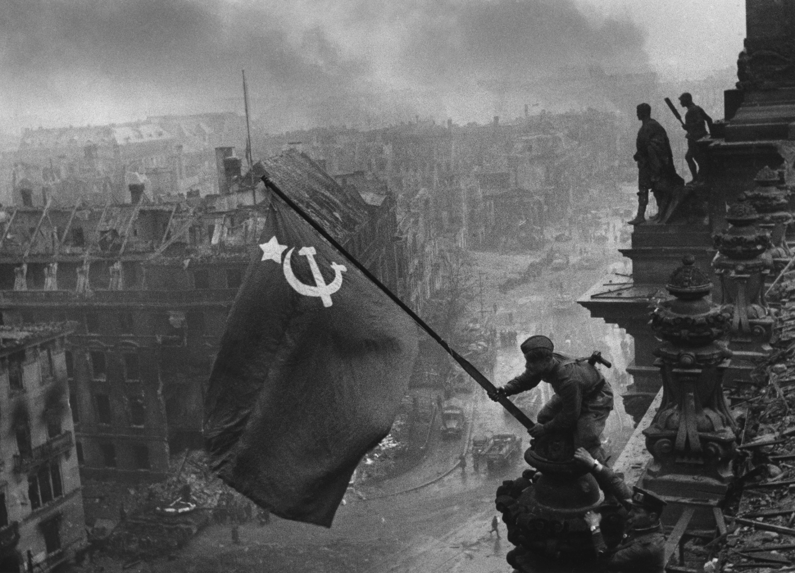
THE ORIGINAL
Khaldei’s photograph, before the darkroom. Look carefully — then we flip.
Notes:
Leave this up for about 20 seconds. Ask people to scan the soldier, the flag, the sky, and the people on the right. Then go to the next slide without commenting.

Slide 4
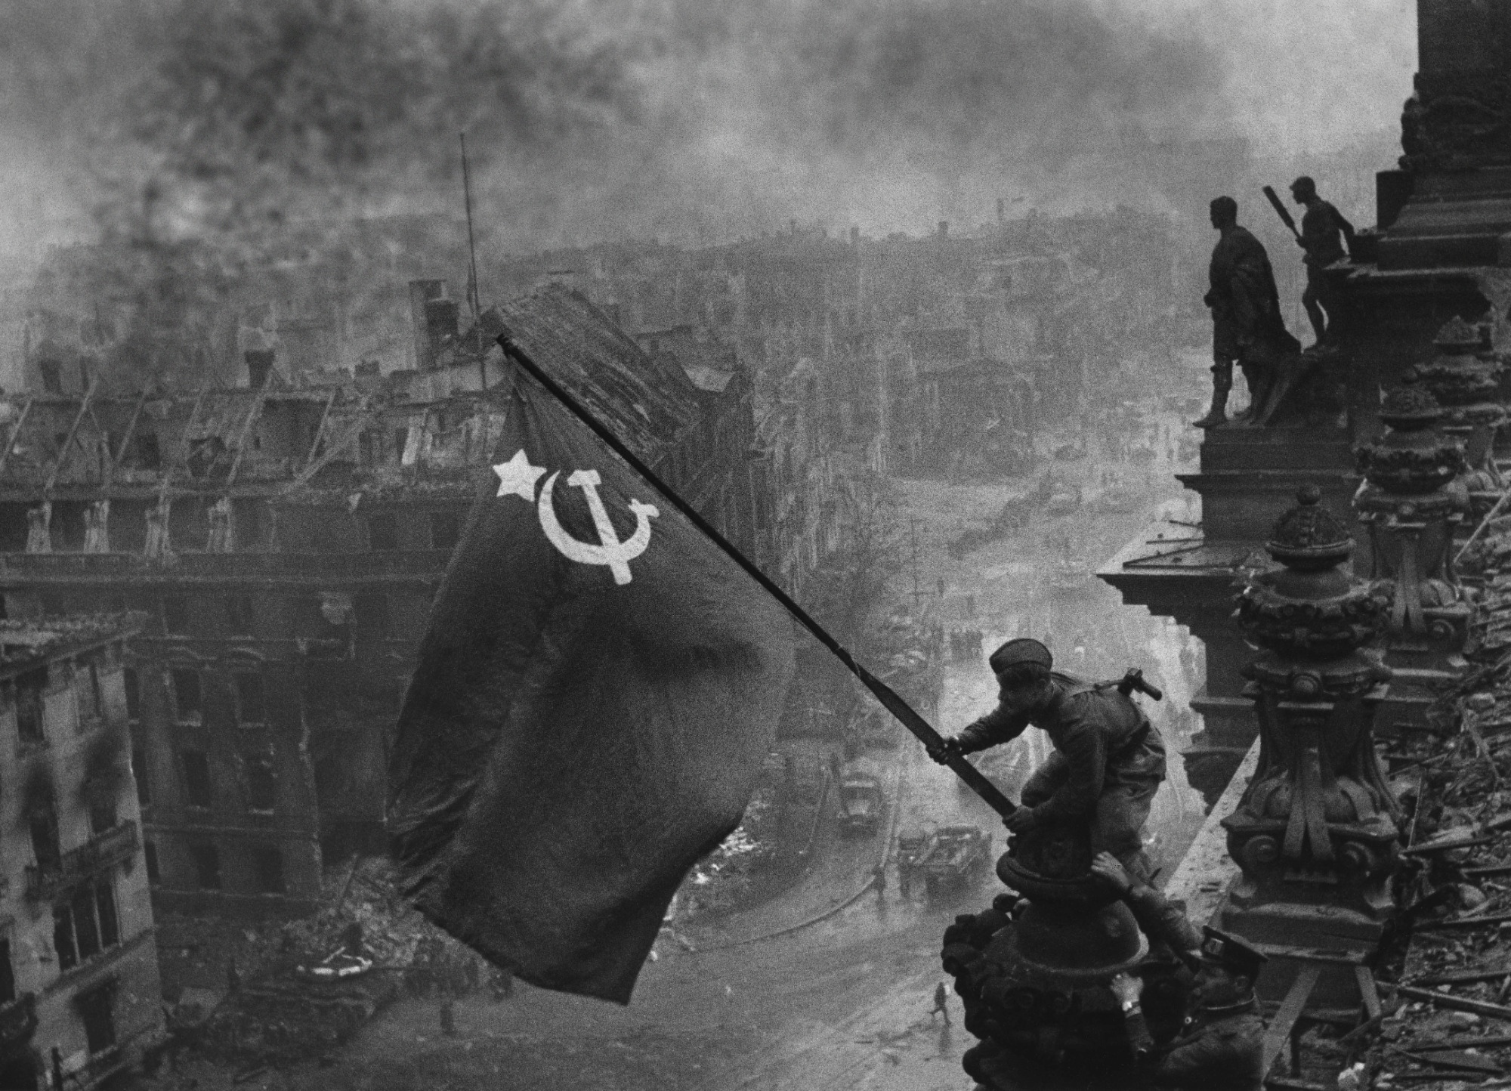
SOVIET PRESS VERSION
Same frame. Two edits. Timer starts now.
Notes:
This is the 'Soviet shared' version: slightly more smoke in the sky, and the wristwatch on the supporting soldier’s right hand is gone. Start the 90-second clock. Collect guesses out loud. Do not confirm yet.

Slide 5
LOOK AGAIN
Original on the left. Soviet edit on the right.
Original
Soviet press version
Notes:
Give the room another 20–30 seconds if needed. Then take 3–4 shouted answers before revealing.

Slide 6
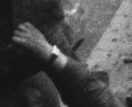
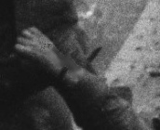
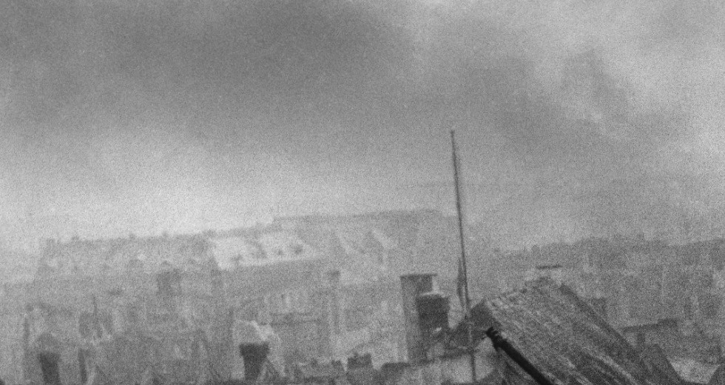
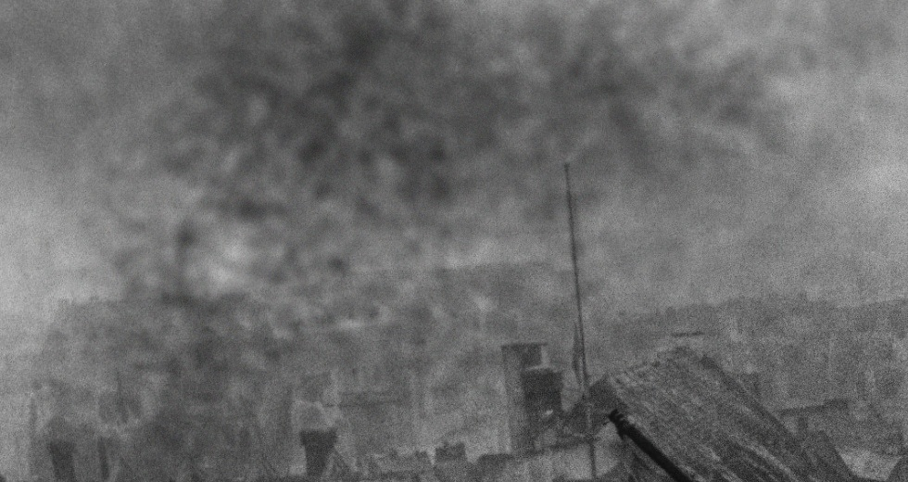
THE TWO EDITS
Both changes were made on purpose.
ORIGINAL SKY
ADDED SMOKE
WATCH ON THE RIGHT HAND
WATCH REMOVED
01 More smoke
02 The wristwatch
Editors darkened the sky and thickened the haze over ruined Berlin. The battle looks bigger, harder, more heroic — a victory worth the flag.
The supporting soldier’s right hand wore a bright watch. Extra watches looked like looting. The published print quietly erased it.
Notes:
Confirm the two answers. Celebrate people who found the watch — it is easy to miss. Mention that these are the real historical edits Khaldei and Soviet censors made: extra smoke from another negative, and a watch scratched out of the print.

Slide 7
WHY IT WAS CHANGED
Glorify the scene. Protect the story.
Smoke
A second negative of smoke was printed over the sky so Berlin looked like a harder-won inferno.
Watch
Jewelry on a soldier’s wrist suggested plunder. That did not fit the hero the editors needed.
The lesson
The photograph is still true — and it is also an argument. Every picture we share does the same.
Your turn
If a photographer took a picture of our team this week, what would you add — or quietly remove — before you shared it?
Notes:
Keep the history to 30 seconds. Then ask the discussion question. Take 2–3 answers and close. If you have extra time: 'What do we airbrush in our own status updates?'

