Slide 1
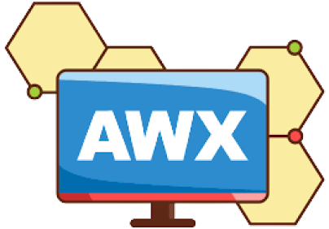

Slide 2
History of Ansible AWX:
====================================================
Ansible was created by Michael DeHaan and released as an open-source automation tool. Its simple, agentless architecture and YAML-based playbooks quickly gained popularity among DevOps and IT operations teams.
In 2016 As Ansible grew in popularity, there was a demand for additional features, particularly around management, access control, and user interfaces. Red Hat acquired Ansible, Inc., and subsequently introduced Ansible Tower—a commercial product that provided a web-based interface, role-based access control, job scheduling, and other enterprise features.
In 2017 To cater to the community and provide an open-source alternative to Ansible Tower, the AWX project was launched. AWX served as the upstream project for Ansible Tower, providing the same features in an open-source format.
In 2018-2020: AWX and Ansible Tower developed in parallel.
While AWX was a testing ground for new features, Ansible Tower provided a more stable, commercially supported product. Features that proved successful in AWX would often be integrated into Ansible Tower.

Slide 3
Ansible AWX:
==============================================
2021: AWX 17 was released, which included numerous improvements in performance, user interface enhancements, and new API features.
As of now, AWX is actively maintained, with regular updates and enhancements. It serves as an important tool for organizations looking for a free solution to manage Ansible automation.
Ansible AWX is an open-source web-based user interface.
It is a dashboard for managing Ansible automation.
It provides a more user-friendly way to manage playbooks, inventories, and automation workflows.
AWX is the upstream project for Ansible Tower, which is a commercial offering with additional features and support from Red Hat.

Slide 4
Core Components:
====================================
Ansible AWX is built on a set of core components that work together to provide a powerful automation platform. Its architecture generally includes:
Web Server:
  A user-friendly web interface built with Django, where users can manage playbooks, inventories, and job templates.
Task Engine:
  A worker process that executes Ansible playbooks. AWX utilizes Celery for managing these asynchronous tasks, allowing for distributed execution.
Database:
  AWX uses a PostgreSQL database to store information about users, projects, inventories, job templates, and job statuses.
API:
  A RESTful API that allows for programmatic access to AWX features. This API can be used for integration with other tools or for custom automation workflows.
Scheduler:
  Manages the scheduling of jobs, allowing users to set specific times for playbooks to run.

Slide 5
Key Features of Ansible AWX
===================================================
Web-Based User Interface:
  Provides an intuitive dashboard for managing Ansible jobs, inventories, and playbooks, making it easier for users to interact with Ansible.
Role-Based Access Control (RBAC):
  Allows administrators to set permissions and roles for users and teams, ensuring that only authorized personnel can execute certain tasks or access specific inventories.
Inventory Management:
  Users can create and manage dynamic or static inventories, making it easy to organize and control the hosts and groups that Ansible manages.
Job Templates:
  Create reusable job templates that define how to run Ansible playbooks, including variables, credentials, and inventory, streamlining the execution of automation tasks.

Slide 6
5. Scheduling:
Schedule jobs to run at specific times, enabling automated tasks such as regular updates or maintenance without manual intervention.
6. Real-Time Job Monitoring:
Monitor the progress and output of jobs in real-time, providing visibility into the execution of automation tasks and making it easier to troubleshoot issues.
7. Notifications:
Integrate with external notification services (like Slack, email, or webhooks) to receive alerts based on job success, failure, or other events.
8. API Access:
AWX provides a RESTful API for programmatic access to its features, enabling integration with other tools and automation workflows.

Slide 7
9. Multi-Tenancy Support:
Supports multiple users and teams with isolated environments, making it suitable for organizations that manage automation for various departments.
10. Integration with SCM:
Easily integrate with source control management (SCM) systems like Git, allowing users to pull playbooks directly from repositories.
11. Credential Management:
Securely store and manage credentials for accessing different systems and cloud providers, ensuring sensitive information is kept safe.
12. Workflows:
Create complex workflows that chain multiple job templates together, allowing for orchestrated automation processes.

Slide 8
13. Use Cases for Ansible AWX
DevOps Automation: Streamline CI/CD pipelines by automating deployments and configurations through a centralized interface.
14. Infrastructure Management:
Manage cloud resources, on-premises servers, and network devices efficiently with inventory management and job templates.
15. Compliance and Security:
Automate compliance checks and remediation tasks to ensure security policies are consistently applied across the infrastructure.
16. Continuous Monitoring:
Schedule jobs to run at regular intervals, performing health checks and updates to ensure systems remain operational.

Slide 9
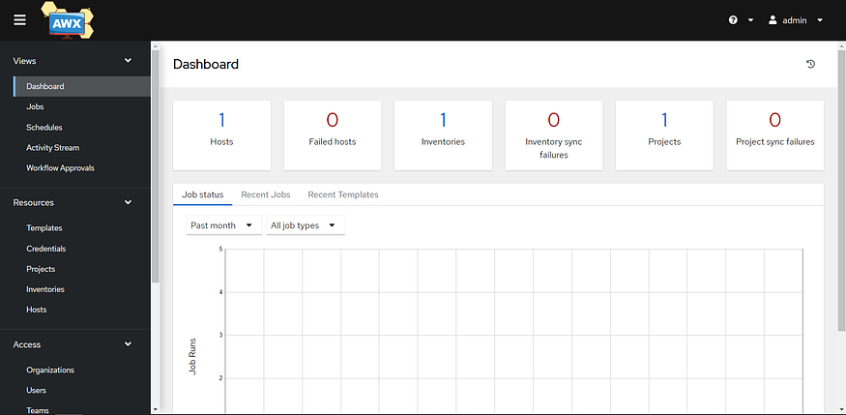

Slide 10
What is Ansible Tower?
it is the commercial GUI Ansible tool that provides
✓ officially supported GUI interface
✓ API access
✓ role-based access
✓ scheduling
✓ notifications
✓ manage environments easily with Ansible
Ansible Tower is a commercial ‘pay for’ product that comes in two versions — Standard and Premium. Looking at the two versions, the prices range as follows:
Standard — $13,000/year, up to 100 nodes, 8x5 support
Premium — $17,500/year, up to 100 nodes, 24x7 support
Check out the pricing page at https://www.ansible.com/products/tower/pricing

