Slide 1
Shell Scripting
ow

Slide 2
What is shell??
When we connect to linux command line and execute command, it execute in an interface that is called shell.
Shell in environment which linux provides to execute command , it is similar to Windows cmd.
Many Shell has developed, all of them has enabled some features from one another.
Default shell of linux is bash

Slide 3
What is script
Linux provides command line,which perform the task.
Now if we have sequence or some kind of automation requires we can put all these command in the script.
Script will provide us a ground to automate the task using linux commands.
In script we can write what we want to execute and control the flow.
When we say control the flow, scripting provides conditional statement and looping as well

Slide 4
Shell script
We need to create a file using vi editor.
File should have .sh extension .
It is recommended to put shebang line in the script.
Why shebang?
Shebang tells when script runs which interpreter will be used.
#!/bin/bash
It is a good practice to put shebang at the start of script

Slide 5
First code
Using vi editor create a file : vi firstscript.sh
#!/bin/bash
echo “Hi “
Save the file
chmod +x firstscript.sh
sh firstscript.sh

Slide 6
How to define variables?
Define variable:In Bash, variables store values such as strings, numbers, or commands. Here’s how you define and use them.
No spaces around =Access the value using $my_var
Enclose the value in quotes if it contains spaces
#!/bin/bash
my_var="Hello, World"
echo $my_var

Slide 7
Understand the requirement
When we write script first we need to understand the requirement and try to create a flow.
Write an automation where we need to create a directory and inside that we need to create a file.
Simple way : As developer we assume directory is not there and we simply write basic script
#!/bin/bash
mkdir test
cd test
touch file

Slide 8
Your thoughts on this??
What should be approach

Slide 9
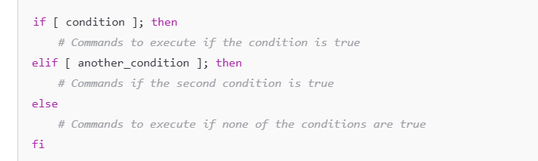
..flow
Check if directory is already there or not
If directory is not at that location, we can follow same flow
If directory is there, we will check file is there

Slide 10
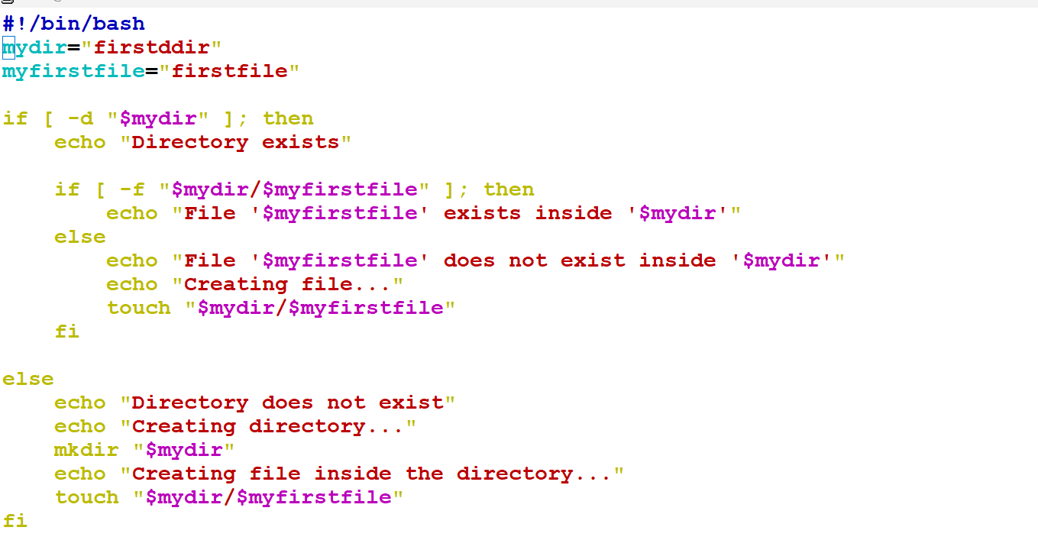
code

Slide 11
Let's understand another requirement
If I need to install more than multiple package in linux.
What would be our approach
We will pass multiple apt/yum command to do
We will create script and write a repetitive flow.
Package list
Repetitive flow pulls on package name from package list
--try to install it

Slide 12
..
First we need define array.
Array in scripting, which contains more than one same type item.
Declaration of array
Packages=(“maven”,”openjdk-17-jdk”)
How to access array item
echo “{packages[0]}”
echo "${packages[1]}"

Slide 13
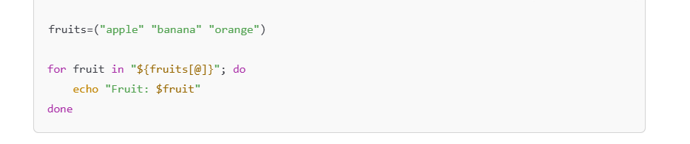
..
How to use this array again and again for all the items

Slide 14
Editor [sed]
We have requirement where we need to modify files data.
Modify data: Replace,delete and insert the data without opening the file.
SED is a powerful text stream editor. Can do insertion, deletion, search, and replace(substitution).
SED command in UNIX supports regular expression which allows it to perform complex pattern matching.

Slide 15
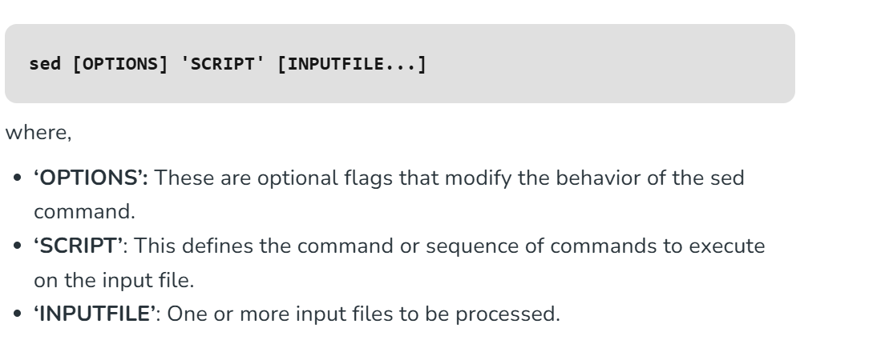
..

Slide 16
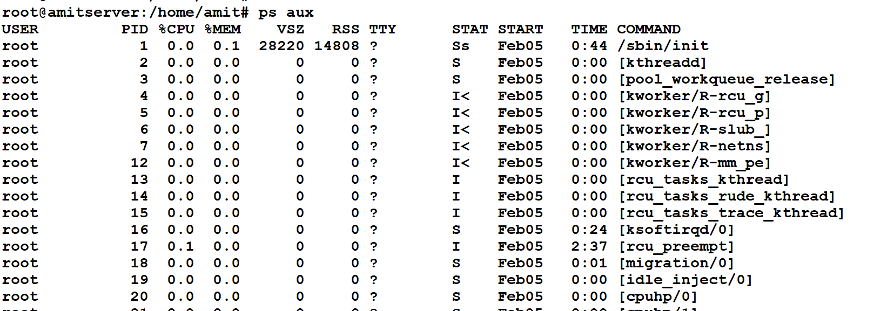
cut
The cut command is a simple but powerful tool in Unix-based systems used to extract sections from each line of a file or input stream, based on delimiters (like spaces, commas, etc.) or by specifying specific column positions.
It’s commonly used in shell scripting and data manipulation tasks.

Slide 17
..
Requirement is to print line 2 and 11
ps aux | cut -d ' ' -f 2,11
-d ' ': Specifies that the delimiter is a space (fields are space-separated).
-f 2,11: Extracts the second column (PID) and the eleventh column (COMMAND).
ps aux | tr -s ' ' | cut -d ' ' -f 2,11
output may contain multiple spaces between columns, which can cause cut to treat them as separate fields. To avoid this, we can first pipe the output of ps aux to tr -s ' ' to replace multiple spaces with a single space.

