Slide 1
Devops
ow

Slide 2
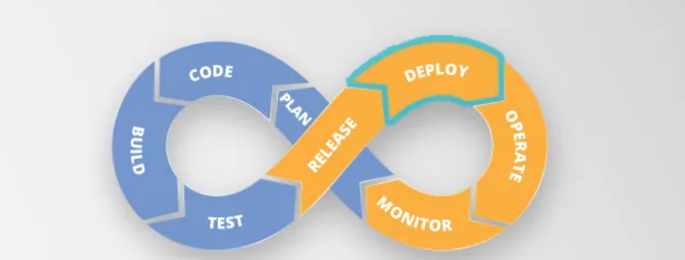
Introduction

Slide 3
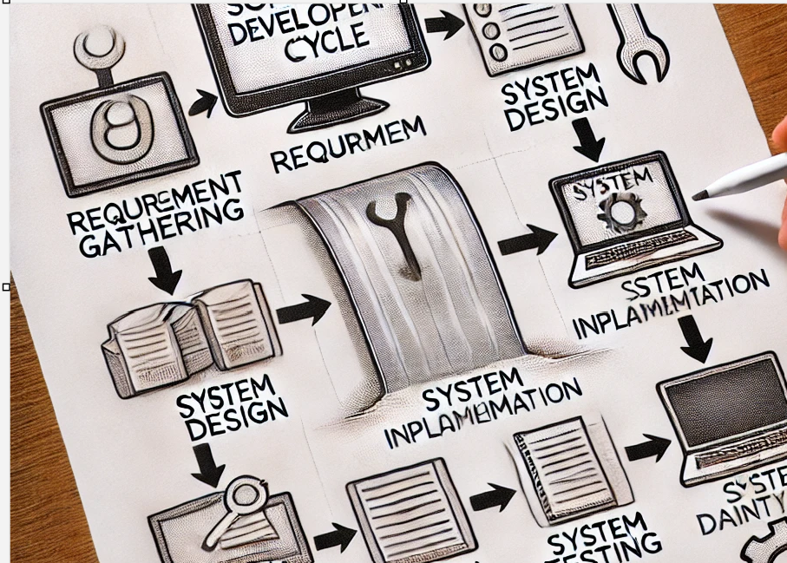
Waterfall model

Slide 4
Phases of waterfall model
­In phase 1- Complete Requirement is gathered and SRS is developed
In phase 2 - This System is Planned and Designed using the SRS
In phase 3 - Implementation of the System takes place
In phase 4 - System is tested and its quality is assured
In phase 5 - System is deployed to the end users
In phase 6 - Regular Maintenance of the system is done

Slide 5
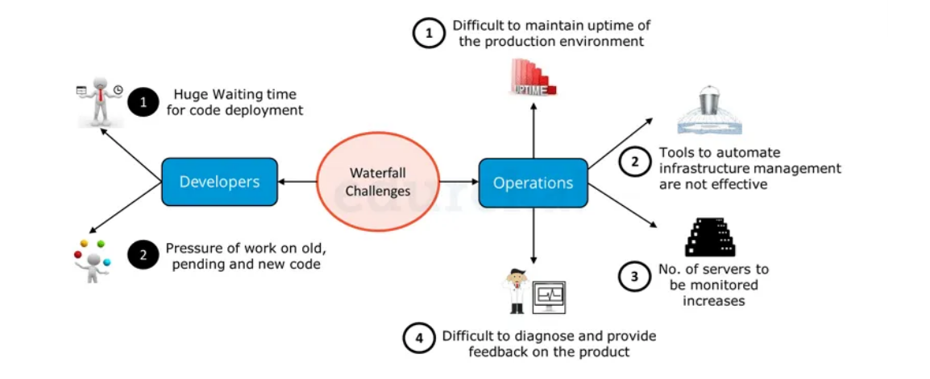
challenges

Slide 6
Solution
From the Developers point of view:
A system which enables code deployment without any delay or wait time.
2. A system where work happens on the current code itself i.e. development sprints are short and well planned.
From Operations point of view:
1.System should have at-least 99% uptime.
2. Tools & systems are there in place for easy administration.
3. Effective monitoring and feedbacks system should be there.
4. Better Collaboration between Development & Operations and is common requirement for Developers and Operations team.

Slide 7
Devops
DevOps is a set of practices that combines software development (Dev) and IT operations (Ops) with the aim of shortening the development lifecycle and delivering high-quality software continuously.
It emphasizes collaboration, automation, continuous integration, continuous delivery (CI/CD), and a culture of continuous improvement.
Dev and Ops : Where a code changes start from Devops side and end up with product release/Deployment, this whole process comes under devops

Slide 8
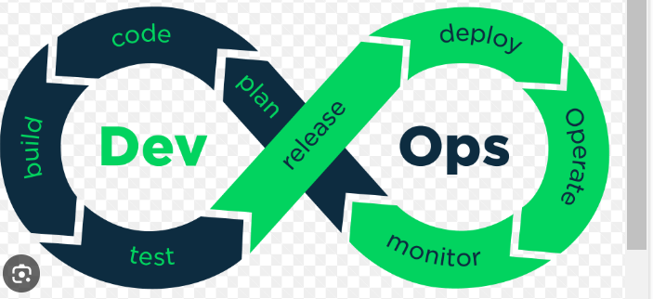
Introduction to DevOps
DevOps is a software development methodology that emphasizes collaboration, communication, and integration between software developers and IT operations professionals.
The goal of DevOps is to increase the speed and efficiency of software delivery while maintaining high levels of quality and reliability.

Slide 9
dev
Developers | challenges | solution
 | Waiting time for code deployment | CI (Continuous Integration) ensures quick deployment of code, faster testing and shared feedback
 | Pressure of work on old, pending and new code | Since wait time has reduced developer can focus more on current code

Slide 10
Ops
OPS | Challenges | solution
 | Difficult to maintain uptime | Virtualization and containerization helps, run app in form of containers
, | Tools to automate management part | Config management , CD tools and iac tools
 | monitoring | Continuous monitoring

Slide 11
CICD
Continuous Integration (CI)
Definition: Developers frequently integrate code into a shared repository,
often multiple times a day.
Goal: Detect integration errors as early as possible.
Tools: Jenkins, GitLab CI, Travis CI, CircleCI.
Continuous Delivery (CD)
Definition: Code changes are automatically built, tested, and prepared for release
to production.
Goal: Ensure that the software can be released reliably at any time.
Tools: Jenkins, GitLab CI/CD, Spinnaker, Argo CD.

Slide 12
Tools
Code management: git
Build: maven, docker
Cicd: gitlab,jenkins,azure devops
Monitoring:nagios
Config management: ansible
Deploy: terraform
Notification: slack,mail

Slide 13
Approach
The DevOps approach involves automating as much of the software development and deployment process as possible, using tools like continuous integration and continuous delivery (CI/CD) pipelines.
By automating routine tasks, DevOps teams can focus on more strategic activities, such as improving code quality and enhancing customer experiences.
Tools we use:
Git,Github,aws code commit
Jenkins, Github actions, Gitlabs,aws pipeline

Slide 14
Benefits of DevOps
One of the key benefits of DevOps is faster time-to-market for software products.
By automating the development and deployment process, DevOps teams can release new features and updates more frequently, which allows them to respond quickly to changing market conditions and customer needs.
Finding the Bugs in early stage.
Integration is quite easier, as platforms are compatible

Slide 15
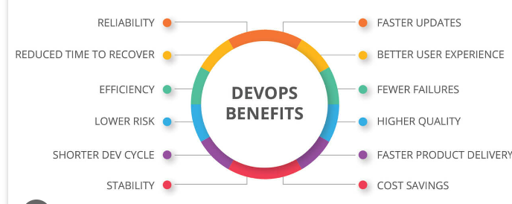
..
Another benefit of DevOps is improved collaboration between development and operations teams.
By breaking down silos and encouraging cross-functional teams, DevOps fosters a culture of collaboration and communication that leads to better outcomes for everyone involved.

Slide 16
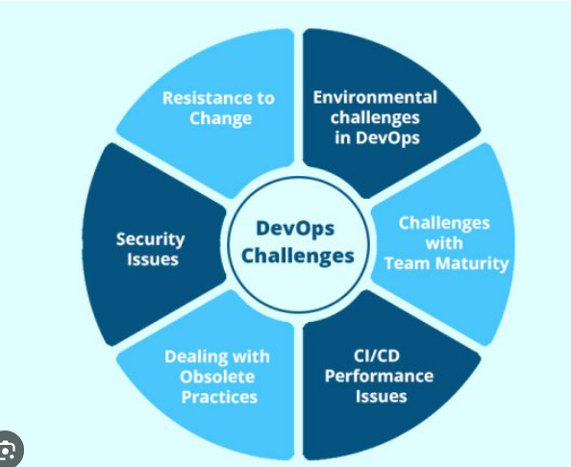
Challenges of DevOps
While DevOps offers many benefits, there are also some challenges associated with this approach. One of the biggest challenges is cultural resistance to change.

Slide 17
..
DevOps requires a shift in mindset and a willingness to embrace new ways of working, which can be difficult for some teams to accept.
Shifting from Traditional approach to Microservice Approach
Tools knowledge (Lot of integration are supported), which itself become a challenges

Slide 18
Implementing DevOps
To successfully implement DevOps, organizations must first assess their current processes and identify areas for improvement.
This may involve conducting a gap analysis or performing a maturity assessment to determine where the organization stands in terms of DevOps readiness.
Once the organization has identified areas for improvement, it can begin implementing DevOps practices and tools.
This may involve adopting new technologies, such as CI/CD pipelines, or reorganizing teams to promote cross-functional collaboration and communication.

Slide 19
DevOps Best Practices
There are several best practices that organizations can follow to ensure successful DevOps implementation. These include automating routine tasks wherever possible, using version control to manage code changes, and monitoring performance and user feedback to identify areas for improvement.
Other best practices include fostering a culture of collaboration and continuous learning, promoting transparency and accountability, and prioritizing security and compliance throughout the development and deployment process.

