Slide 1
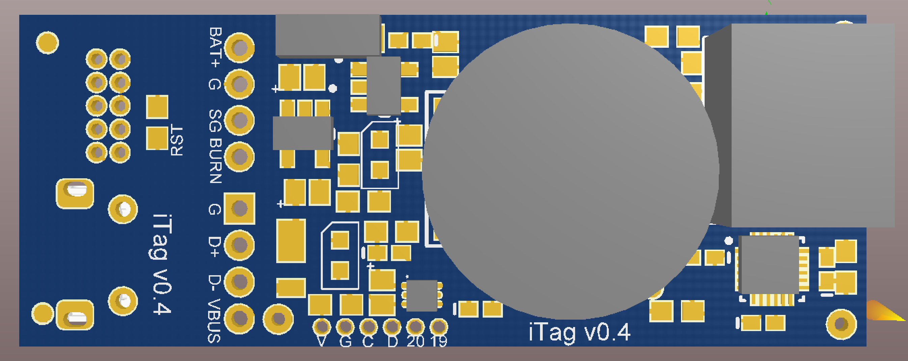
Magnetic switch
Label | Function
BAT+ | Battery +
G | Battery Ground
SG | Switched Ground (for controlling VHF power)
BURN | Switched ground for controlling burn wire (wire that burns is connected to BAT+)
G D+ D- VBUS | USB interface VBUS is used to recharge battery
V | 3.3 V regulated voltage
G | Ground
C | I2C interface SCL
D | I2C interface SDA
20 | Digital Pin 20
19 | Digital Pin 19
O2
Pressure/Temp
Do NOT TOUCH face
IMU
RGB Light Sensor
Led | Function
Red | Charge indicator (goes off when USB plugged in and battery fully charged)
Green | Solid On: At start menu. Not collecting Data Flashing: Writing data for first file (1 minute) Off: Writing data after first file or battery dead.

