Slide 1
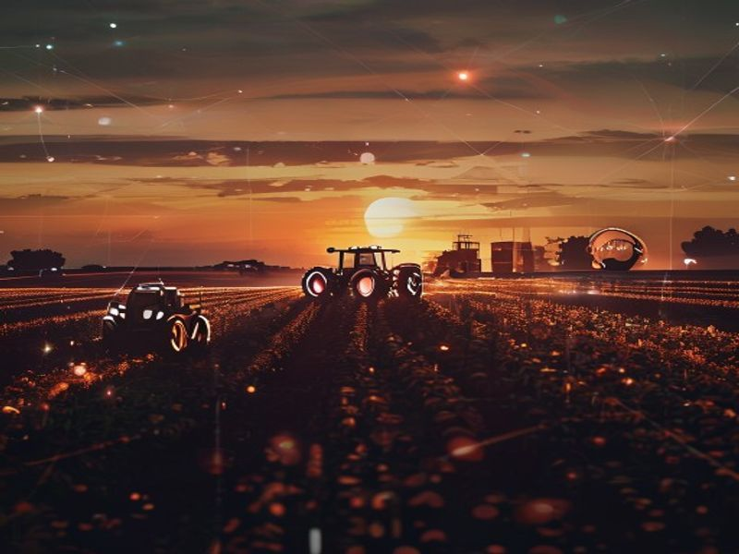
AgroVision
Transforming Agriculture with AI & IoT
Next-Gen Smart Farming OS

Slide 2
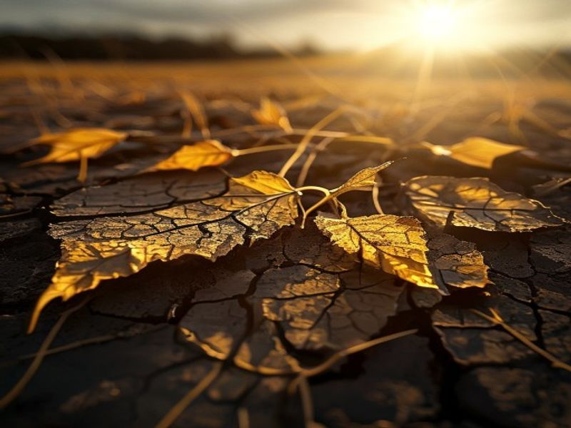
The Problem
Global Food Security at Risk
• Unpredictable Weather Extremes
• Undetected Crop Diseases (Loss up to 40%)
• Declining Farmer Income & Labor Fatigue
• Information Asymmetry in Rural Markets

Slide 3
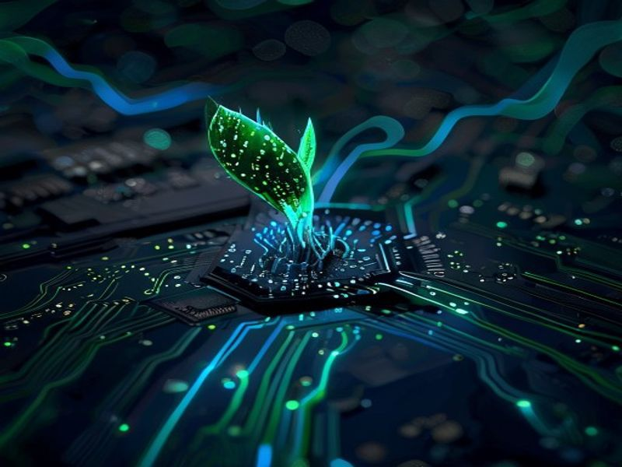
The Solution: Smart Farm OS
Bold. Visionary. Integrated.
• A unified platform for AI + IoT + Weather
• Real-time decision engine
• Actionable intelligence for every farmer
• End-to-End ecosystem from Soil to Scale

Slide 4
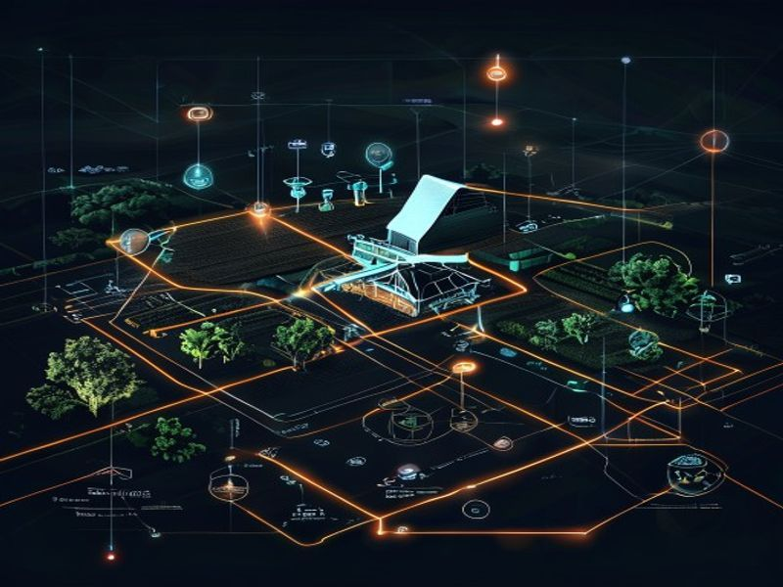
System Architecture
The Flow of Intelligence
• Sensor Array: Real-time ground truth
• Edge Node: Local data processing
• Neural Cloud: Multi-agent Gemini AI
• User Interface: Minimalist Dashboard

Slide 5
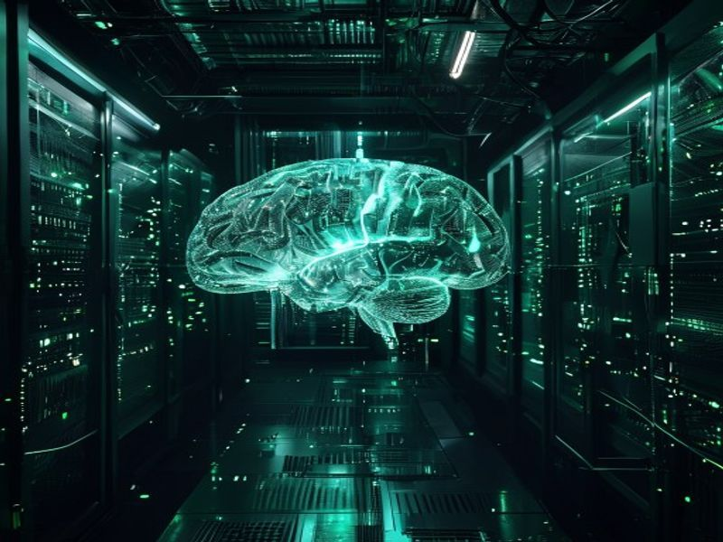
Neural Core AI
The Brain of AgroVision
• Gemini-Powered Smart Assistant
• Multi-Agent Architecture for tasks
• Autonomous Decision Engine
• Predictive Analytics for Crop Health

Slide 6

Disease Detection
AI Diagnostic Engine
• Instant Leaf Image Scanning
• Computer Vision Diagnosis
• Treatment & Fertilizer Recommendations
• Historical Scan Tracking

Slide 7
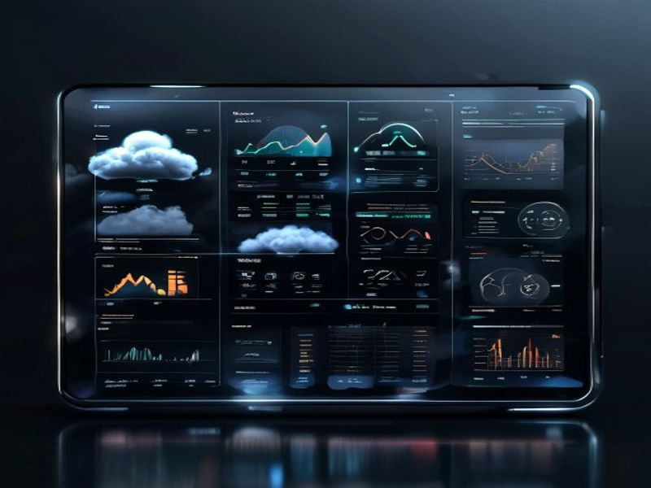
Weather Intelligence
Precision Meteorology
• Open-Meteo API Real-time integration
• Localized Weather Risk Forecasting
• Dynamic Irrigation Scheduling
• Extreme Weather Alerts

Slide 8
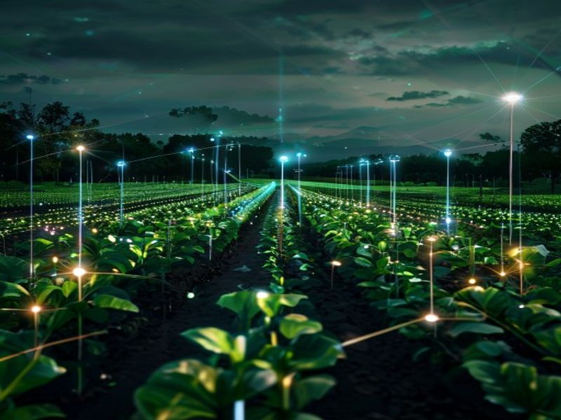
IoT Monitoring
The Farm's Digital Nervous System
• Soil Moisture & Heat Monitoring
• NPK Nutrient Level Telemetry
• Ambient Light & Rain Sensing
• Real-time ThingSpeak Data Stream

Slide 9
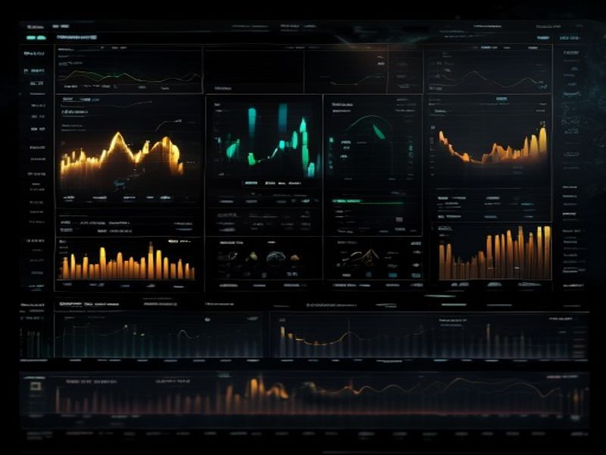
Income Optimizer
Maximizing Farmer Profitability
• Al-Driven Yield Prediction
• Real-time Market Price Trends
• Profit & Loss Estimations
• Crop Rotation Recommendations

Slide 10
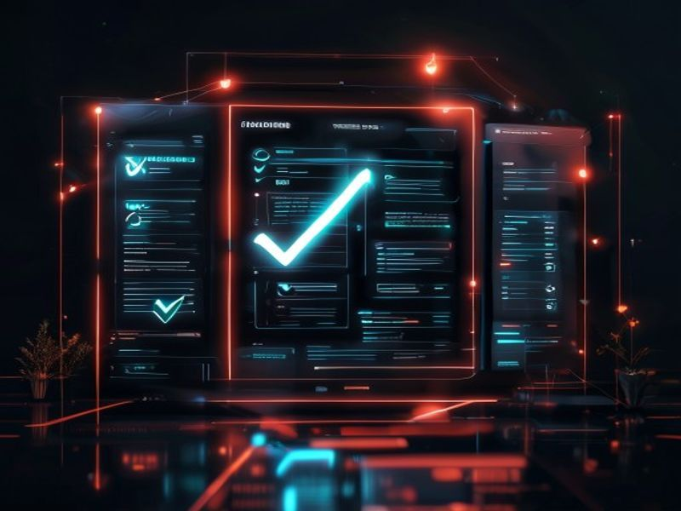
Government Schemes
Bridging the Policy Gap
• Automated Scheme Eligibility Check
• Personalized Benefit Matches
• Integrated PM-KISAN, PMFBY datasets
• Simplified Application Guidance

Slide 11
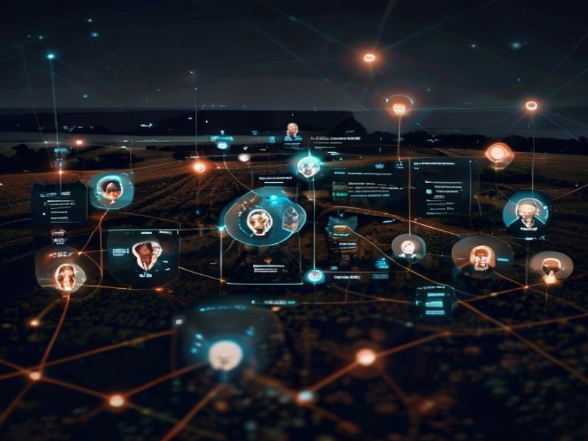
Social Intelligence
The Collaborative Ecosystem
• Inter-Farmer Insight Sharing
• Community Alert System
• Expert-Led Discussion Threads
• Best Practice Marketplace

Slide 12
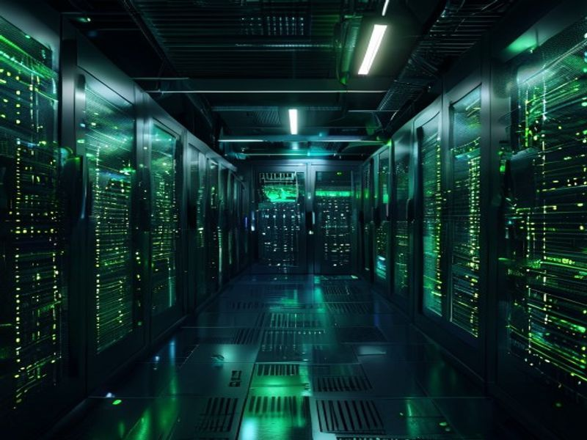
Technology Stack
Built for Scale & Impact
• Frontend: React / Next.js (Obelisk Design)
• Backend: Node.js & Express
• AI Engine: Google Gemini Vision / Groq
• IoT: ESP8266 & Arduino C++
• Database: MongoDB & ThingSpeak

Slide 13
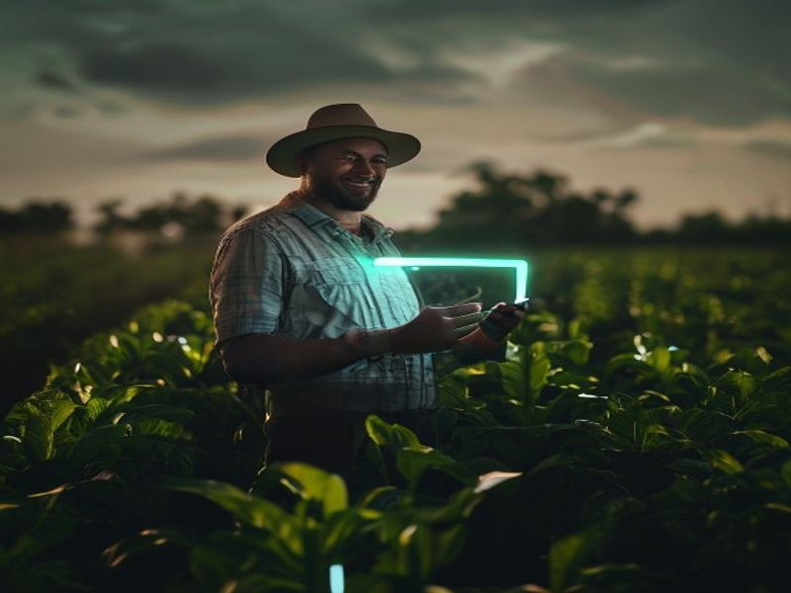
Proven Impact
Results that Matter
• +25% Average Increase in Yield
• -40% Reduction in Water Consumption
• -60% Early Disease Intervention Rate
• Unified control in the farmer's pocket

Slide 14
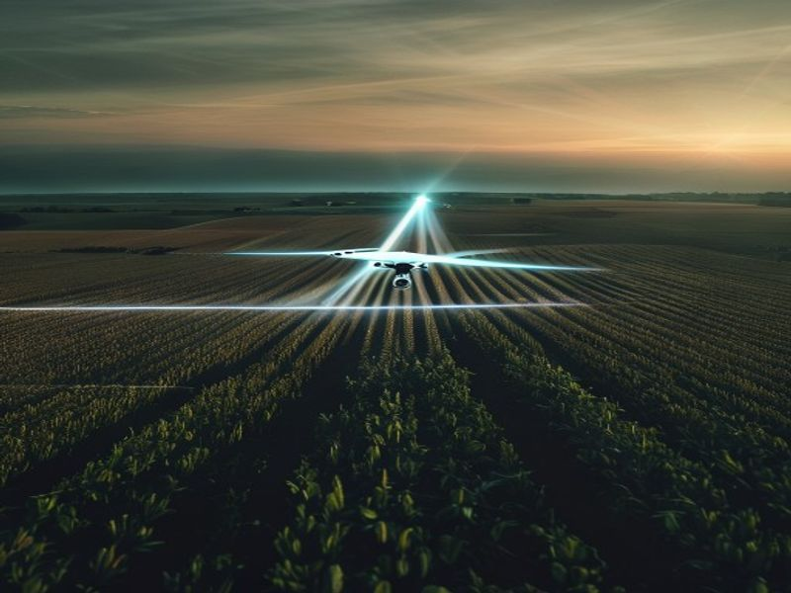
The Road Ahead
Scalability & Innovation
• Native Android/iOS Application
• Blockchain Supply Chain Transparency
• Drone-Based Multispectral Imaging
• AI-Predictive Market Price Engine

Slide 15
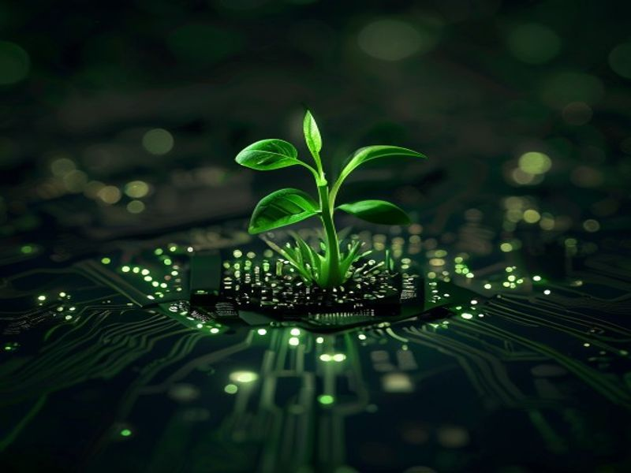
The Future of Farming
Join the AgroVision Revolution
• Smart Agriculture for All
• Sustainable. Scalable. Profitable.
• AgroVision: Elevating Farmers Digitally

