Slide 1
Introduction to GIT

Slide 2
Sources
http://www.git-scm.com/book/
http://almtools/confluence/display/ENG/MGR+move+to+stash
http://nvie.com/posts/a-successful-git-branching-model/

Slide 3
Git is a distributed version control system
Notes:
Unlike centralized VCS’es like SVN, CVS or Perforce.

Slide 4
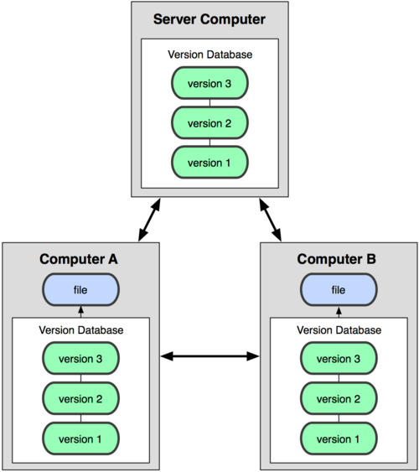

Centralized vs distributed

Slide 5
Goals
Speed
Simplicity
Strong support for non-linear development (thousands of parallel branches)
Fully distributed
Able to handle large projects like the Linux kernel efficiently (speed and data size)

Slide 6
First time installation
$ git config --global user.name "Andrzej Skiba"
$ git config --global user.email \ andrzej.skiba@misys.com
$ git config --global core.editor emacs
$ git config --global merge.tool vimdiff
$ git config --list

Slide 7
Cloning
$ git clone http://andskiba@almtools/stash/scm/risk/mch.git

Slide 8
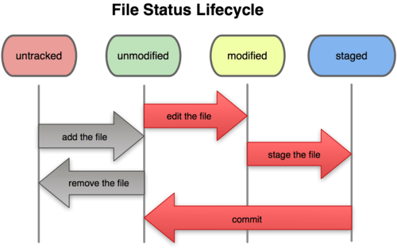
File status lifecycle

Slide 9
File status
See the status of your files:
$ git status
Add file to next commit:
$ git add README
Remove file from next commit:
$ git reset HEAD README
Discard file modifications:
$ git checkout -- README

Slide 10
Ignoring files
$ cat .gitignore
*.class
build/*

Slide 11
Viewing changes
Changes not yet staged:
$ git diff
Changes staged for commit:
$ git diff --cached

Slide 12
Commiting changes
$ git commit
$ git commit -m "MGOE-186: Kobaya XSLT processing.„
$ git commit -a -m "MGO-155: Fixed typos."

Slide 13
Moving and removing files
$ git mv README README.md
$ rm README.md
$ git rm README.md
$ git mv file_from file_to

Slide 14
Viewing history
$ git log
$ gitk
For Windows the is SourceTree

Slide 15
Remotes
Remote versions of your repository existing somewhere on the network or the Internet.
$ git clone \
http://andskiba@almtools/stash/scm/risk/mch.git
$ git remote
origin

Slide 16
Adding remotes
$ git remote add as git://github.com/andskiba/emacs24-starter-kit.git
$ git remote
origin
as
$ git fetch as

Slide 17
Fetching and pulling
Fetch will only get the changes from the remote but will not merge them
$ git fetch [remote-name]
Pull will get the changes and marge them as well
$ git pull [remote-name]
The remote name is optional and will default to the repository you originally clones from (origin).

Slide 18
Branching
Creating a branch is instantaneous
Switching between branches - really fast
Branching is encouraged - multiple branches and merges a day.

Slide 19
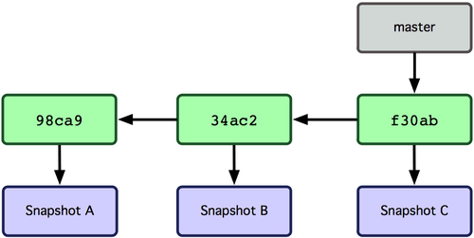
What is a branch?

Slide 20
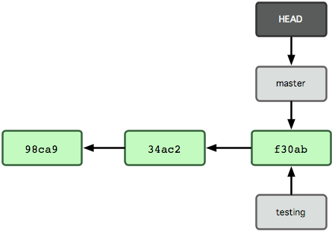
$ git branch testing

Slide 21
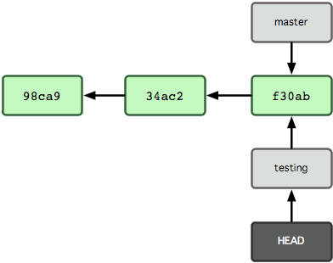
$ git checkout testing

Slide 22
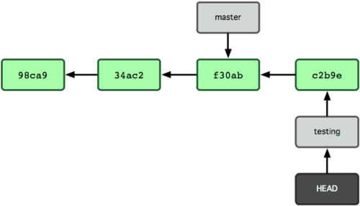
$ git commit -m "Some change"

Slide 23
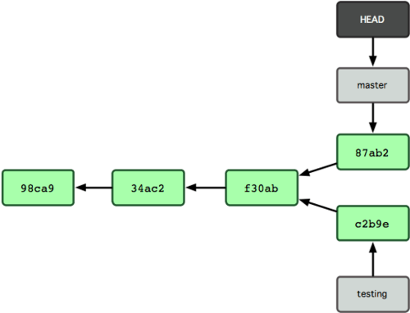
$ git checkout master $ git commit -m "Some other change."

Slide 24
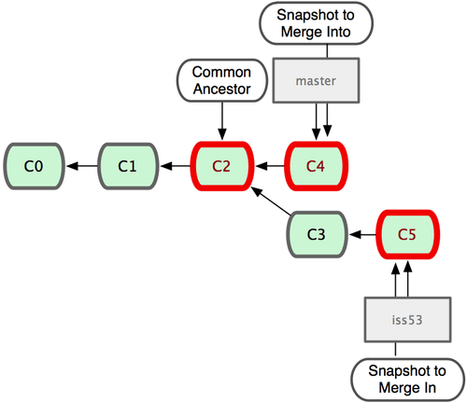
Merging

Slide 25
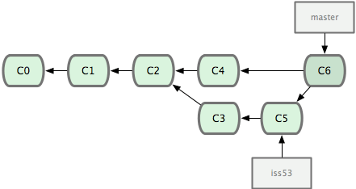
$ git checkout master $ git merge iss53

Slide 26
Git stash
The stash is a way to save you work even if you do not want to commit the work.
It is very usefull when you want to switch branches but you current working copy is in a messy state.
$ git stash # push current work to the stack

Slide 27
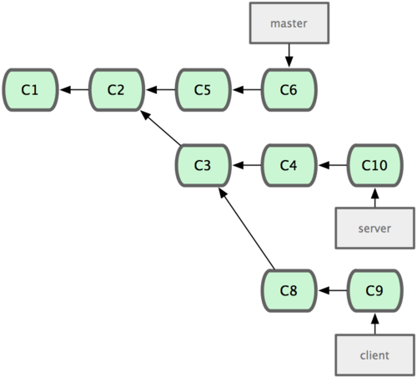
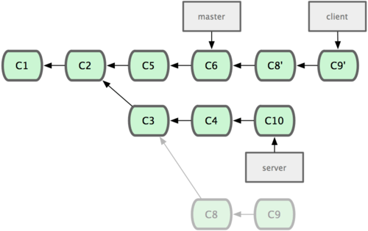
Rebase

Slide 28
Rebase
Change commit messages
Split commits
Squish commits
Move commits between branches
Rebasing modifies history. Do not modify commits that you already pushed to a remote repository.

Slide 29
Rewriting History
$ git commit --amend # change the last commit
You can even edit multiple commits with the rebase command. The below will let you change the last three commits interactively:
$ git rebase -i HEAD~3
Don’t ever do it with commits that are already pushed to the repository.

Slide 30
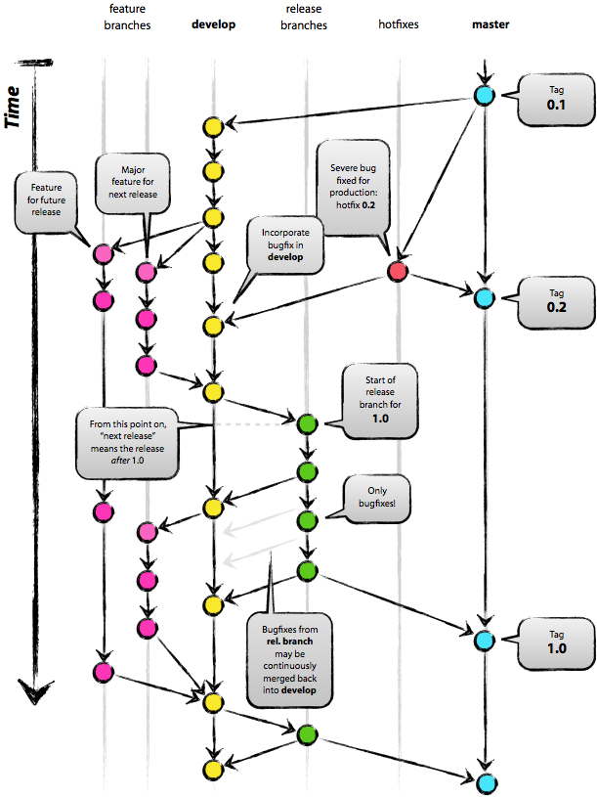
Git workflow

Slide 31
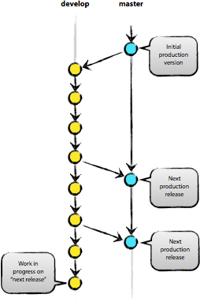
Main branches
Two main branches:
- master
- develop
The HEAD of the 'master' branch is always production-ready. 'develop' contains the changes that are ready for the next release.
When 'develop' reaches a stable state it will be merged into 'master' creating a release.

Slide 32
Supporting branches
There are three types of supporting branches:
Feature
Release
Hotfix

Slide 33
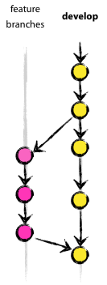
Feature branches
New features are developed. When the feature is decided to go into the next release the branch is merged into develop.
This way it's possible to have features that are developed longer then the release cycle.

Slide 34
Release branches
Created when the development freezes for the next release.
Only bug fixes go on a release branch
That means we can marge features for the release after next to the develop branch.

Slide 35
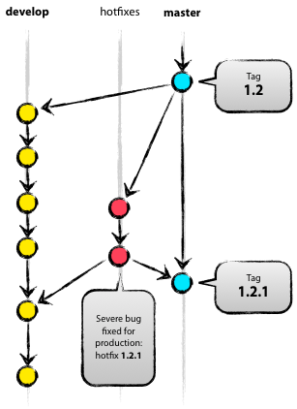
Hotfix branches
Branch off from master. This type of branch is reserved for bugs in production code that cannot wait for the next release.

Slide 36
Stash based git workflow
Is based on the above workflow
Uses Stash for branching and merging
Adds code review as a step in the workflow

Slide 37
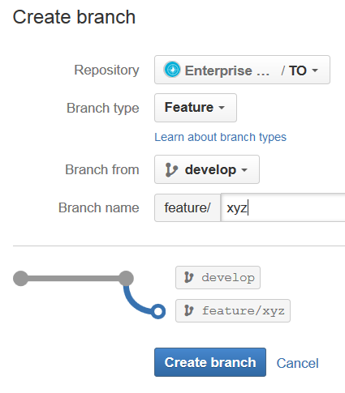
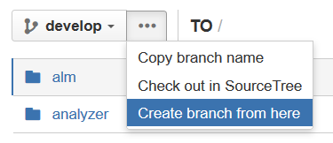
Create a branch

Slide 38
Checkout you branch
$ git fetch origin feature/xyz
$ git checkout feature/xyz

Slide 39
Do some work
[...]
git add .
git commit
[...]
git add .
git commit
git push origin feature/xyz

Slide 40
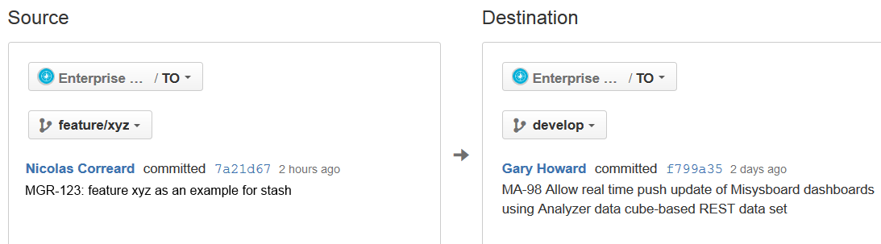
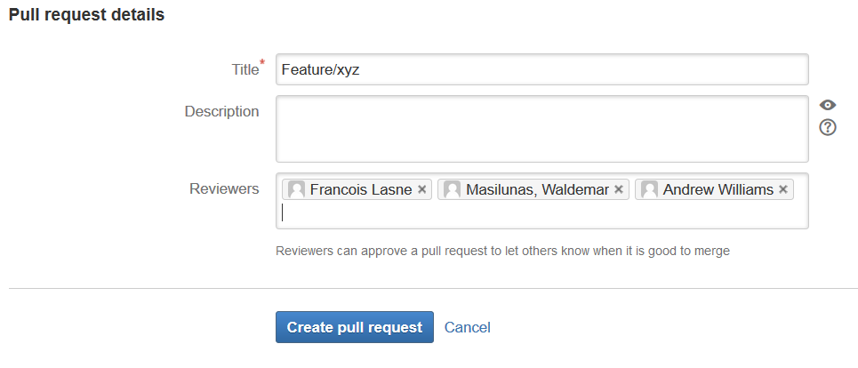
Create pull request

Slide 41
Merge conflicts
$ git fetch origin develop
$ git checkout
$ git merge FETCH_HEAD # FETCH_HEAD is the most recent fetched head, so that's equivalent to "git merge origin/develop"
$ git commit
$ git mergetool # there will be some conflicts, so you need to resolve them
$ git push origin feature/xyz

Slide 42
Fixing bugs
The same workflow as above:
To fix on latest branch branch out from develop
Name the branch bugfix/MGO-XYZ
To backport:
Branch from release/1.1.1
Name the branch bugfix/MGO-ABC where ABC is the backport issue number on JIRA

