Slide 1
Identify city and neighbourhood where to open an Indian Restaurant in US

Slide 2
In Identifying in which city a new indian restaurant to be opened has following considerations
Indians already staying
Most tourists visits
Metropolitan Statistical Area | Indian_American Population | Total population | Percentage_of Total_population
Atlanta | 78980 | 5268860 | 0.015
Austin | 23503 | 1716289 | 0.014
Baltimore | 32193 | 2710489 | 0.012
Boston | 62598 | 4552402 | 0.014
Bridgeport | 15439 | 916829 | 0.017
Chicago | 171901 | 9461105 | 0.018
Cincinnati | 14696 | 2130151 | 0.007
Cleveland | 14215 | 2077240 | 0.007
Columbus | 19529 | 1836536 | 0.011
After cleaning the data and finding the city where most Indian American are already staying found that city is New York

Slide 3
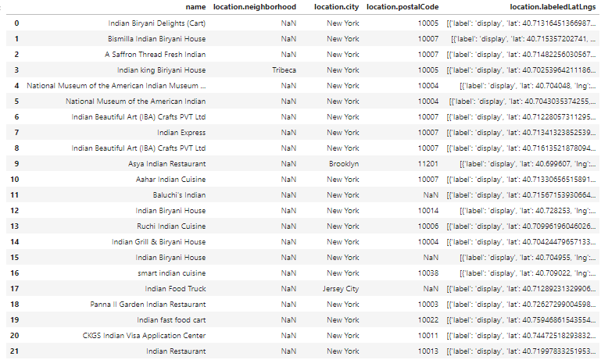
Foursquare data that we got for Indian restaurants

Slide 4
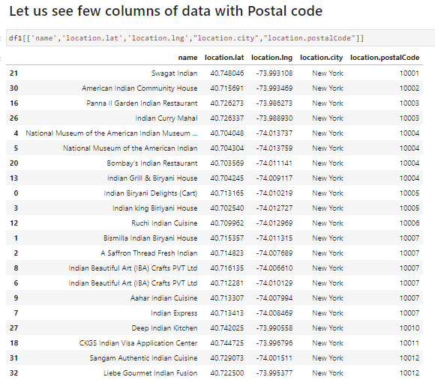
Filtered restaurants only for the city New York

Slide 5
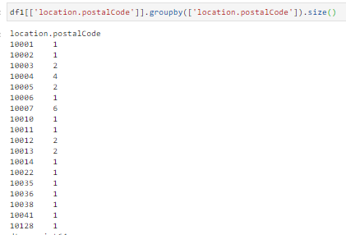
After fetching counts by Postal code, we conclude that Postal code 10007 is the area where maximum Indian restaurants are there in New York.

Slide 6
Conclusion Left the final decision to the stakeholder to decide where exactly he wants to open his indian restaurant as he has to take many aspects into consideration like his Capex budget and additional facilities available at the venue like parking etc.
Concluding that the Stake holder to open the Indian restaurant in Postalcode 10007 as it has maximum number of Indian restaurants with MSA name as New York-Northern New Jersey-Long Island, NY-NJ-CT-PA

