Slide 1

Enhancing Search Engine Relevance for Video Subtitles

Slide 2
Submitted By :-
*Kakarla sarath reddy(IN1240405 ).
Linedin: https://www.linkedin.com/in/sarath-reddy-kakarla-627aa522a/
Github: https://github.com/kakarlasarathreddy
Satyaprakash Sahoo(IN1240805)
Linkedin:linkedin.com/in/sahoosatyaprakash
Github: https://github.com/Satyaprakash23
Team ID - T211134

Slide 3
BACKGROUND:-
In today's digital world, where things change quickly and people expect a lot from technology, search engines are super important. They're like maps that help us find what we're looking for in the huge sea of stuff online. Google is a big name here because they're always working to make searching easier and more accurate for everyone.
Now, imagine you're watching a video, but you can't hear or understand what's being said. That's tough, right? This project is all about making it easier for people to find what they need in videos by improving the accuracy of the subtitles. By doing this, it helps make videos more accessible to everyone, making it easier for people to get the information they need and improving how we all experience online content.

Slide 4
OBJECTIVE:-
This project is all about making that search really good. We want to use fancy computer stuff like natural language processing (which helps computers understand human language) and machine learning (which helps computers learn from data) to make sure we find the right subtitlesfor you.
So, when you type in what you're looking for, our search engine will be super smart. It will look at the words you've typed and figure out what you're asking for. Then, it will use what it knows about subtitles to find the ones that match your query the best. This way, you get exactly what you need, making your video-watching experience even better!

Slide 5
TYPES OF SEARCH ENGINE:- Keyword-Based Search Engine :-
Think of a keyword-based search engine like a super-fast librarian. You tell them what you're looking for using keywords or phrases, and they quickly find and give you back documents that match those words. But, they don't really understand what the documents are about, so sometimes they might not get it quite right, especially if your search is complicated.
Semantic Search Engine :-
Semantic search engines are like super-smart search tools that use fancy language tricks to understand what you're really asking for. Instead of just matching keywords, they try to figure out the deeper meaning and context of what you're looking for. They pay attention to things like what the words mean and how they relate to each other, rather than just finding exact matches. Even though they're more complicated for computers to use, they can give you better results that are more tailored to what you need

Slide 6
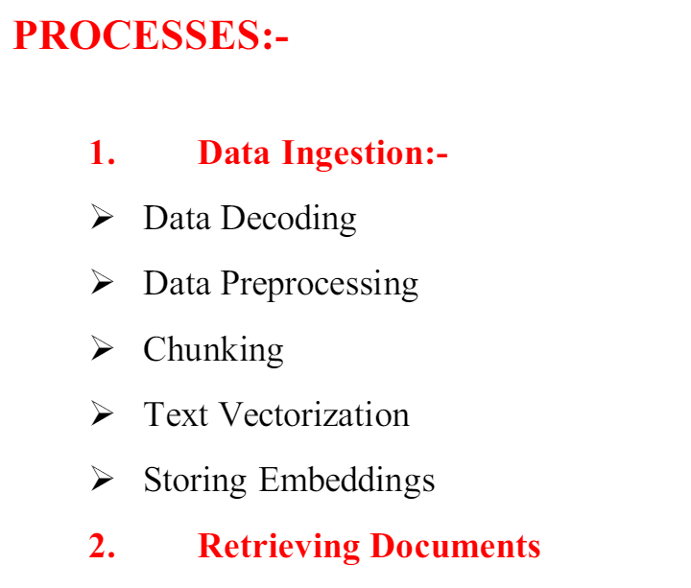

Slide 7
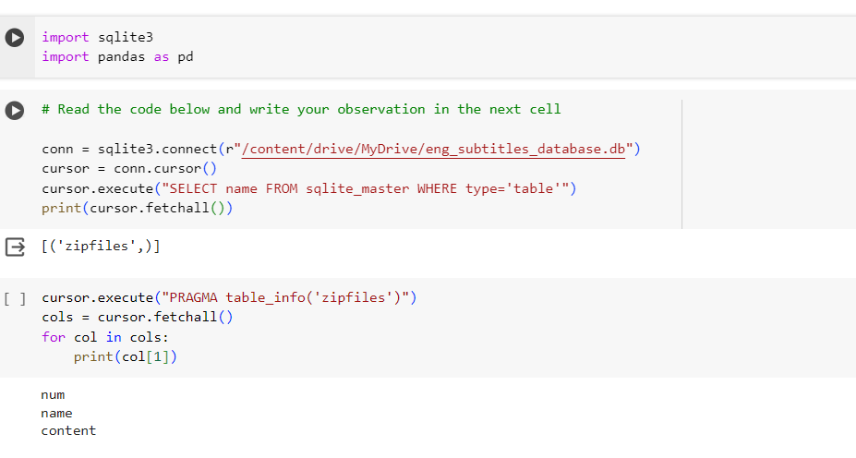
DATA INGESTION
1. Decoding Data:- The subtitle contents are encoded. So they are first decoded in latin-1 and then stored in a dataframe
. 2. Data Preprocessing:- After decoding it was found that there were two types of subtitle texts found in the subtitle file.
1. Removing timestamps
2. Removing the unwanted contents
3. Converting the text to lowercase
4. Removing the Stop words

Slide 8
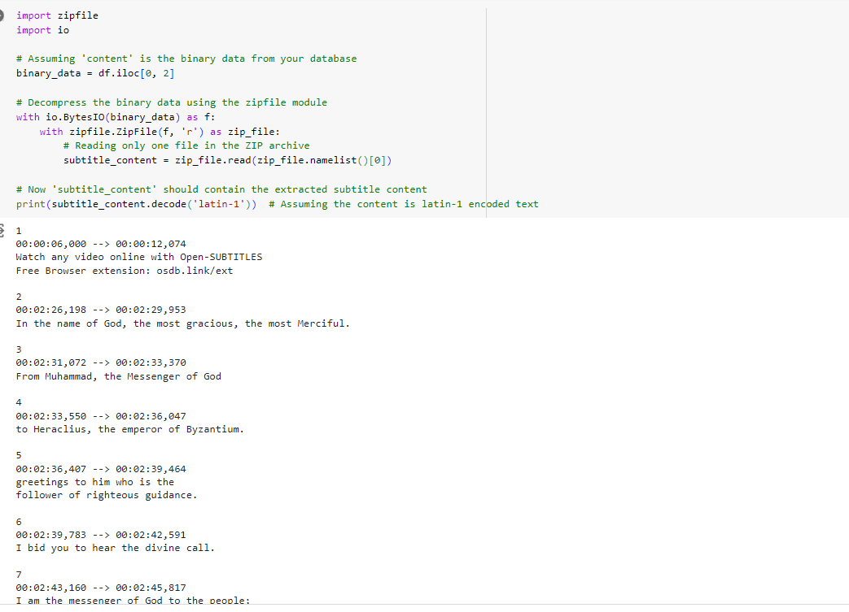
Data conversion

Slide 9
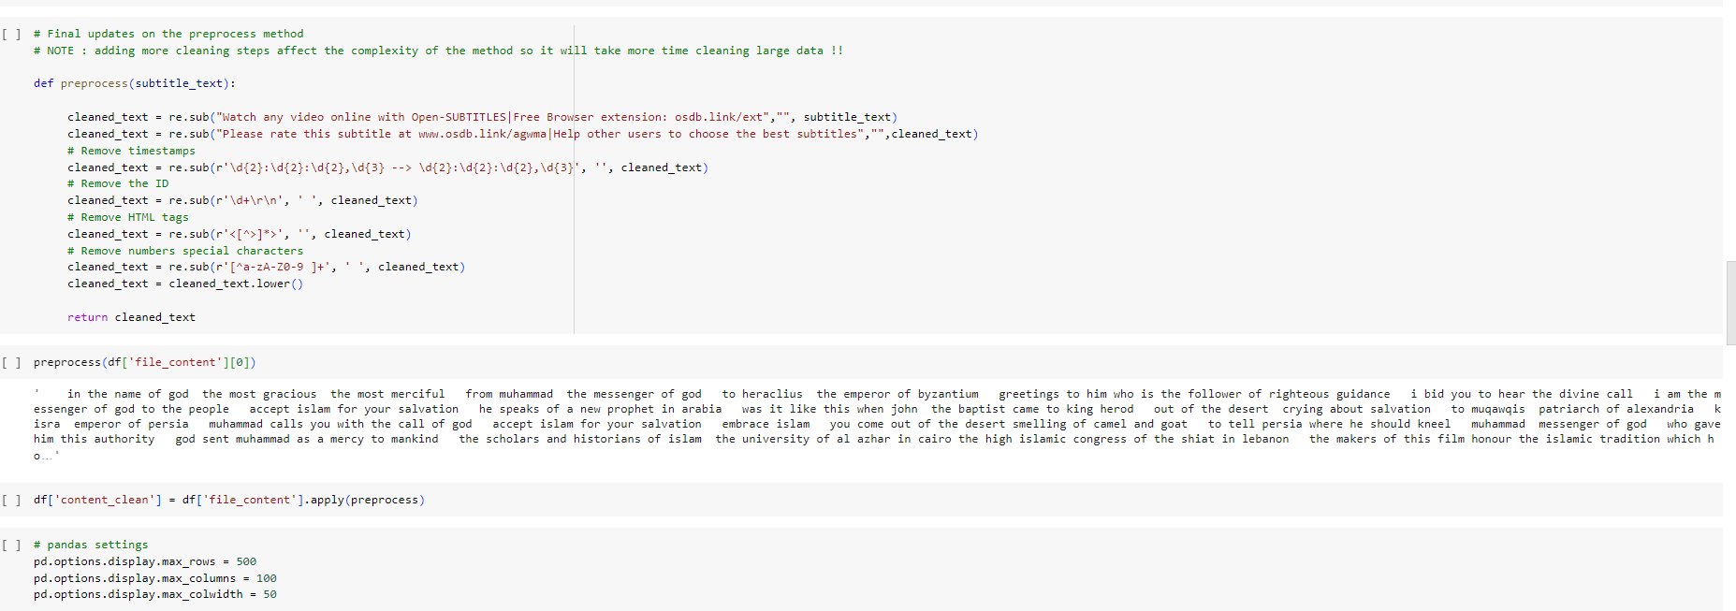
Pre processing
Cleaned content

Slide 10
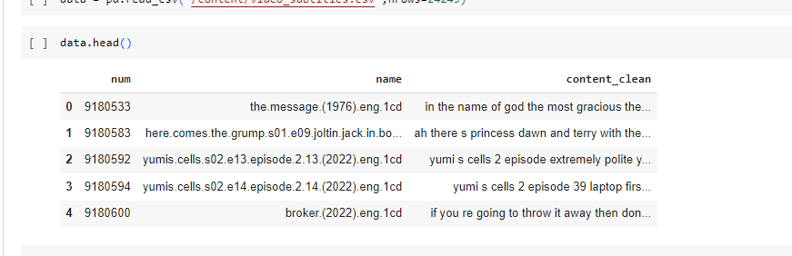
Cleaned conent

Slide 11
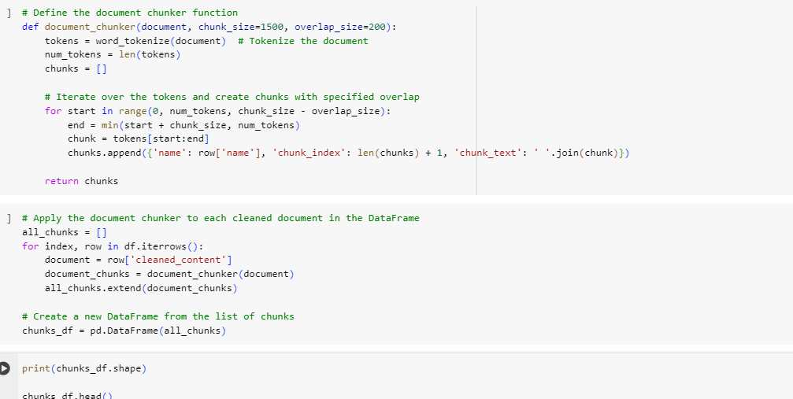
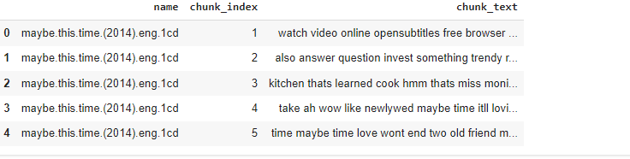
Chunking:-
• Chunking is used for cuts big pieces of writing into smaller parts. It's used a lot in tasks that involve understanding text, like making summaries, sorting documents into categories, or finding specific information. By breaking the text into smaller chunks, it makes it easier to work with, especially when dealing with a lot of writing. So, for example, if you have a really long document, the chunker will slice it into pieces, each about 500 words long, with some overlap between each piece

Slide 12
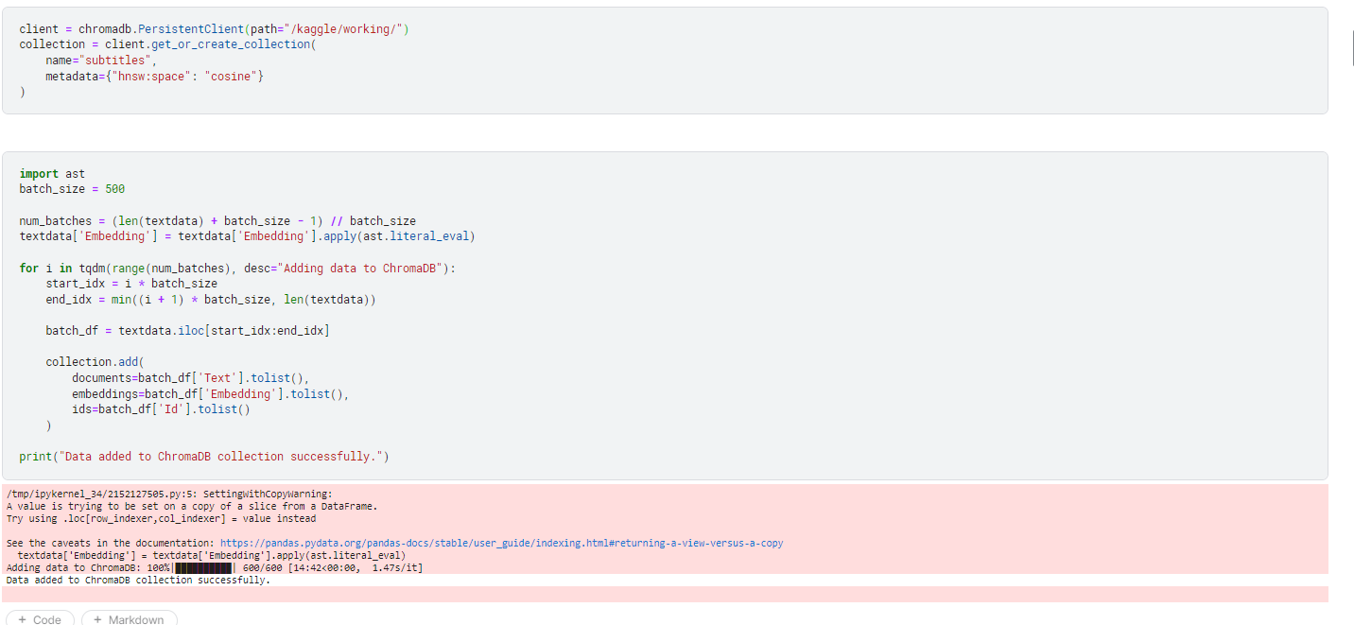
Embaddings.

Slide 13
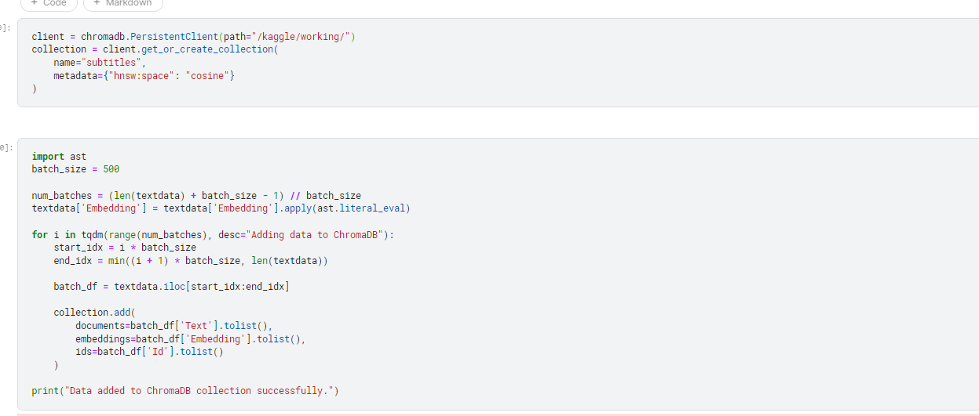
Storing the vectors in Chroma DB :-
Storing embedded vectors in Chroma DB involves associating each vector with a unique identifier (such as document ID), document text, and optional metadata. These vectors are stored efficiently in ChromaDB's vector database, allowing for fast retrieval and similarity searches based on the embedded content. Here I have stored the movie name as metadata for each document in the datab
ase

Slide 14
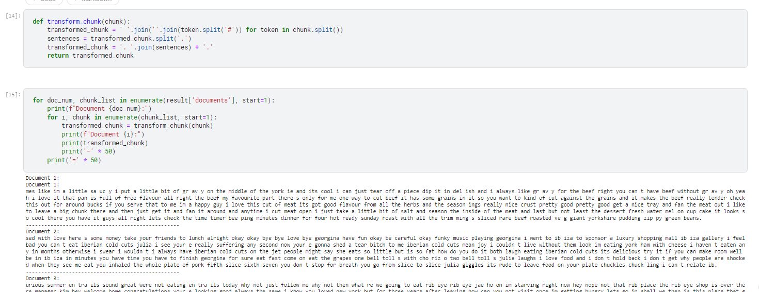
RETRIEVING DOCUMENTS:-
observation
Take the user's search query. • Preprocess the query (if required). • Create query embedding. • Using cosine distance, calculate the similarity score between embeddings of documents and user search query embedding. • These cosine similarity scores will help in returning the most relevant candidate documents as per user’s search query.

Slide 15
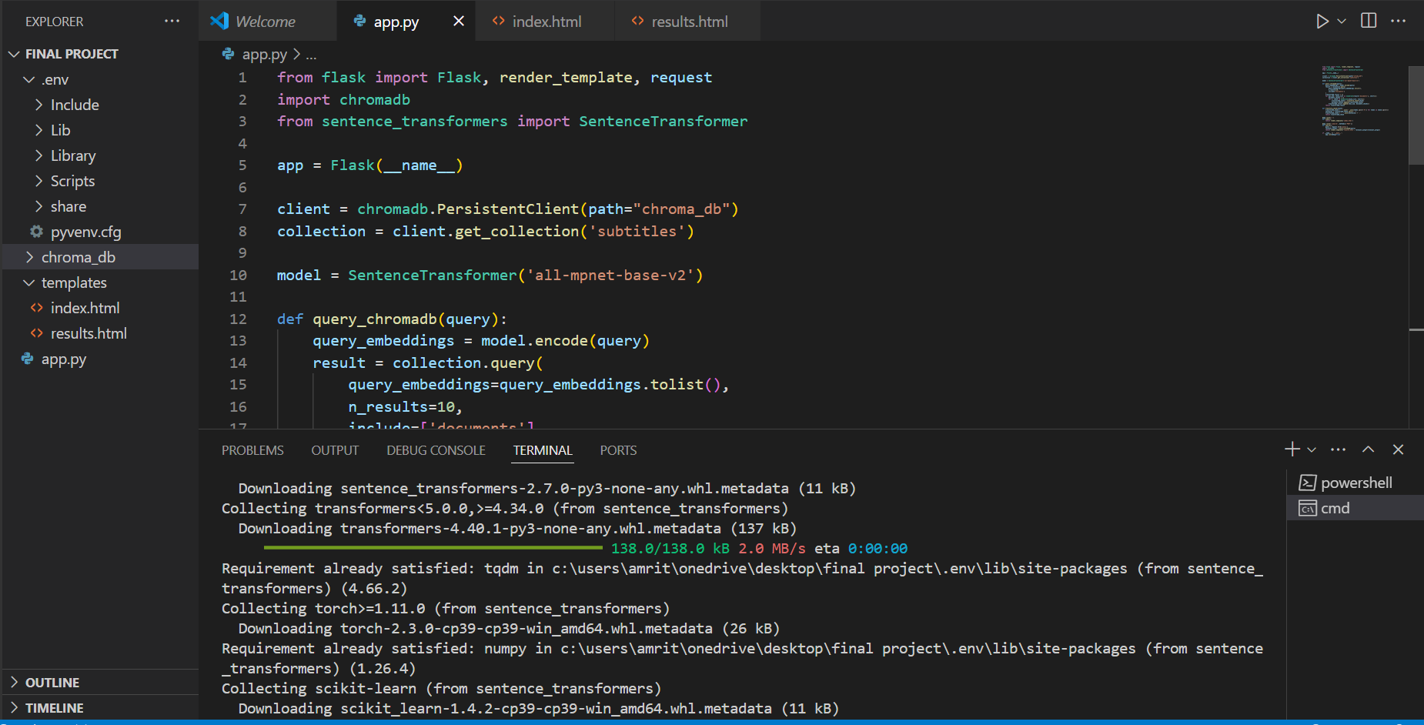
IMPLENTATION:-

Slide 16
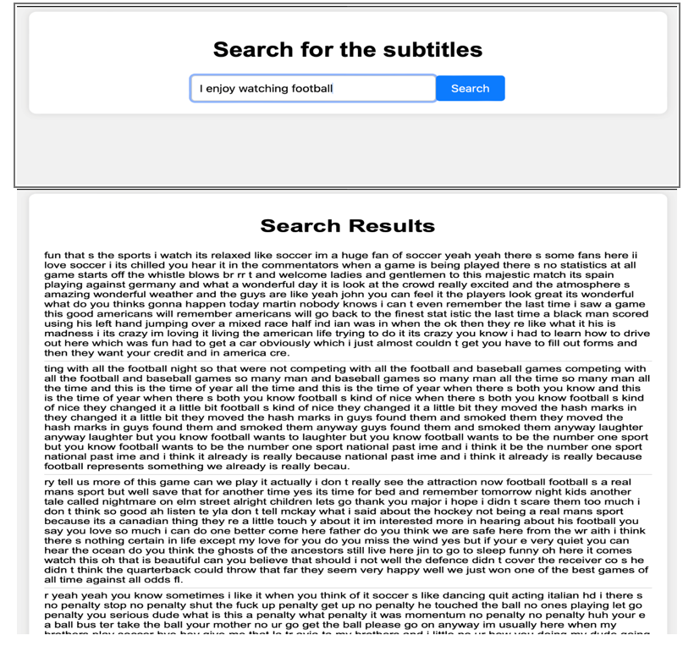
Conclusion
Implementing a movie and series subtitle similarity search system involves importing libraries, preprocessing text data, computing TFIDF vectors, calculating cosine similarity, and building a Flask web app for user interaction. By following the steps outlined in this guide, developers can create effective and efficient subtitle search tools tailored to their specific requirements.

Slide 17

THANK YOU

