Slide 1
Android app development
Nikhil Dasar Naidu
Guided by :
Priyanka Sahu
Himanshu Sahu
Samiksha Shukla
Kunal Kumar Verma
Submitted by :
Nikhil Dasar Naidu
IT 7th Semester
Industrial Training Project

Slide 2
Agenda
Introduction
Why Android ?
Android Studio
Features
Summary

Slide 3
Introduction
Android is an open source and Linux-based operating system for mobile devices such as smartphones and tablet computers. Today android used in many electronic devices like tablets, android TV, Android Auto for cars, and Android watches, each with a specialized user interface. Android are also used on game, digital cameras other electronics.

Slide 4
Why Android ?
Why we should use android if we have IOS, Windows OS,
Symbian OS (Nokia) etc.
4

Slide 5
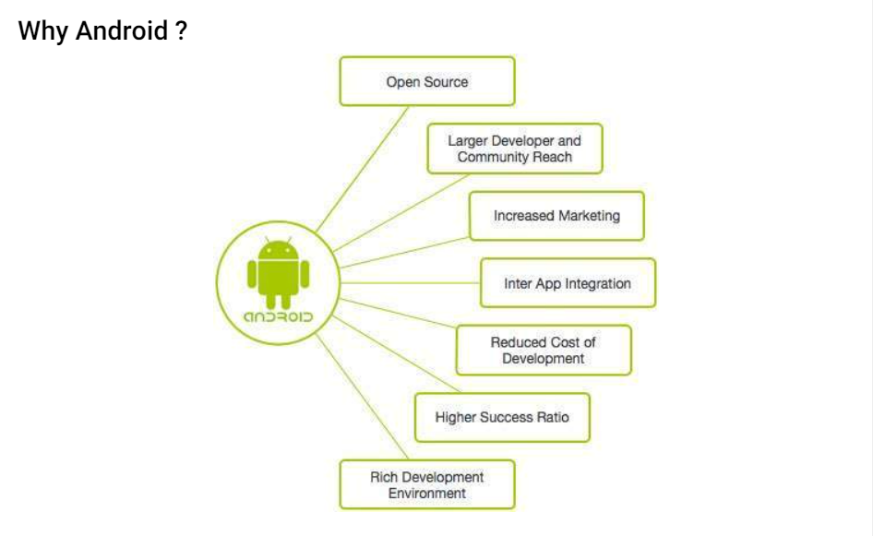

Slide 6
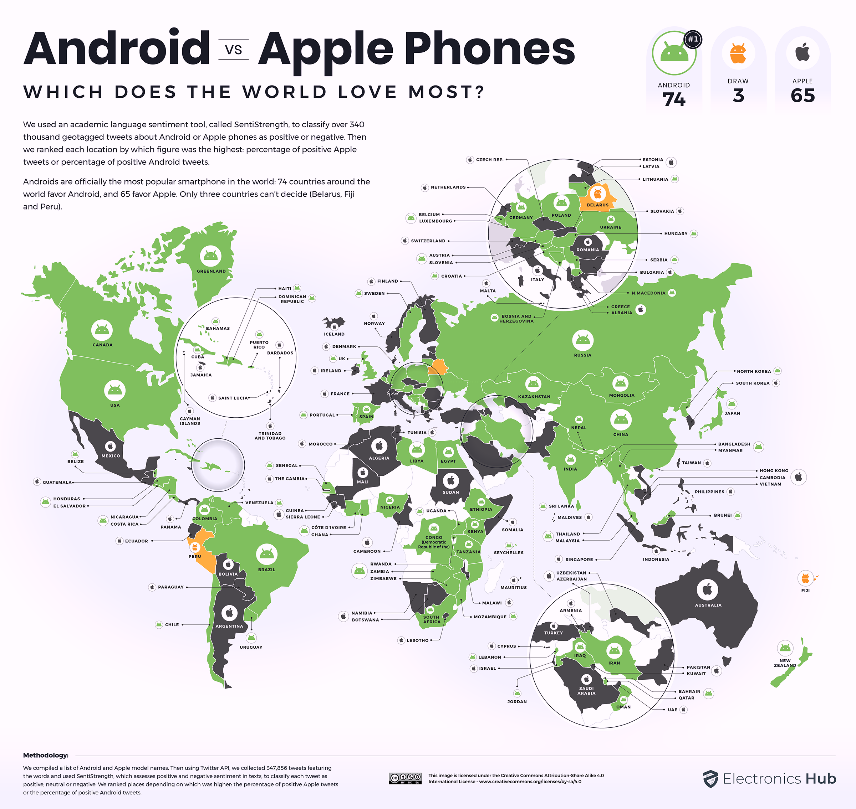
Android is the most popular operating system in the world, with over 2.5 billion active users spanning
over 190 countries

Slide 7
Android Features
Widgets are resizable, so users can expand them to show more content or shrink them to save space.
Beautiful UI
Android OS basic screen provides a beautiful and intuitive user interface.
Connectivity
GSM/EDGE, IDEN, CDMA, EV-DO, UMTS, Bluetooth, Wi-Fi, LTE, NFC and WiMAX.
Web browser
Based on the open-source WebKit layout engine, coupled with Chrome's V8 JavaScript engine supporting HTML5 and CSS3.
A technology that lets apps discover and pair directly, over a high-bandwidth peer-to-peer connection.
Resizable widgets
Wi-Fi Direct
1
2
3
4
5

Slide 8
Android Studio
IDE based on IntelliJ IDEA
8

Slide 9
Android Studio
Initially, Google’s supported integrated development environment (IDE) or development tool was Eclipse using the Android Development Tools (ADT) plugin, In December 2014, Google released Android Studio, based on IntelliJ IDEA, Now its primary IDE for Android application development.

Slide 10
Android applications
Android applications are usually developed in the Java and Kotlin language using the Android Software Development Kit.
Once developed, Android applications can be packaged easily and sold out either through a store such as Google Play, SlideME, Opera Mobile Store, Mobango, F-droid and the Amazon Appstore.
Android powers hundreds of millions of mobile devices in more than 190 countries around the world. It's the largest installed base of any mobile platform and growing fast. Every day more than 1 million new Android devices are activated worldwide.

Slide 11
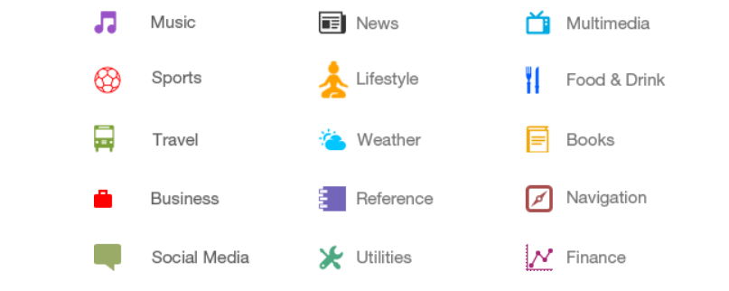
Categories of android apps
There are many android applications in the market. The top categories are −

Slide 12
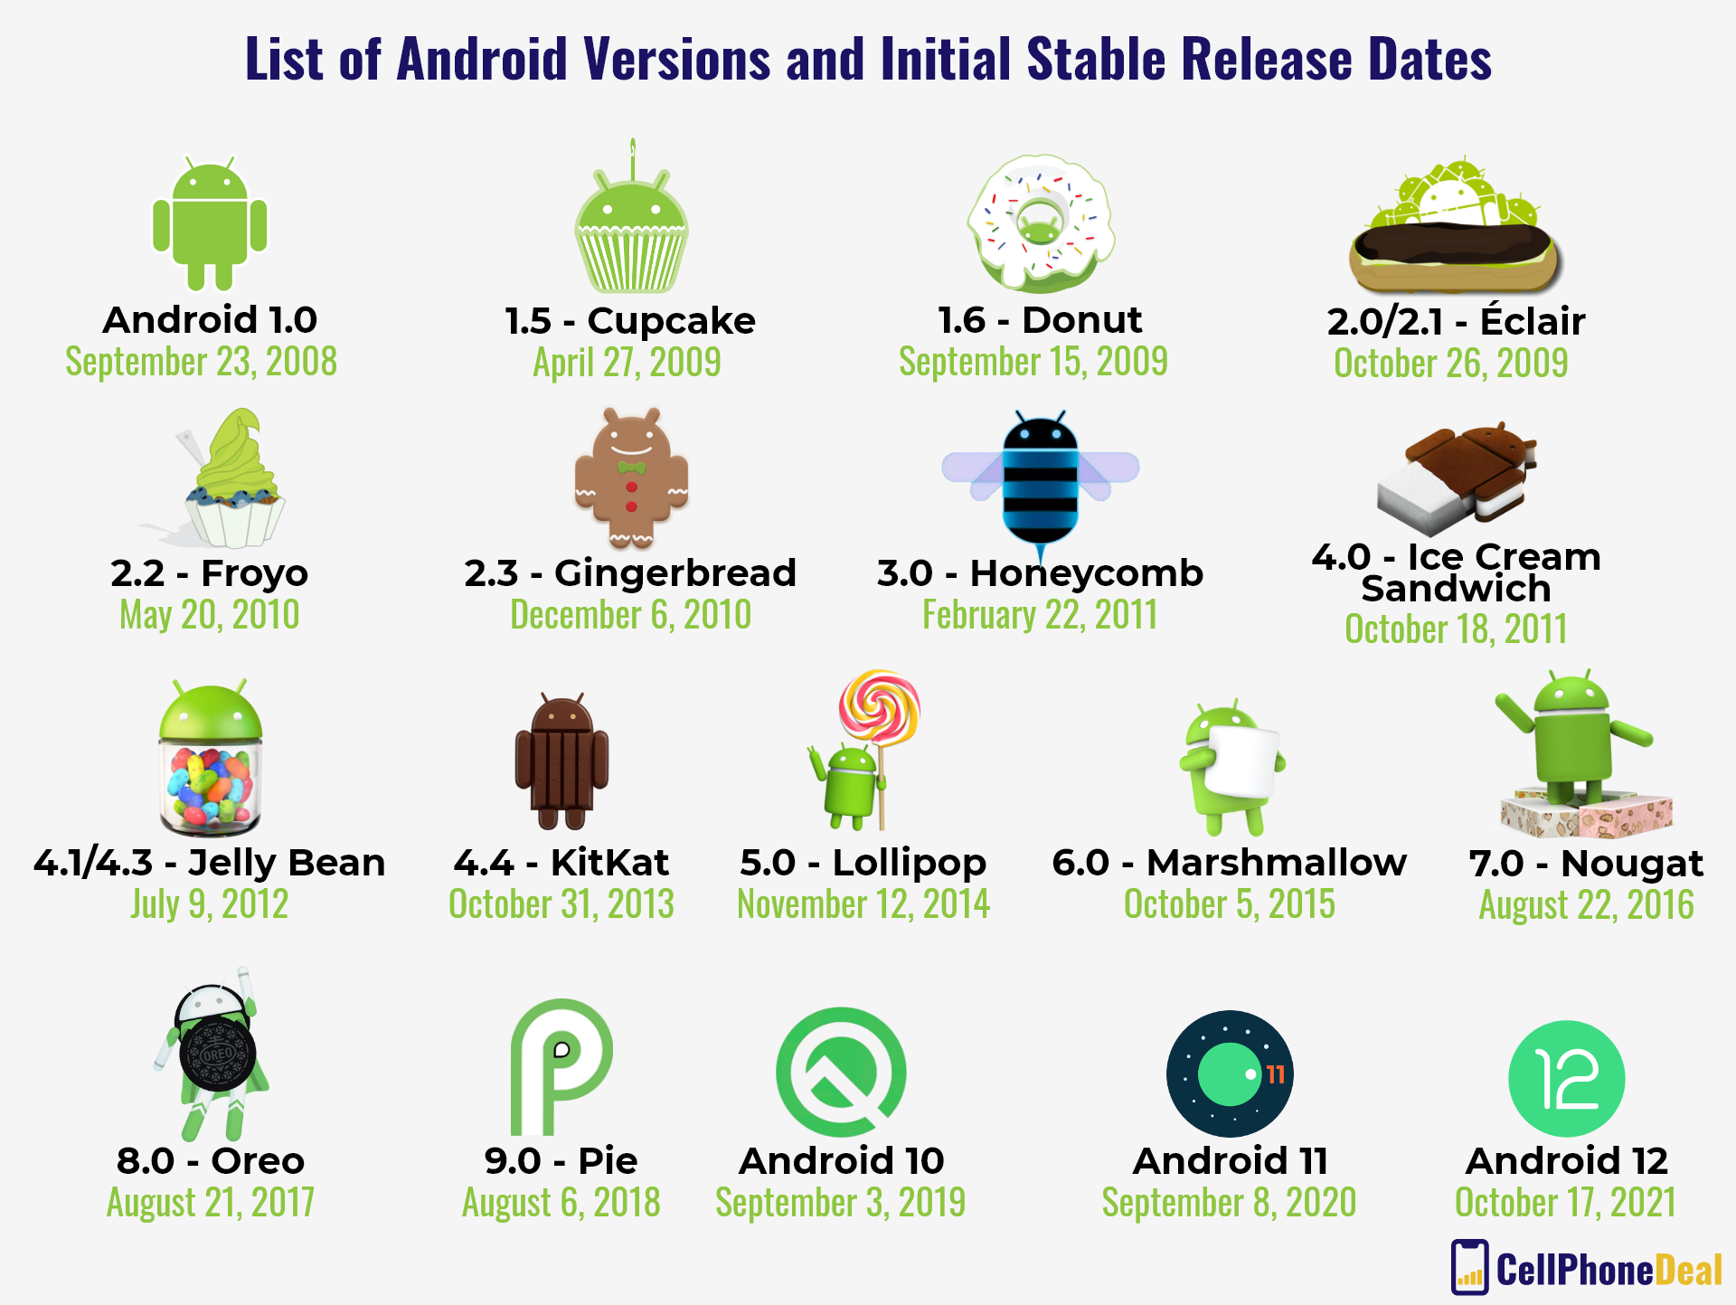
History of android

Slide 13
Android Studio SDK
Android App are written using the Android software development kit (SDK). We extend the functionality of devices using SDK.

Slide 14
Features
An opportunity to directly influence how your users write code
Debugger
Identifying coding errors at various stages of the operating system or application development
Software Libraries
a collection of prewritten code that programmers can use to optimize tasks
Handset Emulator
the use of an application program or device to imitate the behavior of another program or device Coordinate
a way for engineers and programmers to describe their product and the process they used in creating it in formal writing
Sample Code
Documentation
1
2
3
4
5

Slide 15
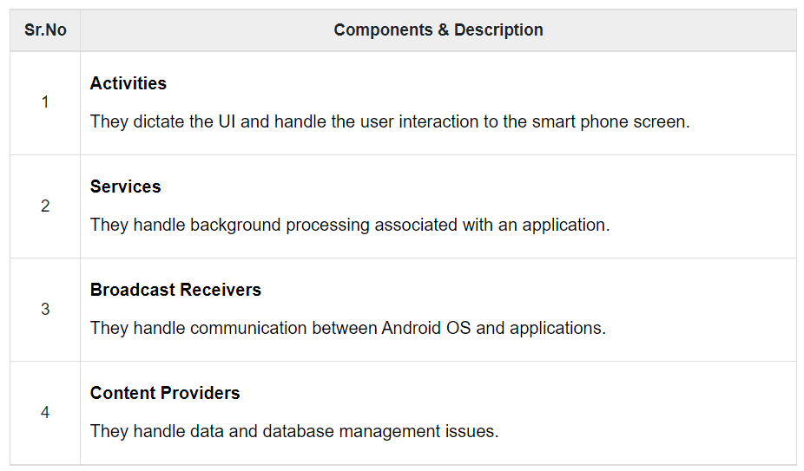
Components of android apps
Application components are the essential building blocks of an Android application. These components are loosely coupled by the application manifest file AndroidManifest.xml that describes each component of the application and how they interact.
There are following four main components that can be used within an Android application −

Slide 16
Components
Activities
An activity represents a single screen with a user interface, in-short Activity performs actions on the screen. For example, an email application might have one activity that shows a list of new emails, another activity to compose an email, and another activity for reading emails. If an application has more than one activity, then one of them should be marked as the activity that is presented when the application is launched.
An activity is implemented as a subclass of Activity class as follows −
public class MainActivity extends Activity { }
Services
A service is a component that runs in the background to perform long-running operations. For example, a service might play music in the background while the user is in a different application, or it might fetch data over the network without blocking user interaction with an activity.
A service is implemented as a subclass of Service class as follows −
public class MyService extends Service {
}

Slide 17
Components
Broadcast Receivers
Broadcast Receivers simply respond to broadcast messages from other applications or from the system. For example, applications can also initiate broadcasts to let other applications know that some data has been downloaded to the device and is available for them to use, so this is broadcast receiver who will intercept this communication and will initiate appropriate action.
A broadcast receiver is implemented as a subclass of BroadcastReceiver class and each message is broadcaster as an Intent object.
public class MyReceiver extends BroadcastReceiver {
public void onReceive(context,intent){}
}
Content Providers
A content provider component supplies data from one application to others on request. Such requests are handled by the methods of the ContentResolver class. The data may be stored in the file system, the database or somewhere else entirely.
A content provider is implemented as a subclass of ContentProvider class and must implement a standard set of APIs that enable other applications to perform transactions.
public class MyContentProvider extends ContentProvider {
public void onCreate(){}
}

Slide 18
Additional Components
View hierarchies that control screen format and appearance of the views.
Fragments
Represents a portion of user interface in an Activity.
Intents
Messages wiring components together.
Views
UI elements that are drawn on-screen including buttons, lists forms etc.
Resources
External elements, such as strings, constants and drawable pictures.
Layouts
Configuration file for the application.
Manifest

Slide 19
Summary
There are 3.48 million apps(Nov 2022) available on Google Play store, which can be use by users by downloading and installing the application’s APK (Android application package) file, or by downloading them using an application store program that allows users to install, update, and remove applications from their devices. Google Play Store is the primary application store installed on Android devices that comply with Google’s compatibility requirements and license the Google Mobile Services software. Google Play Store allows users to look, download and update applications published by Google and third-party developers.

Slide 20
Be Together, Not The Same.
“
”
Android

Slide 21
Don’t be evil.
“
”
Google

Slide 22
Thank you
Nikhil Dasar Naidu
postbox150899@gmail.com
https://kakashihatakesh6.github.io/kakashihatake.github.io/

